Slide 1
The Role of Social Media in Cybersecurity Threats
By: Jasmyn Allen

Slide 2
Social Media
With over 4.6 billion global users across many platforms, social media has become an incredibly relevant part of our daily lives
Many benefits
  Real-time communication (easier to stay in contact with friends and family)
  Build communities with like-minded people
  Self-expression
  Fast real-time spreading of news
  Job opportunities
  Cost-effective promotion for businesses

Slide 3
How Social Media is Exploited
As much as society benefits from social media, misuse and lack of cybersecurity awareness can bring vulnerabilities that bad actors can exploit
Attackers go through sites like Facebook, Instagram, and even LinkedIn to mine for personal information
  Look for details like birthdays, pet names, and workplace roles and relationships
Social engineering stages to plan an attack
  Information gathering: Search social media to collect information and select target
  Relationship development: Build rapport (e.g. impersonating someone they know or relying on general agreeableness to build relationship)
  Exploitation: Using gathered information and relationship to infiltrate
  Execution: Accomplishing the ultimate goal (whether that’s for financial gain, political motives, or even obtaining sensitive data)
Notes:
Looking for details like birthdays and pet names can help in trying to guess passwords

Slide 4
Methods of Social Engineering Through Social Media
Phishing: Emails sent to individuals seeking information or data
Spear phishsing: Emails sent to and targeted toward specific individuals (relevant details to seem more credible found on social media)
Whaling: Emails targeting CEOs
Pretexting: An attacker impersonating a person with power or credibility (ex. Impersonating a boss or someone in high-management to get an employee to do something)
  Attackers can and do create fake profiles to impersonate high-profile executives and well-known brands to trick customers and employees into transferring funds, spread disinformation, and many other things
Smishing: Texting messages (SMS) seeking information
These tactics can use information found on social media are used on individuals, employees, and higher management alike!

Slide 5
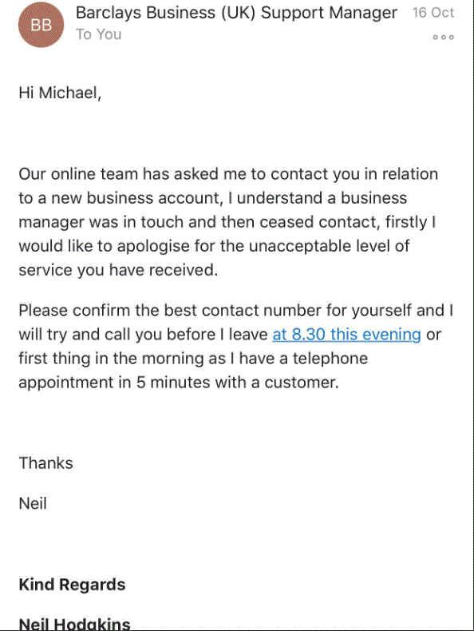
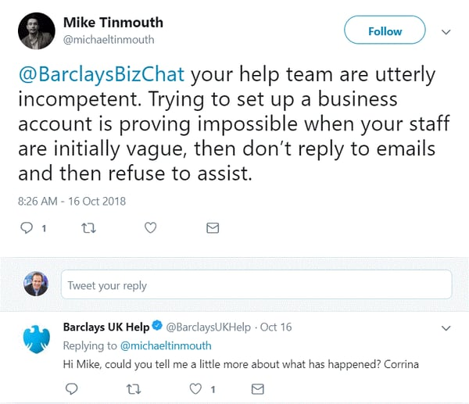
Example
Notes:
Tinmouth replied with his phone number and talked to the cybercriminal who was posing as a customer service rep, and actually eventually initiated the £8,000 transfer, but it was blocked.

Slide 6
How to Mitigate Threats
Limit oversharing: Avoid publishing real-time locations, travel plans, organizational charts, or personal identification details online
MFA: Enabling MFA strengthens account privacy and adds an extra layer of protection in the event credentials are guessed or stolen
Strict organizational policies: For organizations, establishing comprehensive social media policies that define acceptable use can greatly lower the chance of a cyberattack using information found on social media
Education: Continuous awareness training for general users and employees of an organization help recognize oversharing risks and offender tactics like fake friend requests and suspicious messaging

Slide 7
References
Hossain, Md Ishtiak. (2025 September). Exploring the Impact of Social Media on Cyber security Threats and Mitigation Strategies. ResearchGate. https://www.researchgate.net/publication/395339633_Exploring_the_Impact_of_Social_Media_on_Cyber_security_Threats_and_Mitigation_Strategies
‌SecureWorld News Team. (2018, November 29). Social Media Cyber Attack: A Real Life Example. SecureWorld. https://www.secureworld.io/industry-news/social-media-cyber-attack-example
Module 3 Content
Module 6 Content

