Slide 1
Case Presentation
By: Juanika Copeland

Slide 2
The Genieve Shelter
The Genieve shelter serves victims of domestic violence, sexual assault, stalking, and human trafficking. Client A was a survivor of domestic violence who needed the services offered, such as counseling and support. Client A was able to move in with a friend but still needed services that were offered.
Client A needs help finding affordable housing within her budget. Client A is a community client. A community client is a client that needs our services, such as food distribution, counseling, or housing, we label them a community client. They also have shelter clients too, which are the clients who live at the shelters or hotels that we put them in.

Slide 3
Presenting Problem
The Presenting problem is client A needs housing. The person she is staying with gave her until the end of the month to find somewhere else to go. Client A also has 3 children.
Client A is now a single mom of 3 trying to self-resolve from her abusive past with her abuser ex partner.
This Photo by Unknown Author is licensed under CC BY-ND

Slide 4
Background Information
Client A is now a single mom of 3 trying to self-resolve and pick up the pieces from her abusive life with her ex-partner.
Client A is 28 years old.
Client A has a job, and a decent credit score.
Client A has no criminal history.
Client A has no family in the area. She is currently staying with a co-worker.
Client A receives TANF and food stamps.
Client A has a high school diploma.

Slide 5
Impressions and Recommendations
Client A is very smart, very respectful, and well spoken.
Client A strengths are being able to ask for help when needed.
Client A shows resilience and has a positive upbeat attitude to try and better her circumstances.

Slide 6
Treatment plan
Housing stability. Client A needs affordable housing for her and her children. Developing a plan to help client A secure housing is the goal.
Short term goal would be getting client A into a house.
Sending rental applications to client via email.
Checking in on client A daily to obtain her progress with housing.
Continuing counseling for client A and children.
Enrolling client A in our financial literacy seminar.
Long term goal would be monitoring her progress and
following up with her as well.

Slide 7
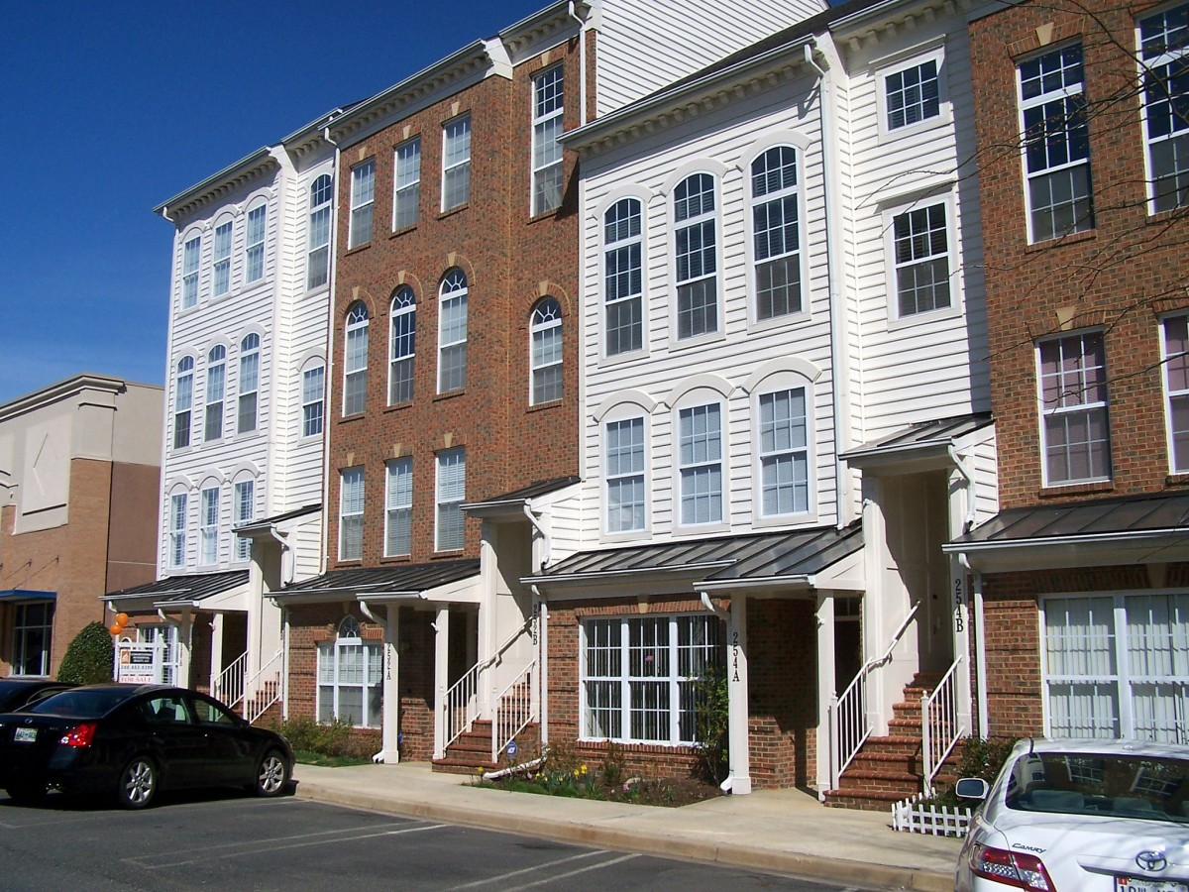
Services Offered
This Photo by Unknown Author is licensed under CC BY-NC
Information and Referrals from us and other agencies
Counseling and Support within the agency
Financial literacy seminar, which is held via zoom every other Tuesday
Referral to ForKids for help with first month’s rent when obtaining housing
Referral to Social Services for help obtaining Section 8, which is low-income housing

Slide 8
Interventions used
Crisis intervention. Client A was clearly going through crisis. Because of the crisis she experienced from her ex, this caused housing insecurity. Her and her partner lived together. However, because of the abuse she sought a safe place to hide until she could figure out her next move.
Client A needs our support and resources to help find affordable
housing for her.
Life skills will also allow us to assess her budget, so that
she can properly manage her money.
This Photo by Unknown Author is licensed under CC BY-SA

Slide 9
NOHS Standard
Standard 15 which states that Human service professionals provide a mechanism
for identifying client needs and assets, calling attention to these needs and
assets, and assisting in planning and mobilizing to advocate
for those needs at the individual, community, and societal level when
appropriate to the goals of the relationship.
I believe that this standard relates to her case due to me addressing
her needs and advocating for affordable housing for her.
This Photo by Unknown Author is licensed under CC BY-SA

Slide 10
Strengths
Strengths would be my nature to help client A.
Active listening skills when listening to client A.
Compassion and understanding towards her.
Building positive relationships with her.
Organizational skills by organizing rental applications
and sending them to her via email.
Asking many questions for better clarity with client A.
This Photo by Unknown Author is licensed under CC BY

Slide 11
Areas of Improvement
I would say I need to ease up on being too self critical of myself. I am somewhat of a perfectionist, which causes me to double check my work more than once. This also causes me to spend more time on tasks.
This Photo by Unknown Author is licensed under CC BY-SA

Slide 12
Challenges
The time frame of obtaining housing for client A is a challenge. She needs housing by end of the month. This builds up some anxiety because I want to make sure that client A and her children are in a home.
Finding housing can be a challenge because of the housing process, such as credit checks, rental deposits, and finding affordable housing within her budget.
Client A wants to live in a certain area if possible. Finding a certain number of bedrooms within the
time frame that’s given is also a challenge.
This Photo by Unknown Author is licensed under CC BY-SA-NC

Slide 13
Learning Points
Sometimes I must remember that I am just an intern while working with client A. Therefore, I should give myself some grace. I must remind myself that I am still learning and to slow down and take in everything one day at a time. Sometimes, I feel like I have a full-time job while helping client A find housing and doing other tasks.
This Photo by Unknown Author is licensed under CC BY

