Slide 1
Cultural immersion experience
Ashley Connell
Human services 346: Diversity Issues in Human Services

Slide 2
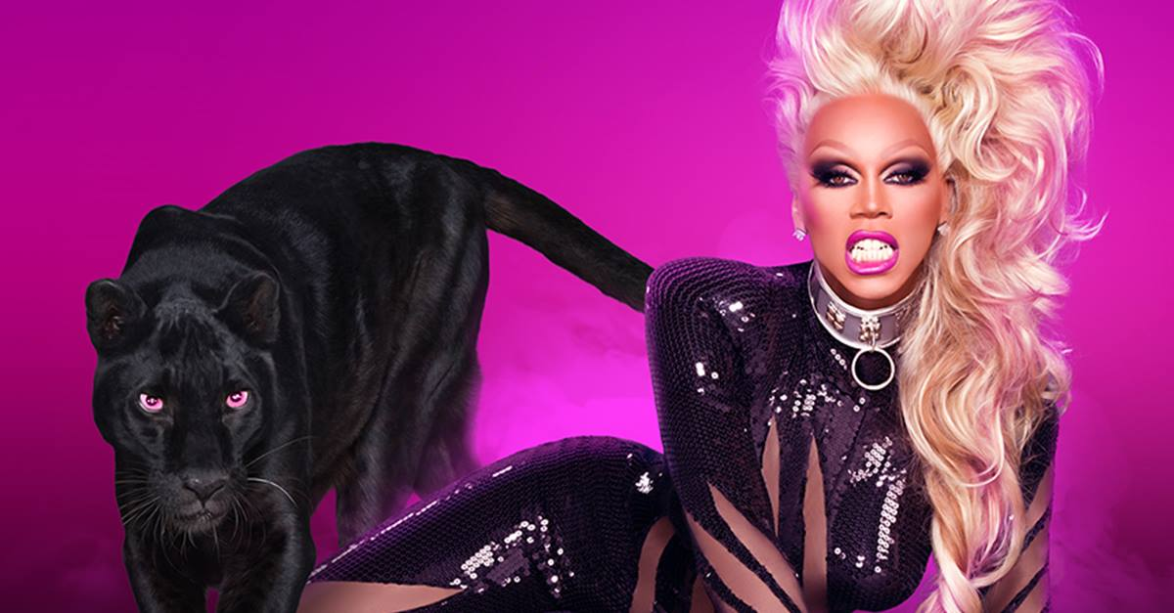
Exploring the coming out process and a "drag queen" lifestyle

Slide 3
Important considerations:
As Human Service Professionals we must approach gender, sexual identity, and lifestyle choices with awareness, knowledge, and understanding.
No matter the race, ethnicity, gender, or age of the client, the helper should use "person-centered" techniques of reflective listening and empathy to establish a non judgemental and non-threatening enviroment for the interview.
Interview questions are based on the "coming out" process, familial support, importance of inclusion in the culture/community, body image and lifestyle choices.

Slide 4
Facts and research
“The phrase “coming out” is used to refer to several aspects of lesbian, gay, and bisexual persons’ experiences: self-awareness of same-sex attractions; the telling of one or a few people about these attractions; widespread disclosure of same-sex attractions; and identification with the lesbian, gay, and bisexual community. Many people hesitate to come out because of the risks of meeting prejudice and discrimination. Some choose to keep their identity a secret; some choose to come out in limited circumstances; some decide to come out in very public ways.” ~American Psychological Association
“Issues related to sexual orientation have garnered increased attention in recent years, especially with increased awareness of bullying and suicides of lesbian, gay, bisexual, and transgender (LGBT) adolescents. Studies show that LGBT youth are “far more likely” to report being bullied, sexually harassed, and/or physically abused than heterosexual peers (Bidell, 2012), and Russell, Ryan, Toomey, Diaz, and Sanchez (2011) found that over 85% of LGBT youth report being verbally harassed because of their sexual orientation. When studying lesbian, gay, and bisexual (LGB) suicidality rates, D’Augelli et al. (2005) found nearly one-third of LGB youth reported a past suicide attempt.” ~Article 46 VISTAS Online, The Counselor’s Role in Helping Students With Sexual Identity Issues: A Case Study of a Mother and Daughter

Slide 5
More to know…
“Drag queens, otherwise known as “female impersonators," are most typically gay cisgender men (though there are many drag queens of varying sexual orientations and gender identities) who perform and entertain on stage in nightclubs and bars.”~Psychology Today
“Dressed in stereotypical feminine clothing and with elaborate makeup and wigs, they usually adopt an eccentric persona or a character that might act as a means of self-expression of their own personalities or allow them to characterize various personality attributes in order to entertain.”~Psychology Today
“It is important here to note that performing in drag is not necessarily rooted in questioning one's gender identity, though this is a common misconception. Drag queens put forth enormous effort and financial cost to establish an ensemble of makeup, outfits, wigs, and also must develop skills at using these means to transform themselves into their highly adorned characters. Their performances commonly involve lip-syncing and dancing to popular music or other talents such as stand-up comedy.”~Psychology Today

Slide 6
My Interviewee
Instead of being like many of the individuals in the research/statistics isolating themselves because of fear and shame due to societal responses and attitudes towards LGBTQ, my interviewee found a way to embrace his sexual identity. He faced the “coming out” process by finding a community of people that were just like him and inspired him with humor and entertainment. Not to say that it hasn’t been difficult exploring and sharing his sexual identity with others but finding the “Drag Lifestyle” has helped him embrace himself with a new sense of confidence.

Slide 7
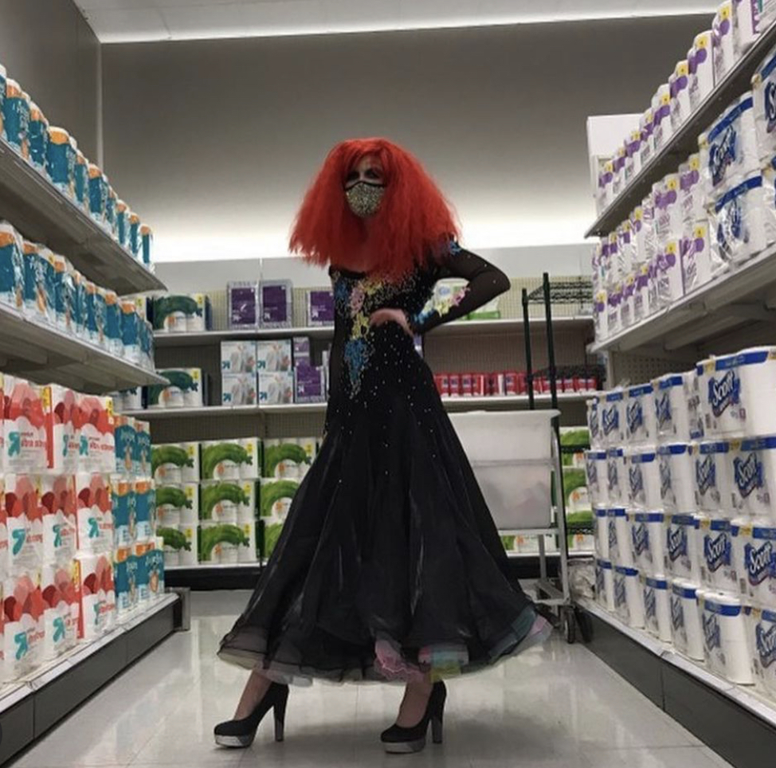
Meet Julius
Julius is an 18-year-old gay male drag queen. My interview with Julius took place on April 2, 2021 and was approximately an hour long. The interview was about his personal experience of "coming out" as gay and how he has embraced the "Drag Queen" lifestyle. After the interview, I was able to be a part of his "Julius to JAM Puddin" transformation. The process of becoming JAM Puddin took almost two hours. Permission was obtained to post all photos involving the process.

Slide 8
The Interview
Me: “At about what age did you first realize you were gay and what has it been like coming out to yourself and others?”
J: “I think I was 13 when I came out. I knew it before then and others probably did too, but we just didn’t say it out loud. Talking to my mom was weird. But coming out really helped my self-esteem. Finally felt like I could be myself.”
Me: “Whom did you tell first and how did they handle it?”
J: My cousin, Bailey. I was in 7th grade and when I told her, she acted like she didn’t hear me. Ignored it. She probably didn’t want to hear it. But the second person was my sister and she was very accepting.
Me: “Tell me about your family. How has your sexual orientation affected your relationship with your family, and do you feel supported my them?”
J: Since coming out I feel more open with my mom. Like I feel comfortable telling her ANYTHING. Same with my sister. But I’m not out to all of my family. My moms sister knows but I’m still not sure of how I will tell my grandparents. The pandemic has kept us apart so I don’t know how they will feel about everything.

Slide 9
The interview
Me: ‘What are your concerns about coming out to the rest of your family?’
J: “You know, I feel like they already know. Especially if they are on social media, but we haven’t had an actual conversation. I feel like I will have to be quiet and behave a certain way so my ”gayness” doesn’t come out. Mostly with my grandparents and the older people in my family.”
Me: “Can you tell me about any particular problems you have faced because of discrimination based on your sexual orientation?”
J: “Mainly just that I don’t have the same friends. Like my male friends. We don’t hang out anymore. I was also bullied when I first came out. Mostly at school. But now the discrimination comes mostly from older people. Like the time I went to Target dressed in drag with my red wig. I was posing in the toilet paper aisle for my Instagram. Old people were shaking their heads and staring. Some parents that had their kids with them covered their kids eyes and drug them away so they wouldn’t see me. And there was another time when my friend’s band was playing at a local bar and she wanted me to come dressed in drag. There were a lot of older (redneck) people there that were judging me. I felt awkward and judged.”

Slide 10
The interview
Me: “ What has it been like for you to be LGBTQ?”
J: “I mean, I’ve never been miserable because my mom and sister have been so accepting. But this community is so small and sensitive to everything. It’s hard for me when I go out in drag or even just with my purse. I don’t let the stares bother me for the most part, but I am still worried about my grandparents thoughts on me being gay. Oh, and a really big thing. I am really open about most aspects of my life, especially since I’m trying to create a social media presence, but I can’t share my political preference. I’m secretly republican. I know, a gay, drag queen republican. Funny, right? But seriously, if my friends or anyone on social media knew, I’d be over. Like I was supposed to hate Trump because most of the gay community did. But I didn’t. Definitely had to pretend though.”
Me: “How open are you about your sexual identity with new acquaintances?”
J: “I mean, new people, I always tell. Maybe not verbally but by behaving true to myself. They should be able to tell from that. If they ask though, I’ll tell them.”

Slide 11
The interview
Me: “Do you want others to be aware of your sexual orientation/gender identity?”
J: “Yes, but not for attention. Like I don’t want to be an attention whore. I want it for acceptance and just so I can be myself.”
Me: “Do you feel isolated or separate from other gay people?”
J: Yes, because a lot of gay men don’t want to date drag queens.
Me: “Do you have gay friends?”
J: “Actually, most of my friends are straight or bisexual females.”
Me: “Do you have concerns about body image or aging?”
J: “YES! I hate that I’m so skinny and look so young. Like my arms and legs are so thin. There are a lot of pressures in the gay community with body image. Because gay men tend to look at the outward appearance especially when it comes to dating. I’ve been working out lately though. And yes, I think about aging all the time. It actually makes me pretty anxious.”

Slide 12
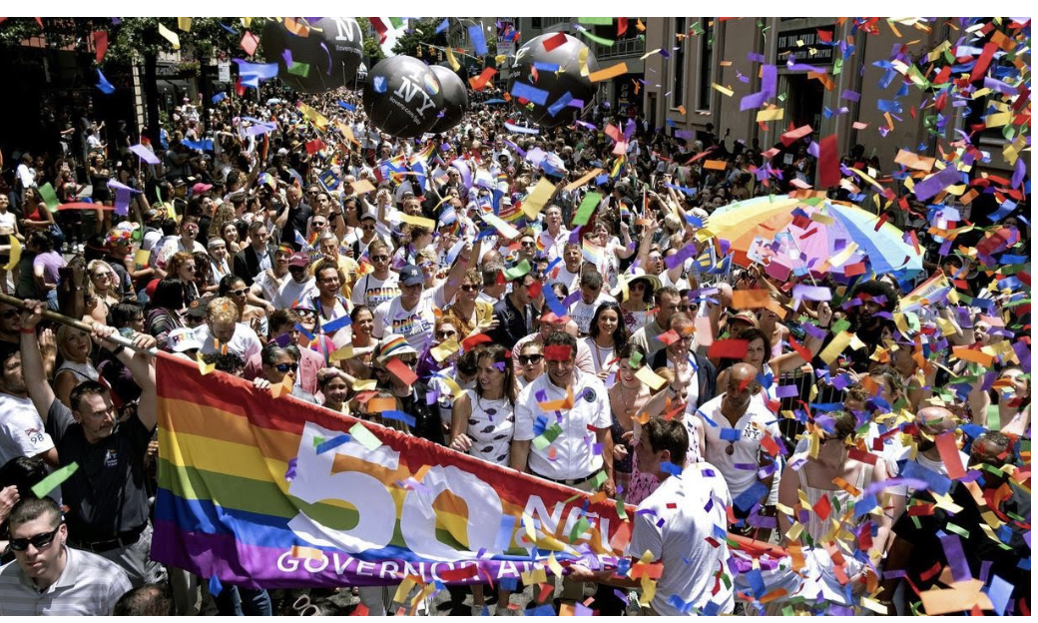
The interview
Me: “How involved are you in the gay community and do you have any concerns about fitting into the community?”
J: “Because of the pandemic, I haven’t been able to really go anywhere. But there are a ton of social media groups and virtual gay pride events. Last year on June 27th, I attended the virtual celebration of the 50th anniversary of the first pride march. And yeah, there’s really only one thing I’m concerned about with fitting in. My political preference. Like I said the gay community is good about treated everyone equally for the most part. But when it comes to political parties, no. I won’t ever say that I’m a republican. It could ruin me.”

Slide 13
The interview
Me: “ I had to do a little research into what the difference between being transgender and being a drag queen is. One explanation I found was, transgender refers to a personal gender identity and an authentic, lasting sense of self. In contrast, “drag” is a temporary and deliberate performance of gender. Would you agree with this definition?”
J: “Yes and no. Because I still feel an authentic sense of self because drag is so much a part of my life now. ”
Me: “How old were you when you started experimenting with the drag lifestyle?”
J: “15”
Me: “Do you want to go out on a date in drag?”
J: “No, I want to just be Julius.”
Me: “When you are doing drag, how much, if at all, does your personality change? Do you take on a larger than life persona or are you still the same personality?”
J: “Yes definitely a different personality. When I am JAM Puddin, I am sassy. Actually, more bit**y. I have way more confidence and love to pose/perform. I can’t wait to start performing in clubs.

Slide 14
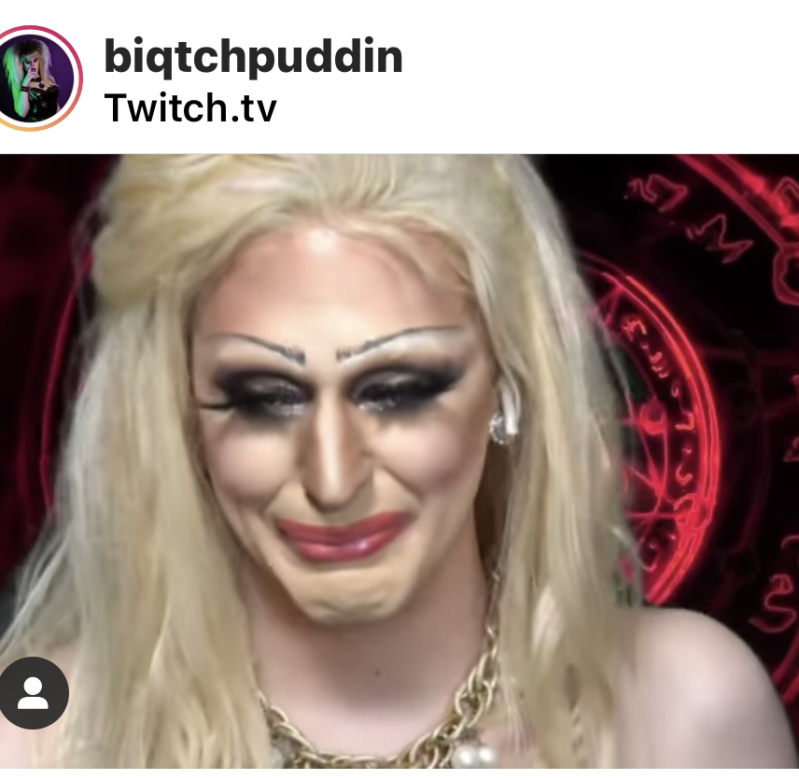
The Interview
Me: “That leads me to the next question. What’s the story behind the name, JAM Puddin?”
J: “Haha, honestly no real story. JAM just represents my initals. But Puddin is a name I took on, well adopted from my favorite drag queen. The one that inspires me most. Biqtch Puddin.

Slide 15
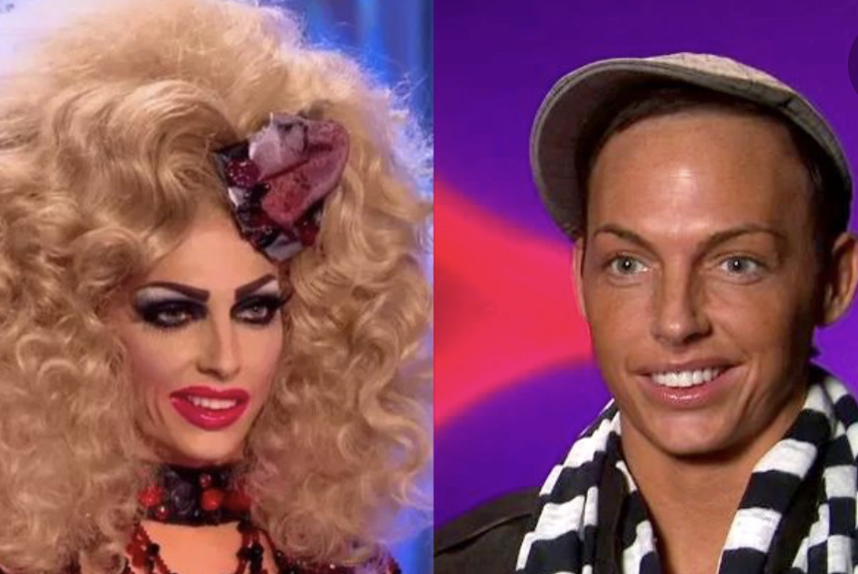
The Interview
Me: “How did you get into drag and who showed you the ropes?”
J: “I started by watching RuPaul’s Drag Race, but then watching Alyssa Edwards, Coco Peru, and of course my idol, Biqtch Puddin.”
Me: “What do you wish more people knew about drag?”
J: “That it’s more about self-expression and entertainment. Not gender. I don’t want to be a woman, but I love dressing up as one.”
Me: “What can young people take away from drag?”
J: “It can help you feel free and less concerned of what others think of you.”
Me: “Is there a difference between you and your drag persona?”
J: “Yes, Julius is more reserved, shy and I honestly don’t go out of my way to look good on social media. But JAM is really confident, outgoing and must look good on social media.”

Slide 16
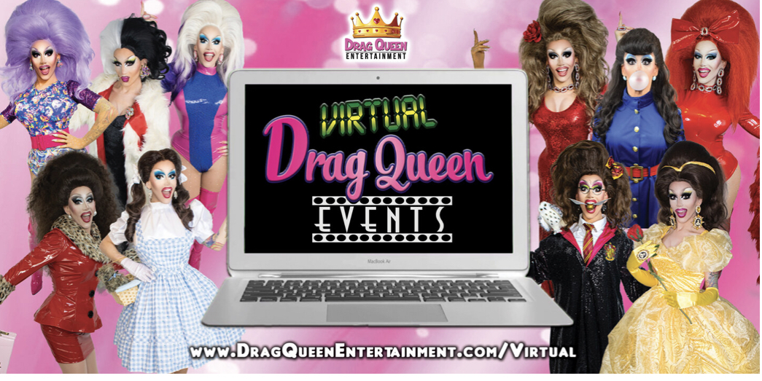
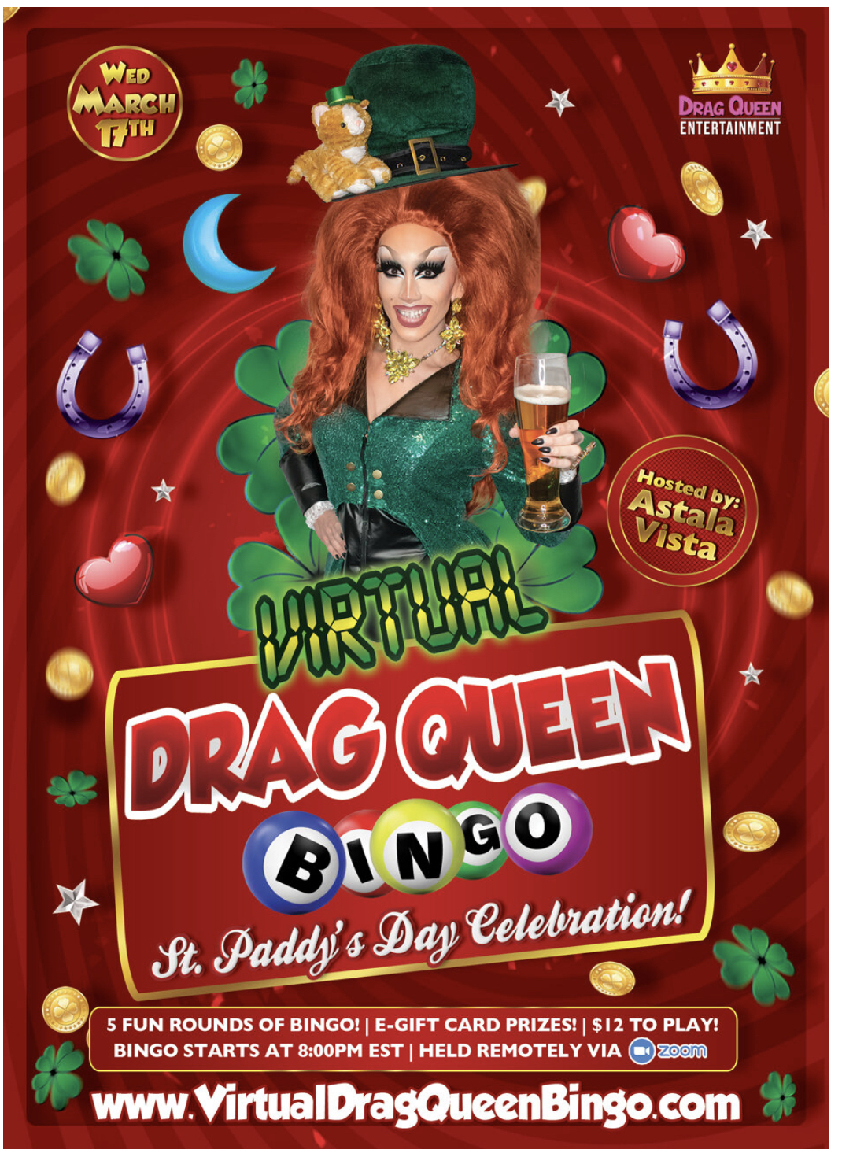
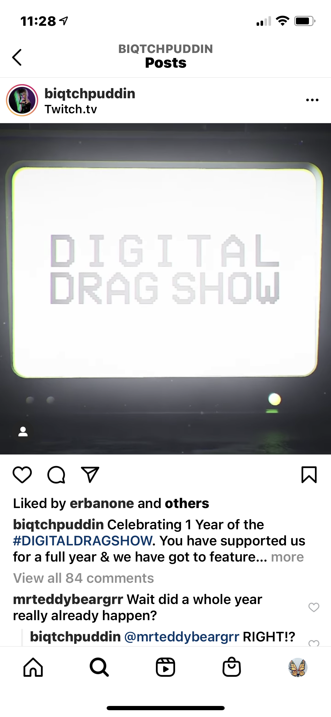
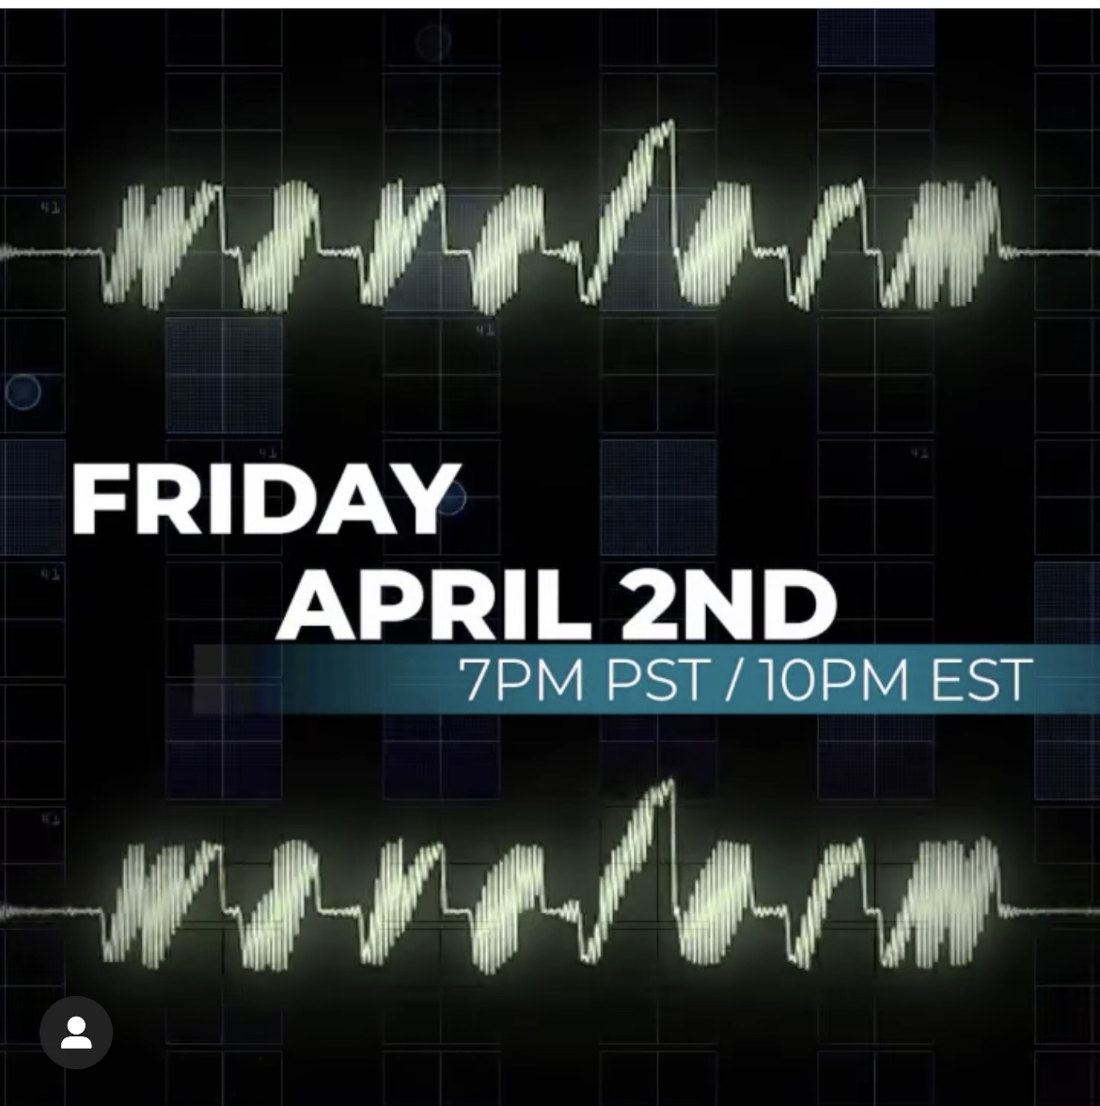
The Interview
Me: “Have you attended any drag events recently and what do you hope to get out of being a drag performer?”
J: “Yeah, I have attended virtual drag events like “Virtual Drag Queen Bingo” and tonight is the 1-year anniversary of the “Digital Drag Show”. I can’t wait to perform and also, I want to try to break that stereotype among the gay community that gay men don’t want to date drag queens.”

Slide 17
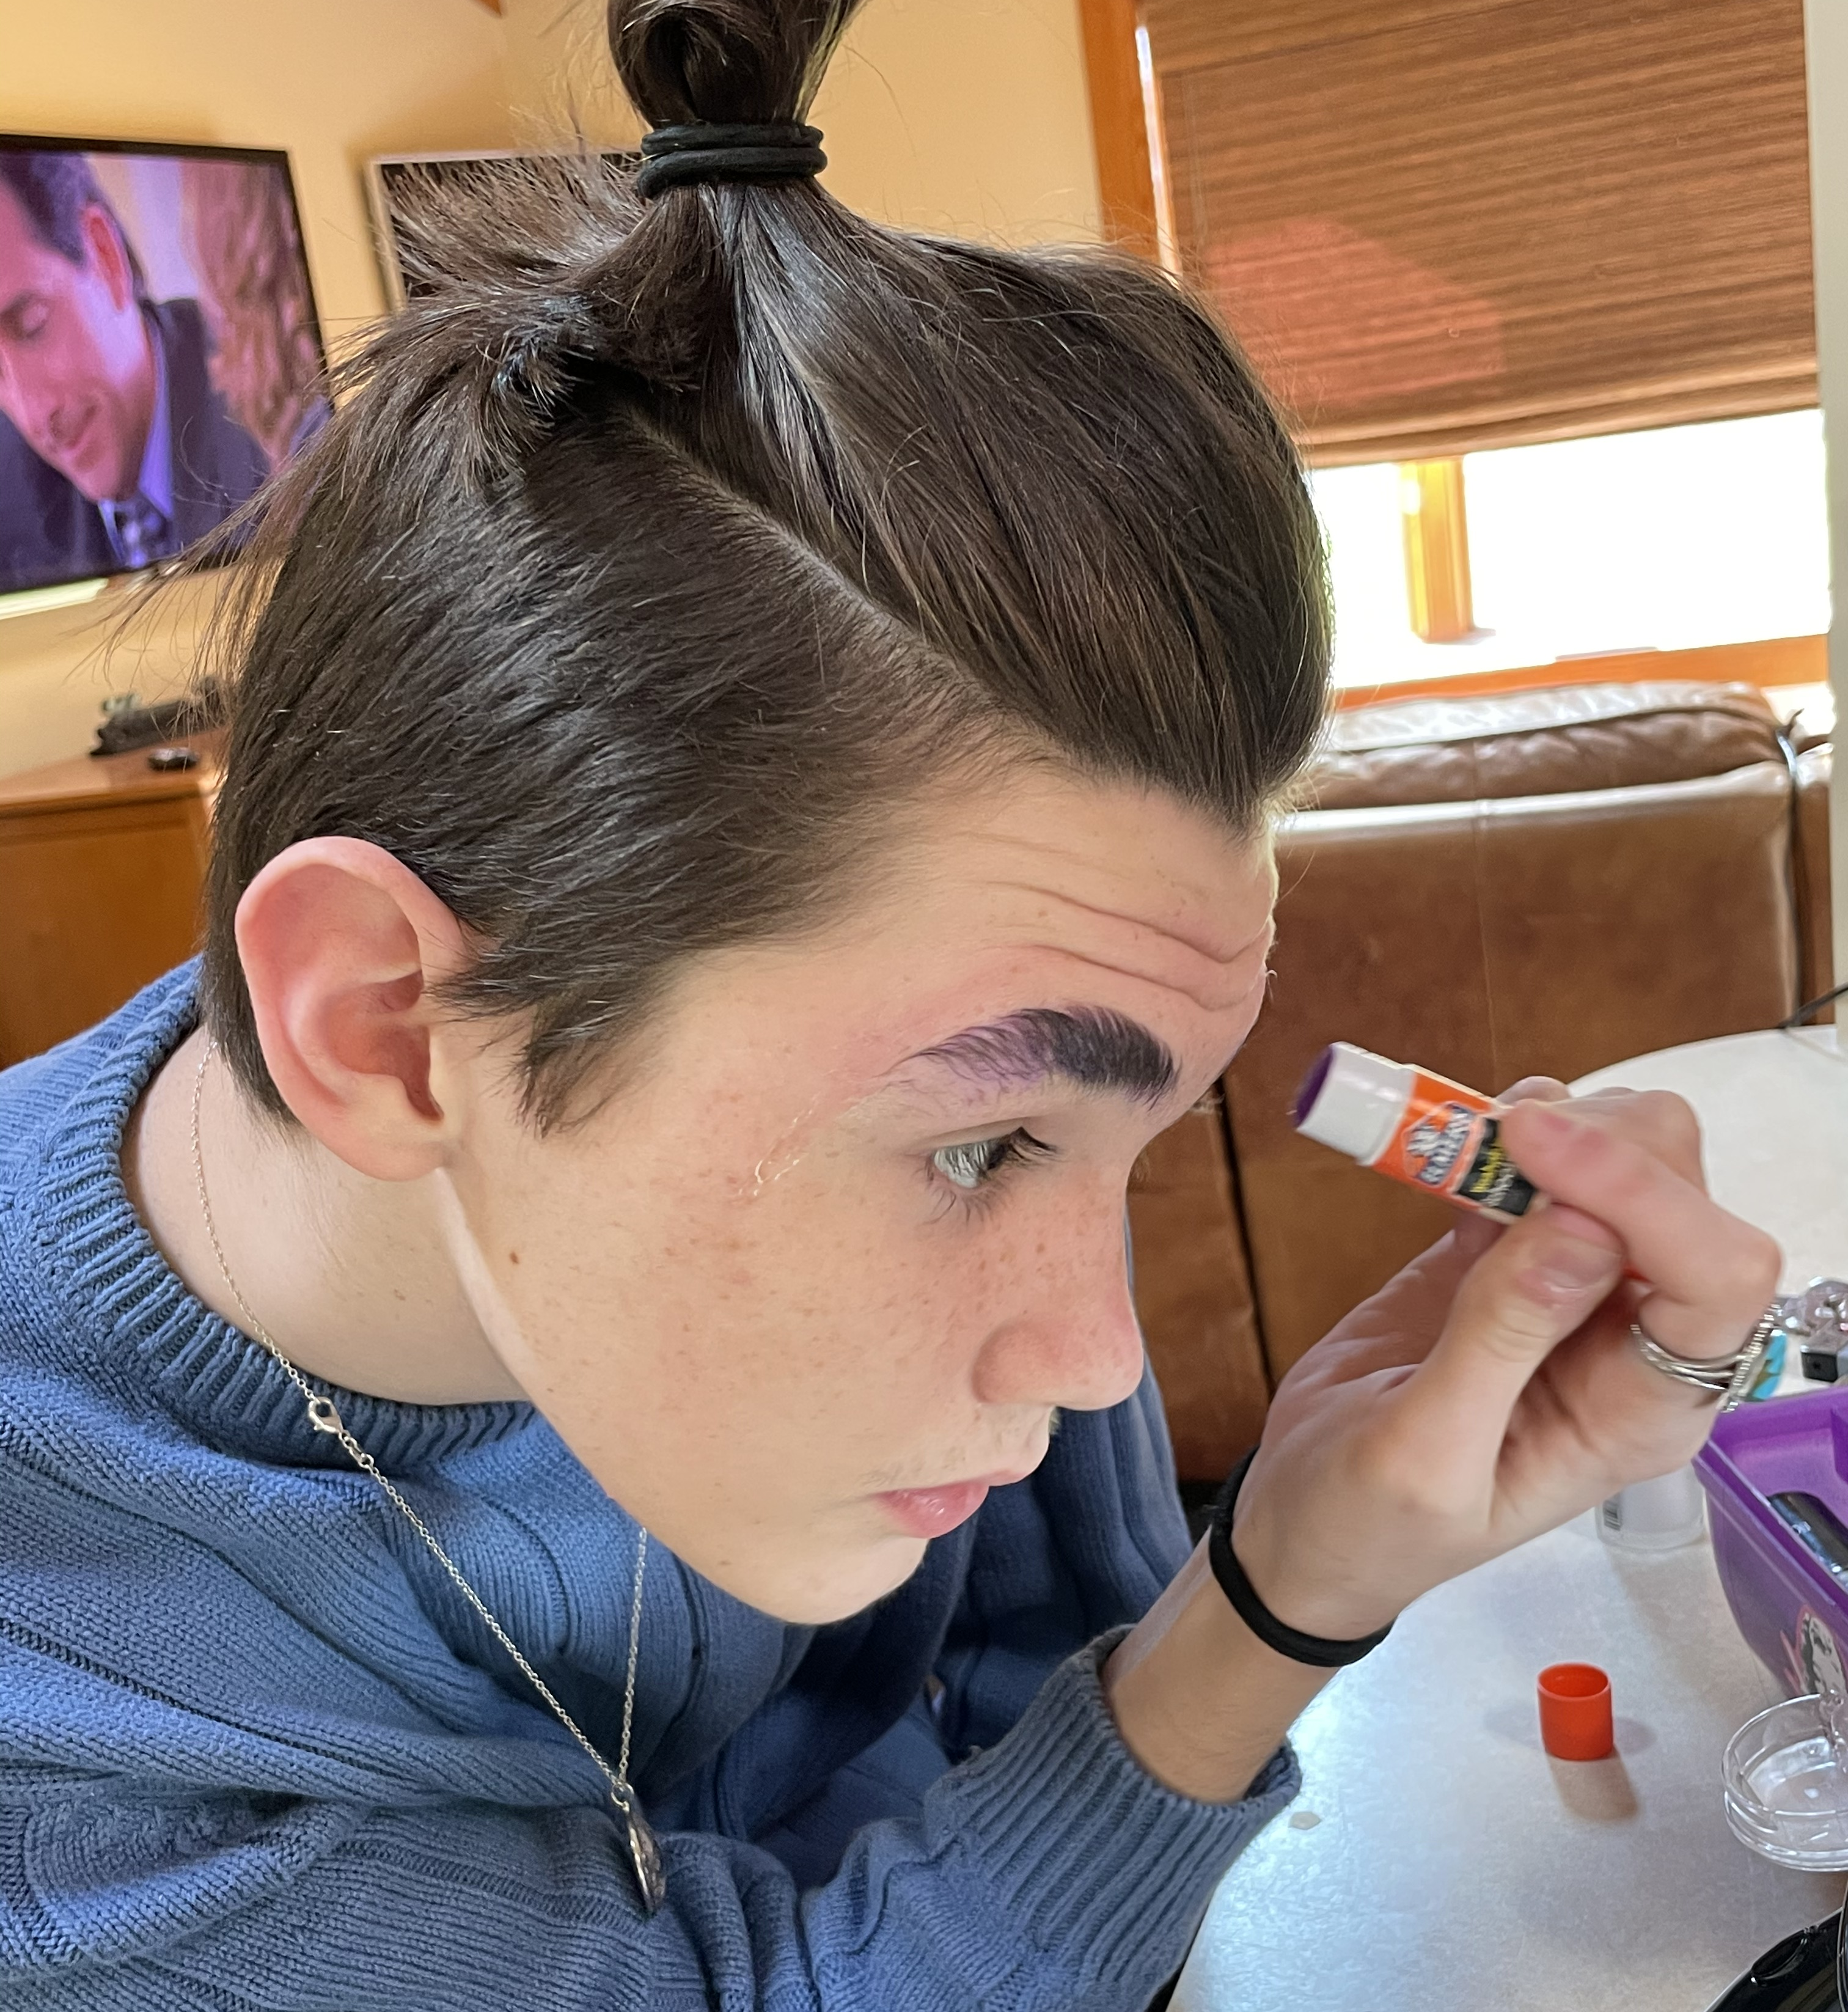
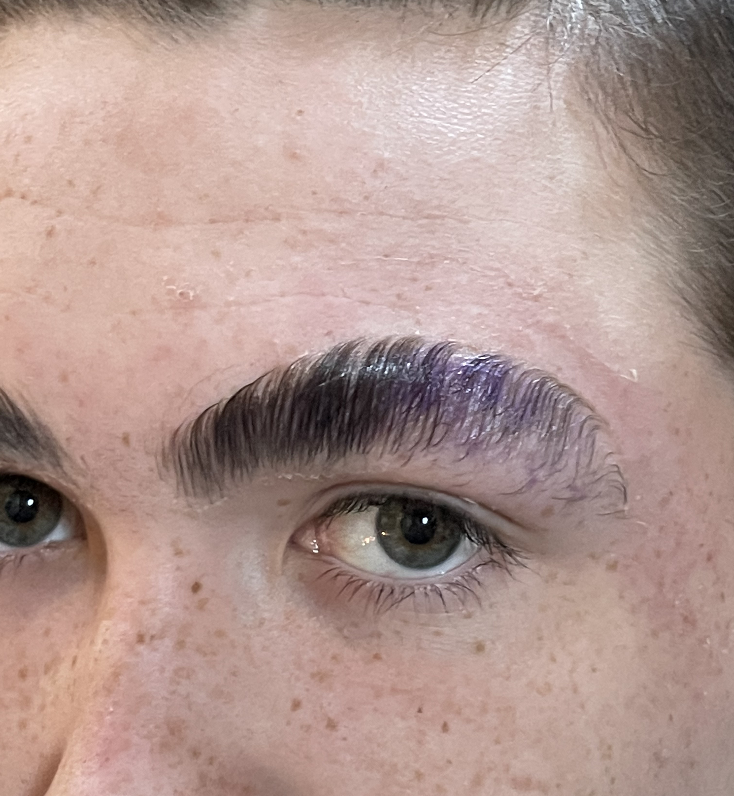
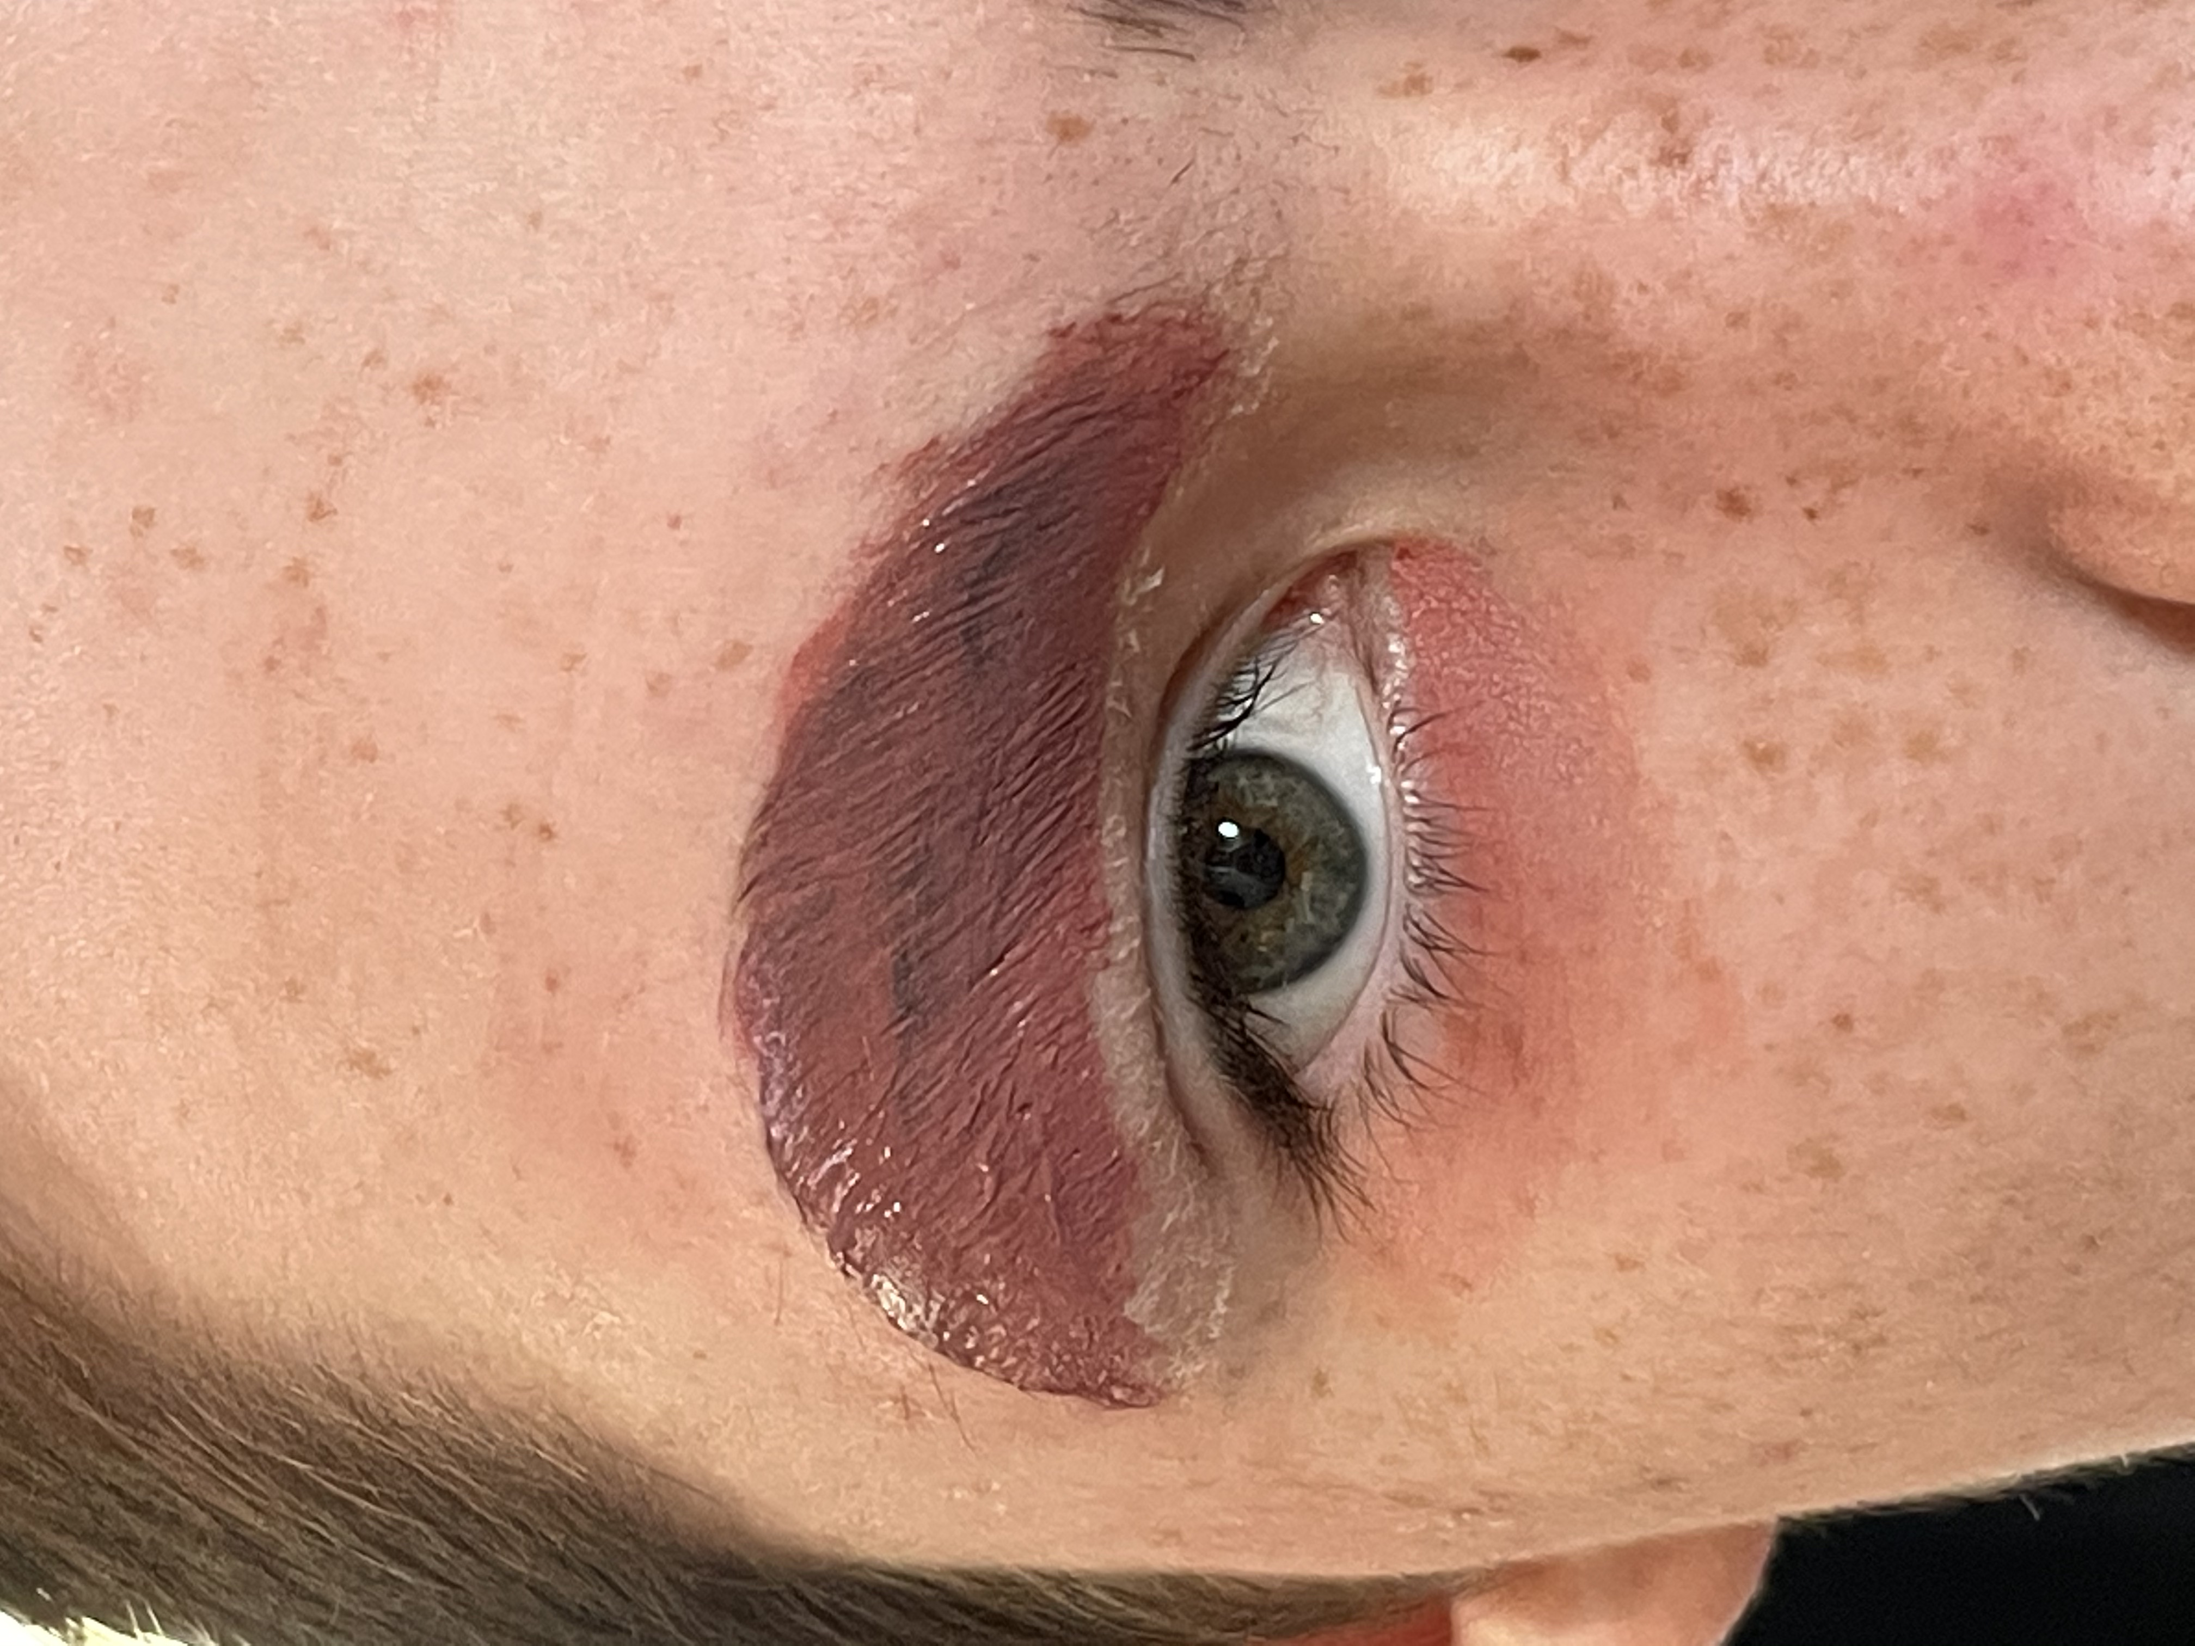
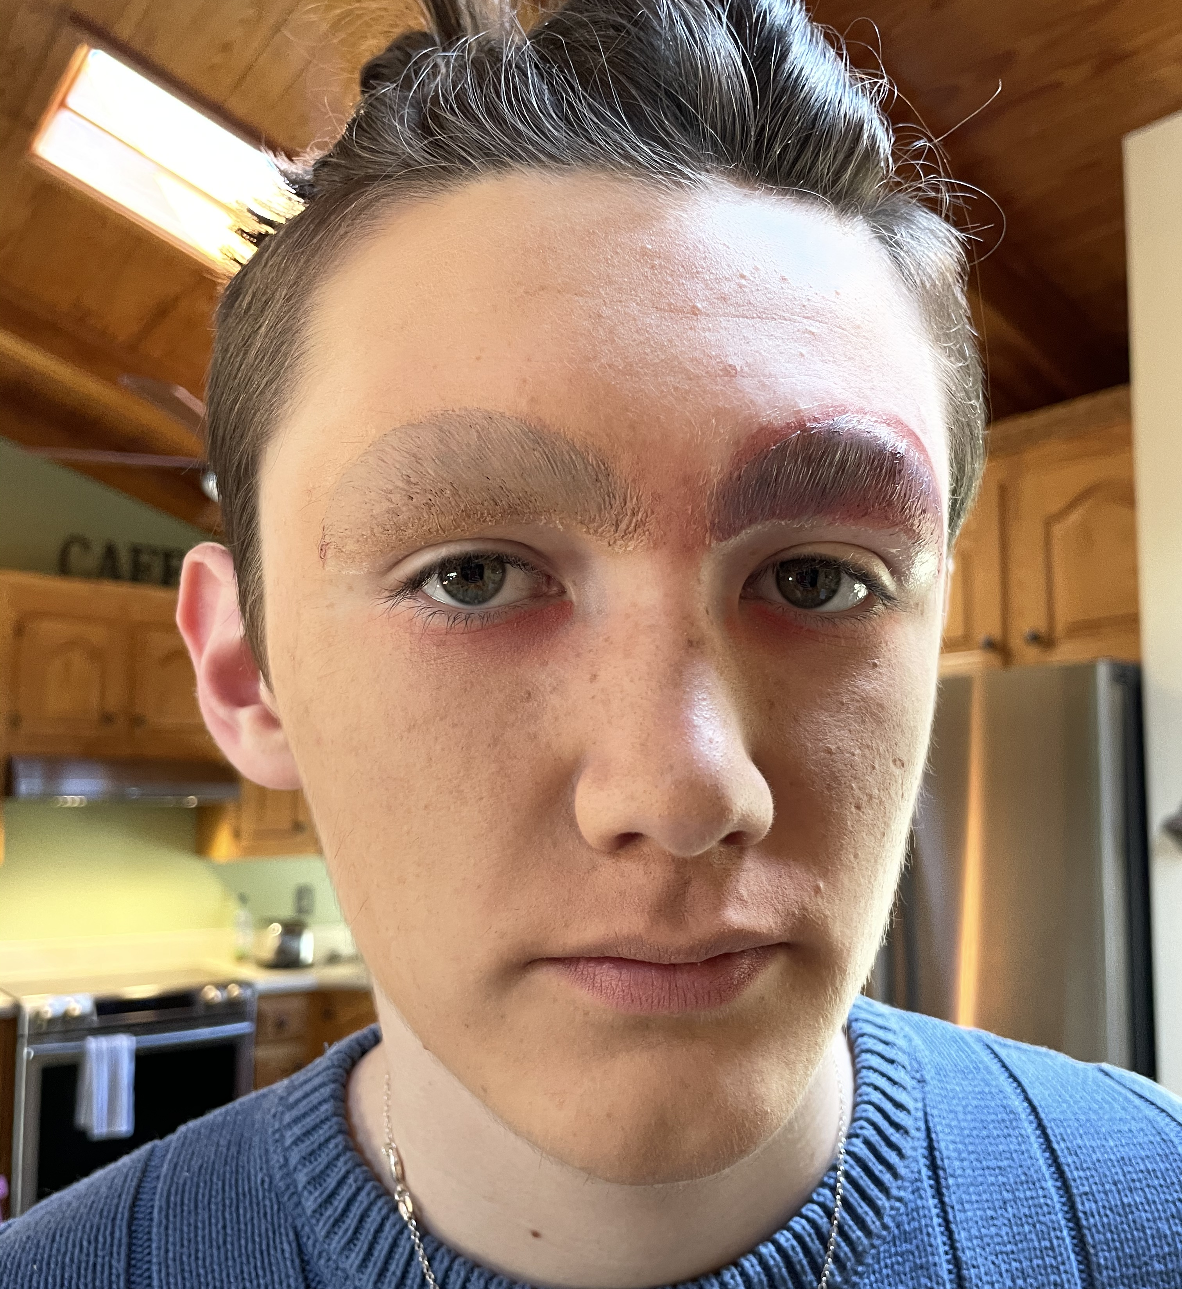
The experience
Transformation from Julius to JAM Puddin
First, he uses glue sticks to tame and flatten his thick brows. Then he uses color correctors to get rid of them so he can draw on his own brows.

Slide 18
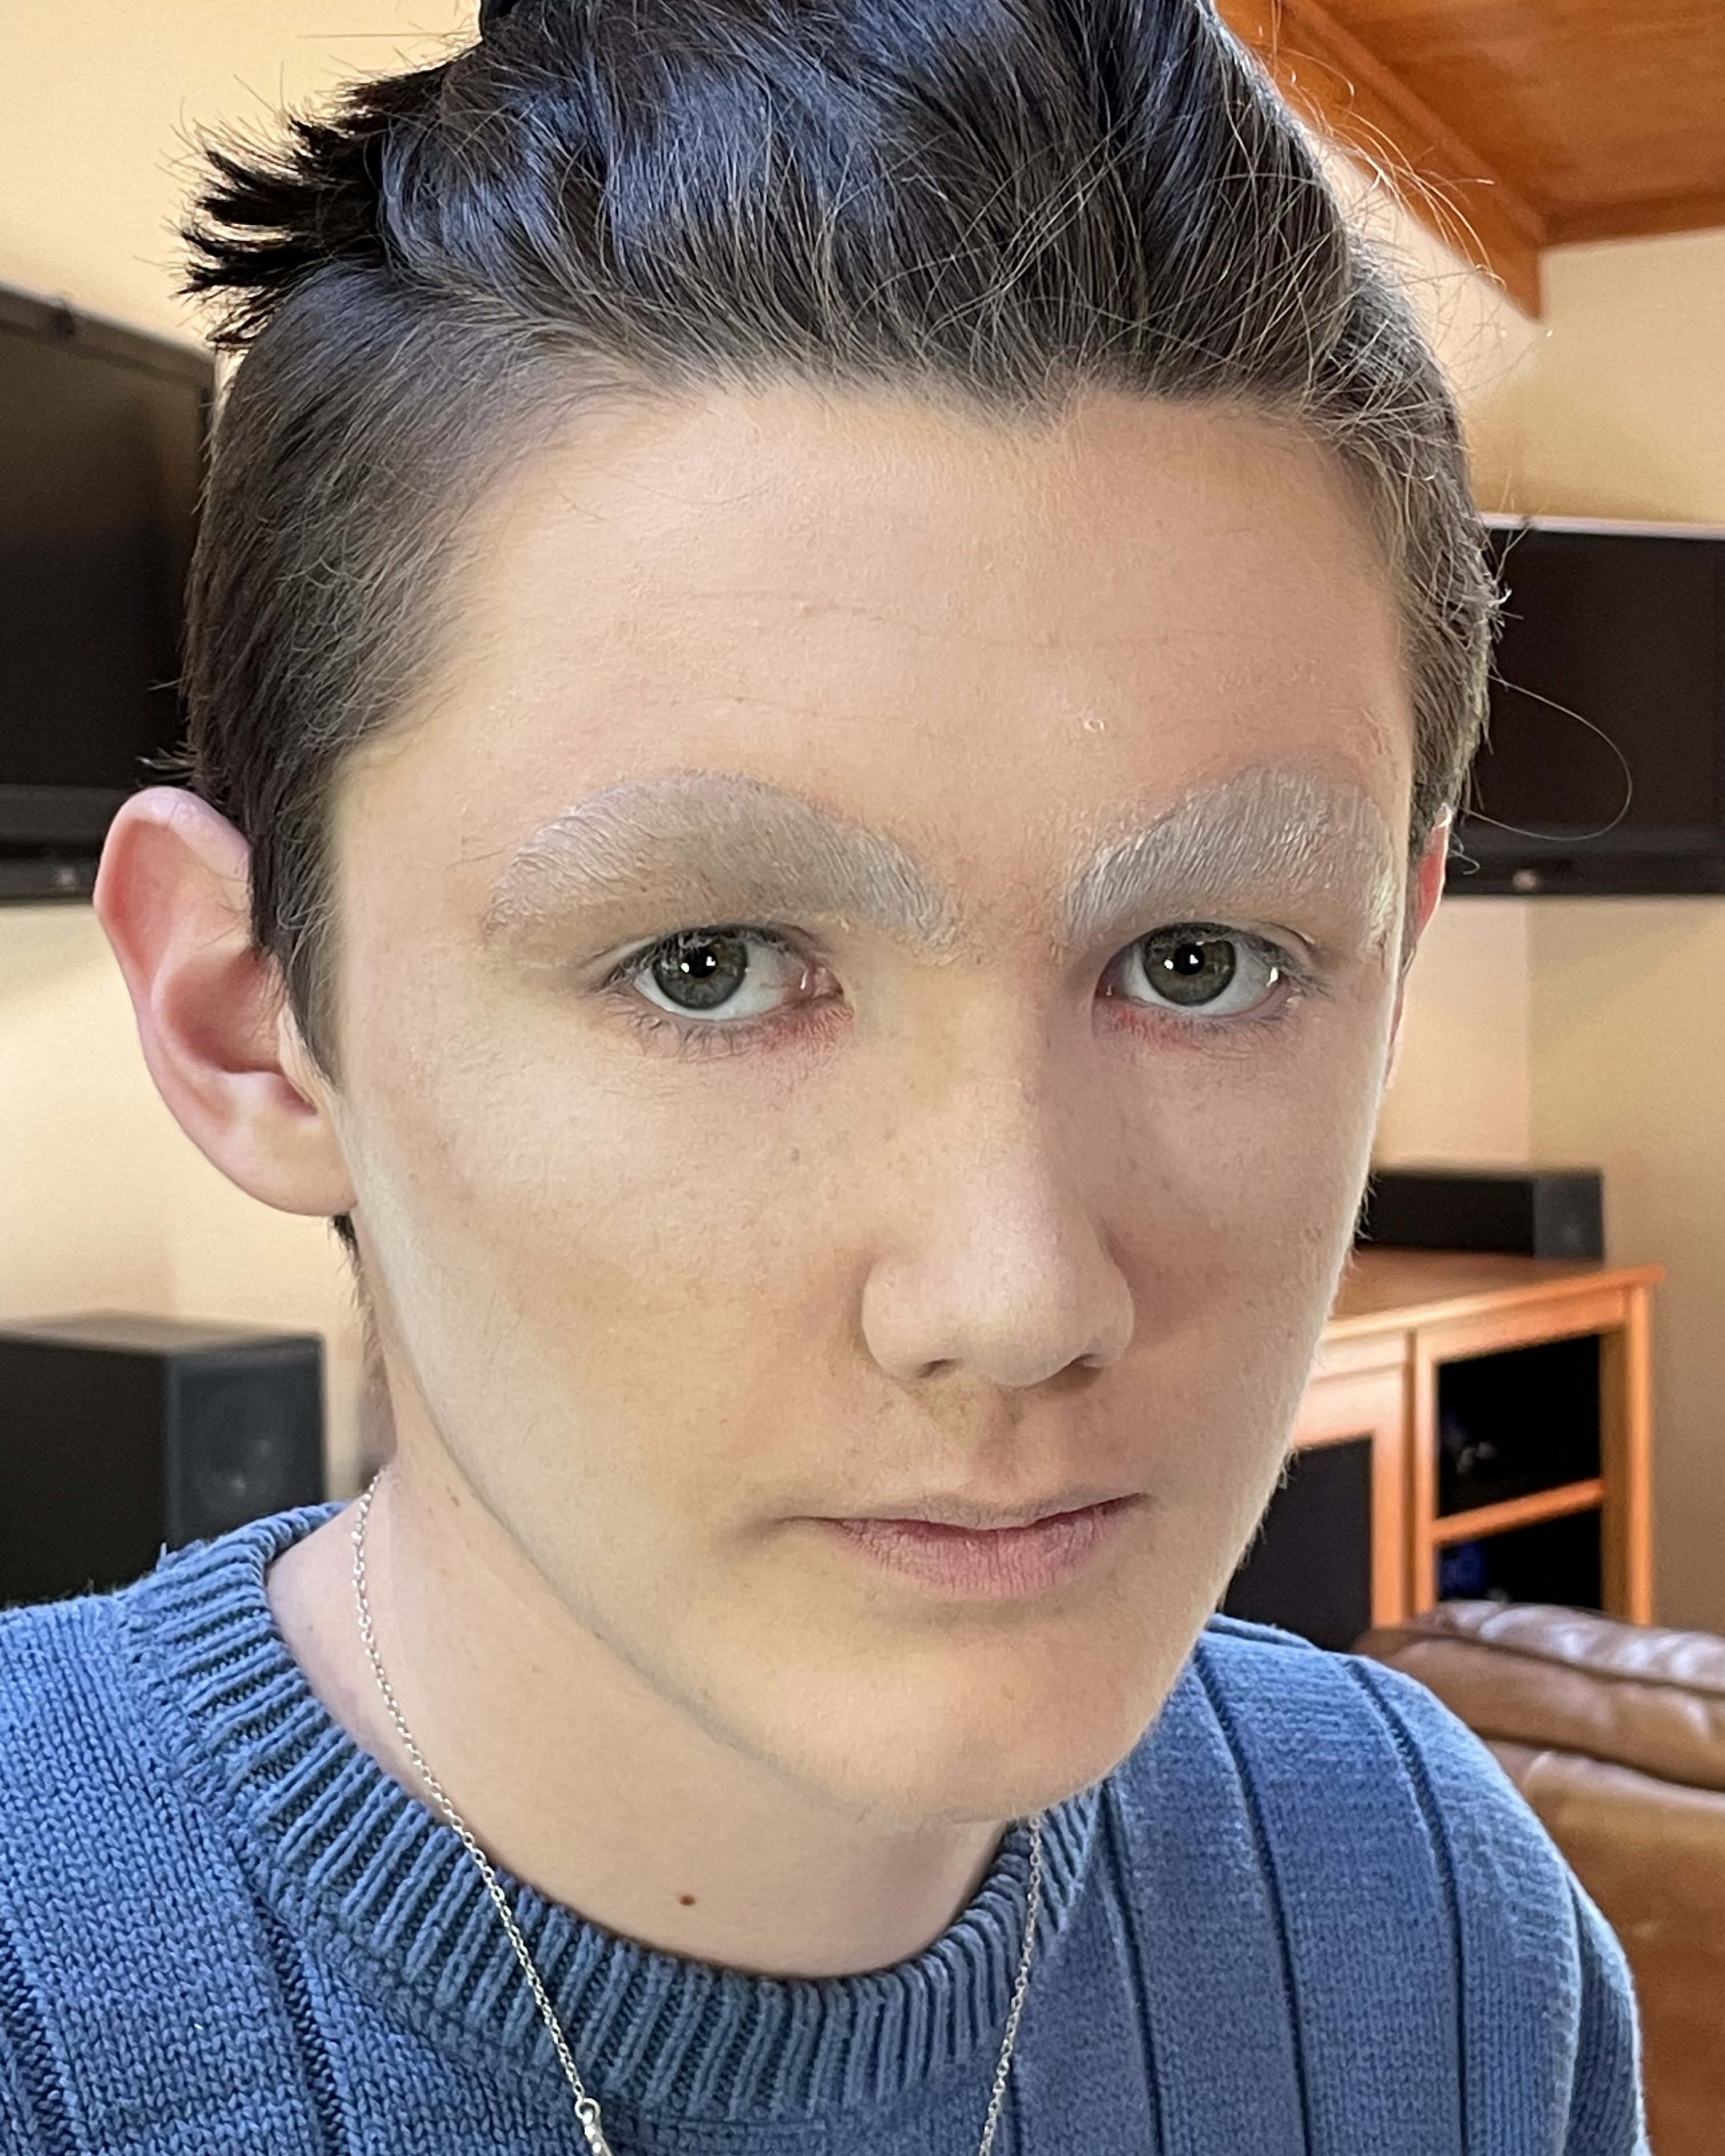
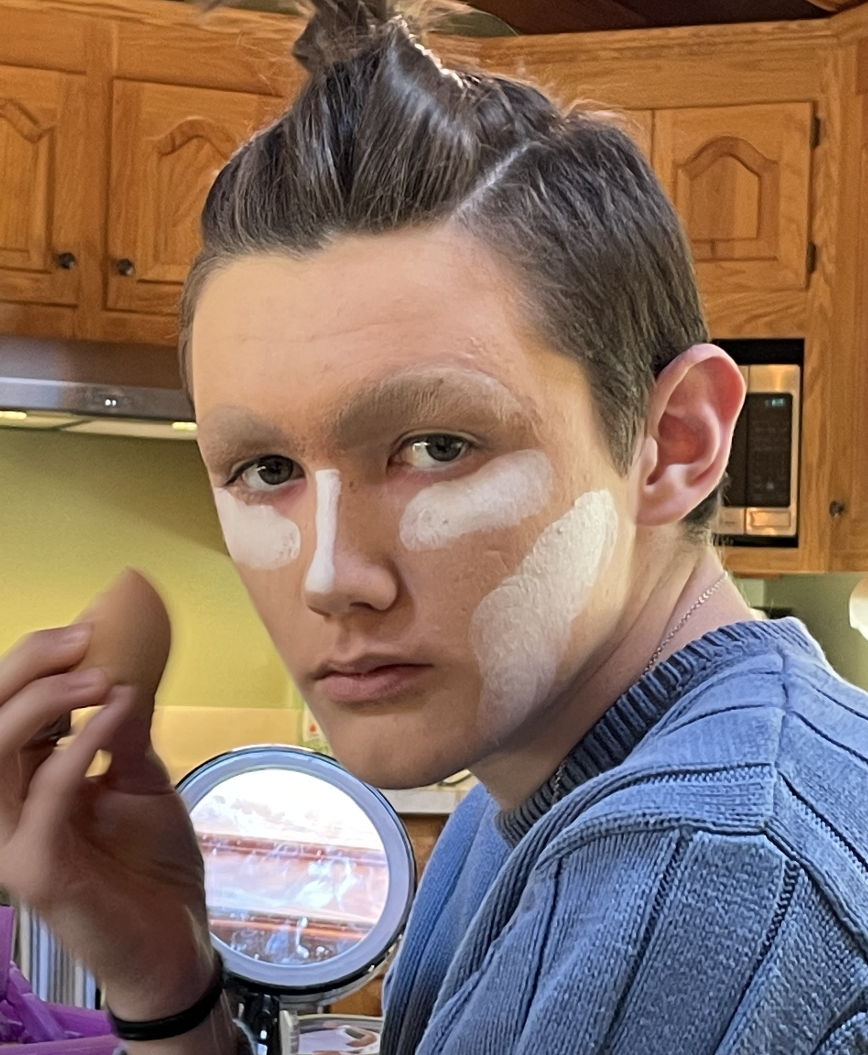
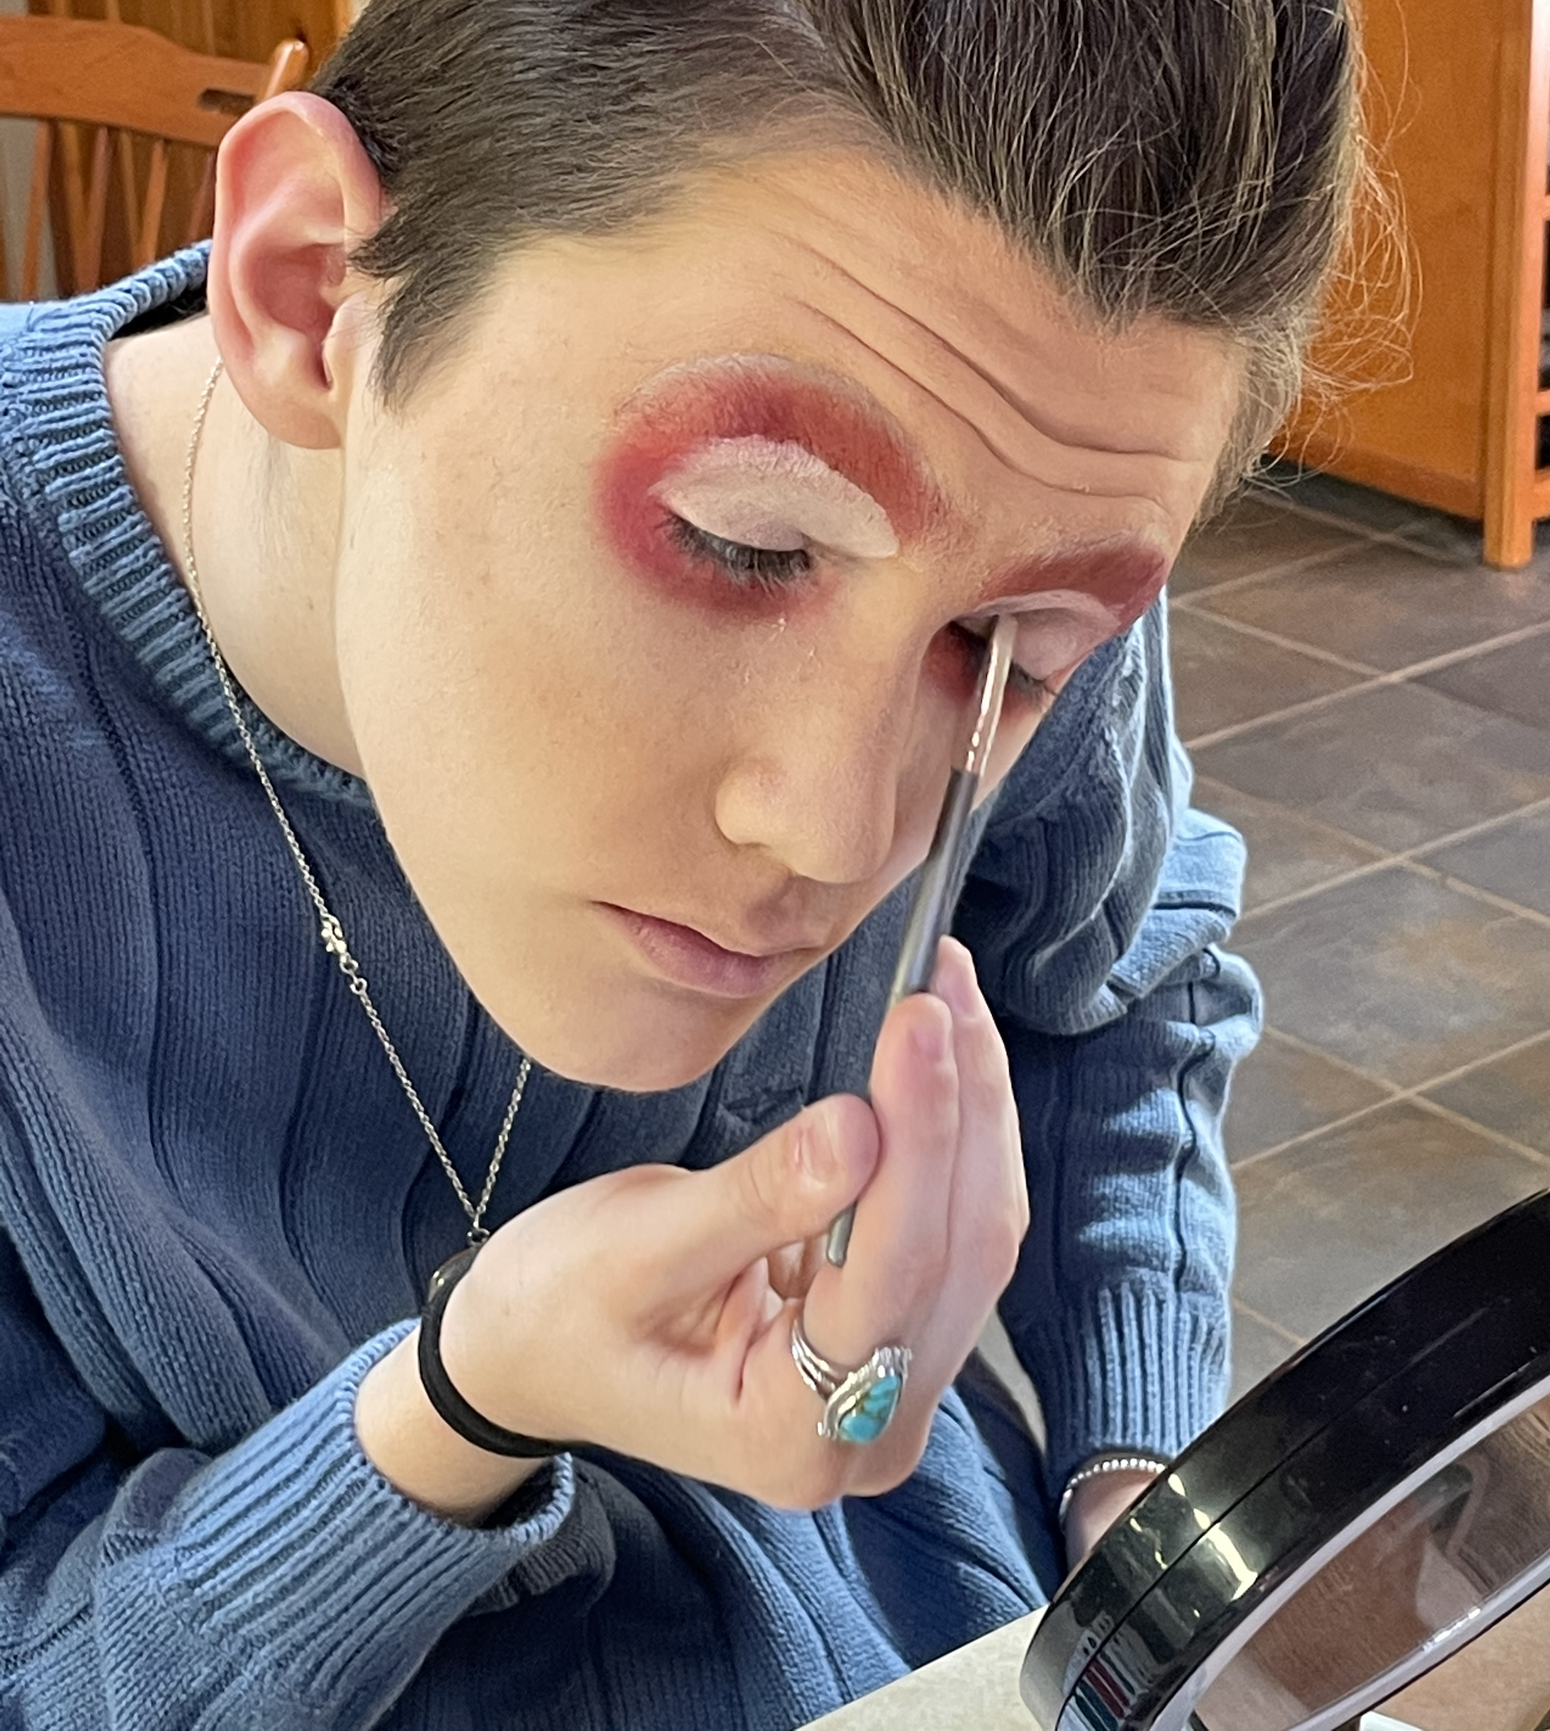
The Experience
Step 2 of the transformation:
Use combinations of foundation and start on the eyes. He goes for a very dramatic eye like Bitqch Puddin. He applies lashes and other finishing touches.

Slide 19
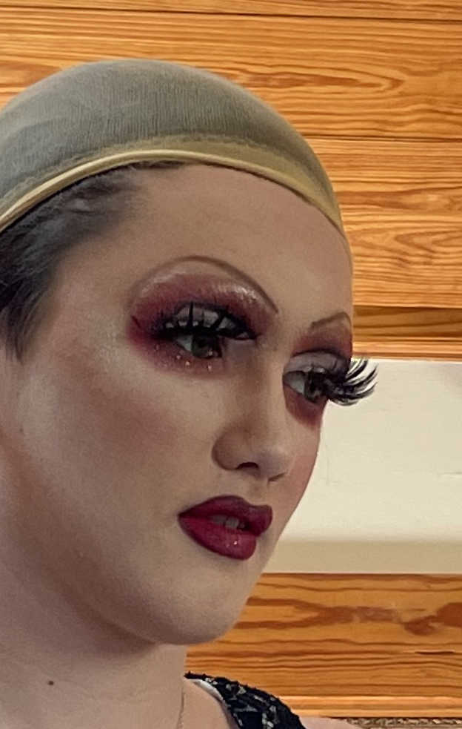
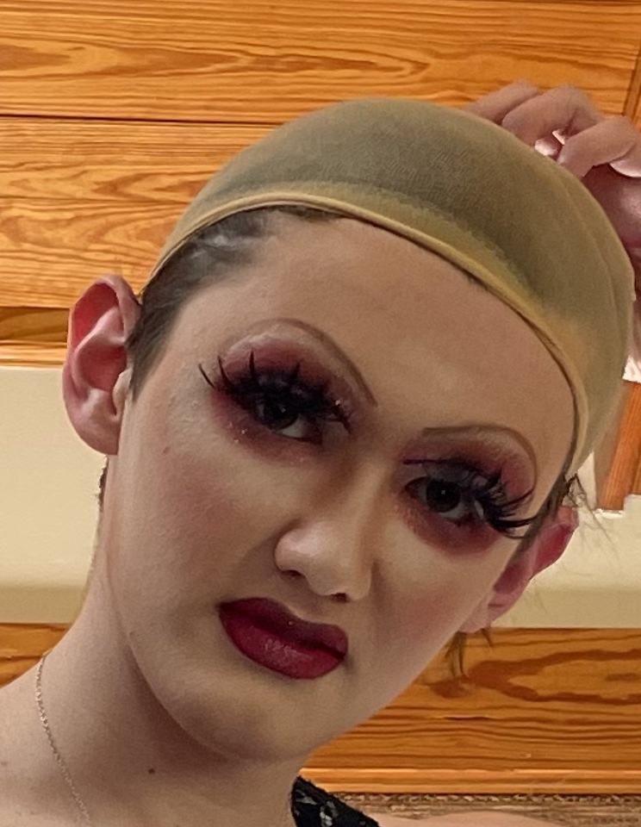
The Experience
He picks out his dress and puts on his wig cap.

Slide 20
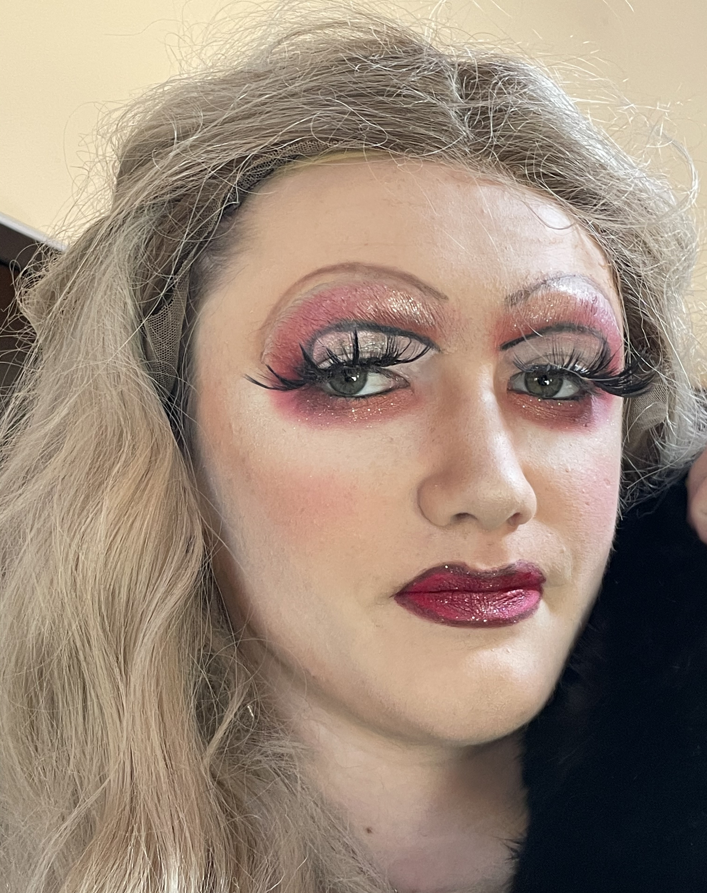
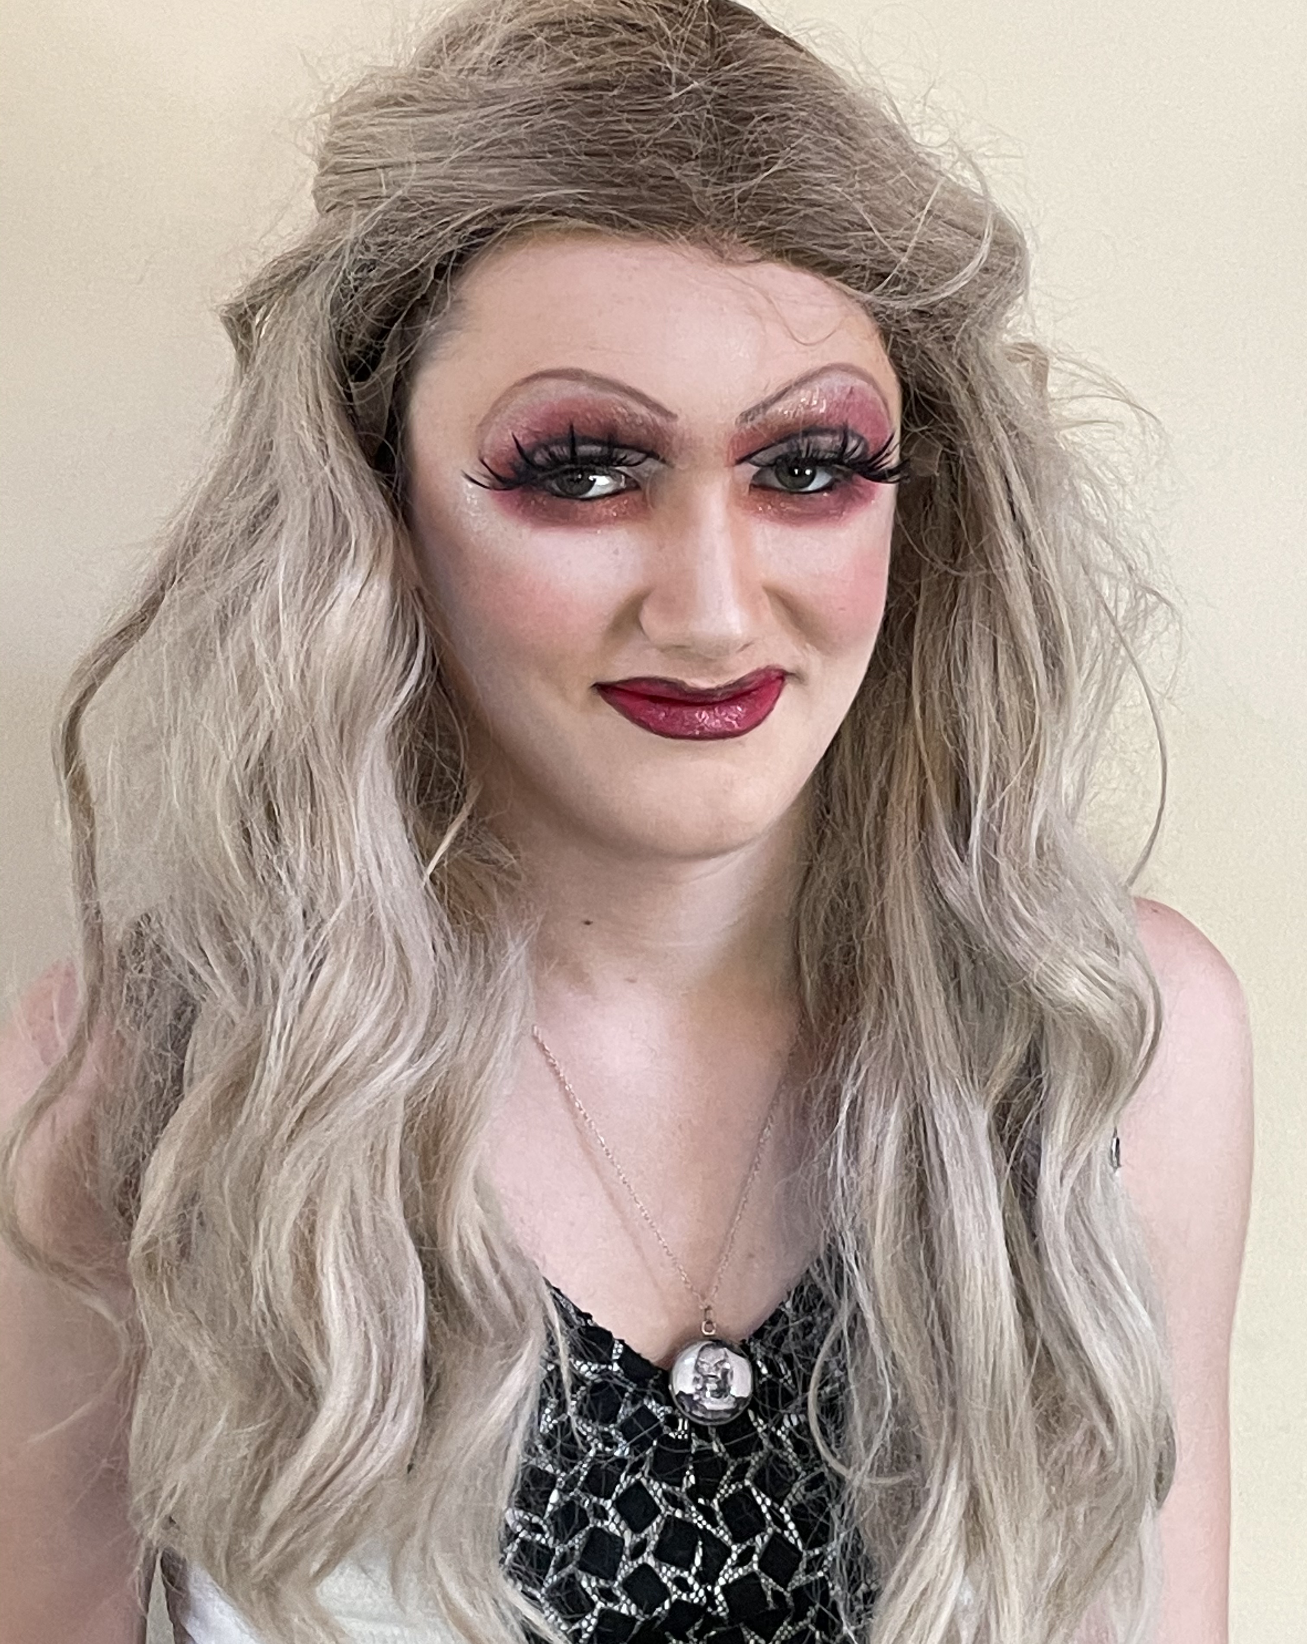
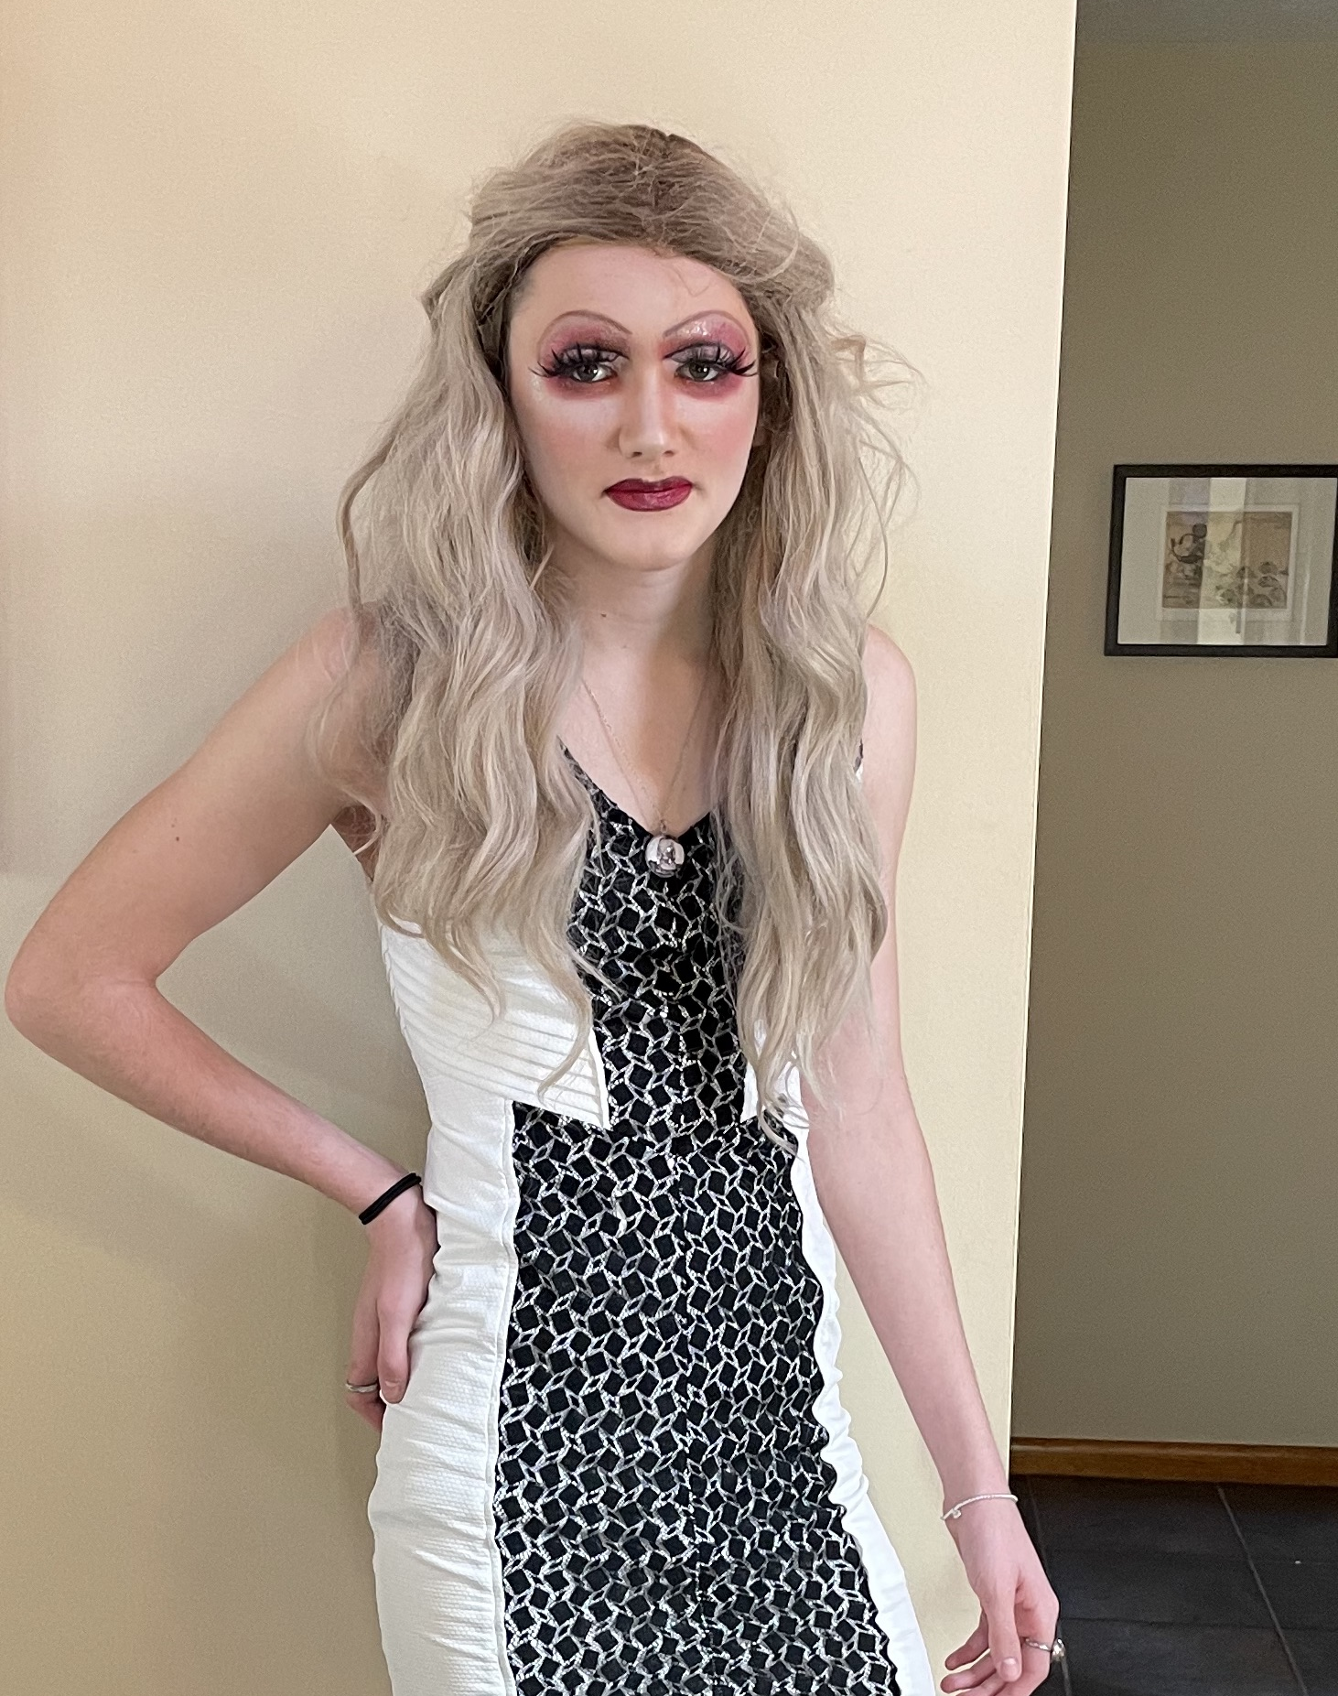
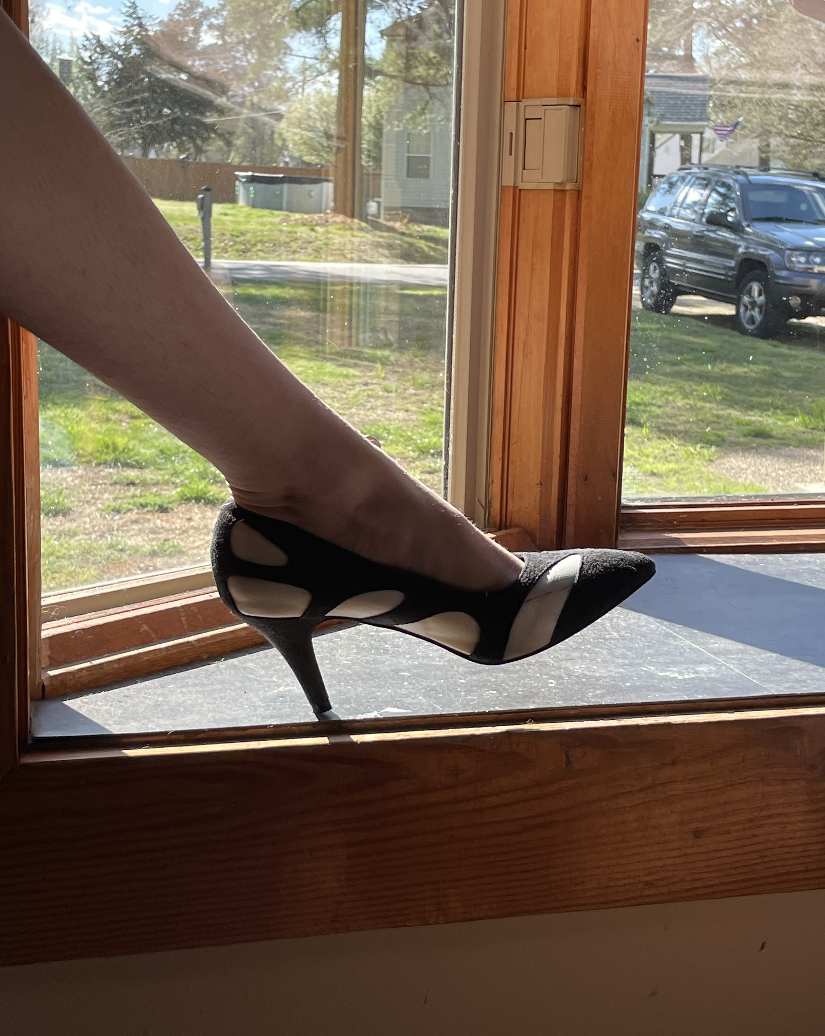
The Experience
Wig and heels come on! JAM Puddin is ready for a night out!

Slide 21
JAM Puddin and her idol, biqtch puddin

Slide 22
My reflection
Conducting this interview with Julius helped me to have a better understanding of his personal beliefs, attitudes, values and even biases. It also taught me that when counseling LGBTQ individuals and those with different lifestyles (such as drag), you must develop an awareness that comes from introspection, reflection and experiences of your own worldview in order to be a competent and empathetic counselor.
Things to practice when working with LGBTQ clients:
Empathetic listening
Appreciate their courage
Be a model of acceptance
Offer support but don’t assume they need help
Ask questions that demonstrate understanding and compassion
And lastly, be prepared to give a referral.

