Slide 1
A Case-Control Study of Mold and Health Issues at Old Dominion University
Jeanette Foxx
jfoxx@odu.edu
April 22, 2020
MPH 616

Slide 2
Research Question and Purpose
Is mold exposure related to health issues for students, faculty, and staff on ODU’s Norfolk campus?
The purpose of this research is to determine if indoor mold is related to reports of being sick by students, faculty, and staff of ODU’s Norfolk campus.

Slide 3
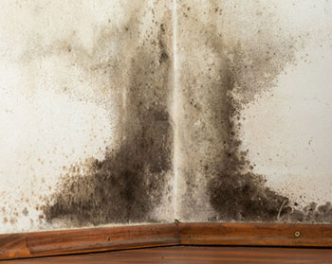
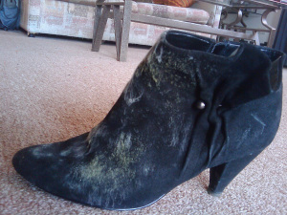
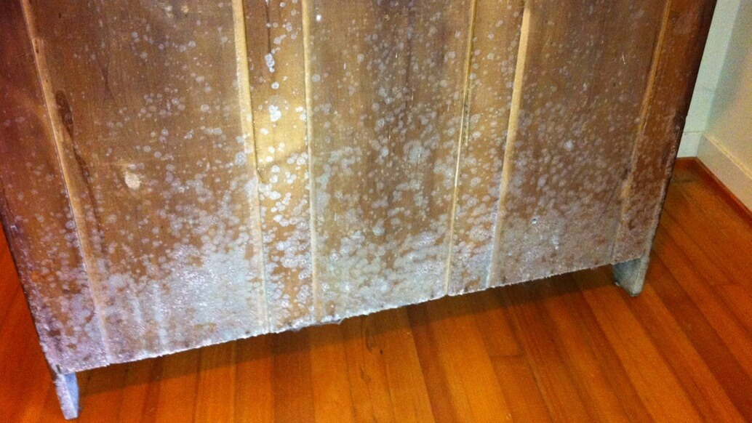
Background
Mold is a group of fungi that live on biological or wet materials.
Mold exposure is associated with health effects that continue to be studied.
There are no exposure limits for indoor mold.

Slide 4
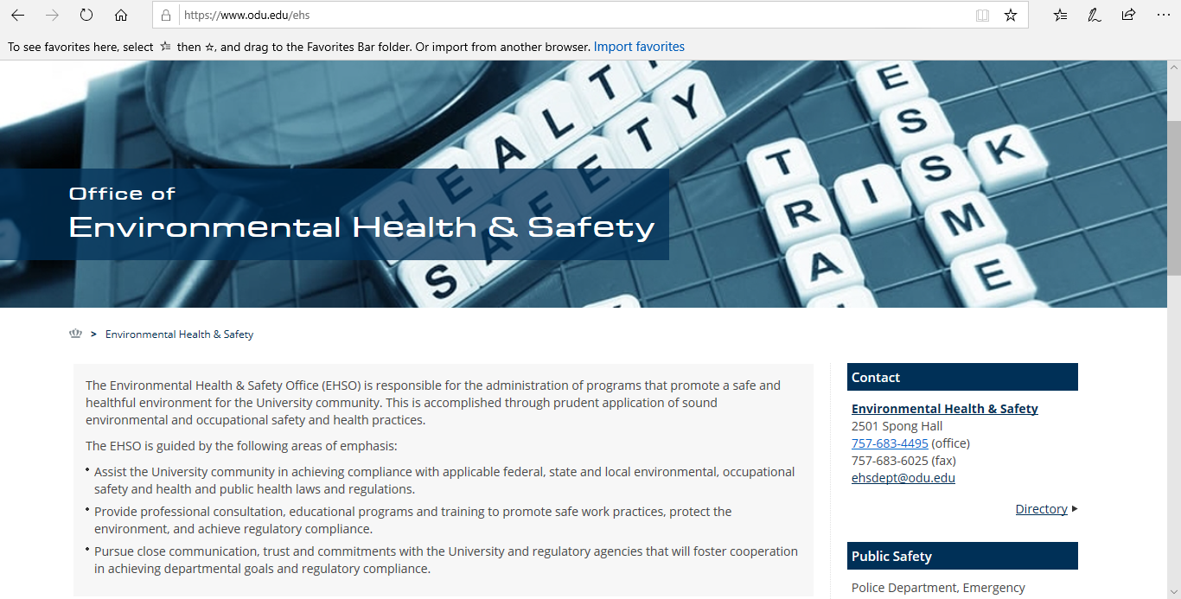
ODU Mold Management Program
Administered by the Office of Environmental Health & Safety.
EH&S investigates all Indoor Air Quality complaints.
If mold is identified, it is tested and remediated at the discretion of EH&S staff.
All complaints and associated actions are recorded and kept on file in the EH&S Office.

Slide 5
Study Design and Data Analysis
Study Design – Retrospective Case-Control Study
Exposure = Mold
Disease/ Outcome = Health issues including but not limited to allergies, asthma, and respiratory infections
Population = Students, faculty, and staff that live and work on ODU’s Norfolk campus
Cases are defined as those individuals who reported health concerns due to suspected mold in their workspace or living space.
Controls are defined as those individuals who did not report health concerns, but suspected mold in their workspace or living space.
Sampling period = January 2015 to December 2019

Slide 6
Results
Variable | Description | Type/Format | Values
Date_ID | Date Reported | Date | Enter date as mm/dd/yyyy
Complaint | Reported Complaint | Numeric | 1 = Health Issues 2 = No Health Issues
Finding | Was Mold Found in reported location. | Numeric | 1= Yes 2 = No
Contact Type | Student, Faculty, or Staff | Text | Student=STUDENT Faculty Member=FACULTY Staff Member=Staff
Location | Location of reported complaint | Numeric | 1 = Health Sciences 2 = Perry 3 = Powhatan 4 = Rollins 5 = Spong 6 = Whitehurst 7 = 3 or less complaints reported
Mold_Type | Mold species found if tested | Numeric | 1 = Aspergillus/Penicillium 2 = Cladisporium 3 = Trichoderma 4 = Other 5 = Not tested 6 = Not applicable. No mold found.
Action | Action taken if mold was found in location | Numeric | 1 = Relocation 2 = Cleaning of affected areas or item removal 3 = None
Variables included:
  Date
  Location
  Health issues reported?
  Contact person/ type
  Was mold found?
  Identified mold species, if tested
  Corrective actions

Slide 7
Results continued
One-Way Frequency Results*
Variable | Percent %
Complaint
Sick | 52
Not Sick | 48
Finding
Mold | 29
No Mold | 71
*Analyses performed with SAS Studio Version 3.8

Slide 8
Results continued
2 x 2 Table
 | MOLD | NO MOLD
CASES | 31% | 69%
CONTROLS | 27% | 73%
Odds Ratio Estimates
Effect | Point Estimate | 95% Wald Confidence Limits
Complaint 1 vs 2 | 1.250 | 0.508 | 3.073

Slide 9
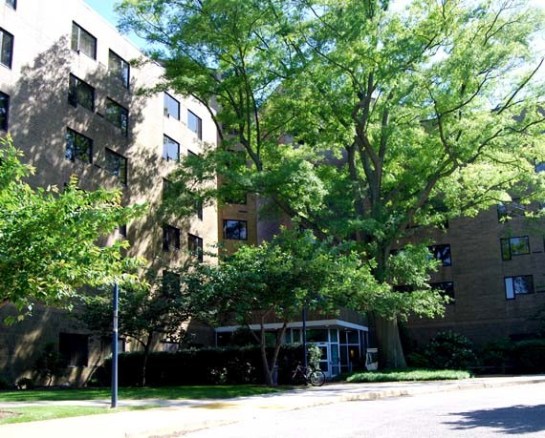
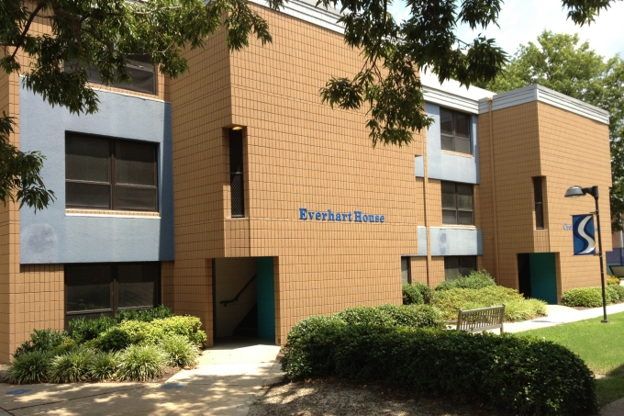
Other Results
Location
  Whitehurst Hall (26%)
  Powhatan Village (14%)
Contact Person
  Staff (51%)
  Student (46%)
Mold Species
  Aspergillus/Penicillium
  Cladosporium
  Stachybotrus

Slide 10
Conclusions
There is no association between indoor mold and health issues on Old Dominion University’s Norfolk campus.
Whitehurst Hall had the highest number of identified mold cases.
Aspergillus/Penicillium was the most detected mold species.
There was a higher frequency of mold findings in the fall months.
No additional action was required for 71% of reports made to the EH&S Office.

Slide 11
References
Azuma, K., Ikeda, K., Kagi, N., Yanagi, U., Hasegawa, K., & Osawa, H. (2014). Effects of water-damaged homes after flooding: health status of the residents and the environmental risk factors. International Journal of Environmental Health Research, 24(2), 158-175. doi:10.1080/09603123.2013.800964
Mold Resource Center. (n.d.). Retrieved from https://www.aiha.org/public-resources/consumer-resources/disaster-response-resource-center/mold-resource-center
Mold. (2019, December 16). Retrieved from https://www.cdc.gov/mold/

