Slide 1
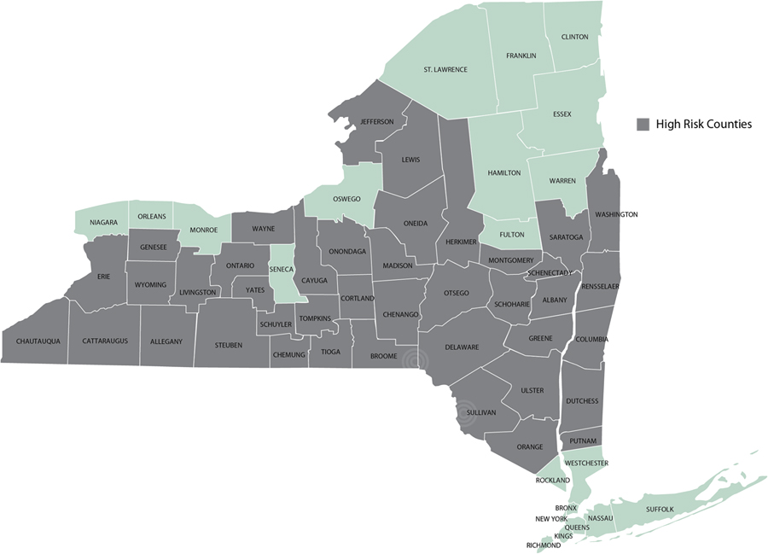

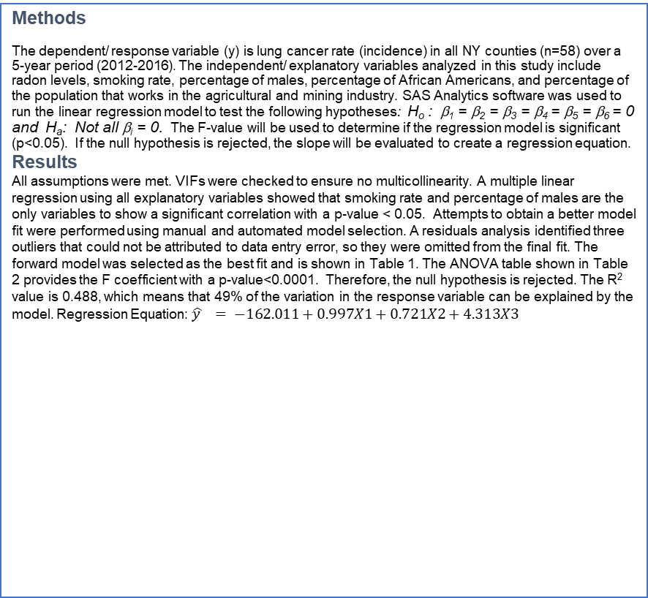
Evaluating the Relationship between Lung Cancer Rate and Radon Levels in New York State- a Multiple Linear Regression Model Jeanette Foxx, CHP 711, Dr. Galadima, College of Health Sciences, Spring 2021
Objective
The focus of this ecological study is to determine if there is a significant relationship between lung cancer rate and radon levels in the state of New York. A multiple linear regression model was used to analyze the association between lung cancer incidence and radon levels, as well as five other potential predictor variables. Other predictors evaluated for the purpose of this study included smoking rate, age, sex, race, and occupational industry.
Background
It is well known that cigarette smoking is the leading cause of lung cancer. However, exposure to radon gas is the top cause of lung cancer in non-smokers, and the second leading cause of lung cancer overall (2020). Radon is a colorless, odorless radioactive gas that is present in the Earth’s crust. When inhaled, radon delivers a dose of radiation exposure directly to the lungs (2020). Many counties in New York State are at moderate to high risk of high radon levels. The EPA has set an action level limit of 4 pCi/L.
Methods
The dependent/ response variable (y) is lung cancer rate (incidence) in all NY counties (n=58) over a 5-year period (2012-2016). The independent/ explanatory variables analyzed in this study include radon levels, smoking rate, percentage of males, percentage of African Americans, and percentage of the population that works in the agricultural and mining industry. SAS Analytics software was used to run the linear regression model to test the following hypotheses: H_{o} : β₁ = β₂ = β₃ = β₄ = β₅ = β₆ = 0 and H_{a}: Not all β_{i} = 0. The F-value will be used to determine if the regression model is significant (p<0.05). If the null hypothesis is rejected, the slope will be evaluated to create a regression equation.
Results
All assumptions were met. VIFs were checked to ensure no multicollinearity. A multiple linear regression using all explanatory variables showed that smoking rate and percentage of males are the only variables to show a significant correlation with a p-value < 0.05. Attempts to obtain a better model fit were performed using manual and automated model selection. A residuals analysis identified three outliers that could not be attributed to data entry error, so they were omitted from the final fit. The forward model was selected as the best fit and is shown in Table 1. The ANOVA table shown in Table 2 provides the F coefficient with a p-value<0.0001. Therefore, the null hypothesis is rejected. The R² value is 0.488, which means that 49% of the variation in the response variable can be explained by the model. Regression Equation: $\hat{y } = −162.011+0.997X1+0.721X2+4.313X3$
Discussion
The best fit for this multiple linear regression model suggests that radon levels, smoking, and being a male may be significant predictors of lung cancer.
These results indicate that exposure to high radon levels in certain counties of New York may be associated with the rate of lung cancer. The top five counties with the highest radon levels included Oneida, Cattaragus, Greene, Cortland, and Jefferson with an average radon level of 10.7 pCi/L, which is over two times higher than the EPA action level of 4 pCi/L. New York City presented the lowest lung cancer incidence, as well as the lowest radon levels and lowest smoking rate. Over the past several decades lung cancer due to smoking has steadily declined. Still, other causes of lung cancer, such as radon exposure, require awareness. Lung cancer caused by radon is highly preventable by regular testing and mitigation. One study showed that over half of participants conducted radon testing within their homes when presented with a free testing kit (2018). Performing the test is simple and passive on the part of the resident. Making tests free and available is an effective way to increase the level of testing, and a way to increase knowledge in the population. Another initiative includes proposed legislation to ensure radon testing and mitigation, if necessary, during real estate transactions (2020).
Limitations of this study include limited radon test results, as testing is not a regulatory requirement and is completely voluntary in personal residences. Radon level results for 15 out of 58 counties included less than 10 residences tested. Comprehensive testing is a recommended goal for counties with potential for moderate to high radon levels.
References
Butler, K. M. (2018). Access to Free Home Test Kits for Radon and Secondhand Smoke to Reduce Environmental Risks for Lung Cancer. Journal of Environmental Health, 81(3), E1-E6.
R. Stanifer, S., & Hahn, E. J. (2020). Analysis of Radon Awareness and Disclosure Policy in Kentucky: Applying Kingdon's Multiple Streams Framework. Policy, Politics & Nursing Practice, 21(3), 132-139.
Table 1: Parameter Estimates
Variable | DF | Estimate | SE | t Value | P-value | VIF
Intercept | 1 | -162.01071 | 49.81549 | -3.25 | 0.0020 | 0
RADON | 1 | 0.99727 | 0.44713 | 2.23 | 0.0302 | 1.05918
SMOKE | 1 | 0.72094 | 0.20277 | 3.56 | 0.0008 | 1.08189
MALE | 1 | 4.31291 | 1.01261 | 4.26 | <.0001 | 1.03128
Table 2: ANOVA Table
Source | DF | SS | MS | F Value | P-value
Model | 3 | 3309.85541 | 1103.28514 | 16.21 | <.0001
Error | 51 | 3470.72096 | 68.05335
Corrected Total | 54 | 6780.57636
Root MSE | 8.24 | R-Square | 0.488
Dependent Mean | 71.854 | Adj R-Sq | 0.458
Coeff Var | 11.480
Figure 1: Map of NY with high radon counties shaded

