Slide 1
Food, Diet, and Sustainability in the Workplace
Jeanette Foxx
MPH 784
Fall 2021

Slide 2
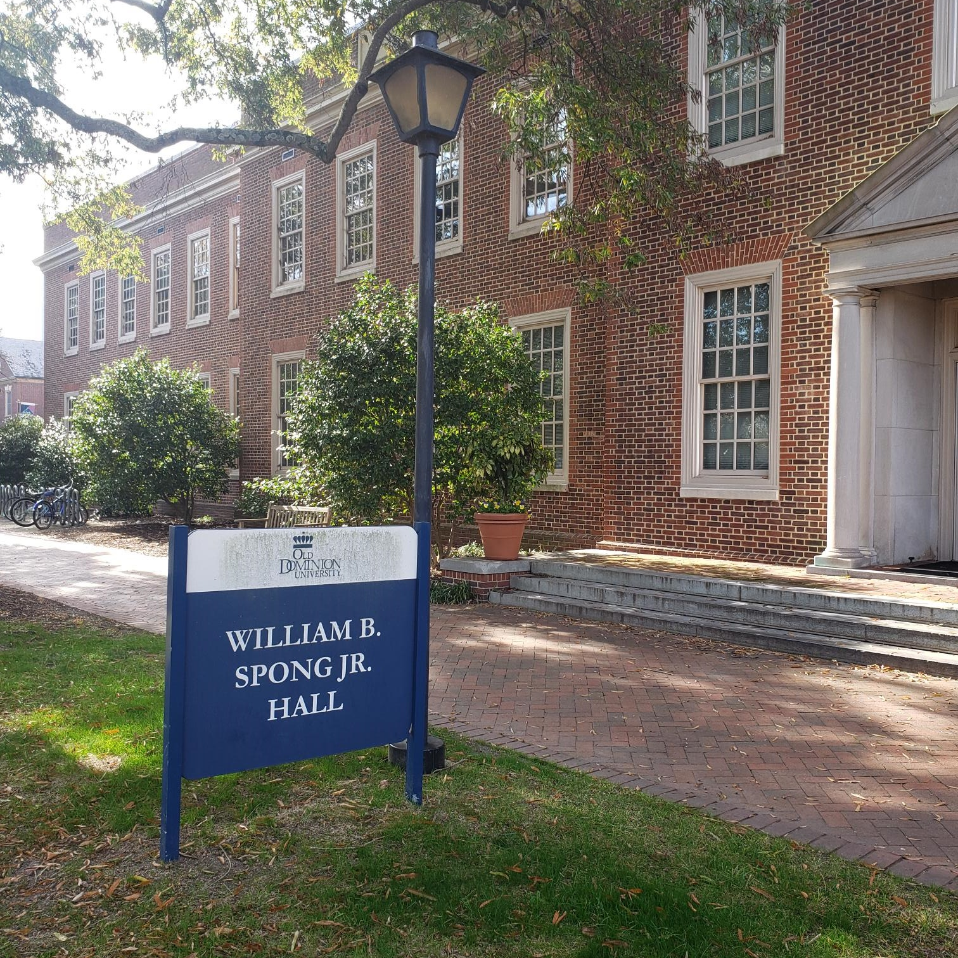
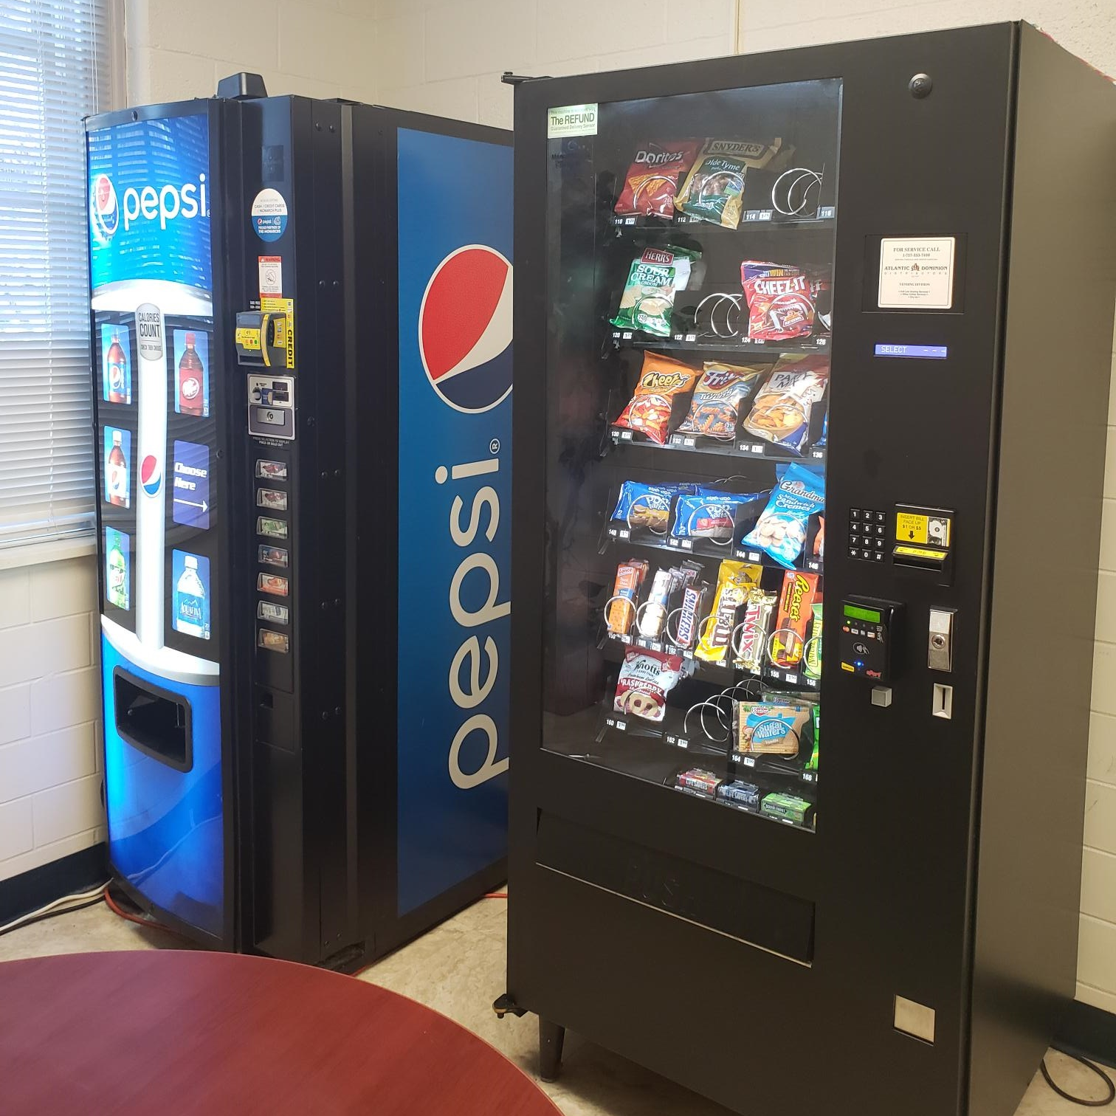
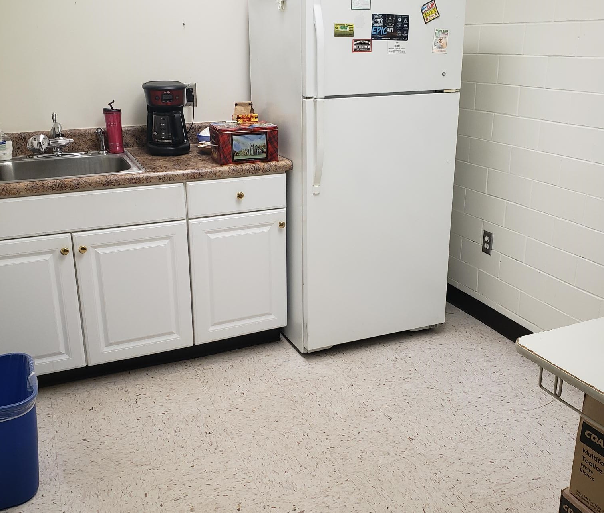
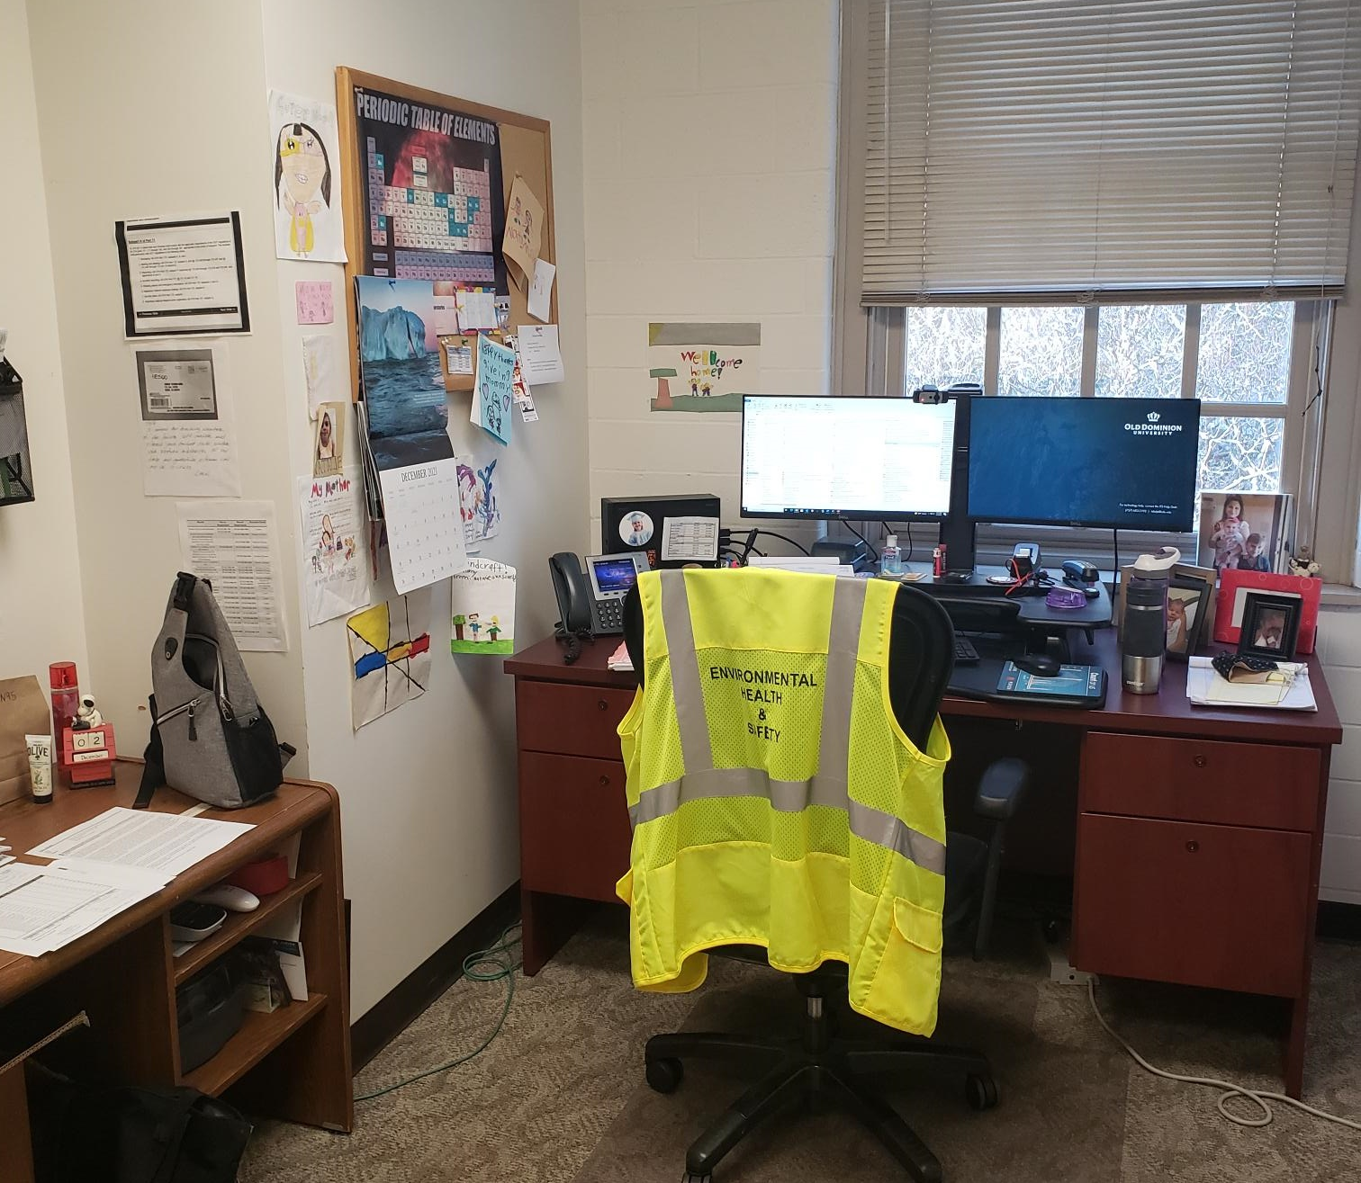
Workplace Setting ODU
Spong Hall
Office Space
Kitchenette
One Break Room (HR)
About ¼ mile to Webb Center

Slide 3
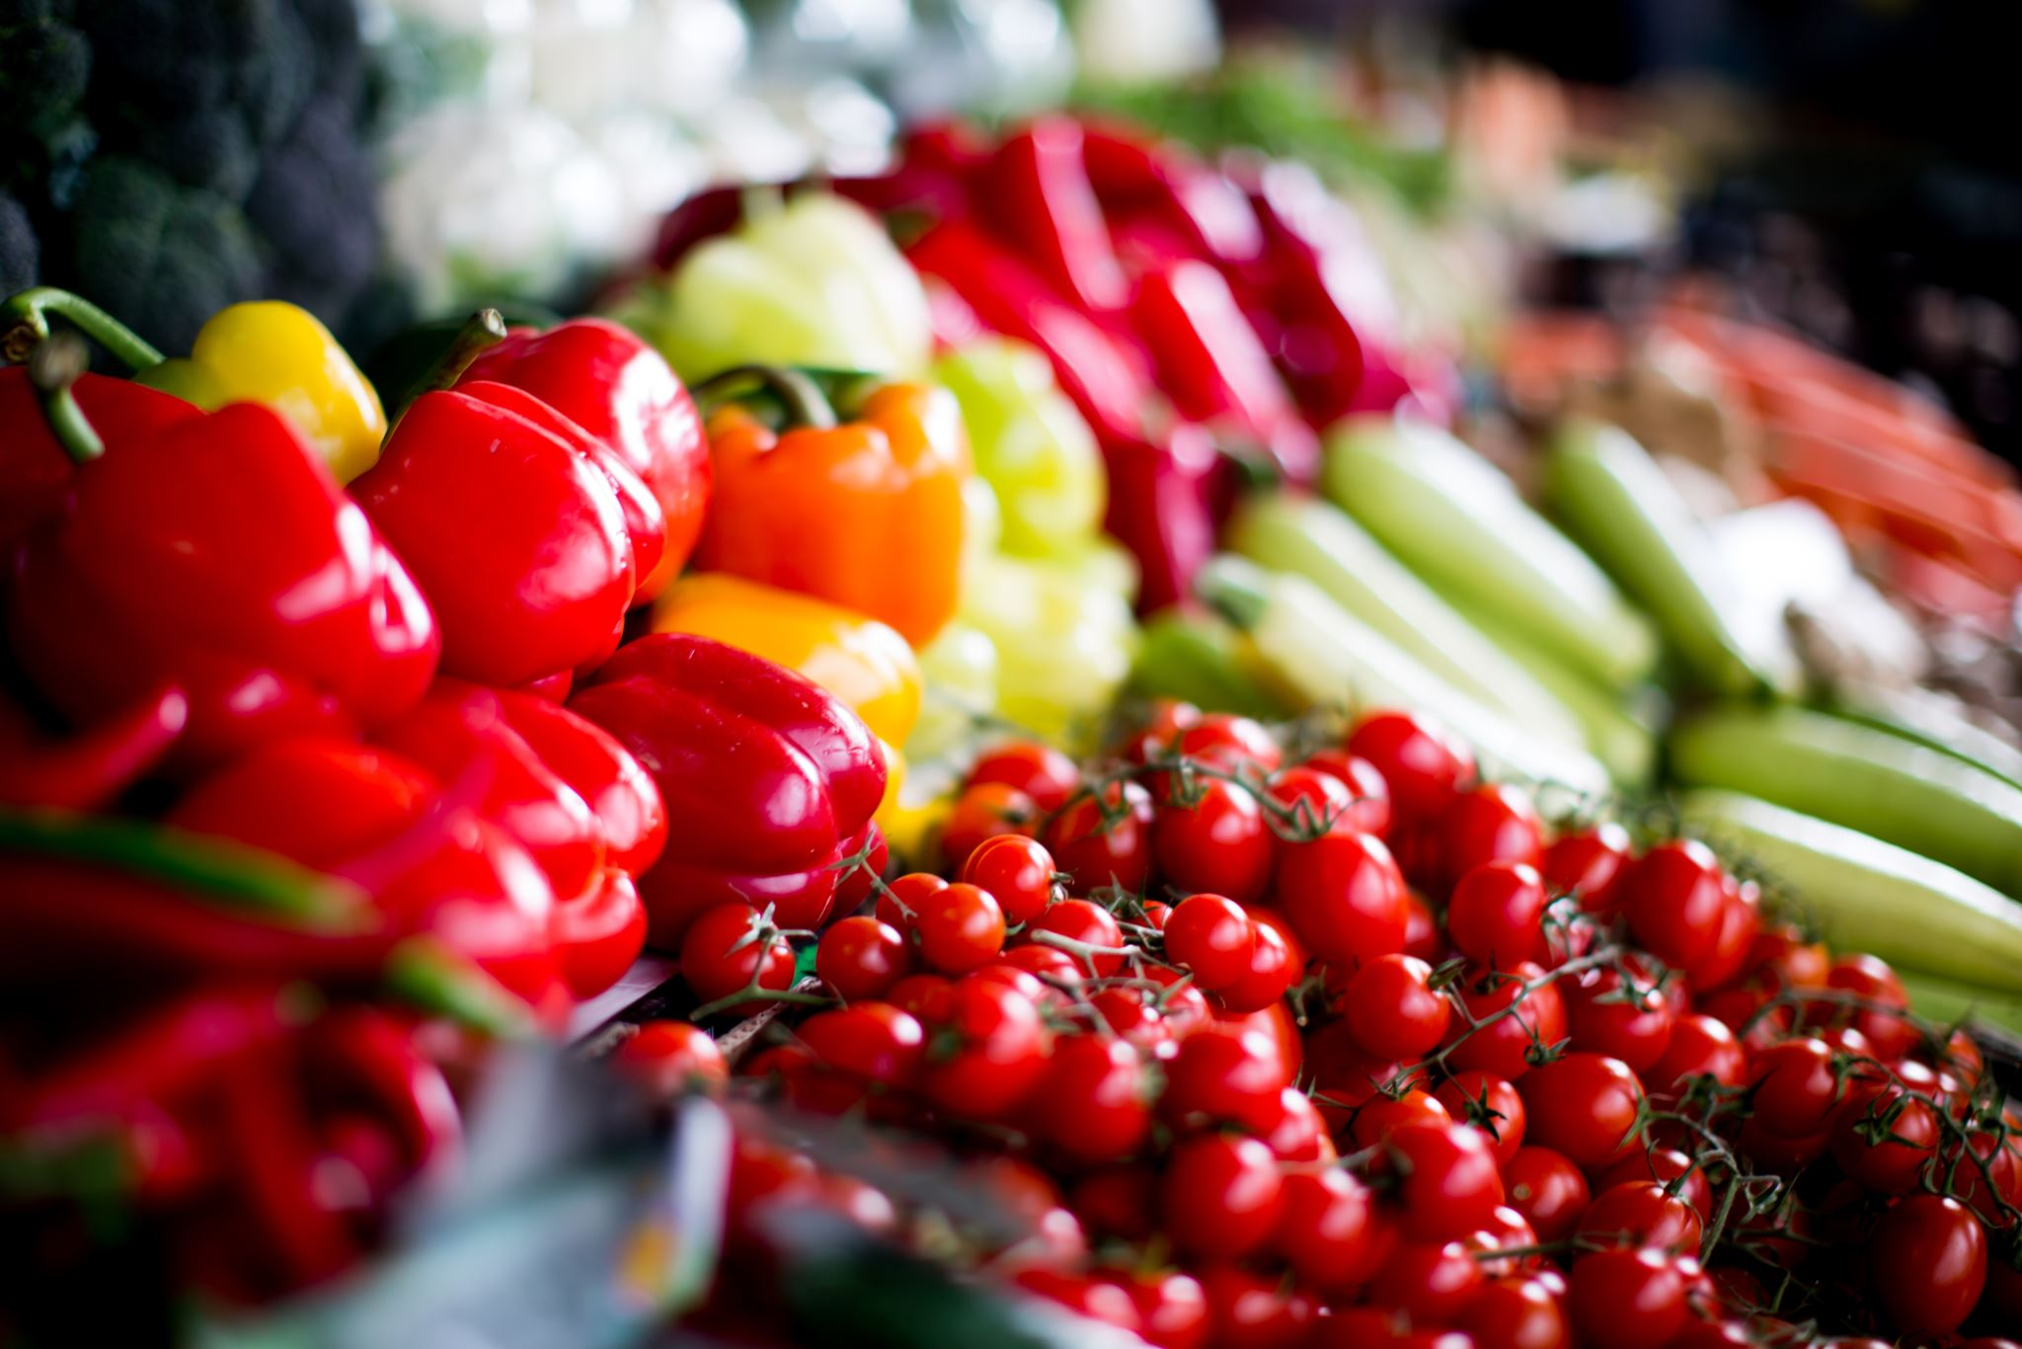
Current Workplace Food/Nutrition Practices
PLENTY of food options located on or near campus
Snack/Drink Vending Machines
Many plant-based options

Slide 4
Workplace Healthy Environment
Pros
Elizabeth River Trail
Healthy Initiatives
Student Rec Center
Cons
Most office workers eat at our desk and work while eating.

Slide 5
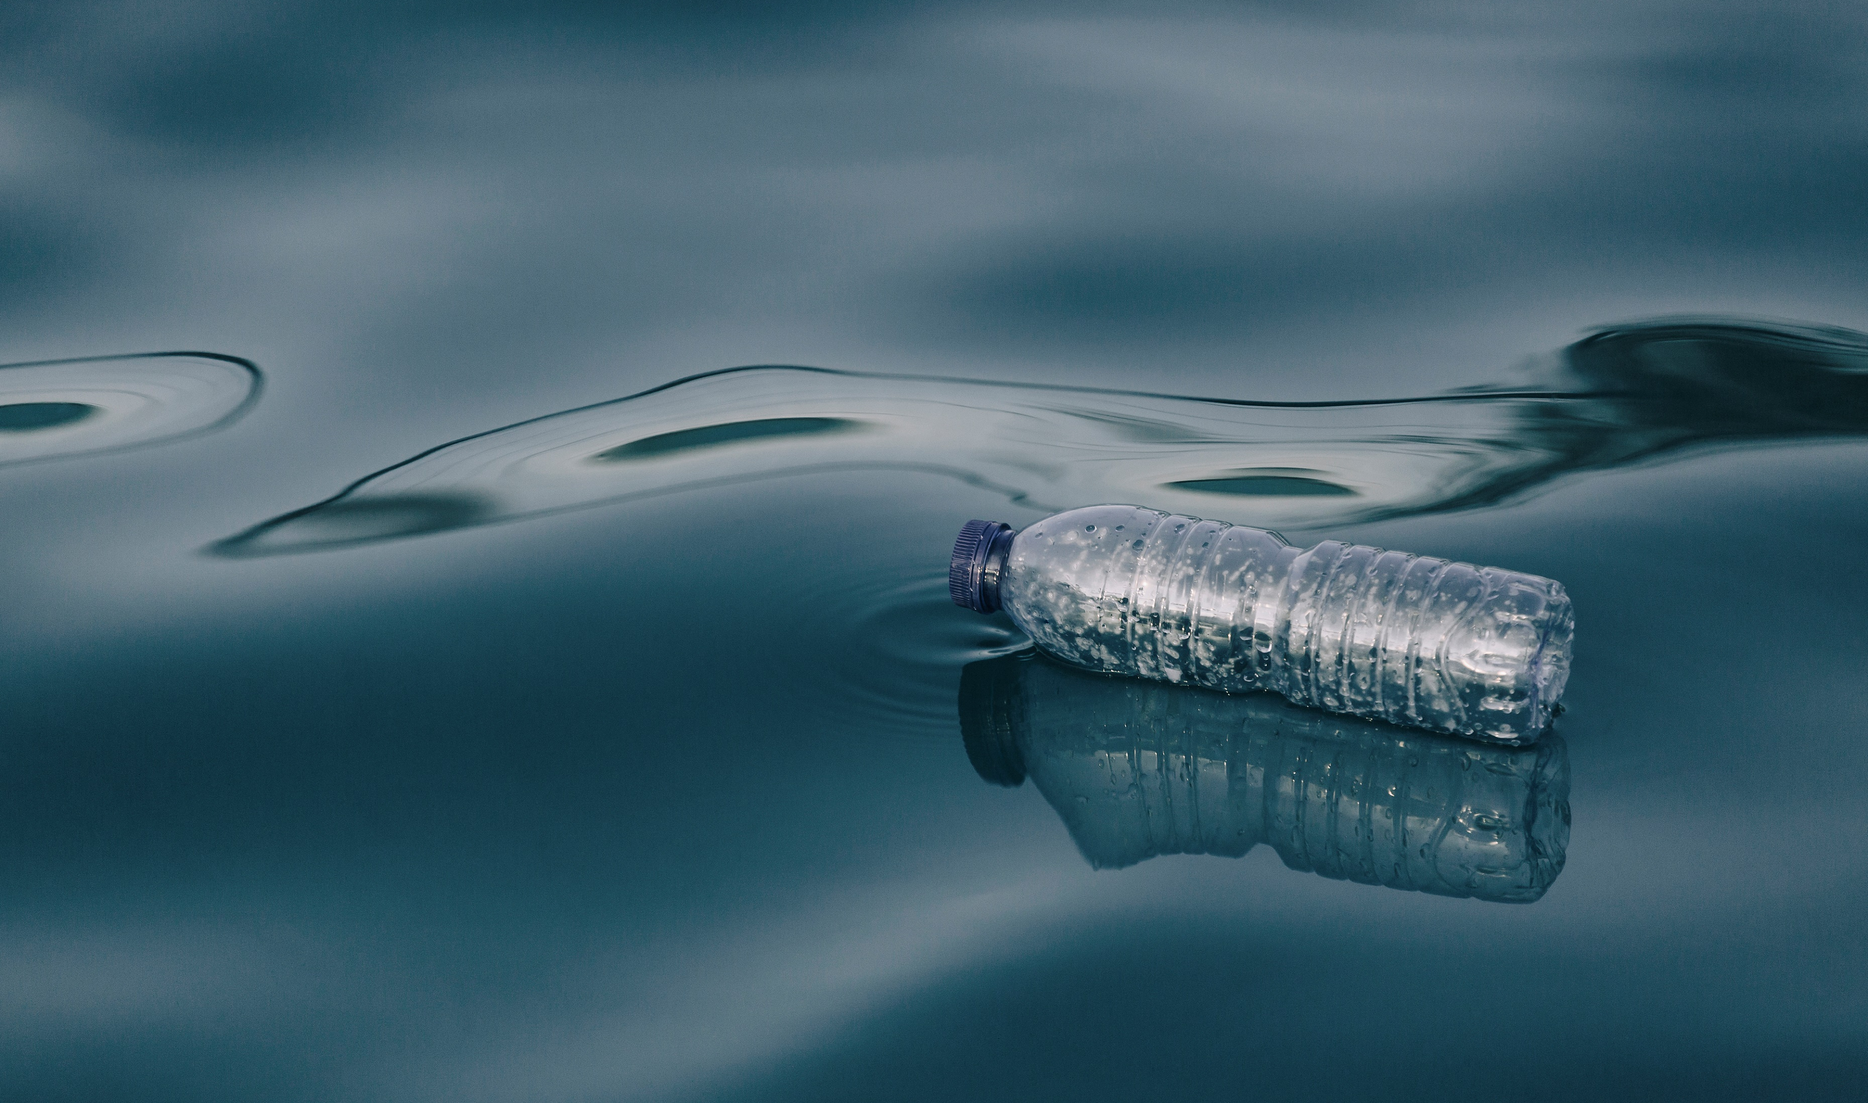
Healthy Initiative #1
Virginia Executive Order 77:
Signed on March 23, 2021
State agencies, including state universities, shall discontinue buying, selling, and distributing:
Disposable plastic bags
Single-use plastic and polystyrene food containers
Plastic straws and cutlery
Single-use plastic water bottles

Slide 6
Healthy Initiative #1: EO 77
Additional Requirements:
100% Phase-Out of all non-medical single-use plastics and polystyrene items by December 31, 2025.
Alternatives MUST be either reusable, compostable, or recyclable.
State agencies shall identify opportunities to divert waste from landfills through composting, beneficial reuse, enhanced recycling, etc.
Enforced by Virginia DEQ.
Future?
Recommendation:
Expedite requirements of EO 77 and be an example for other state agencies and organizations.

Slide 7
Healthy Initiative #2
STARS Rating Application
STARS (The Sustainability Tracking, Assessment, & Rating System) is a program of AASHE (Association for the Advancement of Sustainability in Higher Education).
ODU received a Bronze rating in 2012 and received a “reporter” rating in 2015.
Sustainability categories include: Academics, Engagement, Operations, Planning, and Innovation.
Current Virginia Gold Universities
University of Virginia, Charlottesville
Virginia Tech, Blacksburg
George Mason University, Fairfax
University of Richmond, Richmond
James Madison University, Harrisonburg

Slide 8
STARS Rating Checklist
Sustainable Dining – Programs and initiatives to support sustainable food systems and minimize food waste.
Food and Beverage Purchasing – Food and beverage products are sustainably or ethically produced and/or plant-based.
Outreach Materials and Publications – Produce outreach materials and/or publications that foster sustainability learning and knowledge.
Employee Educators Program – Administer peer to peer sustainability outreach and education programs for employees.
Support Sustainability Research – Have programs to encourage and/or support sustainability research.

Slide 9
STARS Rating Application
ODU will apply for a STARS rating in 2022.
Recommendations:
Strive to receive at least a Bronze rating and eventually a Gold rating.
Maintain a STARS rating by filing an application each year.
Hire a permanent position for Sustainability Officer and eventually create a Sustainability Department.

Slide 10
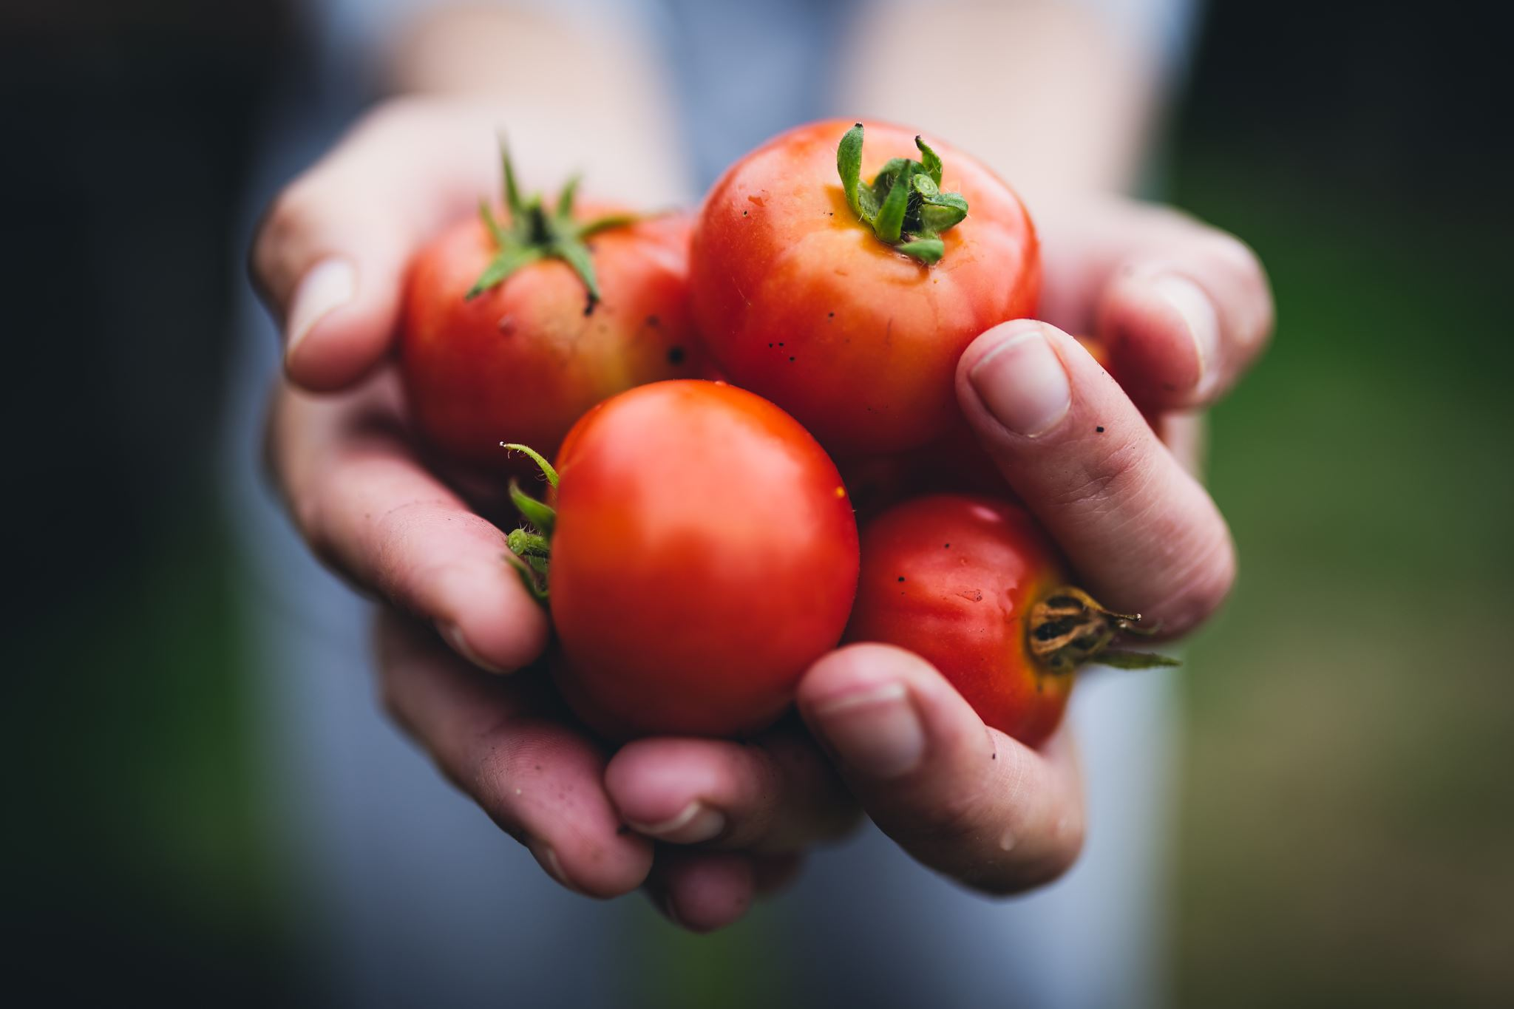
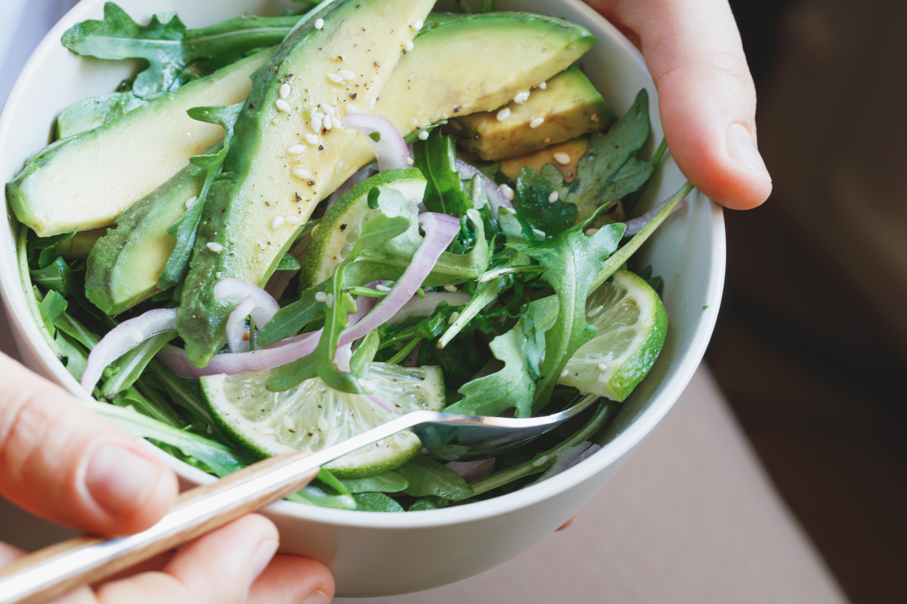
Other Ideas:
Small-Scale Composting
More designated break areas to eat lunch with co-workers
Meatless Monday Challenge
Choice Architecture:
Add more healthy options to snack machines or make healthier options cheaper.

