Slide 1
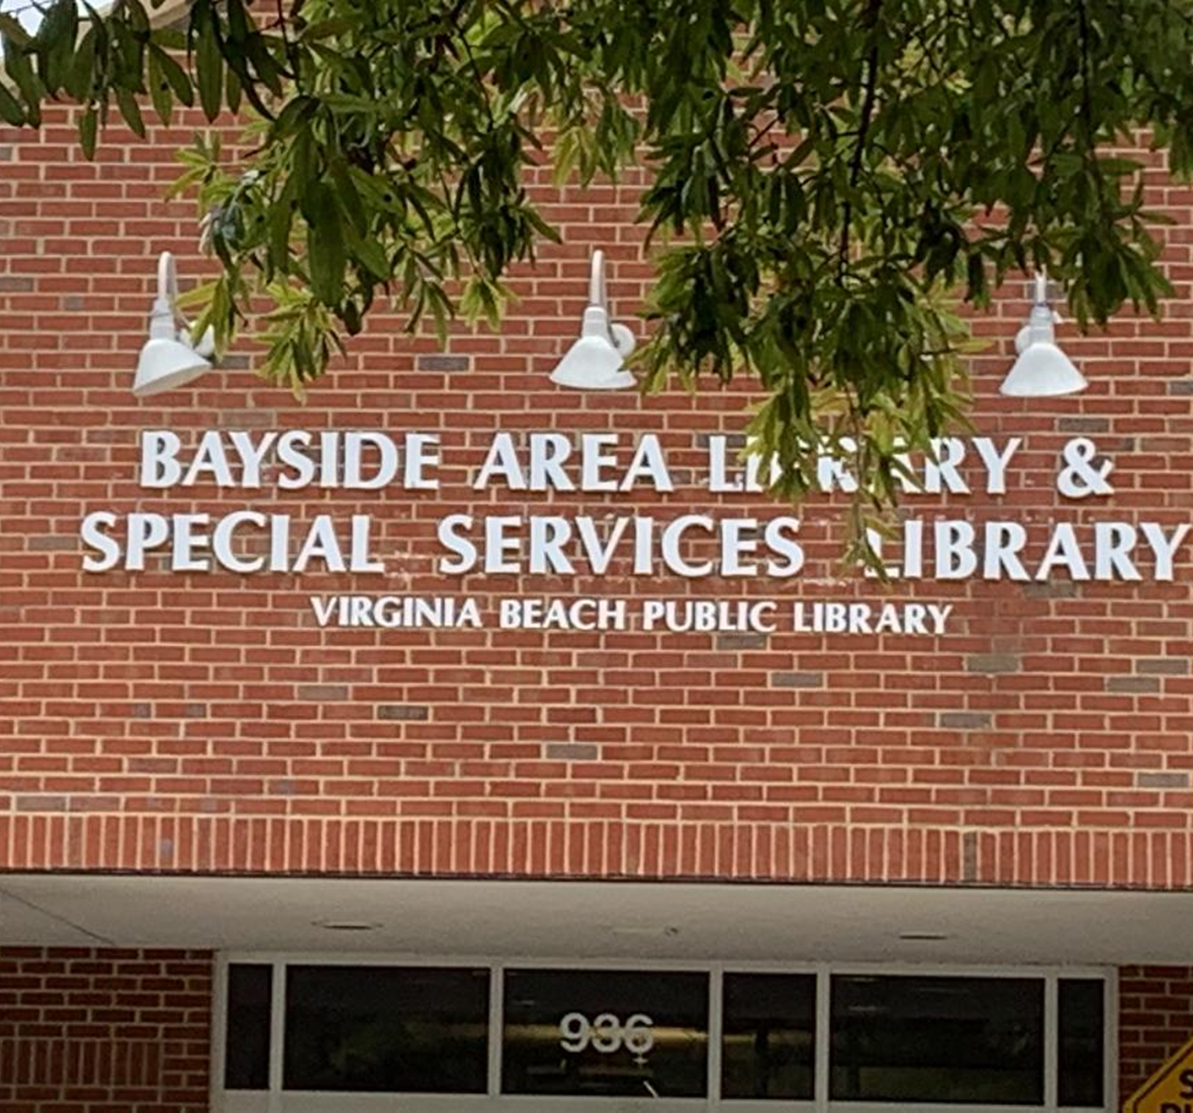

Bayside Library
Accessibility is Key
Jasmyne Ford
LIBS 608
Website: vbgov.com
Address: 936 Independence Blvd, Virginia Beach, VA 23455
Phone: (757) 385-0150
“Various studies support the notion that space affects our mood and behaviors”(Matthews, Soistmann, 2020). I include this here because as we progress through the slides, I think your mood will shift quite a bit.

Slide 2
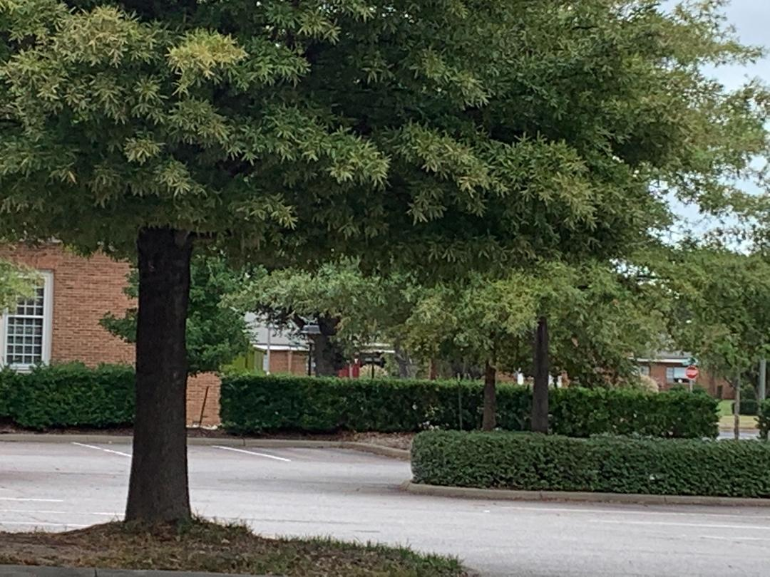
“Physical descriptions underscored this: very few people went for the modernistic, clean, efficient lines that one in fact often sees in modern libraries, and instead drew up visions of wood and art and the human spirit”(King,2010)
Enjoy the parking!

Slide 3
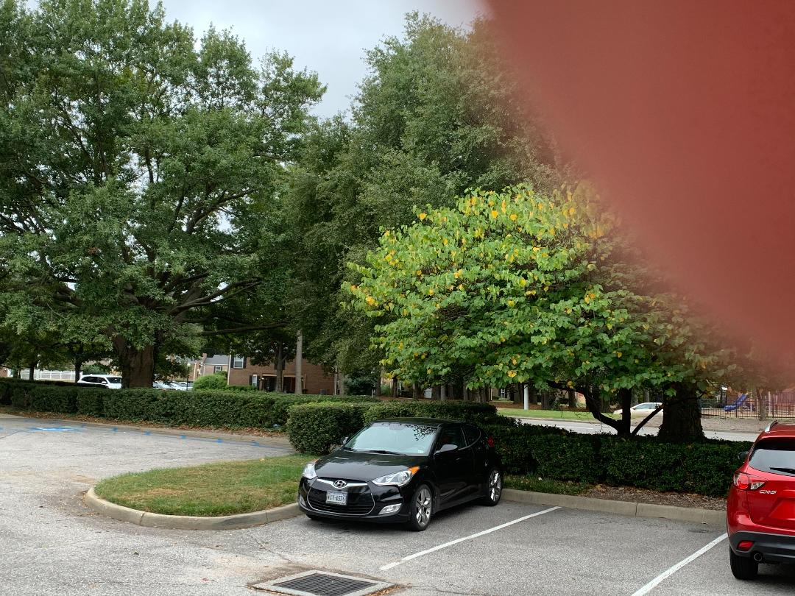
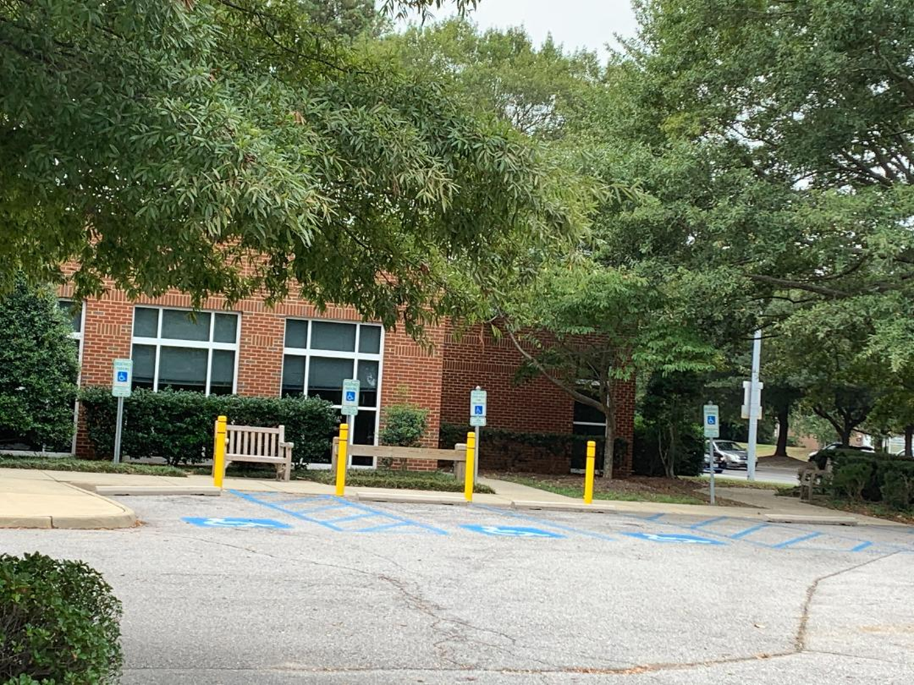
Ample, Wide, and Accessible Parking

Slide 4
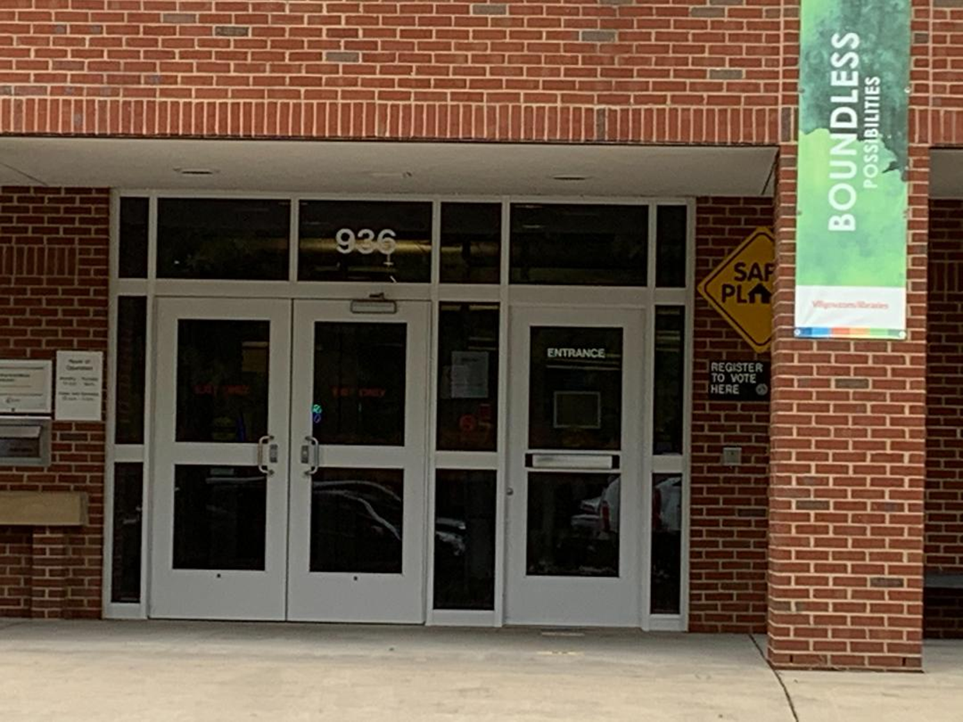
Matthews & Soistmann write:
“We become interaction designers, creating a diverse range of settings for a variety of intended outcomes” (2020).

Slide 5
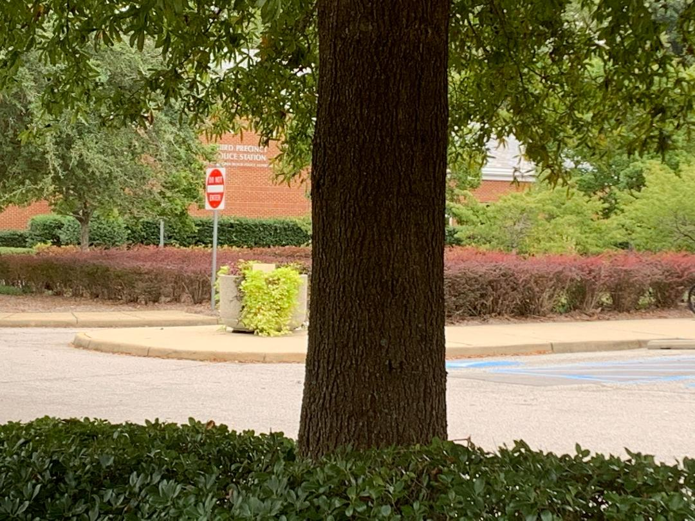
Precinct Neighbors

Slide 6
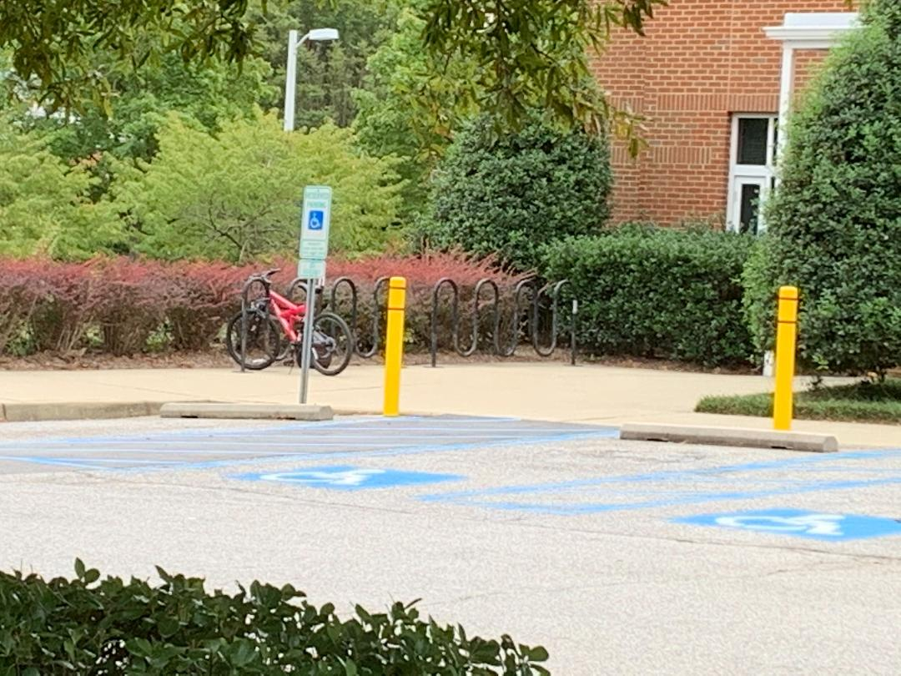
Bike Friendly
VB Residents love their bikes

Slide 7
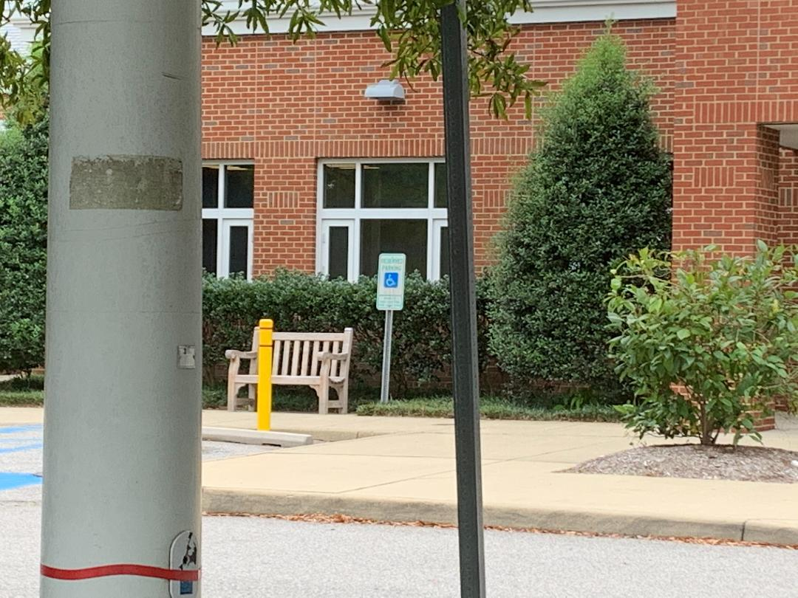
Placement?
Nice bench
Not so nice view

Slide 8
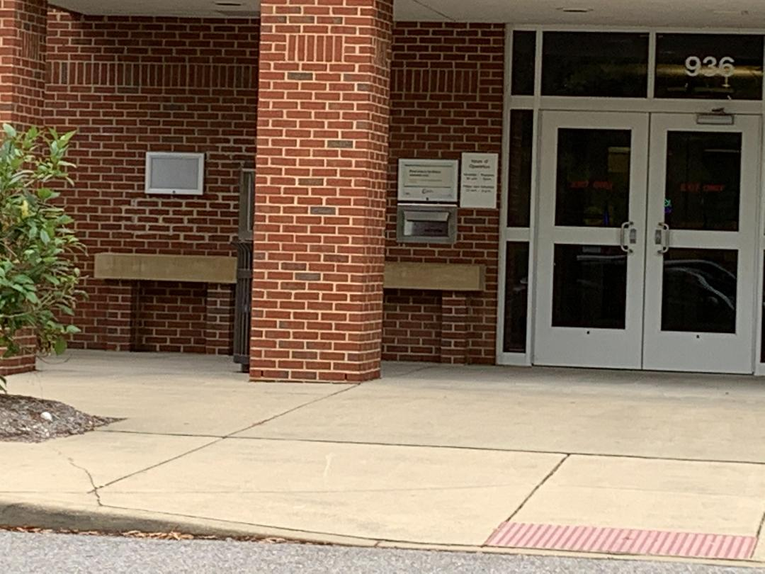
Accessible Book returns
Better lighting?

Slide 9
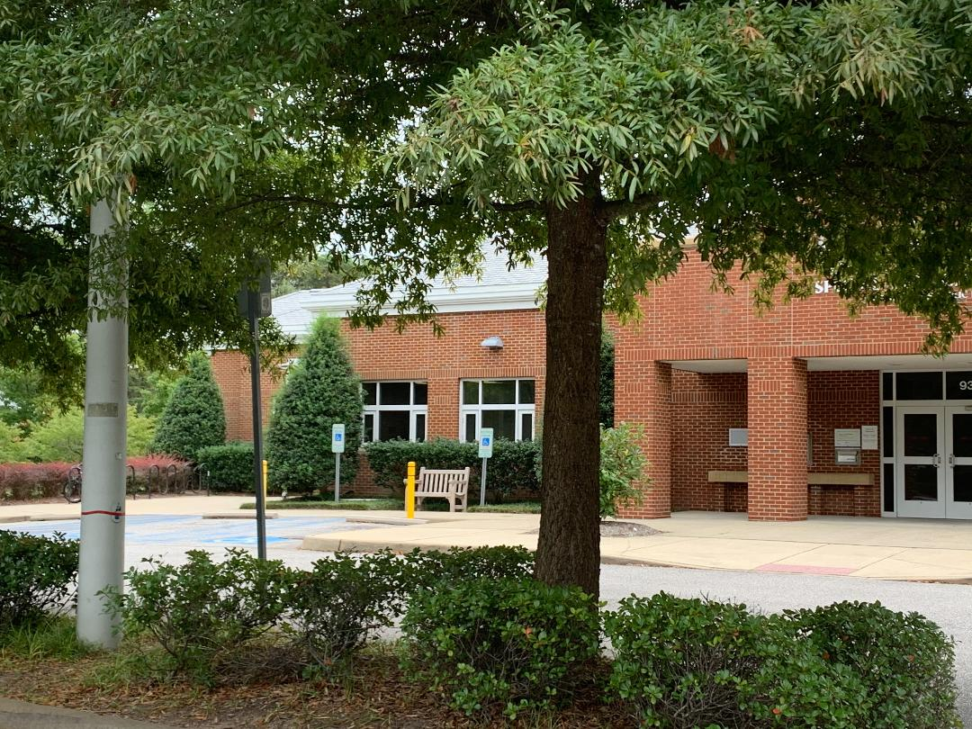

Slide 10
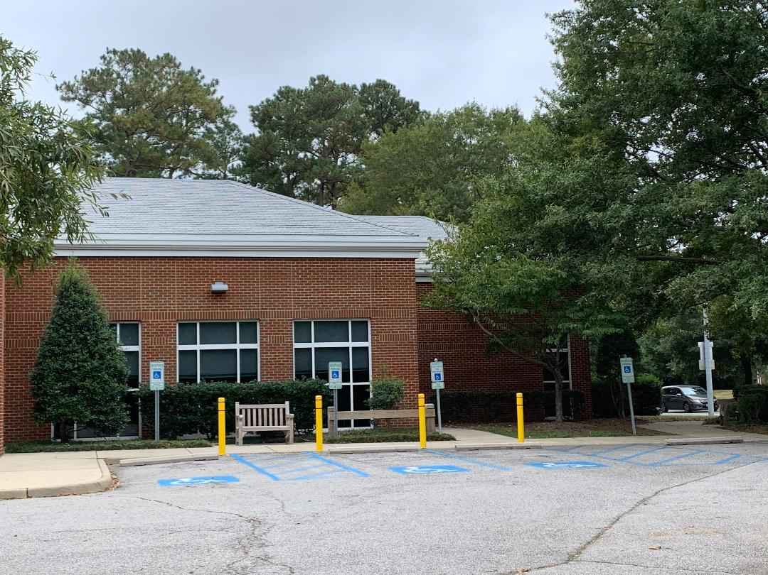

Slide 12
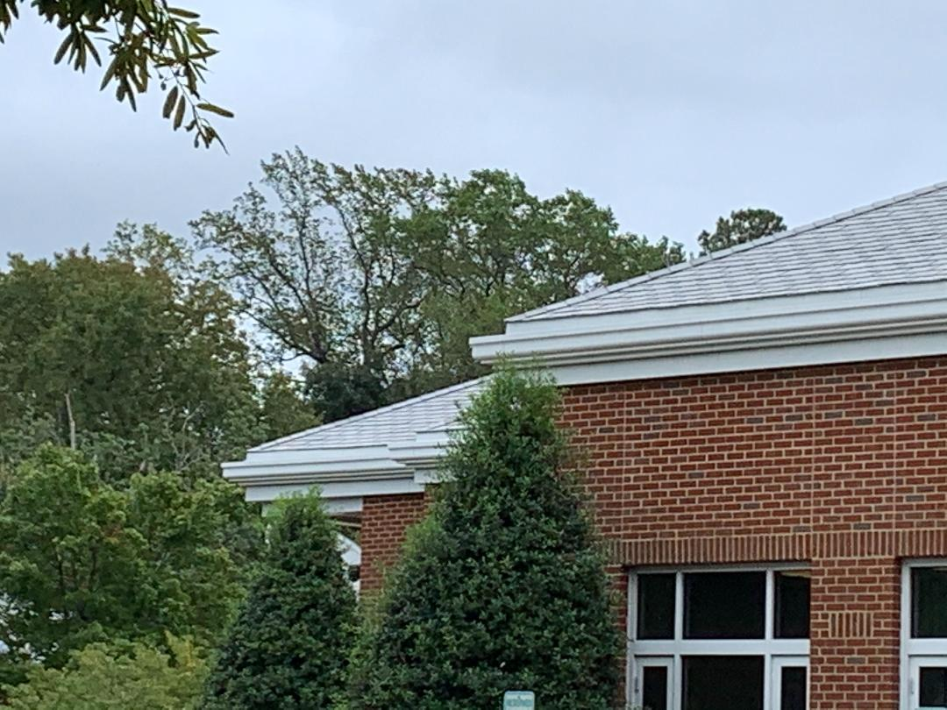
Lenenski and Hope for the future
“Locations with more green space can host community gardens, supporting the consumption of nutritious, non-processed food. Well-lit walking paths and convenient connections to surrounding parks and pathways are popular amenities for many libraries. Weather and climate need not be barriers to using these outdoor paths. The sharing economy has increased borrowing of all sorts of things. Why not offer snowshoe or ski rentals at the library to show a commitment to health and wellness?” (2016)

Slide 13
References
King, Laurie.,(2010,April 15). Fantasy library contest. Retrieved October 10, 2021, from https://laurierking.com/2010/04/fantasy-library-contest/
Lesneski, Traci.,(2016, August 3). Why outdoor spaces are essential for the 21st century library. Demco Interiors. Retrieved October 10, 2021, from https://www.demcointeriors.com/blog/why-outdoor-spaces-are-essential-for-the-21st-century-library/
Matthews, B., &amp; Soistmann, L. A. (2020, August 27). Encoding space. American Libraries Magazine. Retrieved October 10, 2021, from https://americanlibrariesmagazine.org/2020/09/01/encoding-space-library-design/
Rubin, R. E., & Rubin, R. G. (2004). Foundations of library and information science. ProQuest Ebook Central https://ebookcentral.proquest.com

