Slide 1
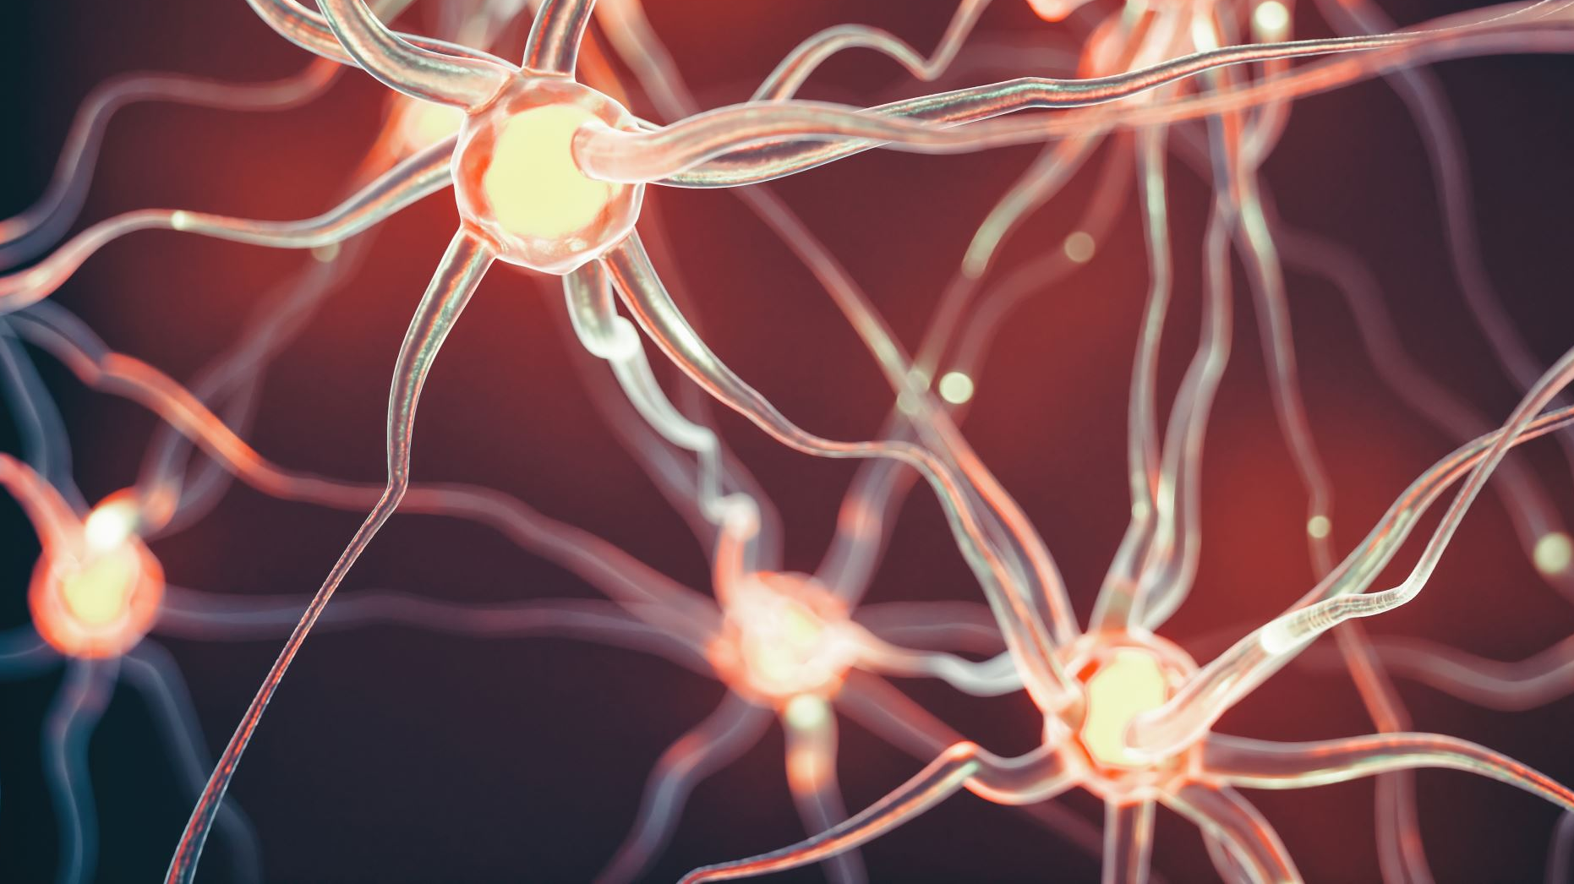
Temporomandibular joint disorder (TMD) and Myofascial Pain Conditions
Does anyone personally struggle with a type of TMD?
Microteach presentation by Kayla M. Jones, RDH BSDH

Slide 2

Objectives
Name two different types of myofascial pain conditions
Explain how the temporomandibular joint works properly
Compare and contrast temporomandibular joint disk displacement with reducing and temporomandibular joint displacement with non-reducing
Discuss the temporomandibular joint exam process
Recommend the best treatment options for temporomandibular disorders

Slide 3
What is your Temporomandibular Joint (TMJ)?
Hinge joint connecting your jaw to your skull
Located in front of your ear
Guides the jaw movement and allows you to open and close your mouth, move it from side to side, talk, yawn, or chew
Only joint in the mouth that has to work together bilaterally

Slide 4
What is TMD?
The hinge connecting the upper and lower jaw isn't working properly
This hinge is one of the most complex joints in the body, responsible for moving the mandibular jaw forward, backward, and side-to-side
Around 10 million people in the US experience TMD
Women are more commonly affected than men, and most affected are 20 to 40-year-old’s

Slide 5
TMD Symptoms
Your dental team can help make a proper diagnosis by taking a complete medical and dental history, conducting a clinical examination, and taking appropriate radiographs
Some of the most common TMD symptoms include:
Headaches, earaches, and pain and pressure behind the eyes
A clicking or popping sound when you open or close your mouth
Pain brought on by yawning, opening the mouth widely or chewing
Jaws that "get stuck," lock or go out
Tenderness of the jaw muscles
A sudden change in the way the upper and lower teeth fit together
If a 60-year-old man comes in complaining of signs that may lead to TMD, should it be dismissed due to his demographics?

Slide 6
Differential Diagnosis
Dental caries
Abscess
Sinus infection
Salivary gland disorders
Oral lesions
Herpes zoster
Herpes simplex
Oral ulcerations
Lichen planus
TMD symptoms can also manifest in autoimmune diseases such as systemic lupus erythematosus, Sjögren syndrome, and rheumatoid arthritis

Slide 7

TMJ Examination Process

Slide 8
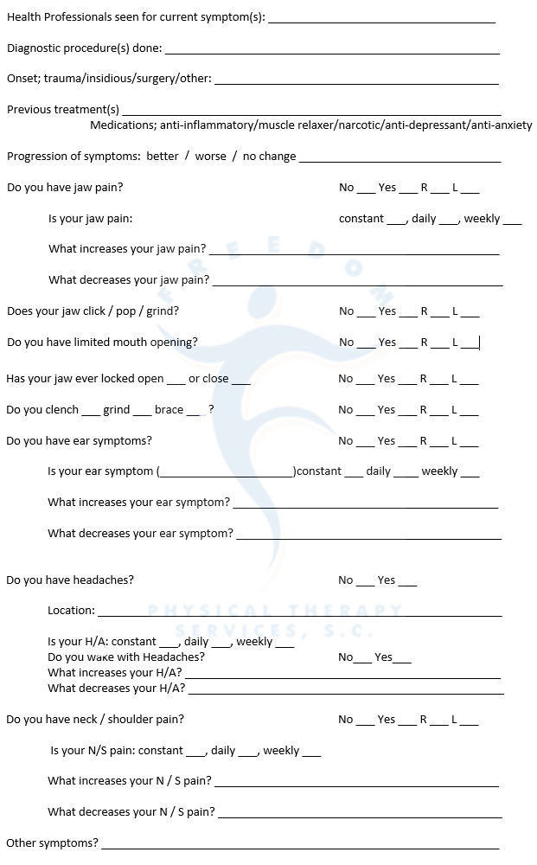
Social History
Daily parafunctional activities
Smoking
Chewing gum
Snoring
Leaning on chin
Biting nails
Lip biting
Clenching teeth

Slide 9
Posture
Forward head posture, rounded shoulders and scapular protraction is common

Slide 10
Palate for Joint Noises
Clicking, popping, crepitus
Open, closing, or both
Ask the patient if they are in pain when it happens
How long it has been going on
Open ended questions
Why are open ended questions important?

Slide 11
Record Deviations
Lateral movements with return to midline
Opening pathway is altered but returns to midline
Usually indicative of a disc displacement WITH reduction or could be neuromuscular dysfunction.

Slide 12
Record Deflections
Lateral movements without return to midline
Usually associated with Disc Dislocations WITHOUT reduction or a unilateral muscle restriction

Slide 13
Range of Motion - ROM
Measure top tooth edge to bottom tooth edge
Opening and closing of mouth Normal opening ~40-50 mm
Functional opening ~36 mm (at least 2 knuckles between teeth)

Slide 14
Protrusion of the Mandible
Normal ~10 mm
Lateral deviation of mandible normal ~10 mm
Note asymmetrical movements - snapping, clicking, popping, or jumps

Slide 15
Alignment of the Teeth
Note cross bite, overbite, underbite, missing teeth, chipped teeth, etc.

Slide 16
Opening and closing of the mouth
Observe if the teeth normally close symmetrically and the jaw is normally centered

Slide 17
Note tongue tie or lip frenums
What can you have a patient do to see if they are tongue tied?

Slide 18
Common Orofacial Pain Conditions

Slide 19
Myalgia
Subjective pain in the muscle on function
Pain that can be replicated by muscle palpation
No trigger point with referring pain
Primary and secondary myalgia differ due to secondary myalgia sources including direct trauma to the muscle (injections) and regional painful pathology such as arthritic joint disease or disk derangement.

Slide 20
Myalgia - Etiology
Medications (stimulants or SSRIs) causing motor hyperactivity
Stress causing muscular hypoperfusion and/or hyperactivity
Waking and sleeping parafunctions (repetitive oral habits and behaviors)
History of traumatic muscle injury (injection)
Local non-muscle pathology (arthritis)
What are stimulant and SSRI medications commonly prescribed for?

Slide 21
Myofascial Pain
Subjective pain in the muscle on function
Pain that can be replicated by muscle palpation in the affected muscles
Trigger point in the band that causes pain to radiate on sustained compression
Note: Myalgia is labeled myofascial pain only when trigger points are present.

Slide 22
Myofascial Pain - Etiology
Common etiologies same as for myalgia
Medications (stimulants or SSRIs) causing motor hyperactivity
Stress causing muscular hypoperfusion and/or hyperactivity
Waking and sleeping parafunctions (repetitive oral habits and behaviors)
History of traumatic muscle injury (injection)
Local non-muscle pathology (arthritis)
Trigger points – suggesting localized neuronal sensitization in muscle

Slide 23
Fibromyalgia
Subjective pain in multiple sites aggravated by function
Widespread pain involving more than three body quadrants
Continuous symptoms (lasting more than 3 months)
Strong pain on muscle palpitation in at least 11 of 18 established body sites
Note: Myalgia is labeled fibromyalgia only when these criteria are met.

Slide 24
Fibromyalgia - Etiology
Common etiologies same as for myalgia:
Medications (stimulants or SSRIs) causing motor hyperactivity
Stress causing muscular hypoperfusion and/or hyperactivity
Waking and sleeping parafunctions (repetitive oral habits and behaviors)
History of traumatic muscle injury (injection)
Local non-muscle pathology (arthritis)
Multiple pain sites, allodynia (pain from an unknow nerve), and mechanical hyperalgesia, suggested central sensitization
Unknown genetic susceptibility that predisposes to fibromyalgia

Slide 25
TMJ DDWR (Disk Displacement with Reduction)
Single noise – click or pop – from the TMJ on a single movement
Noise may be reciprocal (on both open and close)
No restriction or deflection of jaw motion after click

Slide 26
TMJ DDWR - Etiology
Traumatically altered discal ligaments that attach it to the condyle
Parafunction
Joint hyper mobility
Active microtrauma to jaw

Slide 27
TMJ DDNR (Disk Displacement Non-reduction)
Sudden onset, continuous loss of full jaw motion
Pain in the affected joint on wide open attempt
Prior history of clicking in the affected joint that has now stopped
Diagnostic test: MRI shows DDNR in both closed and open positions

Slide 28
TMJ DDNR - Etiology
Common etiologies that cause TMJ DDNR are the same as for TMJ DDWR
Traumatically altered discal ligaments that attach it to the condyle
Parafunction
Joint hyper mobility
Active microtrauma to jaw

Slide 29
Local TMJ Arthritis
Subjective pain in preauricular area aggravated by function
Pain that can be replicated by TMJ capsule palpitation
Joint motion often produces crepitation sounds
Diagnostic test: erosive or remodeling-type joint-surface changes (flatten out) on CT imaging

Slide 30
Local TMJ Arthritis - Etiology
Trauma (microtrauma or repetitive microtrauma)
Prior DDNR in the involved joint

Slide 31
Migraine
Unilateral headache location
Pulsatile severe headache that lasts multiple hours
Nausea associated
Photophobia (light sensitivity)
Phonophobia (fear of loud sounds) associated
Diagnostic test: Negative MRI for pathology involving the CNS
Note: Pain episodes may be preceded by an aura

Slide 32
Migraine - Etiology
Genetics
Hormones
Weather
Exercise
Stress

Slide 33
Cluster Headache Vs. Tension Headache
Cluster headache:
Rapid-onset intense paroxysmal headache pains
One-sided retro-orbital, suborbital, and temporal pains
Pain episodes lasting from 15 to 180 minutes
Headaches occur several times in a 24-hour period
Pain may occur at night, waking the patient up
Diagnostic test: Negative MRI for pathology involving the CNS
Tension headache:
Dull aching bilateral, episodic pain of long-lasting duration (hours to days)
Pain located in the suboccipital, temporal, and frontal regions
Pain typically increases slowly during the day to a later afternoon peak

Slide 34
Etiology
Cluster headaches:
Genetics
Abnormalities in the body’s biological clock (hypothalamus)
Tension headaches:
Stress
Hormones

Slide 35
Bruxism
Sleep-state-related motor hyperactivity causing repeated brief motor activation of the jaw closers, usually with resulting side-to-side motion of the jaw and tooth attrition
Diagnostic test: Wear patterns on full arch splint can prove whether bruxism is active

Slide 36
Habitual Parafunctional and Secondary Masticatory Hyperactivity
Conscious tooth clenching, habitual check chewing, or habitual lip biting
Stress induced masticatory hyperactivity
Consider medication-induced hyperactivity if taking SSRI or stimulant
Elevated masticatory and cervical muscle stiffness evident on palpation
Diagnostic test: Stop suspected medications if patient is on stimulants or SSRIs

Slide 37
TMD Management
Patient education
Pharmacologic therapy
Physical therapy
Orthopedic appliance therapy
Restorative therapy
Surgery

Slide 38
Patient education
Homecare instructions
No “one size fits all treatment”
Conservative, nonsurgical therapy is the best way to begin
Soft foods
Cut food into small pieces (reduce excessive chewing)
Rotate ice pack, jaw exercise, heat

Slide 39
Pharmacologic Therapy
Nonsteroidal anti-inflammatory drugs, such as aspirin or ibuprofen, help relieve muscle pain and swelling
Muscle relaxants help relax right jaw muscles
Antianxiety medications can help relieve the stress that is sometimes thought to aggravate TMD

Slide 40
Physical Therapy
Strengthen muscles
Increase range of motion (ROM)
Correct posture
Botox
TMJ injections/dry needling
TENS unit – electrical current to relax muscles, improve blood circulation, and relieve pain
Ultrasound therapy – uses high-frequency sound waves directed to the TMJ to reduce pain and swelling, and improve circulation

Slide 41
Orthopedic Appliance Therapy
Occlusal splints
Stabilize and improve TMJ
Improve masticatory motor function
Reduce abnormal muscle activity
Protect teeth from clenching and grinding

Slide 42
Types of Occlusal Splints
Soft appliances vs. hard appliances
Partial coverage vs. full coverage
Day splint vs. night splint

Slide 43
Restorative Therapy
Orthodontics
Implants

Slide 44
Surgery
Arthroscopy
Most common
Surgeon explores the jaw and point of pain, removes an inflamed tissue, and prepares for realignment if necessary
2. Arthroplasty
“Open joint” surgery
May allow for realignment after disc displacement and removal of scar tissue or bone spurs
3. Total joint replacement
Done in cases where the joint has degenerated from a traumatic injury, osteoarthritis, or other irreparable damage

Slide 45
Total Joint Replacement Surgery Case Study
Historically, total joint replacement surgery was considered risky and only to be done as last resort
However, a study released by the Internal Journal of Oral and Maxillofacial Surgery followed 300 patients post-operatively for 10 years and found that rebuilding the joint with a total joint prosthesis showed significant improvement in range of motion, speech, and diet for most patients. No one reported severe pain after the six-month post-operative mark.

Slide 46
Summary
I hope that you now have a better understanding of temporomandibular disorders, common myofascial pain conditions, and how to screen for them. Caught early on these conditions may be able to have a simple fix, such as coming off of a stimulant or SSRI medication, or treatment planning an occlusal guard. Being able to now recognize the difference in the various types of myofascial pain and TMD conditions will assist you in treatment planning the best options for your patient. I hope the lesson today has helped you feel more confident in being able to perform this TMJ examination on a patient at a routine checkup, or when they come in experiencing jaw pain.

Slide 48
Case Study
Ms. W is a 22-year-old female that presents to you experiencing:
Jaw pain
Ringing in the ears
Ear pain
Clicking in the TMJ when opening
Headaches
After filling out the medical history form you figure out the patient is a current smoker, takes Zoloft for anxiety, and says she thinks she clenches her teeth at night because her headaches are in the morning.
What questions will you ask Ms. W?
What steps will you perform for the TMJ examination?
What treatment options are available to her that you should make her aware of?

Slide 49
Answers to go over with class…
What questions will you ask Ms. W?
How long have you smoked? How much do you smoke? How long have you been on Zoloft? Have you been treated for TMD previously? If so, what have you had done? When does your jaw click? Does it click every time? When do you experience jaw pain? How frequently do you experience jaw pain? Has your jaw ever locked? – Opening? Or closing? Or both? Do you grind your teeth? How often do your ears ring? What increases your ears ringing? What decreases your ears ringing? Where are your headaches located? How often do you have headaches? Are your headaches in the morning, midday, or evening? Do you have neck and/or shoulder pain? Do you chew gum? Do you snore? Do you bite your nails/pens/pencils, etc.?
What steps will you perform for the TMJ examination?
Check posture. Palate for joint noises (clicking, popping and crepitus) – note if it is on opening, closing, or both, then ask the patient if they are aware of it, if it hurts them, how long it has been going on for. Record any deviation with opening and closing. Record and defection with opening and closing. Record range of motion. Record protrusion and lateral protrusion. Note if there is a crossbite, overbite, open bite, underbite, missing teeth, chipped teeth, etc. Note if the teeth close symmetrically and if the jaw is centered. Note if there is a tongue tie or any lip frenum’s.
What treatment options are available to her that you should make her aware of?
First educate the patient with homecare instructions – eat soft foods and cut foods into small pieces to reduce excessive chewing when TMD conditions flair up. Rotate ice pack, jaw exercises, and heat on the jaw muscle. Jaw exercises can include a chin tuck, stretching your jaw, resistance on the jaw, relaxation of the jaw, and zig-zag of the jaw. Since TMD treatment is not a “one-size-fits-all”, it may include some trial and error. Since the patient is taking an SSRI medication (Zoloft), it may benefit her to talk to her doctor and change to a non-SSRI and non-stimulant medication to see if that helps with her TMD. I would also recommend nonsteroidal anti-inflammatory medications such as aspirin or ibuprofen to help relieve muscle pain and swelling. If changing her anxiety medication does not help, I would recommend a nighttime full coverage hard appliance splint – this will hopefully reduce her clenching at night and decrease her headaches. If this does not help, she may benefit from physical therapy for her TMJ with Botox, TMJ injections, or a TENS unit on her jaw joint.

Slide 50

Test Questions

Slide 51
Test your knowledge…

Slide 52
All of the following are types of myofascial pain conditions EXCEPT one. Which one is the EXCEPTION?
Fibromyalgia
Temporomandibular joint disk displacement non-reducing
Myalgia
Planter fasciitis

Slide 53
All of the following statements about the temporomandibular joint are true EXCEPT one. Which one is the EXCEPTION?
Located behind your ear.
Hinge joint connecting your jaw to your skull.
Only joint in the mouth that has to work together bilaterally.
Allows you to open, close, talk, yawn, or chew.

Slide 54
Which of the following statements is NOT correct about temporomandibular joint disk displacement with reducing?
Click noise.
Pop noise.
Sudden onset, pain in the affected joint on wide open attempt.
No restriction or deflection of jaw motion.

Slide 55
Which of the following is NOT part of the temporomandibular joint exam process?
Periodontal charting
Record any deviations
Range of motion
Palpate for joint noises

Slide 56
All of the following treatment options would be good recommendations for temporomandibular joint disorders EXCEPT one. Which one is the EXCEPTION?
Physical therapy
Stimulant or SSRI pharmacologic therapy
Jaw exercises
Orthopedic appliance therapy

Slide 57
Questions?

