Slide 1
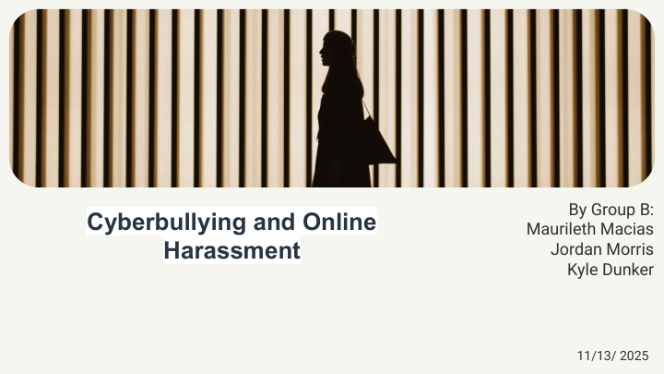

Slide 2
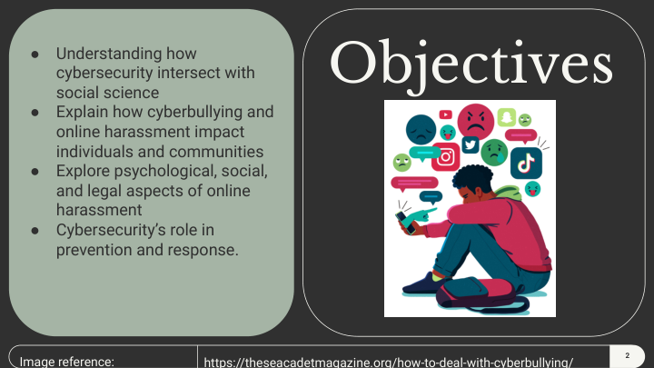

Slide 3
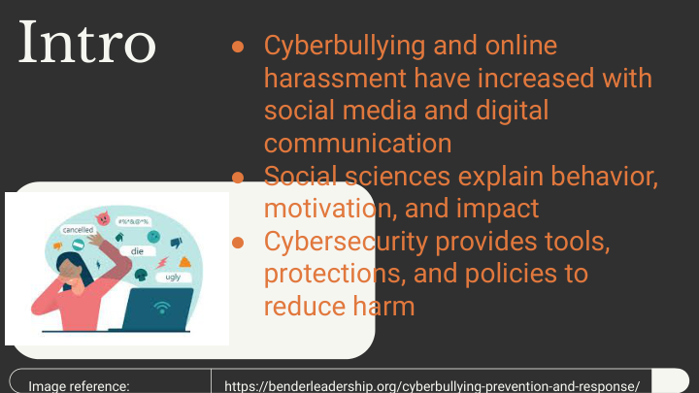

Slide 4
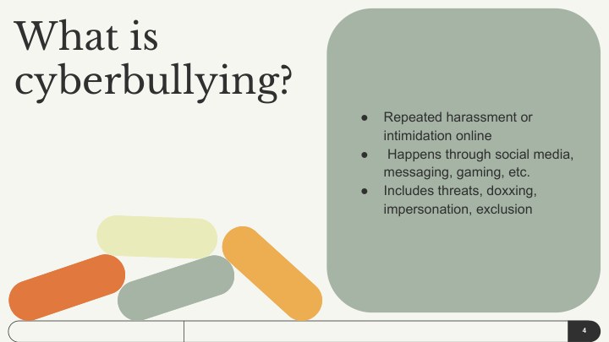

Slide 5
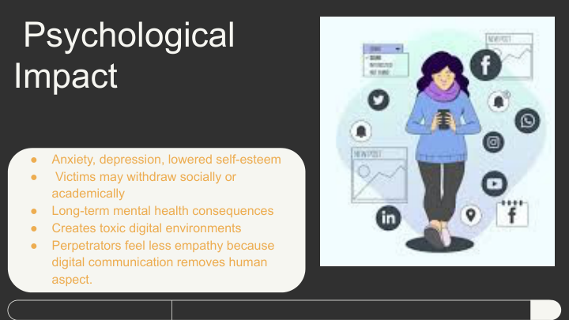

Slide 6
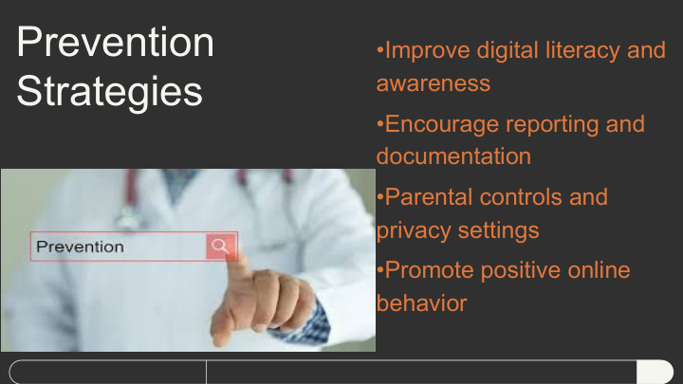

Slide 7
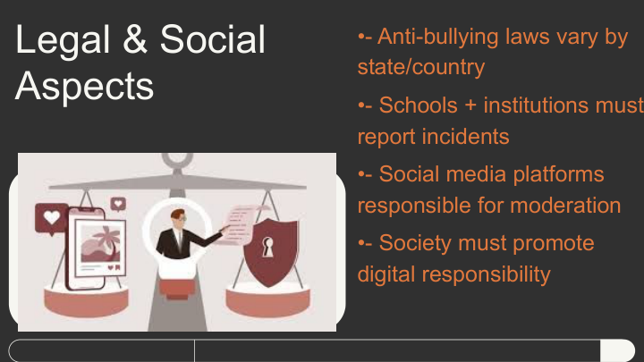

Slide 8
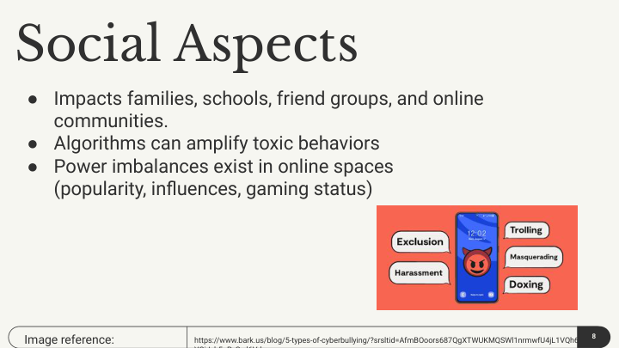

Slide 9
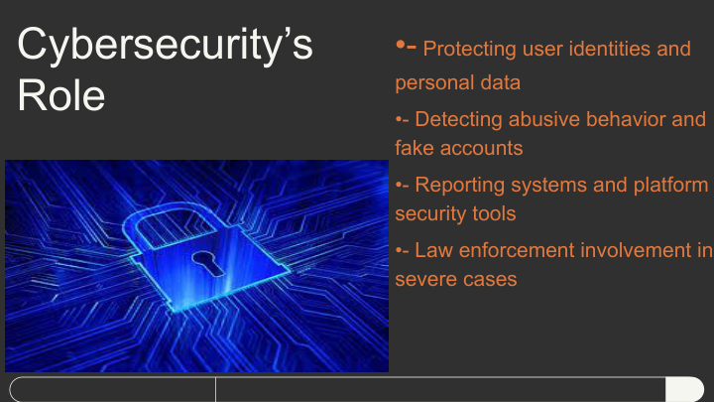

Slide 10
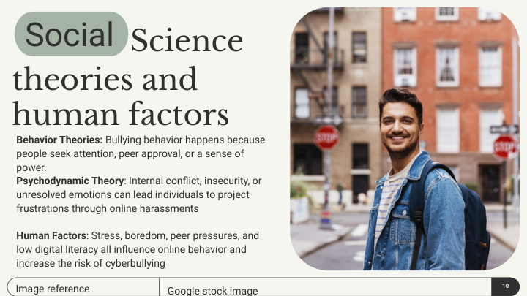

Slide 11
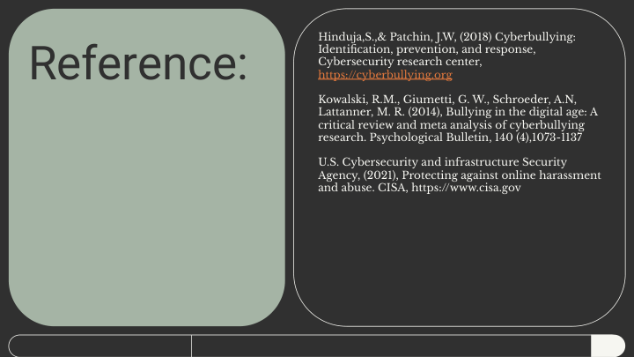

Slide 12
Sociological Factors Behind Cyberbullying
Social status differences increase online power imbalances
Group dynamics influence how people target others
Online disinhibition makes harmful behavior seem acceptable
Cultural norms shape harassment patterns
Marginalized groups experience higher rates of digital abuse

Slide 13
Digital Forensics & Cyberbullying Investigations
IP logs and metadata help identify harassers
Platforms retain digital footprints even after deletion
Cyber forensics retrieves hidden or deleted messages
Law enforcement uses cyber evidence in severe cases
Shows anonymity online is not absolute

Slide 14
Community & School Interventions
Digital citizenship programs teach empathy and responsibility
Schools use monitoring tools to detect harmful behavior
Peer-support systems reduce bullying escalation
Communities create reporting networks and safe norms
Collaboration improves prevention and response

