Slide 1
The Role of Social Media
in Cybersecurity Threats
Korie Cooper

Slide 2
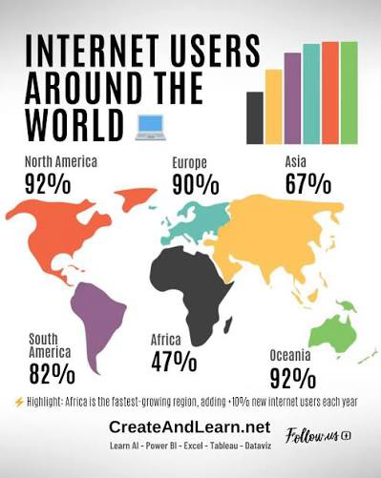
Introduction
- Nearly 4.8 billion people worldwide use social media (UpGuard, 2025)
- Increased usage expands the attack surface for cybercriminals
- Platforms are now active vectors for phishing, identity theft, and social engineering
- This presentation examines how threats spread and how to stop them

Slide 3

How Social Media Spreads Threats
- Phishing and spear phishing: criminals use personal info from public profiles to deceive victims (Pentest People, 2025)
- Identity theft: the more data shared publicly, the easier it is for criminals to commit fraud (Pentest People, 2025)
- Malicious links spread via social platforms can infect devices and hijack accounts (Pentest People, 2025)

Slide 4

Social Engineering
- Attackers use social media during the reconnaissance phase to gather personal details before striking (Proofpoint, 2021)
- Platforms allow criminals to convincingly impersonate trusted people and brands (Proofpoint, 2021)
- Whaling targets executives using public profile info; spoofing impersonates individuals to steal data (UpGuard, 2025)

Slide 5

Real World Impact
- Employees sharing travel plans or work info online expose entire organizations to attack (UpGuard, 2025)
- Criminals build detailed victim profiles using social media to commit fraud and identity theft (Pentest People, 2025)
- Average cost of a data breach globally was $4.88M in 2024
- 3.4 billion phishing emails are sent daily worldwide

Slide 6
Countermeasures & References
- Enable two-factor authentication on all accounts
- Limit personal information shared publicly
- Conduct regular cybersecurity awareness training
- Use simplified and anonymous reporting systems
UpGuard (2025). upguard.com/blog/the-impact-of-social-media-on-cybersecurity
Proofpoint (2021). proofpoint.com/us/threat-reference/social-media-threats
Pentest People (2025). pentestpeople.com/blog-posts/cyber-security-surrounding-social-media

