Slide 1
Mobile Health
Improving access to cancer screenings for adults with intellectual disabilities.
Amy Prusinski, Daniel Soki, Daria Membreno, Krista Plogger, Sarah Adkins

Slide 2
Community Statistics:
Cancer mortality rates in adults with ID are 1.5 times that of the general population.
Despite adults with ID having a lower risk of cancer, it is the second leading cause of death for this population whereas it is the fourth for the general population
Use of cancer screenings:
Pap test for cervical cancer: 66% to 80% with women with disabilities as opposed to 81% in women without disabilities
Mammogram for breast cancer: 61% to 68% compared to 73%
Oral cancers occur at a younger age in adults with ID and are detected at a more advanced stage than in the general population

Slide 3
Social Determinants
Neighborhood and built environment
  Individuals and families with disabilities have lower residential attainment
Social Inclusion
  There is often stigma and negative attitudes associated with adults with intellectual disabilities.
Access to healthcare
  Adults with intellectual disabilities often receive less and often lower quality healthcare due to provider comfort and education
Why this community is at greater risk

Slide 4
Available Resources
Medicare and Medicaid
  Medicare is made available to all individuals with certain disabilities, including intellectual disabilities
  Medicaid is available to individuals with medicare who do not have alternative family healthcare plans
Nonprofit supported living communities
  Services in these communities include aid with medical and dental care
US Dept. of Housing and Urban Development
  Connects the disability community with government services
  Connects the disability community to resources and healthcare services
Disability Community Programs
  Community based inclusion and education programs for the disability community
  Makes connections within the community to improve access to employment opportunities
  Improves community integration, job placement, and independent living skills

Slide 5
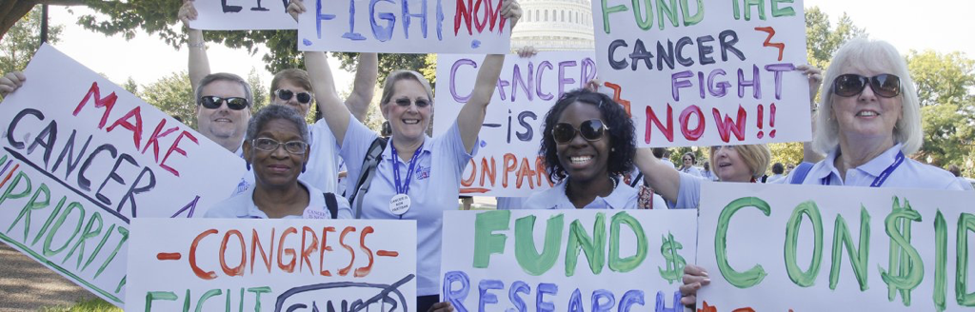
Expected Program Impact:
Increase the prevalence of cancer screenings in adults with ID
Early diagnosis of cancer when it is most likely to respond to therapy
Reduced medical costs associated with the potential treatment
Reduced mortality rates

Slide 6

Importance of Funding
Underfunding such regular screenings for cancer can negatively impact people living with disabilities and highly decrease their life quality and increase the number of deaths due to this matter.
Receiving necessary funds to support such screenings can play a critical role in increasing access to preventative cancer care for this demographic.
People with disabilities often have trouble getting health care for many reasons, including not being able to schedule an appointment and not having transportation to the clinic. As a result, people with disabilities typically have lower cancer screening rates than people without disabilities, making it more likely that their cancer will be found later, when it is harder to treat.

Slide 7
Ethical Dilemmas
Beneficence
Moral obligation to act in the best interest of others, assisting them in pursuing their significant and legitimate goals, often by preventing or removing possible harms
Nonmaleficence
Moral obligation to avoid harm or injury that can arise through acts of commission or omission
If population-based mobile cancer screening programs do not receive the necessary fundings, such financial constraints may come in direct conflict with ethical principles of beneficence and non-maleficence, where health care professionals cannot promote the health of the community and minimize harm

Slide 8
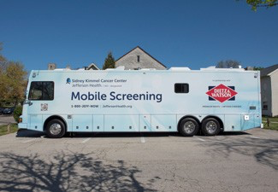
Mobile Health Clinics (MHCs)
School-based programs adapted for use at group homes, assisted living facilities, and disability learning centers.
Dental hygiene & Clinical perspective:
Dental hygienists perform intra/extra oral cancer screenings
Patient Education
Public health perspective:
Health education and promotion
Increase access to care for patients with ID
Reduces the need for transportation to a clinical site
Notes:
Image from https://hospitals.jefferson.edu/news/2021/08/putting-cancer-screening-on-wheels.html
Mobile clinic in Philadelphia
Patient comfort.
Familiarity with their environment
Does not disrupt their routine
Reduce time (to be seen/transportation)

Slide 9

Transportation
New program in Raleigh area (Wake County)
Transportation services for medical appointments
Who qualifies:
  Individuals with Medicaid
  Elderly
  Have a disability
Notes:
Image from: https://twitter.com/wakegov/status/1328419568608370689
GoWake Access is an innovative service being implemented in the Raleigh, North Carolina and the surrounding areas.
In collaboration with the Health Department and regional satellite centers, transportation issues are a barrier that is being removed from this vulnerable population base. Having the infrastructure in place to coordinate patient’s calls, scheduling their pick-up times, and having the numerous vans to execute the transportation has been proven to be valuable.

Slide 10

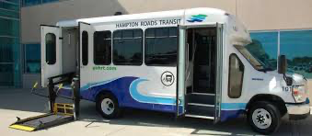
disAbility Navigator
Notes:
https://disabilitynavigator.org: provides information for resources available to the eldery, disabled, post-military personnel.
“Older adults (age 65 and over) and people with disabilities who have a valid HRT Discounted Fare ID card, HRT ADA Certification card, DMV ID, or a valid Medicare card and photo identification are eligible to pay a discounted fare on HRT’s fixed-route services.”

Slide 11
Community Collaboration
Regional branches of Mobile Healthcare Association and dental boards
  Linking programs will create more opportunities for dental professionals
Students from local colleges and universities
  Aid in lowering overall costs
  Clinical rotations–students gain more experience

Slide 12
Auxiliary Funding Opportunities
Maximizing Outcomes through better investments in lifesaving equipment (MOBILE) for healthcare act.
  This is a bill that helps health centers establish new delivery sites to provide comprehensive care to medically underserved populations
Prevent Cancer Foundation
  Provides $25,000 grants to organizations that provide cancer education, screenings or vaccinations.
Section 330 of the Public Health Service Act
  Is federally designated to provide startup funds for new public health facilities.
Improving longevity of the program

