Slide 1
Healthy v. Unhealthy Relationships
Jessica Duke and Jenna Washburn
Notes:
(8 seconds)

Slide 2
What is Love?
Romantic Love
Honeymoon phase
Eventually devolves. . .
Companionate Love
Deep attachment, intimacy, ease with partner, development of trust, loyalty, and acceptance, and being ready to sacrifice.
Notes:
(1 minute 27 seconds)
Who can answer “What is love?”
Well there are two different types of love
Romantic love is symbolic of the honeymoon phase or the love Hollywood says you’re supposed to have. When in reality, romantic love devolves into Companionate love
Companionate love is the feelings of deep attachment, intimacy, ease with partner, development of trust, loyalty, and acceptance, and being ready to sacrifice. The switch from romantic to companionate is often hard due to social stigmas surrounding what love is supposed to look like
So now that we know what love is, lets talk about what makes it work and what doesnt

Slide 3
Aspects of a Healthy Relationship
Mutual Respect
Trust
Honesty and Respect
Good Communication (e.g., listening, compromise, understanding, receptivity, problem solving,)
Individuality (e.g., self love, self confidence)
Effectively managing conflict (e.g., anger control, fighting fair)
https://youth.gov/youth-topics/teen-dating-violence/characteristics
Notes:
(In combination with slide 4, 4 minutes and 10 seconds)
This slide will cover the most common aspects found in a healthy relationship.
First is Mutual Respect
This is seeing you and your partner on the same level. You understand each others view-points and accept them for who they are.
Then you have trust.
Trust is a foundation in a long term relationship. If you are sitting awake at night wondering what your partner is doing on their friends night out, it may be time to sit down and evaluate why you do not trust them. Is it your own insecurities or has your partner proved themselves untrustworthy in someway. Another important thing is to not blow situations out of proportion. Just because your boo didn’t text you back within the first 15 seconds doesn’t mean they’re cheating.
Next is honesty
This is related to respect. You have to respect yourself and your partner enough to be honest with them. If you are doing something that you feel like you have to hide from your partner, is it really good for your relationship? Trust, honesty and respect all build off of each other.
Good communication.
Communication can make or break your relationship. Good communication encompasses compromise, listening, receptivity, problem solving, and understanding. I wont go in depth now as we will cover communication in the next few slides.
Individuality
Is the ability to remain yourself inside of a relationship. It is normal and okay for couples to have differences whether it be in personality, hobbies, friends ect… this is the embodiment of self love and self confidence. You need to be able to love who you are before you can love and give yourself to someone else. You also need to have the confidence to do so. Becoming your partner is not a sign of a healthy relationship, being completely reliant on your partner for your satisfaction in life is toxic.
Effectively Managing Conflict
This is your ability to control your temper whether verbal or physical. This takes a lot of understanding and receptivity or being able to sit down, listen (calmly), relax, and really understand your partners thoughts and feelings. This is letting go of your defenses.
This can also lead into fighting fair. This is dropping the past, no name calling, rude remarks, generalizations, and no personal attacks. The purpose of an argument isn’t to win, it is to understand and come to an agreement, it becomes a fight when you lose anger control and begin to not fight fair
Being a role model, I know this sounds strange but it is important. You must work on being the people who you want to be and want to see from each other
A healthy sexual relationship means that there is no force involved and that sexual matters are consensual
Lastly Affection…simply put…don’t stop dating. Hold their hand while you’re out, kiss their forehead, buy them that piece of candy they eyeballed at the store yesterday, watch their show even though you hate cop shows, just do the cutsie things. Who cares who knows? We all do it

Slide 4
Aspects of a Healthy Relationship
Being a role model
Healthy sexual relationship
Let go of the need to be right
Affection
https://youth.gov/youth-topics/teen-dating-violence/characteristics
Notes:
Being a role model, I know this sounds strange but it is important. You must work on being the people who you want to be and want to see from each other
A healthy sexual relationship means that there is no force involved and that sexual matters are consensual.
Lastly Affection…simply put…don’t stop dating. Hold their hand while you’re out, kiss their forehead, buy them that piece of candy they eyeballed at the store yesterday, watch their show even though you hate cop shows, just do the cutsie things. Who cares who knows? We all do it

Slide 5
Let’s Talk Communication
Fosters mutual understanding, increased emotional intimacy and connectedness, and helps to deepen the feeling of love
True or False? Women speak 20,000 words a day, while men speak only 7,000.
Communication
Compromise
Listening
Understanding
Receptivity
Notes:
Communication is a critical skill in all areas of our lives, both professionally and interpersonally.
Partners who know how to communicate effectively with each other have a better chance of their relationship working out than couples who do not have a good communication strategy. But this does not mean that you cannot work towards bettering your communication skills. The next few slides will focus on communication, as it is one of the most important aspects of a healthy relationship.
Communication
Fosters mutual understanding, increased emotional intimacy and connectedness, and helps to deepen the feeling of love
As discussed on the previous slide, communication is comprised of compromise, understanding, receptivity, and listening.
True or False: FALSE. It was previously thought that women spoke around 20,000 words a day while Men spoke around 7,000, however, this was debunked, and it turns out that both speak roughly 16,000 words a day. That’s a lot of communication.
Overgeneralizations
“Never” and “Always”
Better to say “I feel like…”
Name calling
Bringing up old arguments
Overkill

Slide 6
Types of Communication
SURPRISE
Nonverbal
Computer Mediated
Hand movements
Body gestures
Consent?
Sending flowers
Women/some gay men use more
Eye contact
Touches
Smiles
“Less Risk”
Women tend to use more emoticons
Becomes an issue when people get addicted to the computer conversations.
Notes:
Nonverbal communication comprises 70 percent of all conversations, but it is the most likely to be understood.
This most common nonverbal communication thought about is gestures, but it can be more than that. It can be a way to consent within relationships. We can say a lot with our bodies, especially within the bedroom. Sex may be hard to talk about but it is easy to show sex appeal. This can be pulling your partner in, enthusiastic noises, and sensual touches. However, you also have to be responsive to your partners signs of discomfort. This can be pulling away, not responding to your touch, and stiffening their muscles. As relationships age so do the ways that partners communicate about sex. Some other forms of nonverbal communication can be sending flowers. What are some different ways someone can interpret receiving flowers?
Women are better at deciphering nonverbal communication.
Women/some gay men use more
Eye contact
Touches
Smiles
Who do you think initiates more ”first moves”
When having conversations. It is also women who initiate the first move more often than men.
In terms of computer mediated communication, I felt as thought this would be relevant since we are in the technological age of communication.
In interviews, many of those who reported talking via the internet said they did so because it imposed less of a risk of initial judgment. You cant see the persons face or hear the tone of their voice. But this can become an issue when those get too reliant on the use of a screen to talk to individuals and to gain sexual pleasure.

Slide 7
Notes:
https://www.pewresearch.org/fact-tank/2020/02/06/10-facts-about-americans-and-online-dating/
A study conducted by the Pew Research Center evaluated the online dating statistics based on completed surveys among 4,860 U. in October of 2019. This study shows percentages of those who have used a dating platform and the percentages of those who have gotten married or began a committed relationship as a result.
Is this study experimental or nonexperimental?
What kind of study ?
It was found that three in ten adults have ever used a dating site/app and that the percentages vary significantly when comparing ages and sexual orientation.
48% of 18-29 year old’s have admitted to using dating sites while comparatively 30-49 saw 38%
Past 50 the percentages decrease further
In terms of sexual orientation, Lesbian, gay or bisexual adults(21%) almost double the percentage of heterosexual adults(11%) when admitting they have ever used a dating platform. LGB also shows a greater percentage of becoming committed to the person they met online.
It was also mentioned that even though online daters experience positivity there are certain downsides that are faced as well. Some people become frustrated, pessimistic, and even insecure.
So while the use of technology can mitigate some of the stress faced by face-to-face interactions for some individuals, it can also be detrimental to others.
This same study outlines many other interesting topics about online dating if you would like to check it out. The link is provided in the notes of the downloadable powerpoint.

Slide 8
How to Communicate Effectively
Self Disclosure
Sharing your thoughts, feelings, and wants
What is wrong?
How do you feel about it?
Key to making requests about what you want: Be specific on the change you are asking for
Notes:
Lets get into how we can communicating effectively
Self-Disclosure involves opening up and sharing your thoughts and feelings.
who feels like they are good at self disclosure?
So essentially it is how we open up and share our inner most thoughts and feelings with our partner
Do do this effectively you need to explain: what is wrong
How you feel about it
And being specific about what it is you are asking for
ADD IN MINI SKIT WITH JESS

Slide 9
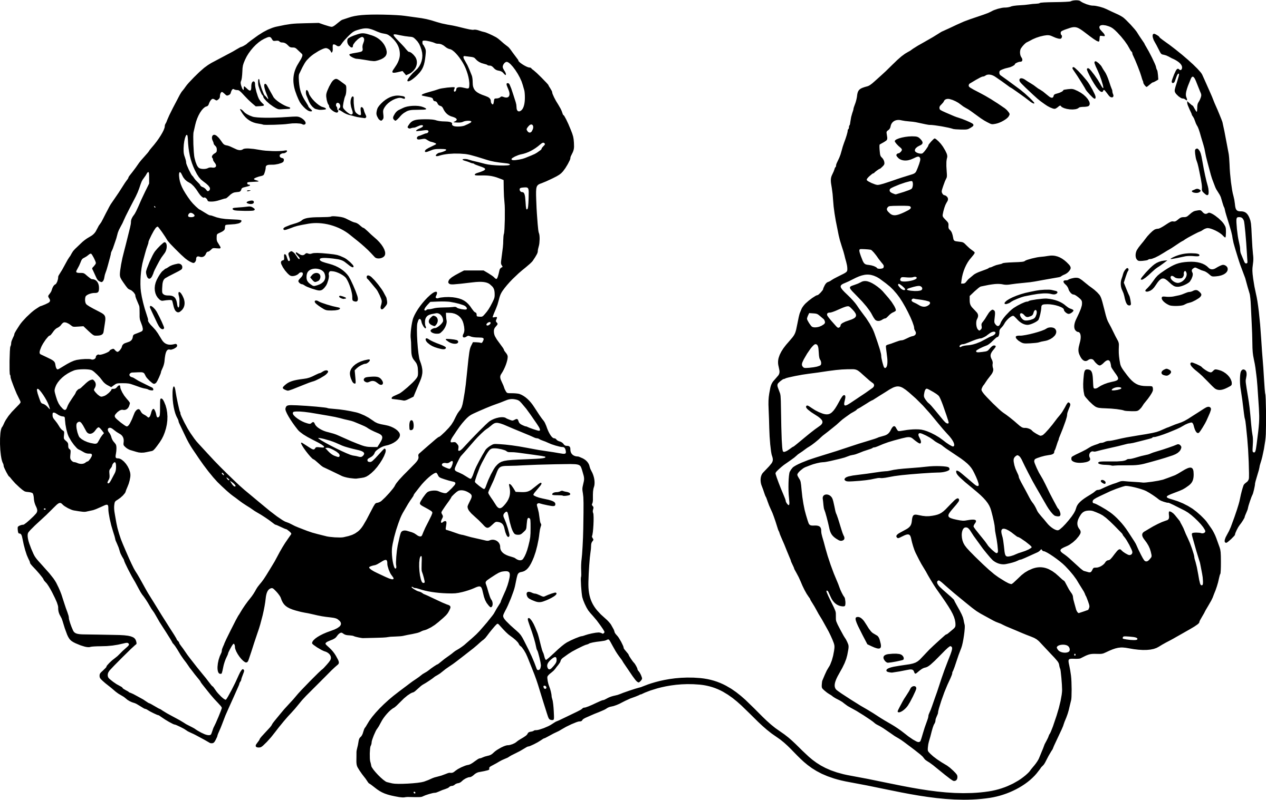
How to Communicate Effectively Asking For What You Need
Talk about communication
Give helpful and supportive feedback
Do not wait until you’re angry
Ask questions
Learn to say no, gently
Be forgiving
Talk about sex
Learn To Listen
Notes:
So you’re probably wondering how to ask for what you want and what you need
It would be a good idea – if you haven’t already – to start working on improving these skills
Talking about good communication
Talk to your partner about what you think is the best way for you to communicate
Give helpful and supportive feed back
Listen to what your partner is saying not just picking and choosing what to address
Do not wait until you’re angry
This will just cause more issues and may lead you to say things you do not mean. When the issue first arises, talk about it.
Ask questions when and where you need to
Learn to say no, gently
Be forgiving
And talk about sex, what do you like what do you not like? Be honest.
All of this leads to being a good listener. Learn to hear what your partner is trying to say. Do not get defensive, this will cause an emotional shut down from your partner and start a new fight.

Slide 10
Speaking of Listening. . .
Relationship Quiz (Gottman, 1999)
What is the name of your partner’s best friend?
Who has been irritating your partner lately?
What are some of your partner’s life dreams?
What are 3 of your partner’s favorite movies?
What are your partner’s major current worries?
What your partner would do if they won the lottery?
Notes:
Speaking of Listening……
How well do you listen?
Give class 2minutes to answer
Who had great ease with this?
Now which of you are extremely confident in your answers?

Slide 11
Aspects of an Unhealthy Relationship
https://youth.gov/youth-topics/teen-dating-violence/characteristics
https://www.joinonelove.org/signs-unhealthy-relationship/
Notes:
Overgeneralizations
“Never” and “Always”
Better to say “I feel like…”
Name calling
Bringing up old arguments
Overkill
Jealousy e.g., control, hostility
Possessiveness
Dependence
Physical and Sexual Violence
Dishonesty e.g., Deflecting responsibility
Manipulation
Disrespect and verbal abuse
These are all aspects of an unhealthy and toxic relationship
Jealousy - a little bit of jealousy is okay but the minute it starts to encompass control over you, hostility, your partner is showing signs of dependence, and escalates in intensity…then there is a problem
As previously discussed jealousy is insecurity, control, and possessiveness. Jealousy has nothing to do with love;
If your partner is constantly questioning you about where you are, who you’re with, and gets jealous over family members that is a sign of toxicity; it is not normal to get extremely jealous of how much time your partner spends with their family, friends, and even their own children. They may phone or text frequently and expect a response right away, just checking in to see what you are doing and with whom. They may also drop by when their partner is at work or school or spending time with other people. Many abusers control the finances; this creates dependency. In extreme cases, these types of abusers refuse to let their partners have jobs for fear of meeting others or develop a support system.
Possessiveness is also common
No you’re not being territorial. You are being possessive and jealous.
Those who are possessive typical exhibit control, hostility, and use intimidation tactics either on their partner or those around their partner. Hollywood has also glorified this is protective and romantic. It is not normal.
Dependency
This is extremely important. Erik Eriksson psychosocial stages of development define the adolescent years as defining your identity and your intimacy. He states that if you are unable or do not properly form your identity then you are not ready to be intimate. A dependent partner has grown up without a definite sense of identity and will form themselves to match their partner. They are completely dependent on their partner for their own satisfaction in life. This is also not normal. You are not someones sole secure form of happiness. You are two whole individuals coming together.
Sexual Violence; Physical Violence, which we will discuss more later
Dishonesty
We talked about how this can get in the way of a relationship. It is also defined by those who deflect responsibility and are always making excuses for their actions. Betrayal also falls into this category
Manipulation
You had reading about the many different forms of manipulation
Who can give me one example?
Another?
Disrespect such as belittling your partner, their accomplishments, and their actions; this verbal abuse is
Guilt tripping them into something they don’t want to do or convincing them everything is their fault
And sabotage, or defamation of your character in anyway. Making you feel insecure.

Slide 12
Quick Involvement
Many victims dated or knew their abusers for less than 6 months before becoming engaged or moving in together.
Abusers come on like a whirlwind, claiming "love at first sight." Abusers flatter their victims with statements like "You're the only person I have ever been able to talk to," "I've never felt loved like this by anyone," or "I'd kill myself if you ever left me.”
The abuser needs someone desperately and will pressure a victim to make a quick and total commitment.
(Dr. Jason Parker, PhD, Old Dominion University)
Notes:
TRUE AND FALSE QUESTIONS
Has any one experienced this? Examples
Quick involvement can become a negative situation very quickly and correlate to quick attachment, making it more difficult for the victim to breakaway from the abuser.
This is like love at first sight, you are the ONLY person for me, and the use of overkill such as I will kill myself if you leave
These individuals are desperate, fall quickly, you’re their soulmate and you MUST NEVER LEAVE. . .or else :)

Slide 13
Controlling Behavior
In the initial stages of a relationship, abusers explain that controlling behavior is concern for the significant other's safety, the need to use time well, or the need to make "good" decisions.
As controlling behavior worsens, abusers tend to interfere more and more in their victims' personal decisions, like choice of clothing, church attendance, or money.
Abusers may even make victims ask permission to leave the room or the house.
(Dr. Jason Parker, PhD, Old Dominion University)
Notes:
MOVE INTO UNHEALTHY RELATIONSHIPS
Controlling behavior is an alarming sign of a toxic relationship because it impedes on your own individuality. Having another individual control you takes away from one’s own self worth. Much like jealousy, as it worsens the abuser begins to interfere into more and more daily activities. Initially they assure you that its just for your own safety but eventually leads into your partner having complete control over your AUTONOMY .

Slide 14
Blaming Others for Their Feelings
Abusers tell their victims "You make me mad," "You're hurting me by not doing what I ask," or "I can't help being angry,"
Abusers make decisions about what they think and feel, then use these feelings to manipulate victims
More subtle are claims like "You make me happy" or "You control how I feel.”
(Dr. Jason Parker, PhD, Old Dominion University)
Notes:
What are some examples of this?
Do you have any that you have experienced?
This is removing themselves from the situation completely and replacing everything with “YOU”
You are their happiness
You are why they are mad
You are why they hit you
Another example of this would the person who absolutely cannot be happy by themselves, they “need” you and if you don’t pick up that phone on the first ring then its your fault they got fired

Slide 15
6 traits people think are normal
Relationship scoreboard
Dropping hints
Holding the relationship hostage
Blaming your partner for your own emotions
Displays of loving jealousy
Buying the solution
https://markmanson.net/toxic-relationship-habits
Notes:
Lastly, I would like to discuss some of the toxic traits that have been romanticized into seeming normal. These will be tied in with class discussion.
As a group you will be evaluating some dialog between partners. You will determine if the scenario is toxic or healthy and list the relative traits that you have found.
Who would like to tell me what a relationship score board is or give an example?
Dropping hints?
Hostage situation?
Emotional blaming?
There should be tons of answers for the next one
Buying the solution?

Slide 16
UTA Group Discussion
In what ways do you think consent about sexual activities changes as relationships develop from the dating stage to being long-term?
With the information learned from todays lecture and assigned readings, which skills do you believe will be the most beneficial when thinking about your present and future relationships?

Slide 17
Scenario One: Group Evaluation

Slide 18
What kind of relationship was presented within this video?
What traits or aspects, relative to the type of relationship, did you notice? Provide at least two with direct examples.
What are your thoughts and how would you react if you were presented with a situation like this?
If applicable – How would you approach this situation in a healthier way?

Slide 19
Communication Bible
“I feel ________” is communicative.
“You” statements are argumentative.
I feel ________, but not at/with you.
Let them “rephrase.”
Remember to keep “dating” each other.
Notes:
So If you take away anything about communication this is it.
This is your way to effectively learn how to communicate with your partner
I feel
YOU statements argumentative
Make sure you specify how you feel but not at or with them if you’re in a situation where you’re unsure why you feel the way you do.
Let your partner rephrase. Talking is hard
Never. Stop. Dating. You will lose who you are together if you do.

