Slide 1
Introduction
Phase: A region in a material that differs in structure and function from other regions.
Phase diagrams:
    Represents phases present in metal at different conditions (Temperature, pressure and composition).
    Indicates equilibrium solid solubility of one element in another.
    Indicates temperature range under which solidification occurs.
    Indicates temperature at which different phases start to melt.

Slide 2
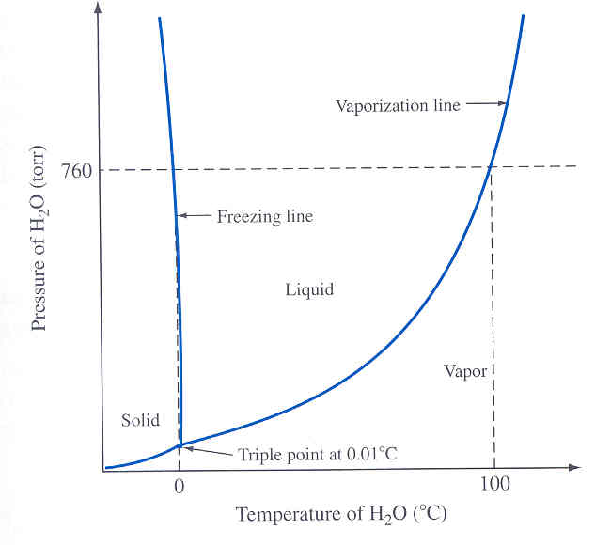
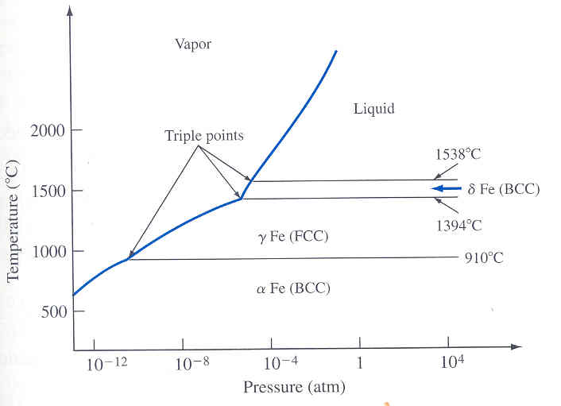
Phase Diagram of Pure Substances
Pure substance exist as solid, liquid and vapor.
Phases are separated by phase boundaries.
Example : Water, Pure Iron.
Different phases coexist at triple point.
BCC
FCC
BCC
After W. G. Moffatt, et al., “The Structure and Properties of Materials,” vol I: “Structure,” Wiley, 1965, p.151

Slide 3
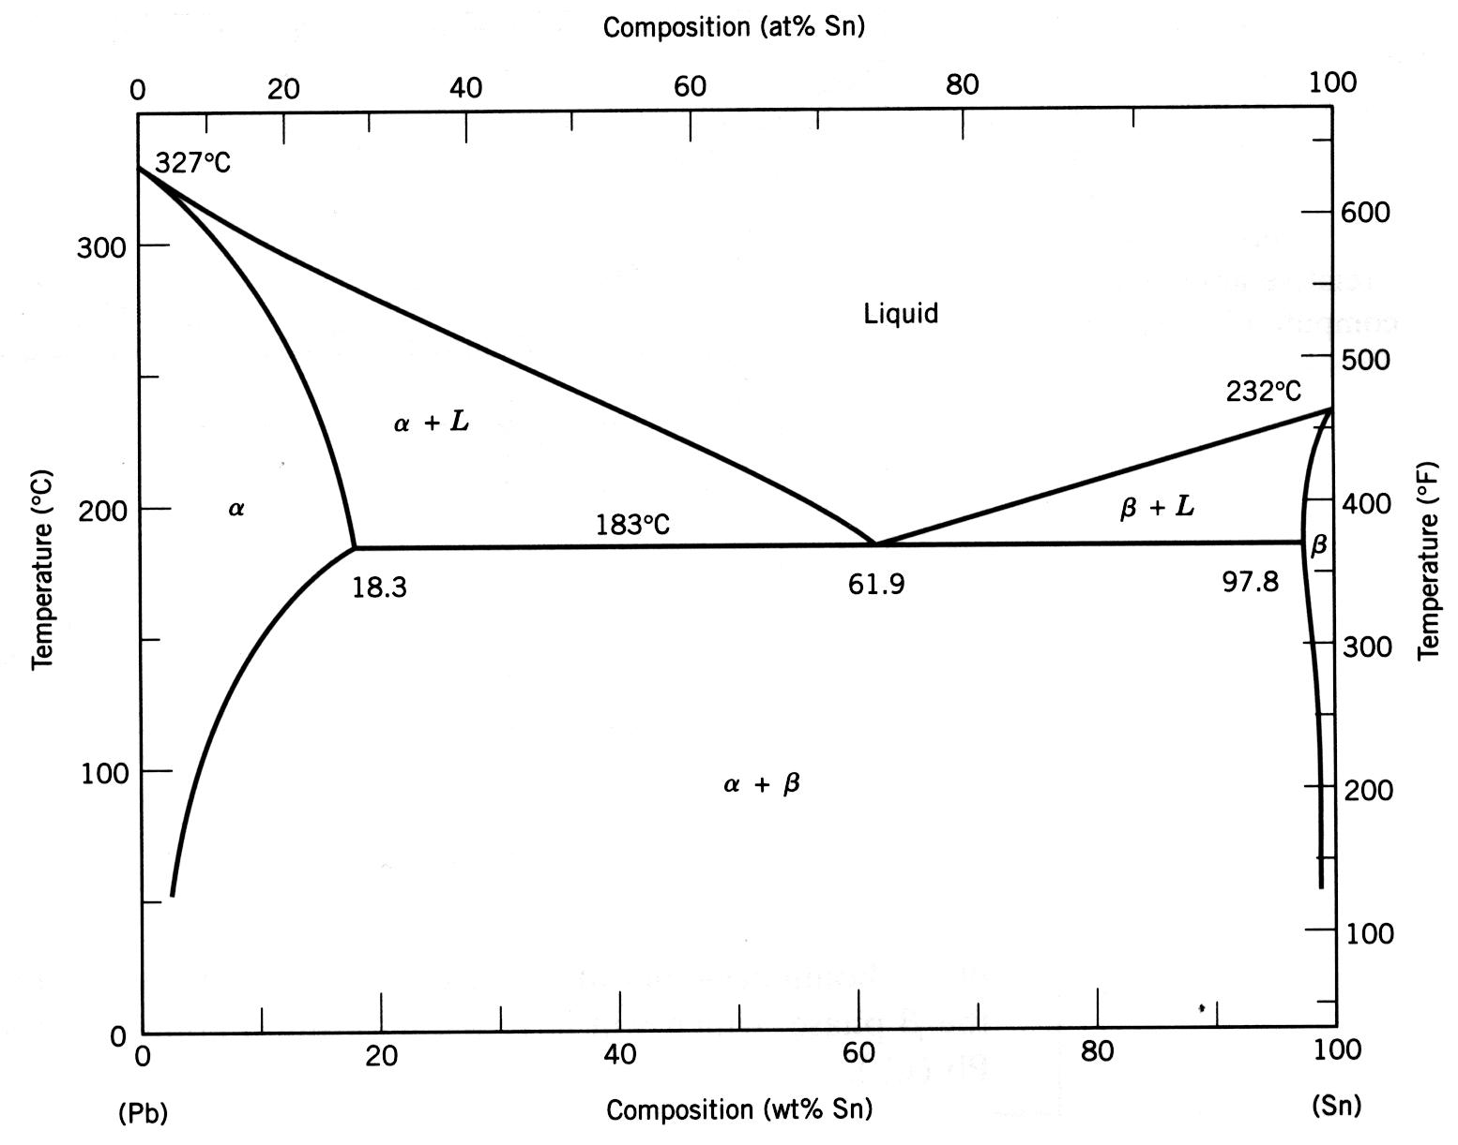
Phase Diagrams & The Equilibrium Constitution of an Alloy
Key Features
  Axes: Composition and Temperature
  Regions Labeled with the Names of Materials
  Lines that Separate the Regions
  Points Where the Lines Intersect
Key Uses are to Predict
  Which Phases Are Present in an Alloy (Mixture)
  How Much of Each
  The Microstructure

Slide 4

Phase Fields for Binary Alloys
Conventions
  “A” and “B” are the generic Components
  Is a solid solution in which A is the solvent and B is the solute
    has A’s Crystal structure
  β Is a solid solution in which B is the solvent and A is the solute
    has B’s Crystal structure
  Other Greek letters are compounds formed from A & B
“A”
“B”
Single Phase and 2-Phase “Phase Fields”
  Pure Components (Lines at limits of the Phase Diagram
  Solutions
  Mixtures of a Liquid & Solid, 2 Different Solids, 2 Different Liq’ds

Slide 5
How to Read A Binary Phase Diagram
Phases Present
  Determine the Constitution Point (C_{B},T)
    C_{B} represents the ingredients; T is the temperature
  Phases Present are Given by the Field in Which the Constitution Point Lies

Slide 6
Composition of the Phases Present
Single Phase Field
  Only Have One Phase
  Phase composition Must Equal Alloy Composition
Liquid
L +
α
L +
β
α
β
α + β
A
B
A vs. α, B vs. β
  A, B are the Pure Components
  α is “A” with some B Dissolved in It
    Same Crystal Structure as Pure A
    Some A Atoms Replaced with B atoms
W
B in the alloy

Slide 7
Composition of the Phases Present
Two-Phase Field
  Two Phases
  Phase Compositions Are @ the Solubility Limits
  Tie-Line Construction Gives Phase Compositions
Liquid
L +
α
L +
β
α
β
α + β
A
W
W
B
α
B in grains
B in grains
β
Tie Line Construction
  Draw a Line of Constant T at T of Interest
  Phase Composition = Composition Where Tie Line Intersects the Phase Field Boundaries
    WHY? (Gives the Solubility Limit at T of Interest!)
W
B in the alloy

Slide 8
For a Real Phase Diagram
Single Phase Field, Alloy #1
  Only Have one Phase
  Phase Composition Must Equal Alloy Composition
Two-Phase Field, Alloy #2
  Two Phases
  Phase Compositions Are @ Solubility Limits
  Tie-Line Construction Gives Phase Compositions
  Note: At Constant T, the Composition of α and β in the Two Phase Field Do NOT Vary with Alloy Composition!
    Why?
Wt% Sn in α
Wt% Sn in β
Wt%Sn in α
Alloy #2 Composition
Alloy #1 Composition

Slide 9
Gibbs Phase Rule
P = number of phases that coexist in a system
C = Number of components
F = Degrees of freedom
P+F = C+2
For pure water, at triple point, 3 phases coexist.
There is one component (water) in the system.
Therefore 3 + F = 1 + 2 F = 0.
Degrees of freedom indicate number of variables that can be changed without changing number of phases.

Slide 10
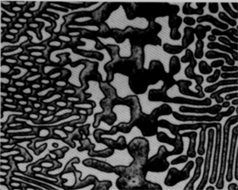
Components and Phases
• Components:
The elements or compounds which are present in the alloy
(e.g., Al and Cu)
• Phases:
The physically and chemically distinct material regions
that form (e.g., α and β).
Aluminum-
Copper
Alloy
β
(lighter
phase)
α
(darker
Adapted from chapter-opening photograph, Chapter 9, Callister, Materials Science & Engineering: An Introduction, 3e.
phase)

Slide 11
Criteria for Solid Solubility
Simple system (e.g., Ni-Cu solution)
 | Crystal Structure | electroneg | r (nm)
Ni | FCC | 1.9 | 0.1246
Cu | FCC | 1.8 | 0.1278
Both have the same crystal structure (FCC) and have
similar electronegativities and atomic radii (W. Hume –
Rothery rules) suggesting high mutual solubility.
Ni and Cu are totally soluble in one another for all proportions.

Slide 12
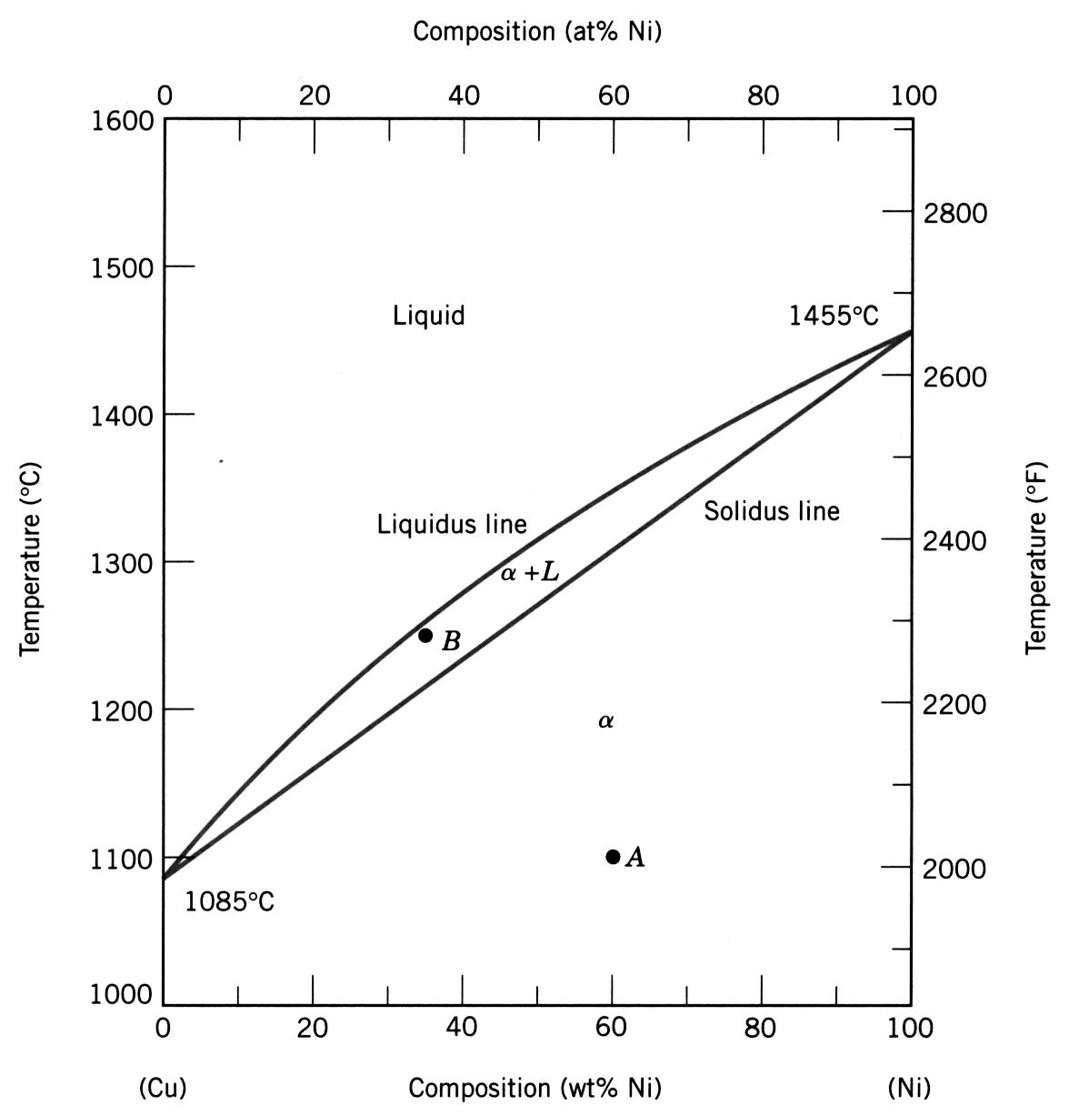
Complete Solid Solubility
Complete Solid Solubility
  Get only one solid (solution) for All Alloy Compositions, W_{B}
  Components Must Be “Similar
  (At minimum, same crystal structure)
Definitions
Liquidus Line
  Line above which the alloy is all liquid
Solidus Line
  Line below which the alloy is all solid
Can give the liquidus and solidus temperature for any alloy composition
Classic Example: Cu-Ni

Slide 13
Isomorphous Binary Phase Diagram
• Phase diagram:
Cu-Ni system.
T(°C)
1600
• System is:
1500
L (liquid)
Cu-Ni
phase
diagram
-- binary
i.e., 2 components:
Cu and Ni.
1400
liquidus
α
1300
+
-- isomorphous
i.e., complete
solubility of one
component in
another; α phase
field extends from
0 to 100 wt% Ni.
L
solidus
1200
α
(FCC solid
1100
solution)
1000
wt% Ni
0
20
40
60
80
100
Adapted from Fig. 10.3(a), Callister & Rethwisch 3e. (Fig. 10.3(a) is adapted from Phase Diagrams of Binary Nickel Alloys, P. Nash (Ed.), ASM International, Materials Park, OH (1991).
13
Notes:
13

Slide 14
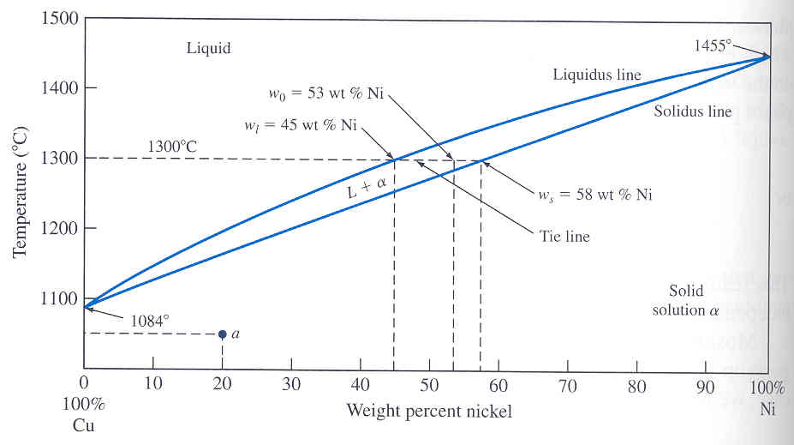
Binary Isomorphous Alloy Systems
Mixture of
two systems
Two component
system
Binary alloy
Isomorphous system: Two elements completely soluble in each other in liquid and solid state.
Example: Cu-Ni solution.
Composition at liquid
and solid phases at any
temperature can be
determined by drawing
a tie line.
Adapted from “Metals Handbook,” vol. 8, 8th ed., American society of Metals, 1973, p. 294.

Slide 15
Phase Diagrams:
Determination of phase(s) present
• Rule 1: If we know T and C_{o}, then we know:
-- which phase(s) is (are) present.
T(°C)
• Examples:
1600
A(1100°C, 60 wt% Ni):
1 phase: α
1500
L (liquid)
B
(1250°C, 35 wt% Ni):
1400
(1250°C,35)
2 phases: L + α
liquidus
α
1300
+
B
L
solidus
α
1200
(FCC solid
solution)
Adapted from Fig. 10.3(a), Callister & Rethwisch 3e. (Fig. 10.3(a) is adapted from Phase Diagrams of Binary Nickel Alloys, P. Nash (Ed.), ASM International, Materials Park, OH (1991).
1100
A(1100°C,60)
1000
wt% Ni
0
20
40
60
80
100
15
Notes:
15

Slide 16
Phase Diagrams:
Determination of phase compositions
• Rule 2: If we know T and C₀, then we can determine:
-- the composition of each phase.
Cu-Ni system
• Examples:
T(°C)
Consider C₀ = 35 wt% Ni
T_{A}
A
tie line
liquidus
At T_{A}
= 1320°C:
1300
L (liquid)
α
L
+
Only Liquid (L) present
B
C_{L} = C₀
( = 35 wt% Ni)
T_{B}
solidus
α
α
At T_{D}
= 1190°C:
L
+
1200
D
(solid)
Only Solid (α) present
T_{D}
C_{α} = C₀
( = 35 wt% Ni)
20
30
32
35
40
4
3
50
At T_{B}
= 1250°C:
C_{L}
C₀
C_{α}
wt% Ni
Both
α
and L present
Adapted from Fig. 10.3(a), Callister & Rethwisch 3e. (Fig. 10.3(a) is adapted from Phase Diagrams of Binary Nickel Alloys, P. Nash (Ed.), ASM International, Materials Park, OH (1991).
C_{L}
= C
liquidus
( = 32 wt% Ni)
C_{α}
= C
solidus
( = 43 wt% Ni)
16
Notes:
16

Slide 17
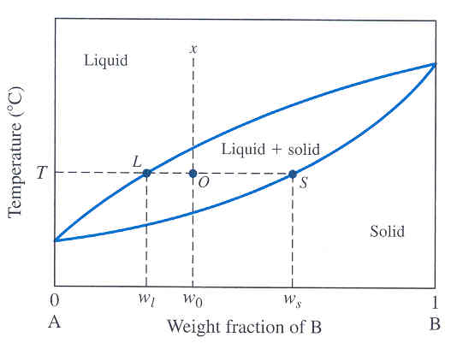
The Lever Rule
The Lever rule gives the weight % of phases in any two phase regions.
Wt fraction of solid phase
= X_{s} = w₀ – w_{l}
w_{s} – w_{l}
Wt fraction of liquid phase
= X_{l} = w_{s} – w₀
w_{s} – w_{l}

Slide 18
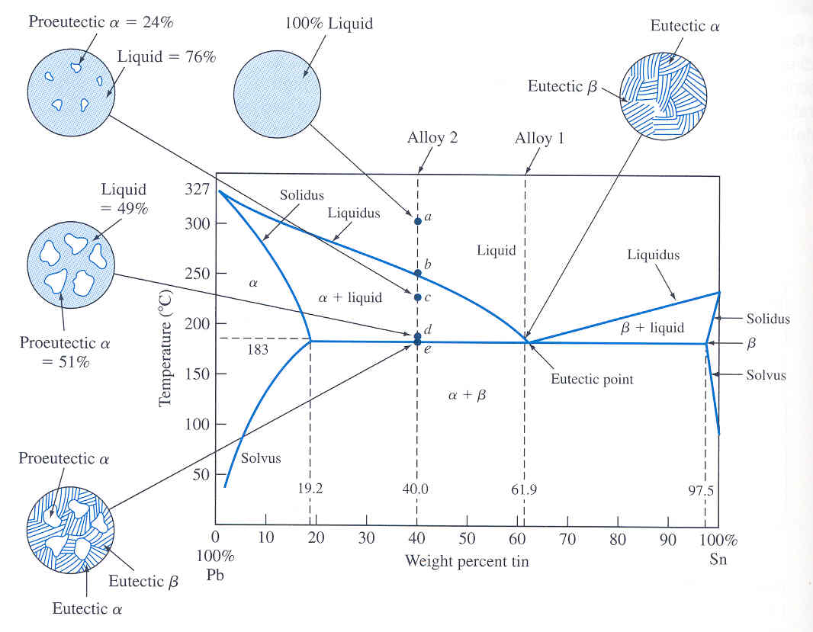
Binary Eutectic Alloy System
In some binary alloy systems, components have limited solid solubility.
Example : Pb-Sn alloy.
Eutectic composition freezes
at lower temperature than all
other compositions.
This lowest temperature is
called eutectic temperature.
Lead
-Tin
Eutectic temperature
Liquid
α solid solution + β solid solution
Cooling

Slide 19
EX : Pb-Sn Eutectic System
• For a 40 wt% Sn-60 wt% Pb alloy at 150°C, determine:
-- the phases present
Pb-Sn
system
Answer: α + β
T(°C)
-- the phase compositions
Answer: C_{α} = 11 wt% Sn
300
L (liquid)
C_{β} = 99 wt% Sn
-- the relative amount
of each phase
α
L
+
α
200
183°C
L
+
β
β
18.3
61.9
97.8
Answer:
150
R
S
S
C_{β} - C₀
W
_{α}
=
=
100
α
+
β
R+S
C_{β} - C_{α}
99 - 40
59
=
=
= 0.67
99 - 11
88
0
11
20
40
60
80
99
100
R
C₀ - C_{α}
W
_{β}
=
=
C_{α}
C₀
C, wt% Sn
C_{β}
R+S
C_{β} - C_{α}
Adapted from Fig. 10.8, Callister & Rethwisch 3e.
40 - 11
29
=
=
= 0.33
99 - 11
88
19
Notes:
19

Slide 20
Microstructural Developments in Eutectic Systems I
• For alloys for which
C₀ < 2 wt% Sn
• Result: at room temperature
-- polycrystalline with grains of
α phase having
composition C₀
T(°C)
L: C₀ wt% Sn
400
L
α
300
L
L
+
α
α
200
(Pb-Sn
T_{E}
α: C₀ wt% Sn
System)
100
α
+
β
0
10
20
30
Adapted from Fig. 10.11, Callister & Rethwisch 3e.
C₀
C
,
wt% Sn
2
(room T solubility limit)
20
Notes:
20

Slide 21
Microstructural Developments in Eutectic Systems II
• For alloys for which
2 wt% Sn < C₀ < 18.3 wt% Sn
• Result:
at temperatures in α + β range
-- polycrystalline with α grains
and small β-phase particles
T(°C)
L: C₀ wt% Sn
400
L
L
300
α
L
+
α
α: C₀ wt% Sn
α
200
T_{E}
α
β
100
α
+
β
Pb-Sn
system
Adapted from Fig. 10.12, Callister & Rethwisch 3e.
0
10
20
30
2
C₀
C
,
wt% Sn
(sol. limit at T
room
)
18.3
(sol. limit at T_{E})
21
Notes:
21

Slide 22

Microstructural Developments in Eutectic Systems III
• For alloy of composition C₀ = C_{E}
• Result: Eutectic microstructure (lamellar structure)
-- alternating layers (lamellae) of α and β phases.
T(°C)
Micrograph of Pb-Sn
eutectic
L: C₀ wt% Sn
microstructure
300
L
Pb-Sn
system
L
+
α
α
β
200
183°C
L + β
T_{E}
100
α + β
160 μm
β: 97.8 wt% Sn
Adapted from Fig. 10.14,
Callister & Rethwisch 3e.
α: 18.3 wt%Sn
0
20
40
60
80
100
18.3
C_{E}
97.8
Adapted from Fig. 10.13, Callister & Rethwisch 3e.
61.9
C, wt% Sn
22
Notes:
22

Slide 23
Microstructural Developments in Eutectic Systems IV
• For alloys for which 18.3 wt% Sn < C₀ < 61.9 wt% Sn
• Result: α phase particles and a eutectic microconstituent
• Just above T_{E} :
T(°C)
L: C₀
wt% Sn
α
L
C_{α}
= 18.3 wt% Sn
L
300
L
_{α}
C_{L}
= 61.9 wt% Sn
Pb-Sn
system
S
L
+
α
W_{α}
=
= 0.50
α
R
+
S
200
R
S
L
+
β
β
W_{L}
= (1-
W
α
)
= 0.50
T_{E}
R
S
• Just below T_{E} :
100
α
+
β
C
_{α}
= 18.3 wt% Sn
primary
α
C
_{β}
= 97.8 wt% Sn
eutectic
α
S
eutectic
β
W
_{α}
=
= 0.73
0
20
40
60
80
100
R
+
S
18.3
61.9
97.8
W
_{β}
= 0.27
Adapted from Fig. 10.16, Callister & Rethwisch 3e.
C, wt% Sn
23
Notes:
23

Slide 24
Eutectic, Eutectoid, & Peritectic
Eutectic - liquid transforms to two solid phases
  L α + β (For Pb-Sn, 183°C, 61.9 wt% Sn)
cool
heat
Eutectoid – one solid phase transforms to two other solid phases
  S₂ S₁+S₃
  γ α + Fe₃C (For Fe-C, 727°C, 0.76 wt% C)
intermetallic compound - cementite
cool
heat
Peritectic - liquid and one solid phase transform to a second solid phase
  S₁ + L S₂
  δ + L γ (For Fe-C, 1493°C, 0.16 wt% C)
cool
heat
24
Notes:
24

Slide 25
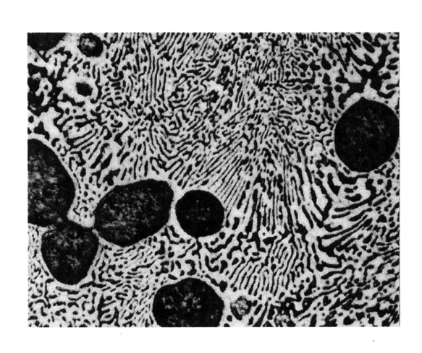

Hypoeutectic & Hypereutectic
300
L
Adapted from Fig. 10.8,
Callister & Rethwisch 3e. (Fig. 10.8 adapted from Binary Phase Diagrams, 2nd ed., Vol. 3, T.B. Massalski (Editor-in-Chief), ASM International, Materials Park, OH, 1990.)
T(°C)
α
L
+
α
200
L
+
β
β
(Pb-Sn
T_{E}
α
+
β
System)
100
0
20
40
60
80
100
C, wt% Sn
hypoeutectic: C₀ = 50 wt% Sn
eutectic
61.9
hypereutectic: (illustration only)
(Figs. 10.14 and 10.17 from Metals Handbook, 9th ed.,
Vol. 9, Metallography and Microstructures, American Society for Metals, Materials Park, OH, 1985.)
α
eutectic: C₀ = 61.9 wt% Sn
β
α
β
α
α
β
β
α
β
α
β
175 μm
160 μm
Adapted from
Fig. 10.17, Callister & Rethwisch 3e.
eutectic micro-constituent
Adapted from Fig. 10.17, Callister & Rethwisch 3e. (Illustration only)
Adapted from Fig. 10.14, Callister & Rethwisch 3e.
25
Notes:
25

Slide 26
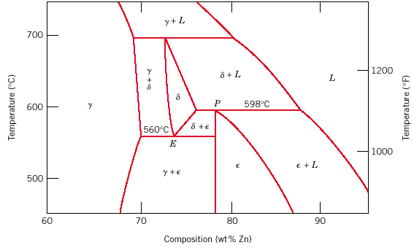
Eutectoid & Peritectic
Peritectic transformation γ + L δ
Adapted from Fig. 10.21, Callister & Rethwisch 3e.
Eutectoid transformation δ γ + ε
26
Cu-Zn Phase diagram
Notes:
26

Slide 27
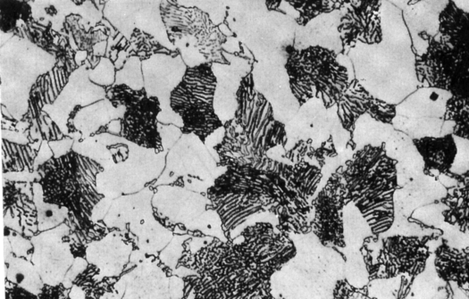
Hypoeutectoid Steel
T(°C)
1600
δ
1400
L
γ
γ
γ
+L
(Fe-C
γ
γ
System)
γ
1200
1148°C
L+Fe₃C
(austenite)
γ
γ
γ
γ
1000
γ
+ Fe₃C
Adapted from Figs. 10.28 and 10.33,Callister & Rethwisch 3e.
(Fig. 10.28 adapted from Binary Alloy Phase Diagrams, 2nd ed., Vol. 1, T.B. Massalski (Ed.-in-Chief), ASM International, Materials Park, OH, 1990.)
α
Fe₃C (cementite)
α
γ
γ
800
727°C
γ
α
γ
α
600
α
+ Fe₃C
400
0
1
2
3
4
5
6
6.7
α
(Fe)
C, wt% C
C₀
0.76
pearlite
100 μm
Hypoeutectoid
steel
pearlite
proeutectoid ferrite
Adapted from Fig. 10.34, Callister & Rethwisch 3e.
27
Notes:
27

Slide 28
Hypoeutectoid Steel
T(°C)
1600
δ
1400
L
γ
+L
(Fe-C
α
γ
System)
α
γ
γ
1200
1148°C
L+Fe₃C
α
(austenite)
γ
γ
1000
γ
+ Fe₃C
Adapted from Figs. 10.28 and 10.33,Callister & Rethwisch 3e.
(Fig. 10.28 adapted from Binary Alloy Phase Diagrams, 2nd ed., Vol. 1, T.B. Massalski (Ed.-in-Chief), ASM International, Materials Park, OH, 1990.)
W_{α} = s/(r + s)
Fe₃C (cementite)
W_{γ} =(1 - W_{α})
800
r
s
727°C
α
R
S
α
600
α
+ Fe₃C
pearlite
400
0
1
2
3
4
5
6
6.7
(Fe)
C₀
C, wt% C
W_{pearlite} = W_{γ}
0.76
W_{α’} = S/(R + S)
Hypoeutectoid
100 μm
steel
W =(1 – W_{α’})
Fe₃C
pearlite
proeutectoid ferrite
Adapted from Fig. 10.34, Callister & Rethwisch 3e.
28
Notes:
28

Slide 29
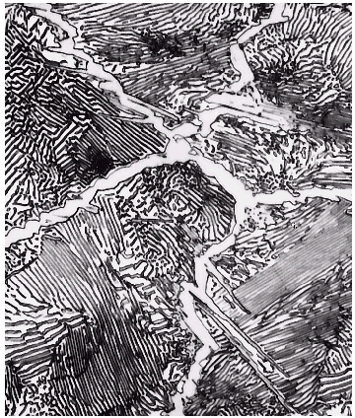
Hypereutectoid Steel
T(°C)
1600
δ
1400
L
(Fe-C
γ
γ
+L
System)
γ
γ
γ
γ
1200
1148°C
L+Fe₃C
(austenite)
γ
γ
γ
γ
1000
γ
+Fe₃C
Adapted from Figs. 10.28 and 10.36,Callister & Rethwisch 3e. (Fig. 10.28 adapted from Binary Alloy Phase Diagrams, 2nd ed., Vol. 1, T.B. Massalski (Ed.-in-Chief), ASM International, Materials Park, OH, 1990.)
Fe₃C
Fe₃C (cementite)
γ
γ
800
γ
γ
α
600
α
+Fe₃C
400
0
1
C₀
2
3
4
5
6
6.7
(Fe)
0.76
C, wt%C
pearlite
60 μm
Hypereutectoid
steel
pearlite
proeutectoid Fe₃C
Adapted from Fig. 10.37, Callister & Rethwisch 3e.
29
Notes:
29

Slide 30
Hypereutectoid Steel
T(°C)
1600
δ
1400
L
(Fe-C
γ
+L
System)
Fe₃C
γ
γ
γ
1200
1148°C
L+Fe₃C
(austenite)
γ
γ
1000
γ
+Fe₃C
Adapted from Figs. 10.28 and 10.36,Callister & Rethwisch 3e. (Fig. 10.28 adapted from Binary Alloy Phase Diagrams, 2nd ed., Vol. 1, T.B. Massalski (Ed.-in-Chief), ASM International, Materials Park, OH, 1990.)
W_{γ} =x/(v + x)
Fe₃C (cementite)
W =(1-W_{γ})
800
v
x
Fe₃C
α
V
X
600
α
+Fe₃C
pearlite
400
0
1
C₀
2
3
4
5
6
6.7
(Fe)
0.76
C, wt%C
W_{pearlite} = W_{γ}
W_{α} = X/(V + X)
60 μm
Hypereutectoid
W =(1 - W_{α})
steel
Fe₃C’
pearlite
proeutectoid Fe₃C
Adapted from Fig. 10.37, Callister & Rethwisch 3e.
30
Notes:
30

Slide 31
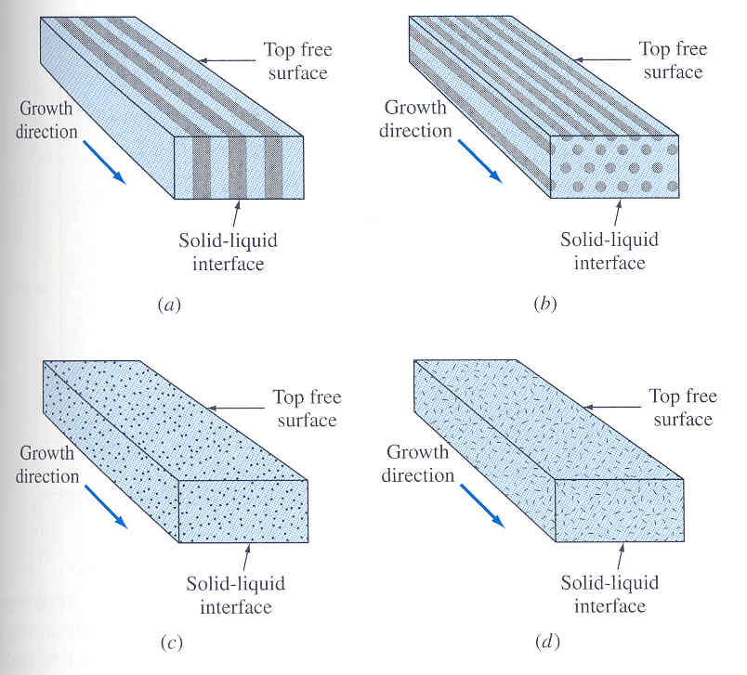
Various Eutectic Structures
Structure depends on factors like minimization of free energy at α / β interface.
Manner in which two phases nucleate and grow also affects structures.
After W. C. Winegard, “An Introduction to the Solidification of Metals,” Institute of Metals, London, 1964.

Slide 32
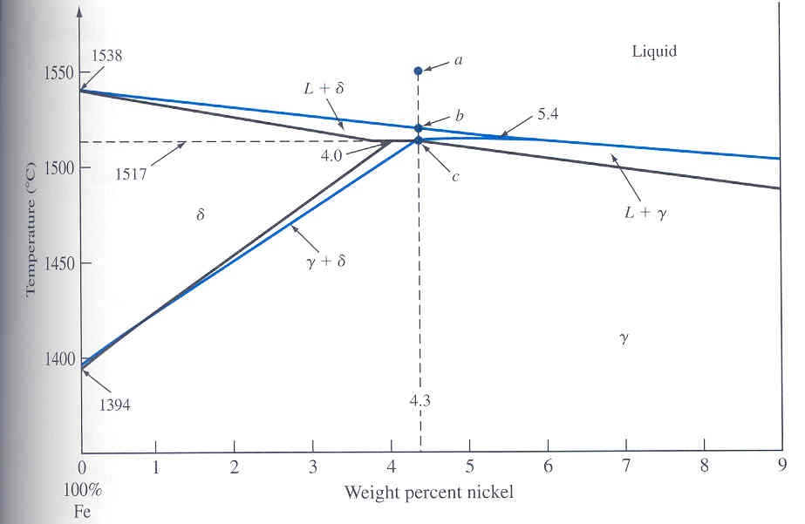
Binary Peritectic Alloy System
Peritectic reaction: Liquid phase reacts with a solid phase to form a new and different solid phase.
Liquid + α β
cooling
Peritectic reaction occurs
when a slowly cooled alloy
of Fe-4.3 wt% Ni passes
through Peritectic
temperature of 15170C.
Peritectic point is invariant.
cooling
Liquid(5.4 wt% Ni) + δ (4.0 wt% Ni) γ 4.3 wt % Ni

Slide 33
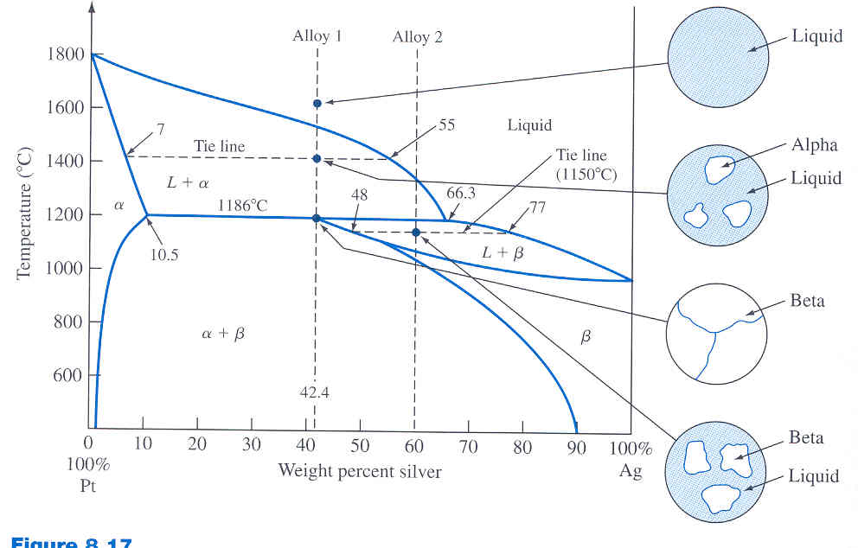
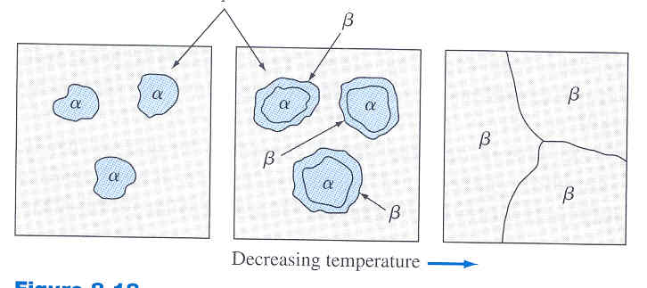
Peritectic Alloy System
At 42.4 % Ag & 1400⁰C
Phases present Liquid Alpha
Composition 55% Ag 7%Ag
Amount of Phases 42.4 –7 55-42.4
55 – 7 55 - 7
= 74% = 26%
At 42.4% Ag and 1186⁰C – ΔT
Phase Present Beta only
Composition 42.4% Ag
Amount of Phase 100%
At 42.4% Ag and 1186⁰C + ΔT
Phases present Liquid Alpha
Composition 66.3% Ag 10.5%Ag
Amount of Phases 42.4 –10.5 66.3-42.4
66.3 – 10.5 66.3–10.5
= 57% =43%

