Slide 1
The Social Impact of Cybercrime
Presented by: Leyah

Slide 2
Introduction
What is cybercrime?
Cybercrime is something that deals with illegal activities that are carried out using a computer network, or even the internet.
Some cyber criminals target governments, organizations, and even people.
Cybercrime affects millions of people every year

Slide 3
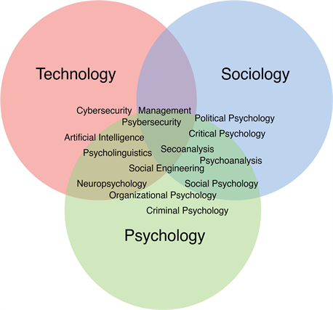
Cybersecurity and Social Science Connection
Social sciences study human behavior, relationships, and society
Cybersecurity depends on human decisions and their actions
Attackers often manipulate emotions
Examples
Phishing emails rely on humans emotional mindset
Social media scams people exploiting their trust and curiosity
Social science helps researchers understand
Social engineering tactics
Privacy concerns
Fear and trust online

Slide 4
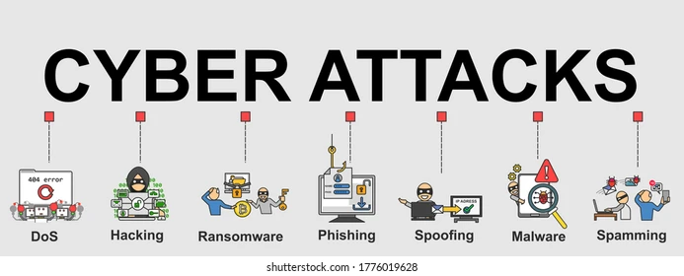
Types of Cybercrimes
Phishing
Fake emails or messages designed to steal personal information
Identity Theft
Criminals trying to steal personal information for fraud
3. Cyberbullying and Harassment
Terrible online behavior targeting individuals
4. Financial Fraud
Online scams that involve making fake purchases, banking, or investment schemes

Slide 5
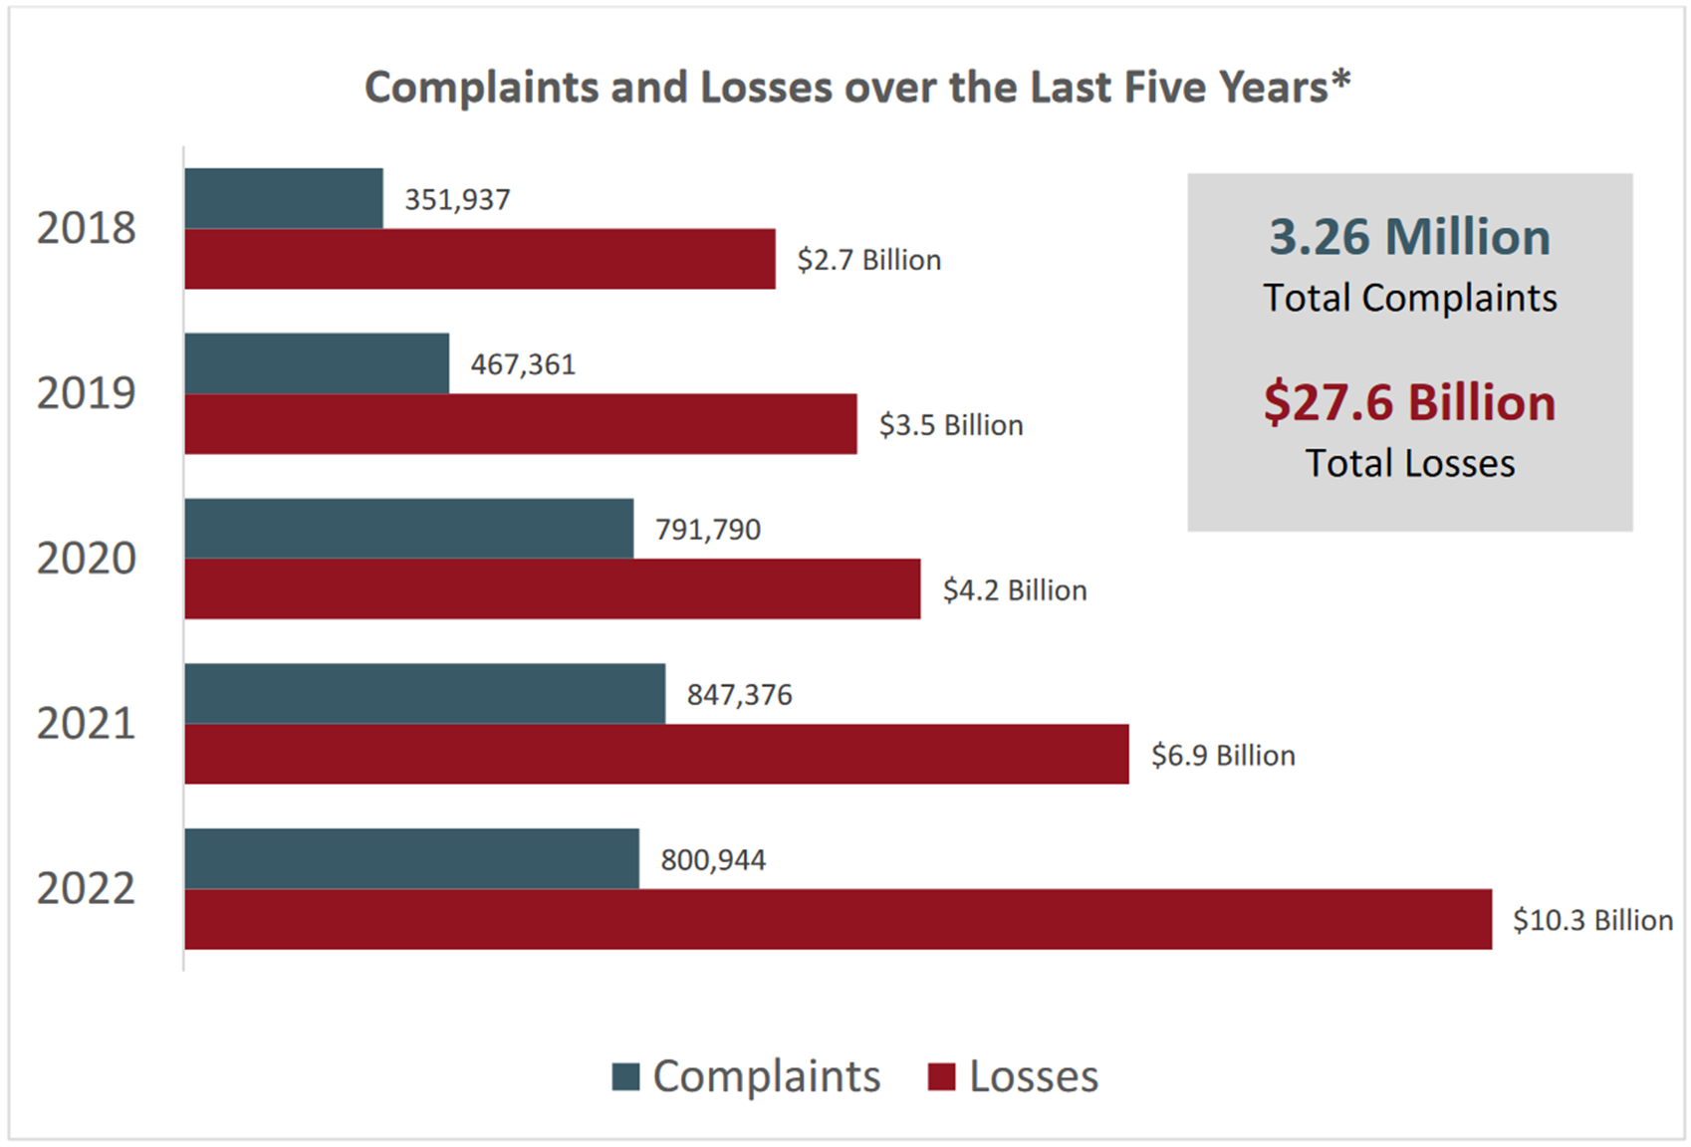
Social Consequences of Cybercrime
Effects cybercrime has on society
Financial Impact
People lose savings and personal funds
Loss of Trust
People lose trust in online services, social media, and banking
Emotional and Psychological Impact
Online harassment can leads to some depression mood swings and becoming isolated from loved ones

Slide 6
Privacy and Ethical Concerns
Cybercrime and Digital Ethics
Privacy Issues
Data breaches expose personal information
Companies collect large amounts of people’s data
Ethical Concerns
Balancing cybersecurity with their personal privacy rights
Companies are responsible for protecting users data
Social Impact
Increased fear of online tracking
Growing concerns with digital privacy

Slide 7
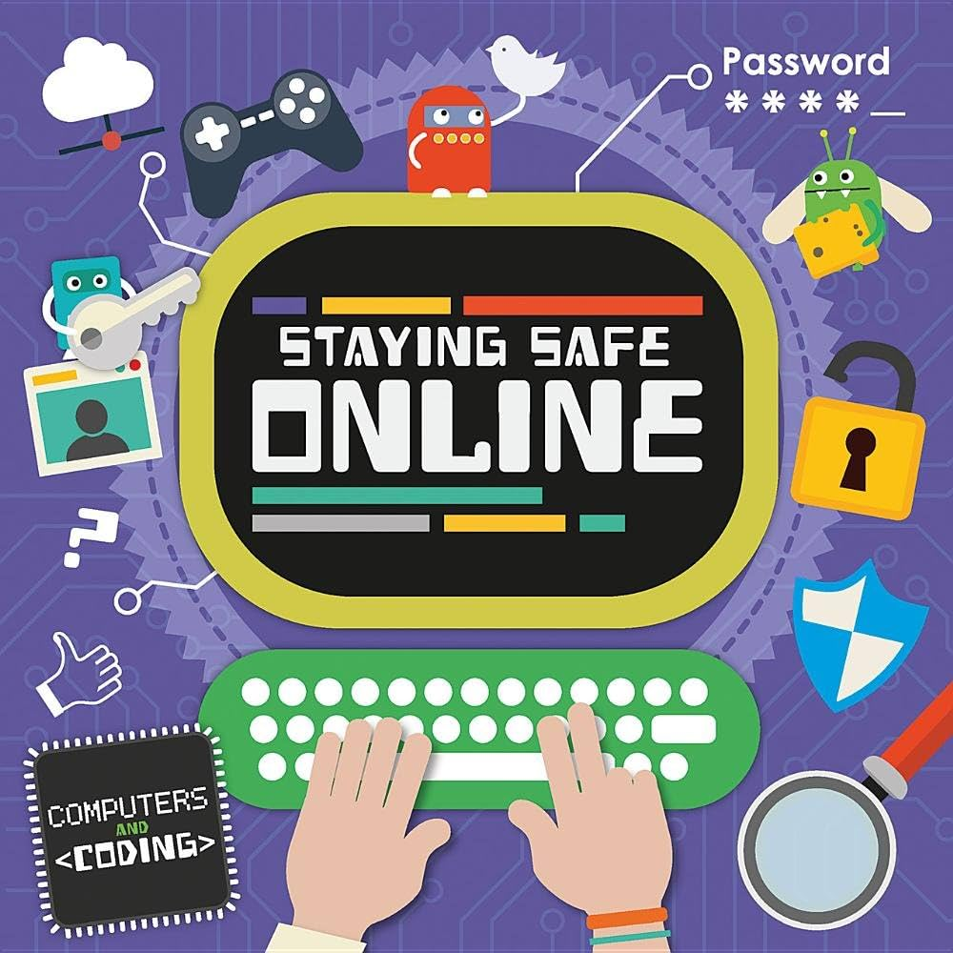
Closing
As society becomes more connected to the online world, understanding the relationship between cybersecurity and its social sciences becomes more important. Protecting the digital systems also means they are protecting people and their communities.

Slide 8
References
Nicolás-Sánchez, A., & Castro-Toledo, F. J. (2024). Uncovering the social impact of digital steganalysis tools applied to cybercrime investigations: a European Union perspective. Crime Science, 13(1), Article 11. https://doi.org/10.1186/s40163-024-00209-7

