Slide 1
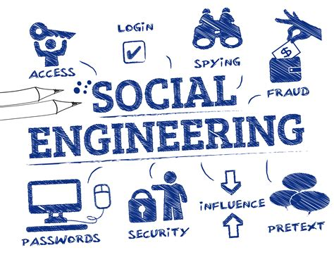
Cybersecurity and social engineering
Marlik Robertson
This Photo by Unknown Author is licensed under CC BY-SA-NC

Slide 2

What is Social engineering?
Manipulating people to give up information
Targets human behavior, not systems
Uses trust, fear or urgency
Sometimes called human hacking

Slide 3
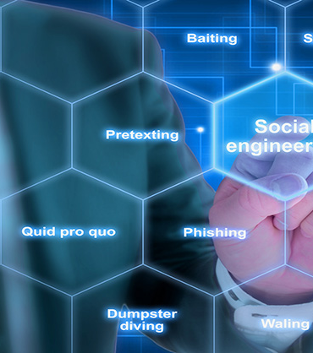

Common Attacks
Phishing through fake emails , texts and websites
Spear fishing or targeted attacks
Baiting using free downloads or USBs
Pretexting pretending to be someone trusted

Slide 4

Why it works
Exploits human behavior and emotions
People trust authority such as IT support, banks or government agencies
Creates urgency or fear
Uses curiosity

Slide 5
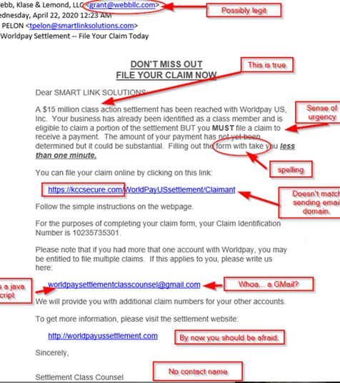
Prevention
Don’t click unknown links or attachments
Verify messages before responding
Look for red flags
Keep personal information private

Slide 6
References
IBM. (2022, June 14). What is Social Engineering? IBM; IBM. https://www.ibm.com/think/topics/social-engineering
Fortra. (2023, April 14). 9 Examples of Social Engineering Attacks | Terranova Security. Www.terranovasecurity.com. https://www.terranovasecurity.com/blog/examples-of-social-engineering-attacks
‌Firch, J. (2024, March 3). Social Engineering: What Is It & Why Is It Effective? PurpleSec. https://purplesec.us/learn/why-social-engineering-works/
CISA. (2021, February 1). Avoiding Social Engineering and Phishing Attacks. Cybersecurity and Infrastructure Security Agency CISA; CISA. https://www.cisa.gov/news-events/news/avoiding-social-engineering-and-phishing-attacks

