Slide 1


Social Engineering: The Human Element in Modern Cyber Threats
Marshall Shepherd
Old Dominion University
CYSE 201S
Professor Diwakar Yalpi
12/05/2024

Slide 2

Understanding Social Engineering Fundamentals
Social engineering exploits human psychology to gain unauthorized access frequently
Attackers leverage emotional triggers like fear, urgency, and curiosity daily
90% of cyber attacks begin with social engineering attempts
Common attacks target both personal information and corporate security systems
Social engineers study behavioral patterns before launching sophisticated attack campaigns
Psychological manipulation remains the primary tool in social engineering attacks
Notes:
Social engineering as a threat act differently than most in that it aims directly at human beings instead of computer systems. Attackers have learned to deceive people using sensitive, emotional buttons, especially fear, haste, and curiosity. Statistics show that about ninety percent of all successful cyber attacks stem from social engineering threats, making it one of the most significant threats out there. Companies are under constant threat as these attacks are dual-pronged in attacking the individual's data and the company's security infrastructure. Social engineers spend much time researching organizations' behavioral patterns and structure before they embark on their manipulation exercises. These are psychological, ultimately making these attacks unique and dangerous since they nullify basic trust and assumptions about other people's goodwill. These basic concepts become essential to build adequate defense strategies against such manipulation attempts.

Slide 3
Psychology Behind Social Engineering
Research
Attackers gather detailed information about targets through various sources
Connection
Building rapport and trust through carefully planned interactions daily
Exploitation
Using psychological triggers to manipulate target's decision making process
Execution
Implementing the attack while maintaining trust and avoiding suspicion
Collection
Gathering valuable data or achieving access to targeted systems
Exit
Covering tracks while maintaining possibility of future attack attempts
Notes:
The attack cycle of social engineering shows that today's threats are not random or haphazard. In fact, during the research phase, the attackers take their time to gather information about the targets from social media, records and any website related to the targeted organization. The connection phase is characterized by building credible relationships through planned interaction, which can take weeks or months to build trust. Exploitation occurs when the attackers use the psychological buttons found during reconnaissance to make the targets violate security measures. The attack occurs during the final and execution phases, keeping the trust relationship intact. In collection, information that is of great value or access to a system is obtained in a structured manner without being noticed. Last but not least, one of the stages is cleaning traces and denial of the attack while retaining the ability for a repeated attack or keeping control over the compromised account.

Slide 4

Common Attack Vectors in Social Engineering
Phishing emails masquerade as legitimate communications from trusted organizations daily
Vishing calls manipulate victims through urgent phone-based social engineering tactics
Baiting attacks use promises of rewards to spread malicious software
Tailgating exploits human courtesy to gain unauthorized physical access to entry
Quid pro quo offers false services in exchange for information
Pretexting creates fabricated scenarios to extract sensitive information from targets
Notes:
Social engineering has appeared over time in various sophisticated attack vectors, each of which will exploit human vulnerabilities for a specific reason. Phishing emails continue to be one of the most prolific means, with campaigns now using incredibly advanced impersonations of real organizations to elicit credentials and sensitive information. Vishing attacks take advantage of the personal nature of phone communications to create urgent scenarios that compel the victim to take action (Alabdan, 2020). Baiting attacks rely on human curiosity and the desire for gratification, leaving infected USBs lying around or making enticing downloads filled with malware. Tailgating takes advantage of simple courtesy, where unauthorized individuals can gain physical access to a secure facility by following legitimate employees. Quid pro quo attacks promise the victim something beneficial in return for the administrative data, while pretexting involves the creation of an entirely fictional scenario to get targets to disclose confidential information. Each vector requires different awareness and countermeasures to defend against it effectively.

Slide 5
Real-World Case Studies and Their Social Impact
Twitter Bitcoin scam showed how even verified social media accounts are not safe
RSA Security was breached through targeted phishing, which resulted in SecurID compromise
Sony Pictures hack revealed sensitive information by using social engineering techniques
The Target data breach started with a social engineering attack by the HVAC vendor
The attack on the Ukrainian power grid initially used spear-phishing to get into the systems
Colonial Pipeline ransomware attack originated from compromised VPN credentials
Notes:
Large-scale cyber attacks in the past years show that social engineering threats can be extremely dangerous. The recent Twitter Bitcoin scam demonstrated that taking control of verified accounts would affect global trust, leading to tremendous losses. RSA Security was attacked through a spear phishing campaign that resulted in the company losing control over its SecurID authentication system, which millions of users across the globe use. The Sony Pictures station was attacked by revealing its top-secret information through a more advanced social engineering technique, which affected corporations and individuals. The hack at Target was one of the biggest, and it started with the HVAC vendor's credentials to prove the supply chain risks. The Ukrainian power grid attack primarily relied on a spear-phishing attack, which proves how soft the critical infrastructures are. The Colonial Pipeline ransomware attack that began with the theft of VPN credentials led to fuel shortages and mass purchases across the eastern part of the United States.

Slide 6
Psychological Triggers Exploited
Fear: Creating urgent scenarios that demand immediate action from targets
Authority: Impersonating leadership figures to command compliance from employees
Scarcity: Limiting time or availability to force quick decision-making
Curiosity: Exploiting natural human inquisitiveness to trigger malicious actions
Social proof: Using crowd behavior to validate fraudulent activities
Reciprocity: Offering false favors to create an obligation for response
Notes:
The analysis of the hierarchy of psychological triggers used in social engineering shows the complexity of the attack methods used by the attackers. Fear has consistently emerged as the most potent stimulus, which forces victims to act fast without proper scrutiny whenever they are confronted with threats or consequences. This is followed by authority exploitation, where an attacker pretends to be a leader to get people to do things they usually would not do. Lack of creates artificial time constraints or perceived shortage, leading to a decision-making process disregarding normal security concerns. Social proof uses people's behavior to mimic other people's behavior, making victims more inclined to be scammed with positive publicity. Reciprocity builds on people's sense of fairness, and exploitation takes advantage of people's curiosity. When properly understood, these psychological principles are the basis for designing countermeasures and training.

Slide 7
Organizational Impact and Vulnerabilities
Financial losses average $4.2 million per successful social engineering attack
Employee productivity decreases by 30% following social engineering incidents
Reputation damage leads to 17% customer base reduction
Legal liability increases due to compromised sensitive customer information
Operational disruptions last an average of 48 hours post-attack
Recovery costs include both technical fixes and employee retraining
Notes:
Social engineering attacks have seriously destroyed organizations, and the after-effects go far beyond immediate financial loss. On average, the financial impact is $4.2 million per successful attack due to direct theft, system recovery costs, and legal fees (Naqvi et al., 2023). Employee productivity decreases significantly by 30% after incidents while the staff struggles with compromised systems and heightened security measures. This happens because the organization's reputation takes a measurable hit, which normally translates into a 17% loss of customers due to the erosion of trust. Legal liability increases decisively since sensitive customer information is exposed to expensive litigation and legal fines. Operations are disrupted on average. An attack often disrupts operations for up to forty-eight hours after the attack, resulting in significant business continuity problems. Recovery costs are not only merely technical immediate fixes but also include large chunks of money in employee retraining, upgrades of security systems, and reputation management campaigns.

Slide 8

Social Science Perspective on Victim Behavior
Cognitive biases influence decision-making during social engineering attempts
Stress responses impair critical thinking during high-pressure attack scenarios
Group dynamics affect information sharing about potential security threats
Cultural differences impact susceptibility to various social engineering tactics
Trust relationships become complicated by digital communication channels today
Psychological aftermath affects future security behavior and decision-making
Notes:
Viewed from a social sciences perspective, the victim's behavior reveals a different level of psychological complexity that dictates the likelihood of a target falling into a social engineering attack. Cognitive biases are one of them, significantly how stress responses affect critical thinking during high-pressure situations an attacker contrives. Group dynamics in organizations affect information flows that may assist in the identification of potential security threats leading to silos of information that an attacker can leverage (Jesus et al., 2023). Cultural differences in vulnerabilities to various social engineering attacks create a need for specialized approaches to security awareness training. Trust relationships become increasingly complicated in digital communication ecologies where traditional signs of trust may not apply or can be easily falsified. The aftermath of successful attacks almost always leaves the victim with long-term changes in mind, which in turn influences security decisions for the future. These may manifest in extreme caution or a wearing-off effect in security awareness due to fatigue.

Slide 9

Prevention Strategies and Social Solutions
Regular security awareness training focusing on current social engineering
Building an organizational culture that promotes questioning unusual requests daily
Implementing multi-factor authentication across all sensitive access points now
Developing clear communication protocols for sensitive information requests today
Creating incident reporting systems that encourage employee participation actively
Establishing reward programs for identifying and reporting suspicious activities
Notes:
Effective prevention strategies must blend technical fixes with broad social awareness programs. Regular security awareness training programs are needed and must be constantly updated to address emerging social engineering tactics. They also include real-world situations with interactive simulations. A security culture should be instilled in an organization at all levels that empowers users to ask questions about suspicious requests without retribution or consequences. Multi-factor authentication should be implemented at all sensitive access points for proper technical barriers that prevent compromised credentials. Clear communication protocols for processing sensitive information requests help the employee identify and resist social engineering attempts (Steinmetz et al., 2021). Incident reporting systems should proactively encourage employee participation through user-friendly interfaces and positive reinforcement. Reward programs for spotting and reporting suspicious activities will help reinforce security awareness and provide valuable threat intelligence. Such comprehensive strategies need constant updating to new attack vectors and changing organizational dynamics.

Slide 10
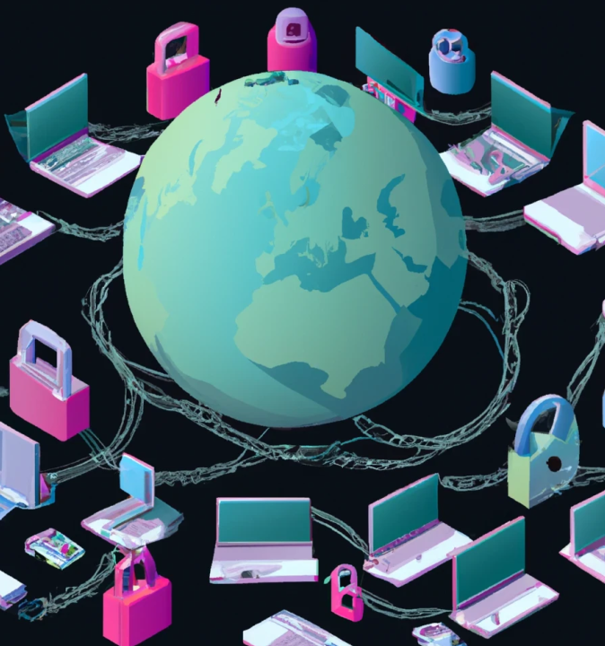
Future Trends and Emerging Threats
Artificial intelligence enhancing the sophistication of social engineering attacks globally
Deepfake technology enables more convincing impersonation attack scenarios daily
Remote work environments create new vulnerabilities for social engineers
Internet of Things expanding attack surface for social engineering
Social media integration increases opportunities for reconnaissance and targeting
Blockchain technologies introducing new social engineering attack vectors worldwide
Notes:
These emerging technologies will change the landscape of social engineering threats very fast. Artificial intelligence enhances the sophistication of the attacks, allowing highly personalized automated social engineering campaigns that were previously unimaginable at this scale. Advances in deepfake technology create highly plausible impersonation scenarios where traditional verification methods are no longer sufficient. Remote work environments introduce new vulnerabilities as traditional security boundaries blur between professional and personal spaces. The growth of the Internet of Things makes attack surfaces grow exponentially, offering new avenues through which social engineers can exploit interconnected systems. Integrating social media into daily life offers attackers unparalleled reconnaissance opportunities with new targeting vectors. While blockchain technologies lock down some aspects of digital interaction, they also introduce new vectors of social engineering attacks through cryptocurrency scams and smart contract exploits (Ivanov et al., 2021). This is why understanding such emerging threats is essential for proactive defense.

Slide 11

Building Societal Resilience
Developing cross-generational cybersecurity awareness programs in educational institutions today
Promoting cyber-hygiene practices through community outreach programs actively now
Creating public-private partnerships to share social engineering threat intelligence
Implementing behavioral science research in security awareness training programs
Establishing support systems for victims of social engineering attacks
Fostering international collaboration to combat evolving social engineering threats
Notes:
Building enduring societal resilience against social engineering requires complex approaches involving educational institutions and a variety of private and public organizations. The creation of cybersecurity awareness across generations should consider the technological literacy level and security perspectives people have across different age groups. Community outreach programs build cyber-hygiene practices across more people for broader awareness and defense capabilities than just inside the organizational boundaries (Odo, 2024). Public-private partnerships also share threat intelligence due to emerging social engineering tactics. It embeds the best behavioral science research in security awareness training to help drive program effectiveness with evidence-based approaches. In addition, support systems dealing with victims of social engineering attacks must question immediate recovery needs and long-term psychological impacts. With the transcendence of social engineering attacks beyond national boundaries, international collaboration cannot be further de-emphasized but is in great demand for coordinated response strategies and shared defense mechanisms.

Slide 12
References
Alabdan, R. (2020). Phishing Attacks Survey: Types, Vectors, and Technical Approaches. Future Internet, 12(10), 168. https://doi.org/10.3390/fi12100168
Ivanov, N., Lou, J., Chen, T., Li, J., & Yan, Q. (2021). Targeting the Weakest Link: Social Engineering Attacks in Ethereum Smart Contracts. Proceedings of the 2021 ACM Asia Conference on Computer and Communications Security, 787–801. https://doi.org/10.1145/3433210.3453085
Jesus, V., Bains, B., & Chang, V. (2023). Sharing Is Caring: Hurdles and Prospects of Open, Crowd-Sourced Cyber Threat Intelligence. IEEE Transactions on Engineering Management, 71, 6854–6873. https://doi.org/10.1109/tem.2023.3279274
Naqvi, B., Perova, K., Farooq, A., Makhdoom, I., Oyedeji, S., & Porras, J. (2023). Mitigation Strategies against the Phishing Attacks: A Systematic Literature Review. Computers & Security, 132, 103387. https://doi.org/10.1016/j.cose.2023.103387
Odo, C. (2024). Strengthening Cybersecurity Resilience: the Importance of Education, Training, and Risk Management. Social Science Research Network. https://doi.org/10.2139/ssrn.4779289
Steinmetz, K. F., Pimentel, A., & Goe, W. R. (2021). Performing social engineering: A qualitative study of information security deceptions. Computers in Human Behavior, 124, 106930. https://doi.org/10.1016/j.chb.2021.106930

