Slide 1
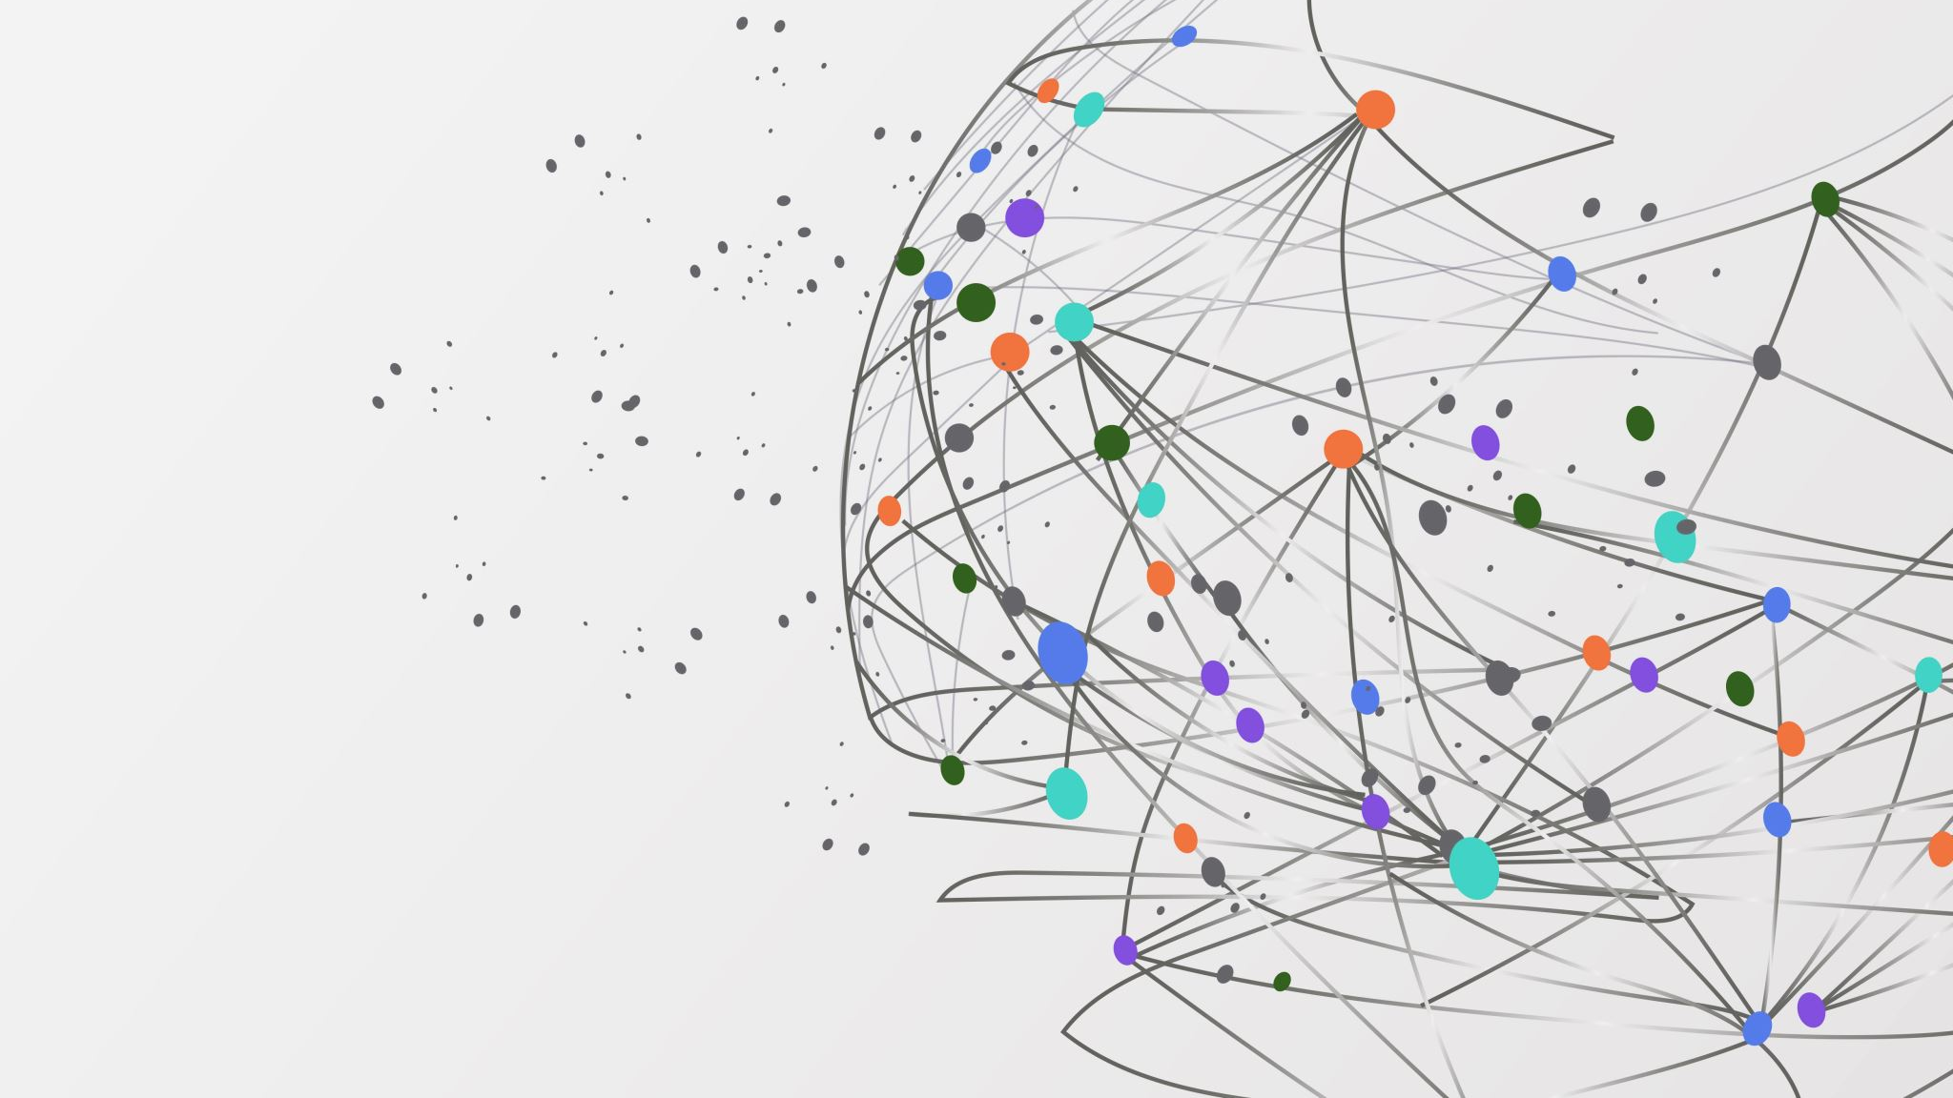
SCADA Systems
What is it and why we Need it

Slide 2
What is SCADA Systems?
It watches everything that happens in a process and sets off alarms if something breaks.
SCADA Systems is one Giant Monitor.

Slide 3
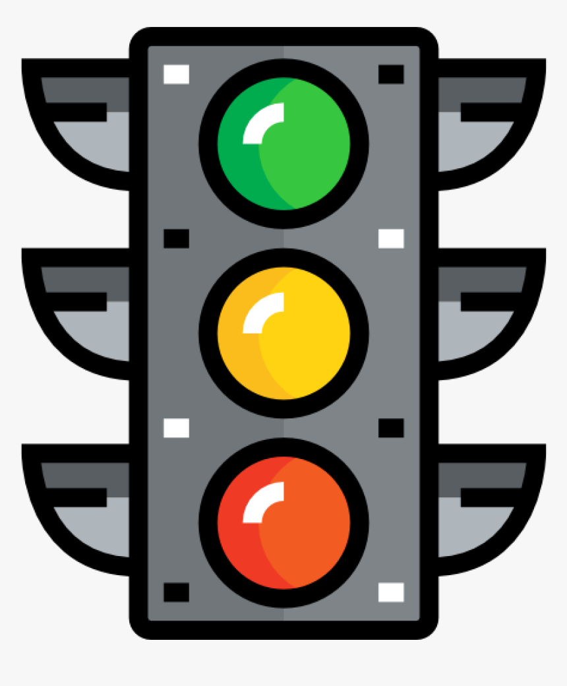
Where Are SCADA Systems Used?
Airports
Factories
Stop Lights

Slide 4
How is SCADA Systems used?
Places like Airports, Factories, and even Stop Lights, having a lot of parts and components to make sure they are operating effectively and efficiently.
SCADA Systems keeps an eye on every component apart of the overall system, and can fix what is broken, monitor toxicity levels, or alert workers to a problem.

Slide 5
How is SCADA Systems used?(Continued)
If a lightbulb should go out, a valve come loose, or a pipe lose pressure somewhere in the system, the worker at the main control desk would be immediately alerted as they monitor the system.

Slide 6
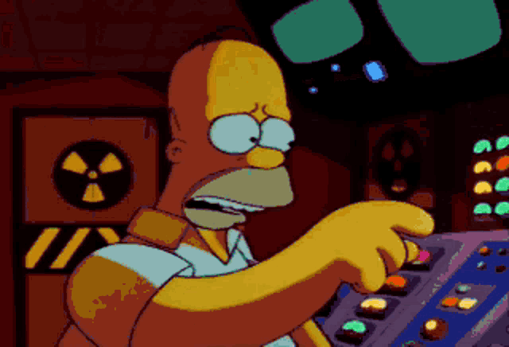
Why is Scada systems necessary?
Any problem is easily identifiable and can be quickly fixed before it costs money or causes damage. With SCADA Systems, it doesn’t have to be a guessing game.

