Slide 1
Database Project
Work done while Interning at NNS
Notes:
Hey everyone. Because I am not legally allowed to show the actual project I worked on while at the Newport News Shipyard, I decided to instead explain the principles of what I did, in a few short slides. In summary, I was tasked with making a Database that would combine multiple tables together that had already been created, pull information from the internet every month, refresh immediately upon opening, and could not repeat information. Throughout this presentation, I’ll explain the components that went into it and a little bit about how I did. Hope yall enjoy.

Slide 2
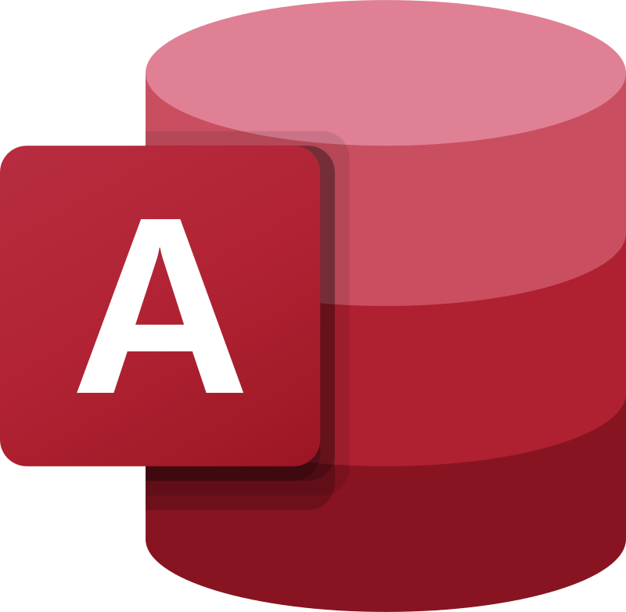
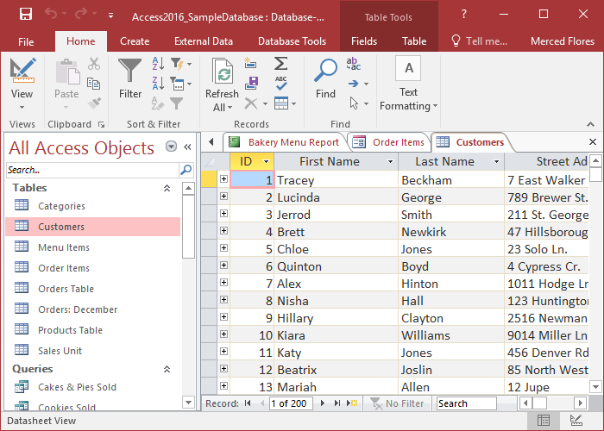
Microsoft access
Notes:
The database was built using Microsoft Access. Microsoft Access is a tool specially designed to make databases, that are able to hold specialized tables with specialized data. I created a table much like the one in the example and linked other tables to it. I did so in a way that did not allow the data to repeat itself, so that when the multiple tables I linked together become one giant table, there would be no overlapping or repeated data. The table was comprised of CVEs, descriptions of the CVEs, implanted fixes, and other such details. While combing the tables made one large database with plenty of information, the database needed to be updated frequently, which is where the RSA feeds come into play.

Slide 3
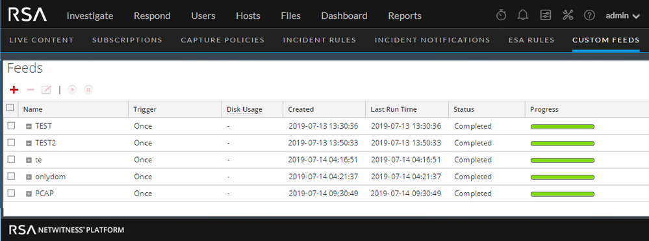
RSA Feed
Notes:
RSA feeds are automatically generated reports, or data, that can be sent to one's email. I was able to link an RSA feed with new CVE information directly to my table in the database. This way, every time a new report came out, the table was updated. I once again had to ensure that the new data did not repeat what was already in the table, and I had to make it, so the table was updated as soon as Microsoft Access was opened up. This way, the table is always fresh and new, and one does not have to manually enter in new data or manually refresh the feed or table.

Slide 4
CVE Database
Notes:
A CVE is a number and description given to recognized vulnerability and stored in the national CVE database. Every known vulnerability has a registered CVE number. These vulnerabilities are important, as many correlate to the machines and software used at the shipyard. Because of this, we had to keep an updated list of important CVEs at all time, and we needed to know which ones had been fixed and which ones were still open. I incorporated CVEs into the table, via RSA feeds and past data collected.

