Slide 1
Confucianism and Professional Ethics
Getting a better grasp on Case Analysis 4
Notes:
Hey everyone, I just wanted to make this short little slideshow, to better explain some concepts talked about in my Case Anyalsis 4, that you can find on my website. Hopefully this will provide you with a better understanding of the topics discussed in the paper, and will provide you with the tools to be successful. So, let’s jump right into it, and talk about the ACM code of ethics.

Slide 2
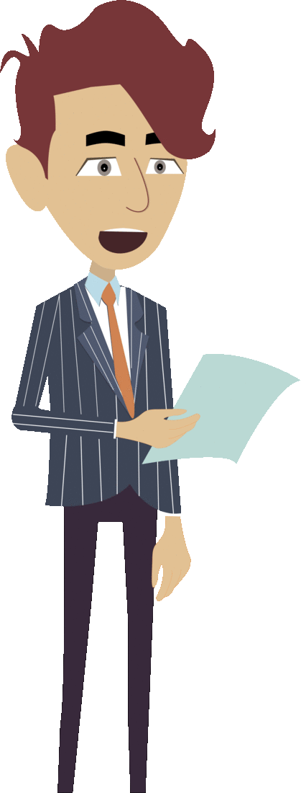
ACM’s code of Ethics
Notes:
So, you might be wondering, is there really an official agreed upon code of ethics? Well, yes and no. There are many established codes of ethics, such as the ACM code of ethics, but they’re not always agreed upon. I just want to discuss the main topic, and let you decide for your own if they are applicable. The main topic covered in the case analysis, is to be Honest and Trustworthy. I think we can all agree that those are two pretty important traits to have. If you are in the business world, your employer will respect you greatly, and your company will have a great reputation, if you make the decision to be honest and trustworthy. Sourour wrote some problematic code for the company he was working for, and I will let you decide if you think what he did was honest and trustowrhty.

Slide 3
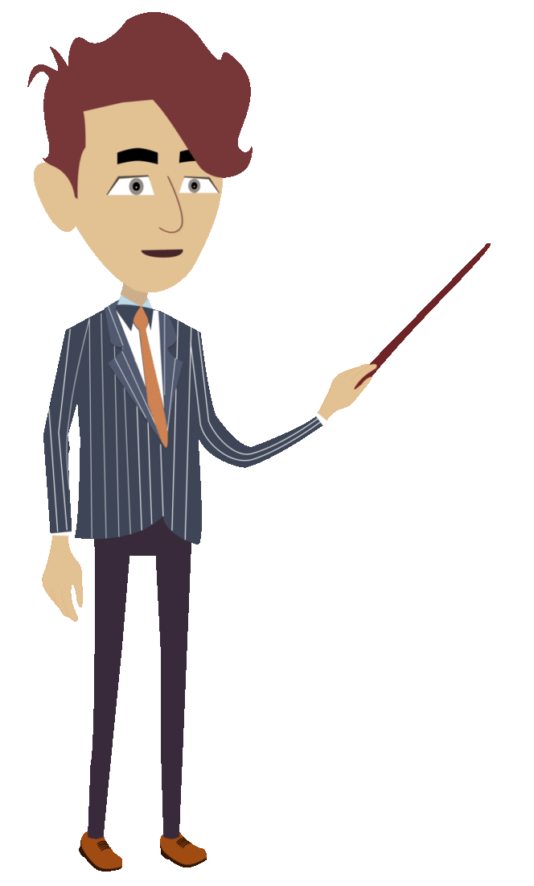
Confucianism and Roles
Notes:
Another big topic covered in the Case Analysis is Confucianism and roles. For example, if you are a son, your role is to respect your father. If you are an employee, your role is to do what you have told. We each have our own specific roles, and Confucius thought that the most important thing in a controversial situation, is if you play your roll well or not. This makes things a little sticky, trying to figure out if we think Sourour did the right thing or not.

Slide 4
Take Action, Speak Out – Armstrong
Notes:
Another important topic in the paper, is the thoughts of Armstrong. He believed that we should take action and speak out, when we are aware of something wrong. If you are a construction worker, and your boss asks you to put your stamp of approval on something you know is unsafe, Armstrong believes that you should instead take action and speak out because it might prevent others from being inured by the construction. Should Sourour have taken action and spoken out? I’ll let you decide when you read the paper.

Slide 5
Conclusion
Notes:
Now that you know more about the topics discussed in the paper, I think you are ready to tackle the case analysis and make your own judgements on whether Sourour was in the wrong or not. Regardless, we need to make sure that we operating in an ethical manner at work, you just have to decide whether your ethics comes from ACM and Armstrong, or from Confucius. Thanks for listening!

