Slide 1
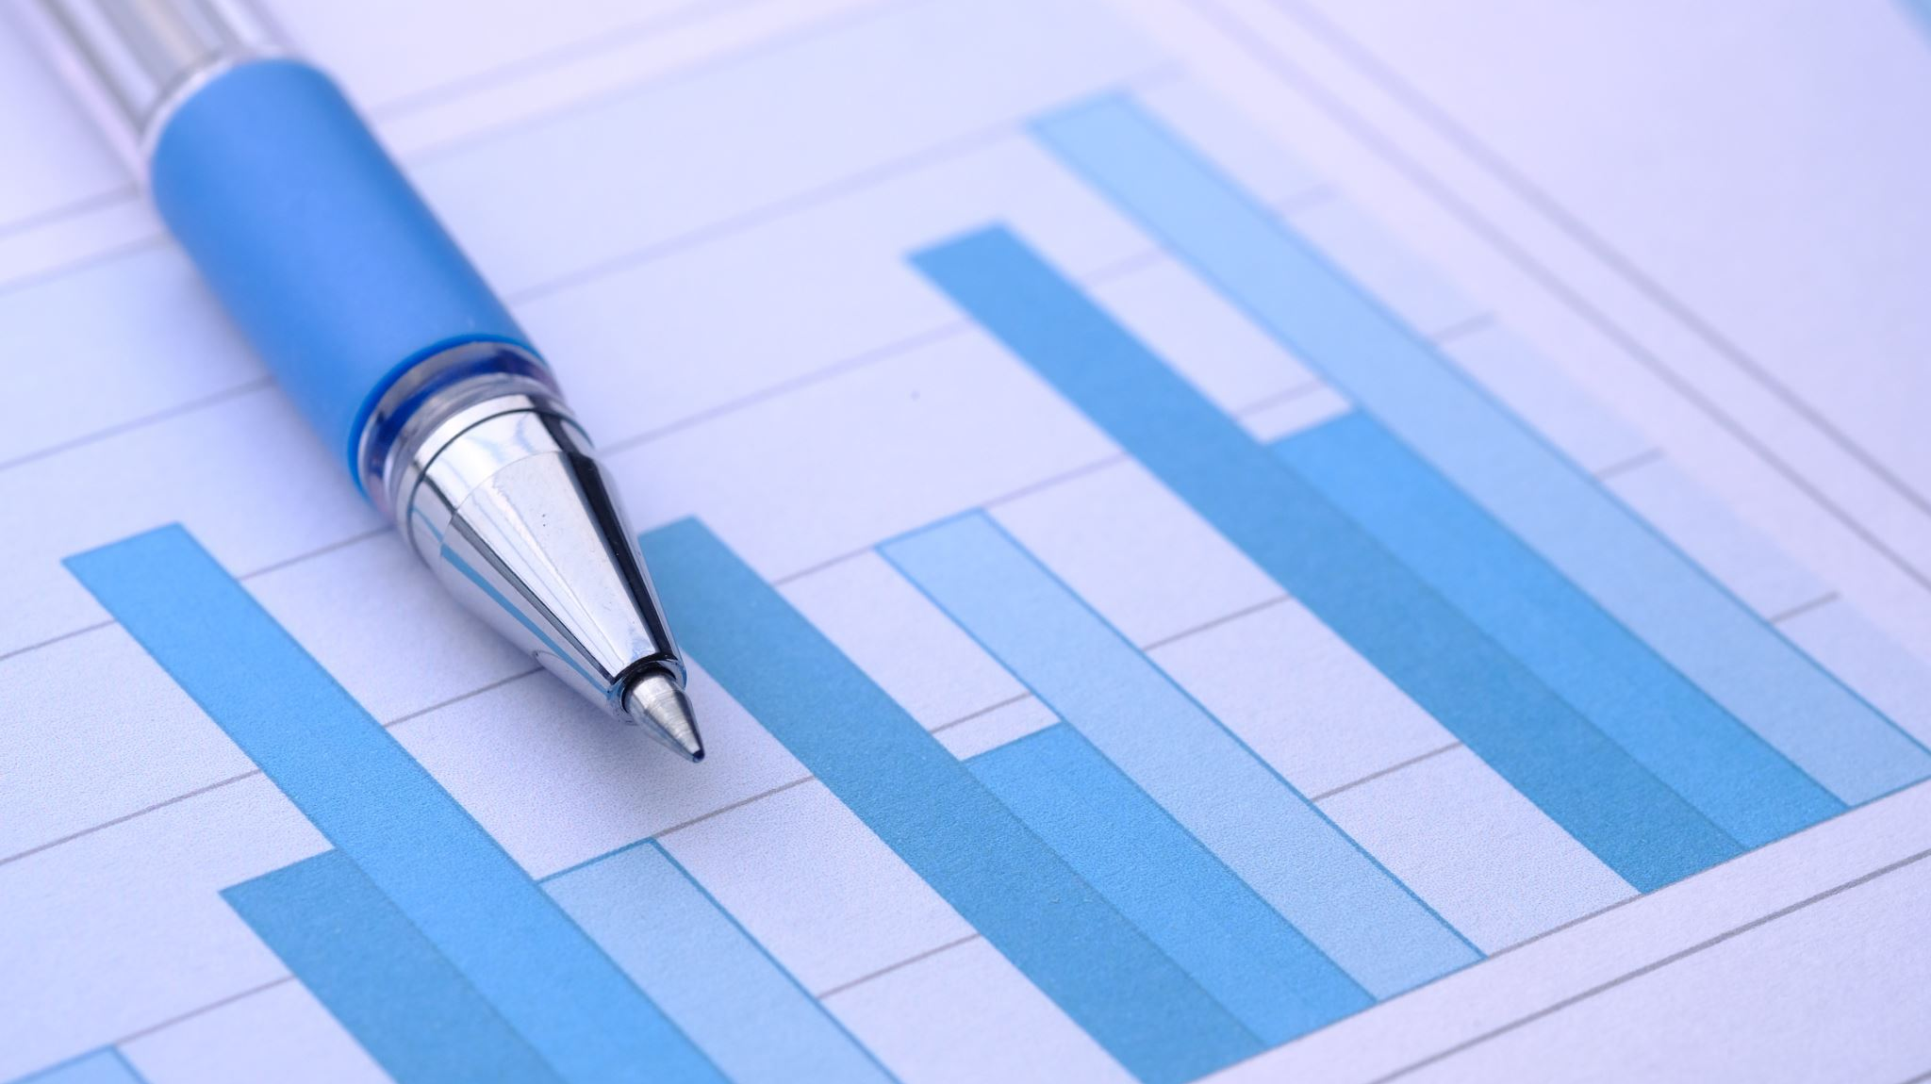
Case Analysis 3: Corporate Social Responsibility
Click to Advance
Society or the Employee?

Slide 2
Introduction
Equifax, a credit card reporting company, was breached and many of its users had their important and explicit data exposed. Those customers were then vulnerable to identity theft and their information being stolen and used by someone else. However, the company was late to report the breach, and then made the customers pay them money if they wanted to freeze their accounts, so that a hacker could not use it. Not only that, but the chief financial officer sold his stock before releasing a statement about the breach, and the customers were unable to contact anyone who was willing to help them. Now, the customers very sensitive data was breached, and their credit score could plummet, without them being able to do anything about it. In this Case Analysis I will argue that utilitarianism shows us that the Equifax breach harmed millions of users, by being slow to report the breach, being sloppy in preventing the breach, and doing little after the breach to help their users, and that was morally bad.

Slide 3
Social Responsibility – Friedman
The central concept I want to focus on from Friedman is the idea of “Social Responsibility”. This is a rather confusing and controversial term. The notion that a head of a company is socially responsible, means that many times, he is putting the best interest of the customer, employee, and stockholder last, even though his actions claim to be towards the betterment of all. He becomes a public citizen and focuses on the betterment of society as a whole, instead of working to making the company and those connected to it most profitable. This might mean choosing unskilled and untalented employees over talented and hardworking employees, just because the one doesn’t have a job, and thus will reduce poverty by being given a job. It seems like a good thing to do, but it’s not hard to see how choosing a less talented workforce will hurt a company. Secondly, the head of a company could become so focused on reducing pollution, that they turn to worse forms of energy production, that while cleaner, are much less effective and more expensive, which in turn will cause the price of their goods to go up, or their employee’s salaries to go down, all in the name of helping the environment. The executive is no longer serving in the best interests of the company and those attached to it, but they are focused on some noble act for society.

Slide 4
Equifax puts the company first
What the executives at Equifax did was in a way the opposite of social responsibility. They put the company’s interest first, before the interest of millions of users and banks. They were seemingly purposefully lackadaisical about their security measures around sensitive data, which allowed them to make enormous sums of money off of users having to pay to freeze their accounts after the breach. The chief financial officer sold stock before releasing news about the breach, which saved him money, at the expense of the money of the company’s users. Lastly, they gave little to no support to the customers whose data had been hacked, and the banks continued giving customers data to Equifax, even after the breach. Equifax profited, banks carried on as usual, while customers and users paid the price. This seems to be the opposite of social responsibility, and rather corporate greed and a disdain for others. While one cannot solely focus on the need of society at the expense of the company, one also cannot solely focus on the betterment of the company at the cost of its users and customers.

Slide 5
Utilitarian correlation with Social Responsibility
The utilitarian action would have actually been the socially responsible action in this case. A utilitarian would argue for the decision to bring the most joy and benefit to the most amount of people. The executives at Equifax focused on themselves. They neglected the safety of its users, the well being of its users, and the needs and complaints of its users, while actively charging them money for security. Due to these decisions, thousands if not millions of customers were wronged and badly affected. This might have caused more poverty, more stress, more homelessness, more wealth inequality, and more distrust in corporations. This was clearly not the socially responsible action and not a utilitarian decision at all, as it only benefited the few elites, at the expense of the innocent masses.

Slide 6
Social Contract – Anshen
A central concept from Anshen, is the idea of the social contract. While Anshen did not originate this idea, he goes into great detail explaining it. The social concept is basically agreed upon norms and either explicit or implicit standards by which every member of a society agrees to. These norms are agreed upon for the betterment of society as a whole. Also, many proponents of the social contract would argue that men can be brutish, and rash left to their own devices, so there must be a set of standards in a society to keep such men from committing acts of anarchy and to keep society as a whole together. In American, parts of the social contract include the agreeance not to hurt or kill anyone. Anyone who does these things is then taken out of society. An example of an implicit rule of the social contract in America is the expectation that someone will chew with their mouth closes, raise their hand if they have a question, and will not walk in front of a camera if someone is taking a picture. If these specific social norms are broken, there is no legal penalty, but there will be social penalties. The most important thing about the social contract, is that you must agree with it if you want to live and function in society and be accepted by those around you. If not, you are deemed weird, strange, rude, or could even face legal trouble, based on what rule you broke. This in theory, is in the best interest of everyone and society as a whole.

Slide 7
Equifax breaks the Social Contract
Equifax broke the social contract. They were dishonest, untrustworthy, unreachable, and acted in corrupt ways which only benefited themselves. They were not thinking about society as a whole, they only had themselves in mind. What’s more, the executives at Equifax didn’t even have their employees in mind. The employees were the ones being contacted, yelled at, and blamed, and the executives remained unreachable. They created mistrust, they allowed a mass security breach, and they basically forced users to pay them money to protect their own data which should’ve already been protected. All of these actions broke the social contract, as they did not do the socially responsible thing. Due to this, there were social and even legal ramifications. These ramifications are put in place to prevent such actions from happening.

Slide 8
The Social Contract, a Utilitarian concept
The social contract is a utilitarian concept. Each decision made should benefit the most people. The social contract demands that each person within a society act and live a certain way, to keep society intact and to keep it from falling to anarchy. Equifax did not follow the social contract. They worked in their own best interest, which is not necessarily evil. However, in doing so, they actively hurt more people than they helped, they reduced security for all, safety for all, and increased fear. All of this just because they weren’t willing to increase security, and to save money for themselves. This disdain for the social contract, is a perfect example of why people argue in favor of utilitarianism. If decisions had been made based off of what was most beneficial for the most people, this crisis might not have happened. However, due to their disdain of the social contract and the lives of others, they made morally bad decisions, hurting most people involved

Slide 9
Conclusion
Overall, after looking at Equifax’s actions, their disdain for social responsibility, their breaking of the social contract, and their refusal to make even the slightest utilitarian decision, it is clear to see they made the morally wrong decision. However, that doesn’t mean that the decision was necessarily a bad decision for the company. They saved a lot of money, in fact they made a lot of money, and were able to continue doing business with banks, and remain a superpower in the industry because of their selfish decisions. It is hard to argue that these decisions were moral or good, however, it is easy to see why they would make those decisions. Businesses are in the business of making money, so they did what they could to make money in the face of a crisis which could have potentially cost them a lot. Still, if there is a business that is focused on trust from the community it works with, then a crisis like this should’ve been handled much differently, in order to ensure future users and future profits. It was a very one dimensional, nearsighted decision, that was morally wrong any way you look at it.

