Slide 1
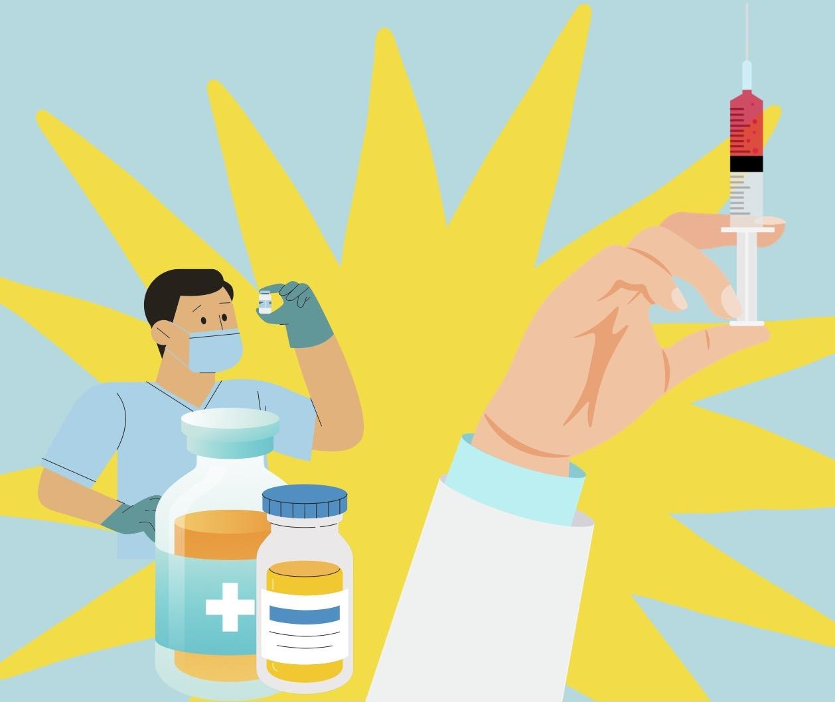
Vaccines:
Impact & Influence

Slide 2

Welcome to the Lesson
We’re a collection of ODU students from various backgrounds. Today we’ll be teaching you all about viruses!!
Notes:
Kahoot.it
Note Sheet

Slide 3

Where do Vaccines Come From?
Presented by:
Savannah

Slide 4
Keyword
Edward Jenner

Slide 5
Information
China 1000 CE
Practiced in China, Turkey, Egypt
Influential Leaders
  Edward Jenner (Founder of Vaccinology)
  Louis Pasteur
Notable Vaccines: Chicken Pox, Hepatitis, Tdap, Meningitis, HPV
Notes:
Evidence supports smallpox inoculation as early as 1000 CE in China, but was found to be practiced in other regions including Turkey and regions in Africa
Edward Jenner is considered the founder of vaccinology in the West in 1796, after he inoculated a 13 year-old-boy with cowpox, and it demonstrated immunity to smallpox. In 1798, the first smallpox vaccine was developed. Over the 18th and 19th centuries, systematic implementation of mass smallpox immunisation led to its global eradication in 1979.
In 1885 Louis Pasteur contributed to science by making the rabies vaccine which set off many more vaccines to be discovered including those for diphtheria, tetanus, anthrax, cholera, plague, typhoid, tuberculosis, and more were developed through the 1930s.
The mid 1900’s was a very innovative period of vaccine development due to scientific and technological advances. Vaccines for polio were developed as well as other common childhood diseases like measles, mumps, and rubella.
Some other notable vaccines which became available in the late 1900’s to early 2000’s include the chickenpox vaccine, hepatitis vaccines, the Tdap vaccine, meningitis vaccine, and the HPV vaccine.
And finally, the vaccine of the hottest topic currently is the mRNA vaccine which came out in December of 2020 to combat the respiratory disease COVID-19.

Slide 6

How Do They Work?
Presented by:
Mackenzie

Slide 7
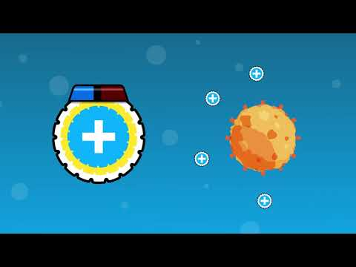

Slide 8
Keyword
Immunity, Antigen

Slide 9
Information
Protectors in the body
Antigen: Create immunity in the body
Immunity: Prepare the body for exposure without getting sick
Mouth, Needles, and Nasal Spray
Notes:
What are vaccines?
In simple terms, vaccines are protectors in the body, and they form specific immunity to certain diseases. Immunity means that once the product is injected into the body, you can be exposed to that sickness without getting sick.
There are a few different ways a vaccine can be introduced into the body, the most common is through a needle. Through the naval cavity but spraying is a second way and then a lesser common tactic is by the mouth.
More specifically, vaccines are usually made from lesser amounts of dead germs that cause the disease that is being vaccinated against.
Biological defense in body
How vaccines work in the body
Again, to put it simply vaccines are made to create immunity in the body against a specific antigen. (an antigen is a fancy term to describe a foreign object entering the body; something that causes an immune response)
Vaccines introduce a harmless version of a dangerous germ into the body, which then causes the body to react in a way that will give immunity. The body senses that it needs to fight off that germ, and then it remembers that germ in the future to continue to fight against it

Slide 10
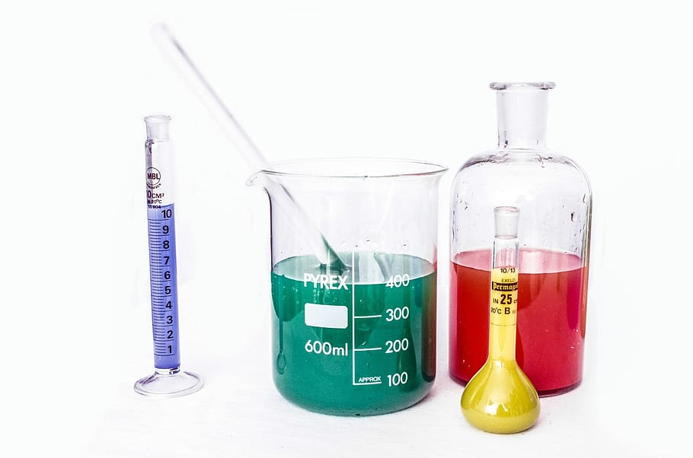


There are Different
Types?
Presented by:
Sarah

Slide 11
Keyword
Pathogen, mRNA Vaccine

Slide 12
Information
Pathogen: a microorganism, virus, or bacteria that has potential to cause disease
Live: Weakened state (Chickenpox)
Inactivated: Pathogen Killed/Series Vaccinations (Rabies)
mRNA: No actual pathogen/No risk to become infected by vaccine (Covid-19)
Notes:
Much like the name implies, a live virus vaccine is created by using the actual live virus itself, but in a weakened state. This weakened state decreases its virulence, and in turn, prevents the virus from actually causing harm to the patient being given the vaccine. However, it is important to note that it is not typically recommended for pregnant women, or those with compromised immune systems to receive a live virus vaccine. An example of this type of vaccine is the Chickenpox vaccine.
Inactivated vaccines are much alike the live vaccine, in regards to the real pathogen being used in it, however, in an inactivated form, the pathogen is killed, and so it tends to be a safer option in many cases. Inactivated vaccines don’t generally work to the same extent as live vaccines do, and so, multiple boosters may be required in order to receive its full immunity. An example of this is the Rabies vaccine.
mRNA vaccines are a fairly new, yet increasingly popular type of vaccine due to Covid-19. mRNA vaccines are made of proteins which, to your immune system, resembles the actual virus. This allows the vaccine to be effective against the virus without actually needing to contain it. One benefit to this particular type of vaccine is that because it does not contain any actual pathogen, there is no associated risk of becoming infected due to the vaccine itself. As stated previously, the covid-19 vaccine is a type of mRNA vaccine.

Slide 13
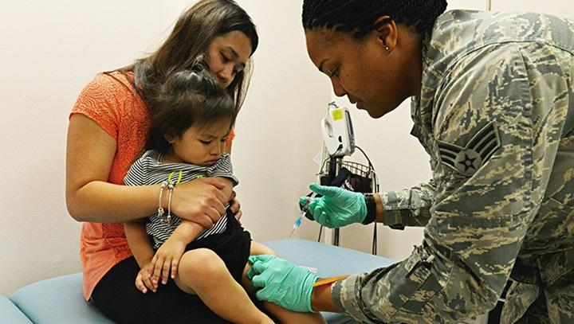


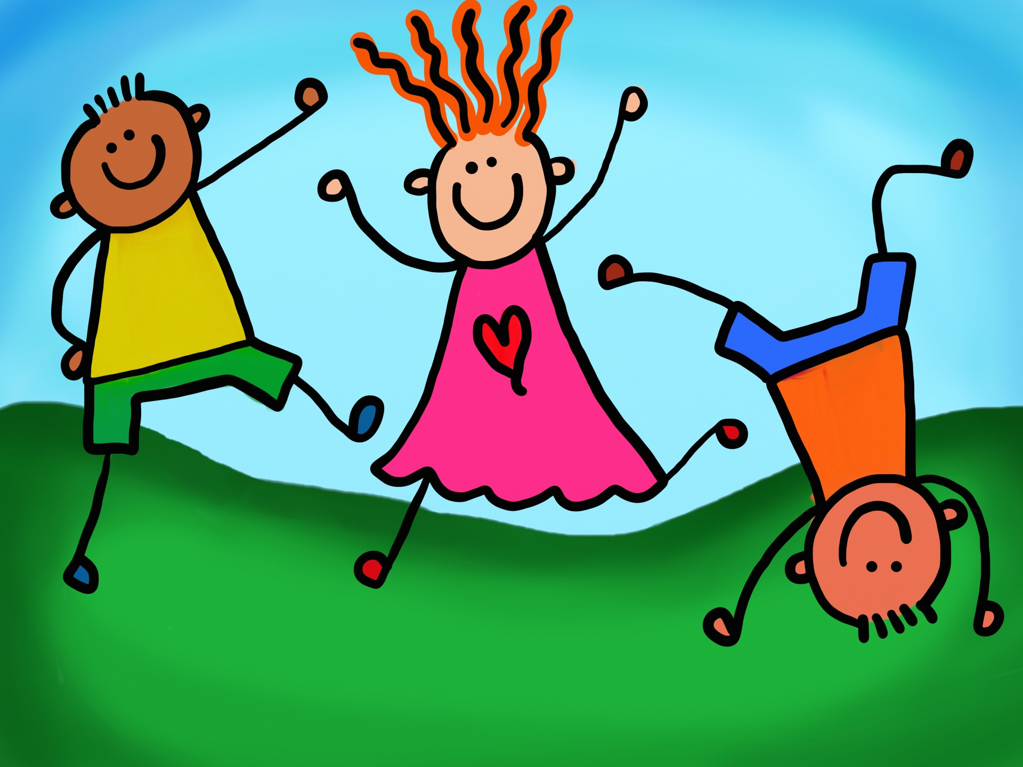
When Should We Get Them?
Presented By:
Annika

Slide 14
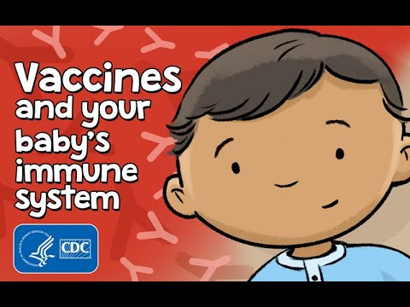

Slide 15
Information
Protect child from deadly diseases
Polio
Milk is to the bones as vaccines are to baby immune systems
Notes:
Importance of getting them as babies
Protects children from deadly diseases
At birth and the future
Example: polio
Protects children as well as anyone around the children
Children are susceptible to diseases at a young age
Failure to vaccinate your baby can put them at risk
A baby’s immune system is weak and the vaccines help strengthen them
They handle most germs but can’t handle the deadly diseases
Vaccines allow the baby’s immune system to recognize and fight diseases
Small amounts of antigens are in the vaccines to assist with this

Slide 16

What happens if we don’t get them?
Presented By:
Shannon

Slide 17
Keywords
Measles, Pertussis

Slide 18
Information
2014: 667 measles cases in 27 U.S. States
Over 50% of cases occurred among unvaccinated individuals
Pertussis: Whooping Cough
Notes:
Effect of not vaccinating
The US has experienced 667 measles case from 27 states in 2014 which was the highest number of cases since the eradication of the disease in 2000. This was due to vaccine refusal.
Over ½ of cases of measle outbreaks occurred among unvaccinated individuals. Most of these cases had nonmedical exemptions
Herd immunity is important because some vaccines may have greater immunization effects in some individuals than others. Having a well immunized community protects the less protected individuals as well as the individuals who cannot get vaccinated for medical issues.
The third elimination effort of measles was started in the 1990s and included the formal second dose of the vaccination. This reduced the case in the United States to less than 1 case/ 1 million population. Since then, there have been. Number of measles cases in the United States. Importation related cases in 2014 totaled fewer than 250 cases out of the 668 reported cases that year. This totaled 23 outbreaks
Pertussis (whooping cough) has held a steady increase in cases with an interval like the prevaccine era

Slide 19

Possible Complications?
Presented By:
Shelby

Slide 20
Keyword
Idiopathic Thrombocytopenic Purpura

Slide 21
Information
Minor: Pain, Redness & Swelling at the injection site, Fever, Malaise, Headache
Severe: Anaphylaxis, Idiopathic thrombocytopenic purpura, Narcolepsy
Idiopathic thrombocytopenic purpura: Measles/Autoimmune condition (1/24,000 doses)
Notes:
Side effects/ health effects
Common side effects
A new vaccine normally requires safety studies involving thousands of individuals. Most side effects are common and very well known.
Common side effects include:
Pain, redness and swelling are injections site
Fever
Malaise
Feeling of discomfort, illness, or uneasiness
Headache
Most common side effects subside within the first couple of days after vaccination.
Most side effects reflect the development of vaccine-induced protection.
Rare side effects
Severe side effects are rare
Anaphylaxis (Fewer than one in a million doses)
Potentially life-threatening reaction to an allergen
Individuals with known allergies should avoid vaccines that may have those products left over from the production period.
Cannot predict this side effect but can be managed if the vaccine is administered by a trained health professional.
Idiopathic thrombocytopenic purpura (1 in 24,000 doses)
Autoimmune condition characterized by low levels of platelets in the blood
This side effects comes from the measles vaccination
Narcolepsy
Rare common sleep disorder characterized by extreme sleepiness during the day and sudden sleep attacks.
From 1 in 55,000 to 1 in 16,000 recipients of an AS03-adjuvanted 2009 pandemic H1N1 influenza vaccine
There is debate whether the trigger was the vaccine, the adjuvant or some combination or ever the circulating virus

Slide 22
Present Day Applications
Presented by: Makayla

Slide 23
Keywords
Pandemic

Slide 24
Information
Overall attack rate
  9% to 4.6%
Non-ICU hospitalization decreased by 63.5%
ICU hospitalization were reduced by 65.6%
Deaths by 69.3%
Only 40 % of the population is vaccinated
Notes:
After a 2 -dose COVID vaccine
Overall attack rates (%age of an at-risk population that gets the disease) was reduced from 9% to 4.6% in the unvaccinated
Non ICU hospitalization were reduced by 63.5%; ICU hospitalizations by 65.6%, and deaths by 69.3%
The faster everyone gets vaccinated, the less likely a resistant strain will be formed (Which is part of the reason why there’s some new strands forming; total of 6 variants {Alpha, Beta, Gamma, Delta, Lambda, and Mu})
Issue because as new strands form, the vaccine may become less effective because, like all vaccines, they aren’t 100% effective and it could form a ‘superbug’

Slide 25
“Everything is theoretically impossible, until it is done”
-Robert A. Heinlein

Slide 26
Any
Questions?

Slide 27
Sources: Websites and Citations
https://www.immune.org.nz/vaccines/vaccine-development/brief-history-vaccination
https://www.cdc.gov/vaccines/vpd/varicella/public/index.html
https://www.historyofvaccines.org/timeline/all
https://www.immunize.org/catg.d/p4205.pdf
https://www.cdc.gov/mmwr/preview/mmwrhtml/rr5517a1.htm
https://labblog.uofmhealth.org/body-work/new-study-emphasizes-harm-of-vaccine-refusals
https://www.ncbi.nlm.nih.gov/pmc/articles/PMC5007135/
  Office of Infectious Disease and HIV/AIDS Policy (OIDP). (2021, May 4). Vaccine types. HHS.gov. Retrieved October 14, 2021, from https://www.hhs.gov/immunization/basics/types/index.html.
  Live Virus Vaccine. National Cancer Institute. (n.d.). Retrieved October 14, 2021, from https://www.cancer.gov/publications/dictionaries/cancer-terms/def/live-virus-vaccine.
  Pollard, A.J., Bijker, E.M. A guide to vaccinology: from basic principles to new developments. Nat Rev Immunol 21, 83–100 (2021). https://doi.org/10.1038/s41577-020-00479-7

