Slide 1
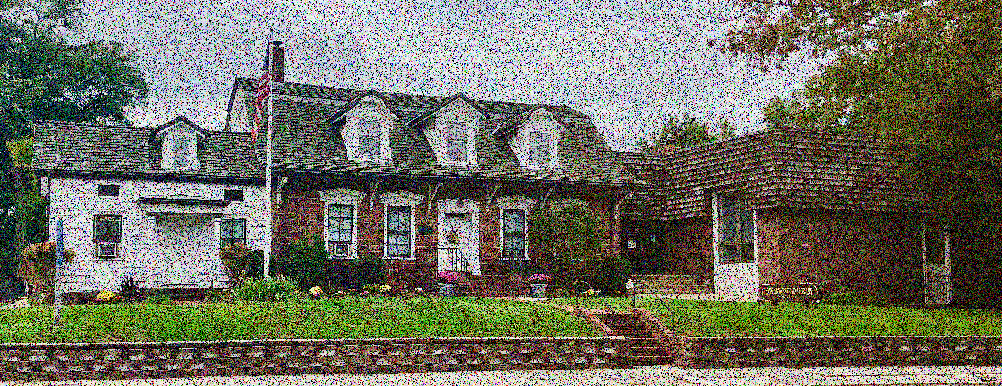

Library Visit #2
The Exterior Experience
A look at a historic building,
converted into a library
Old Dominion University | LIBS 608: Foundations of Library & Information Science
Dr. Dawn Betts-Green | October 8, 2021| Christen Governale

Slide 2
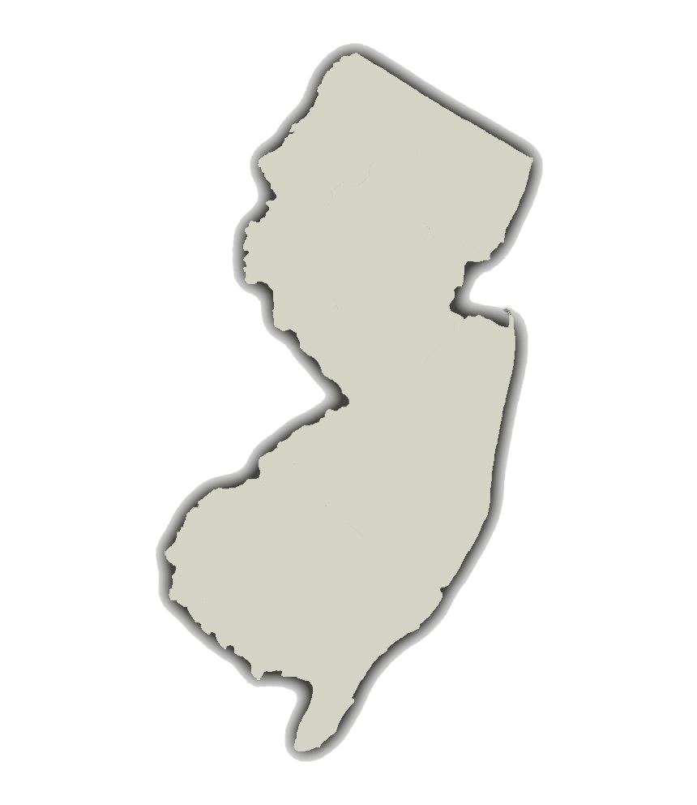
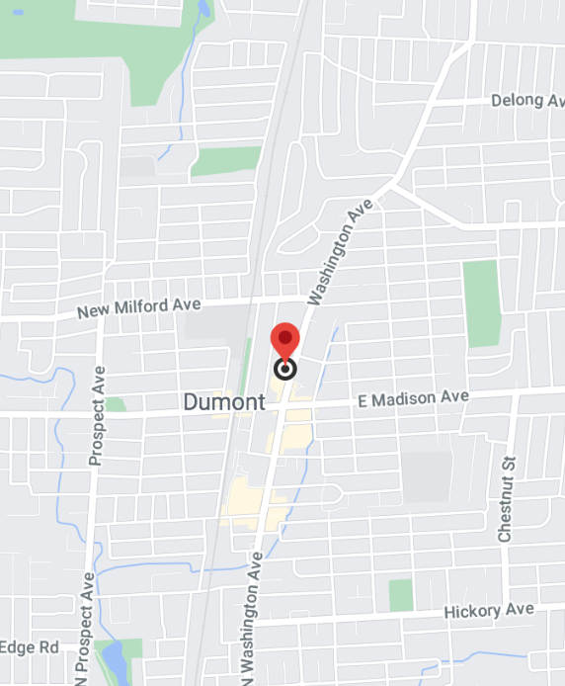
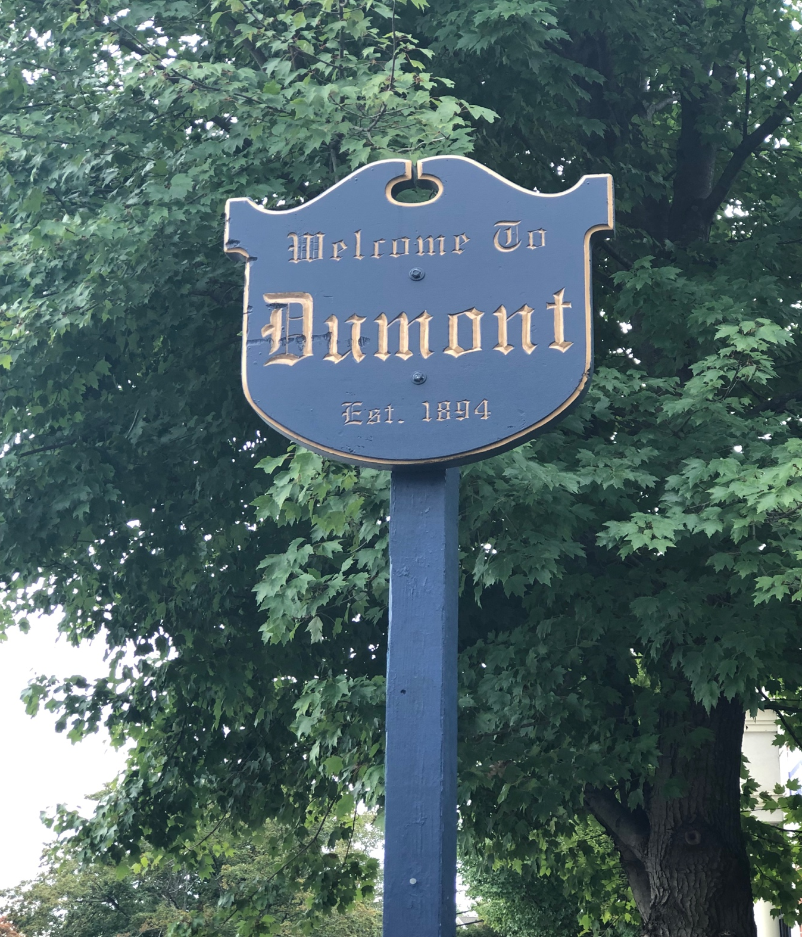
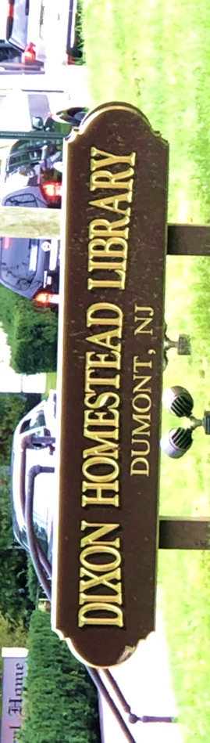
Location of Dixon Homestead Library in Dumont, NJ
This Photo by Uknown Author is licensed under CC BY-NC

Slide 3
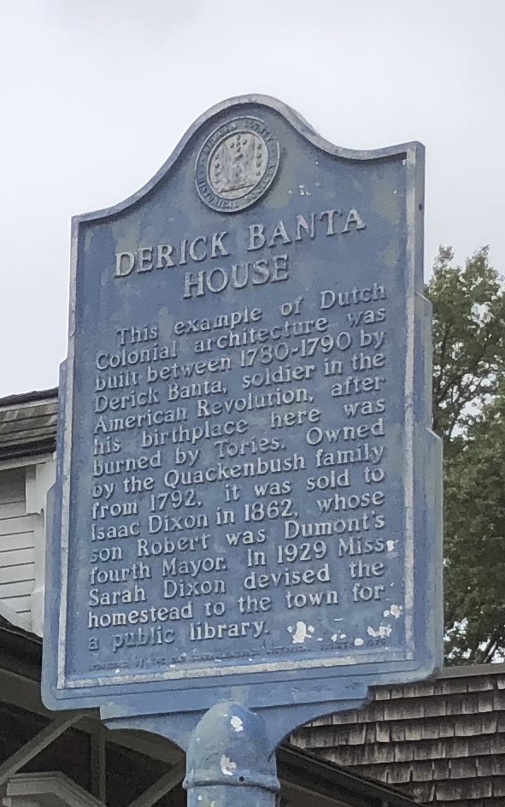
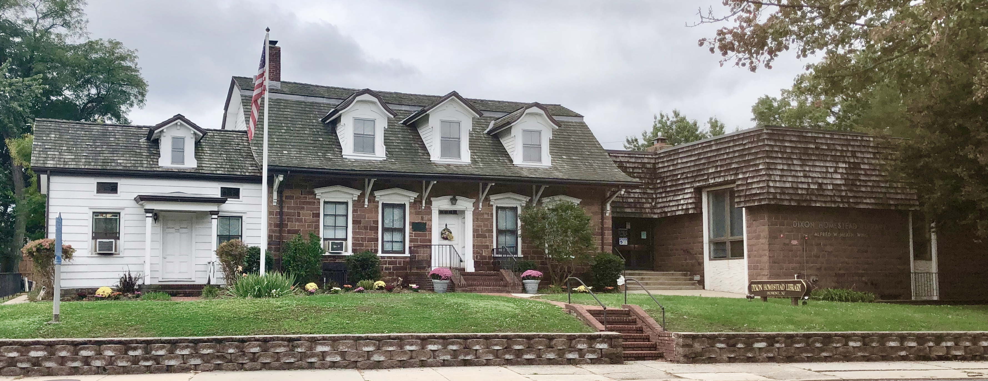
Historical Uniqueness of Dixon Homestead Library

Slide 4
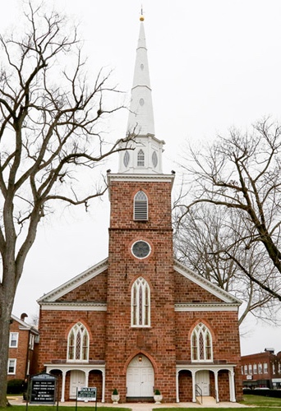
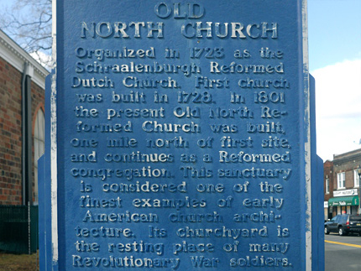
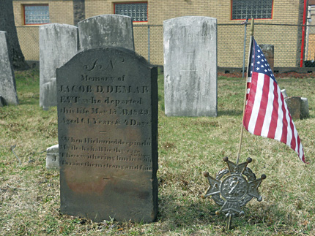
Other Local Points of Interest in Dumont
The Old North Church

Slide 5
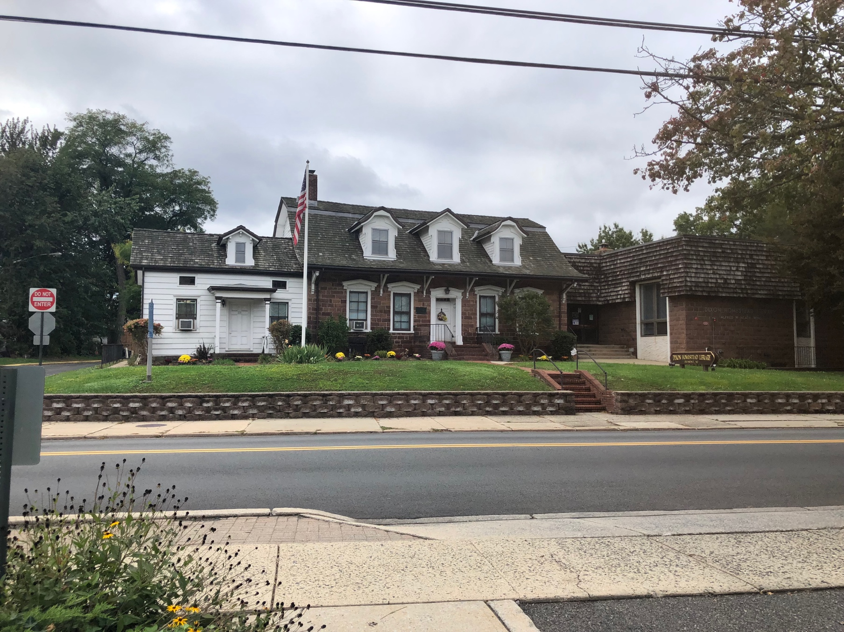
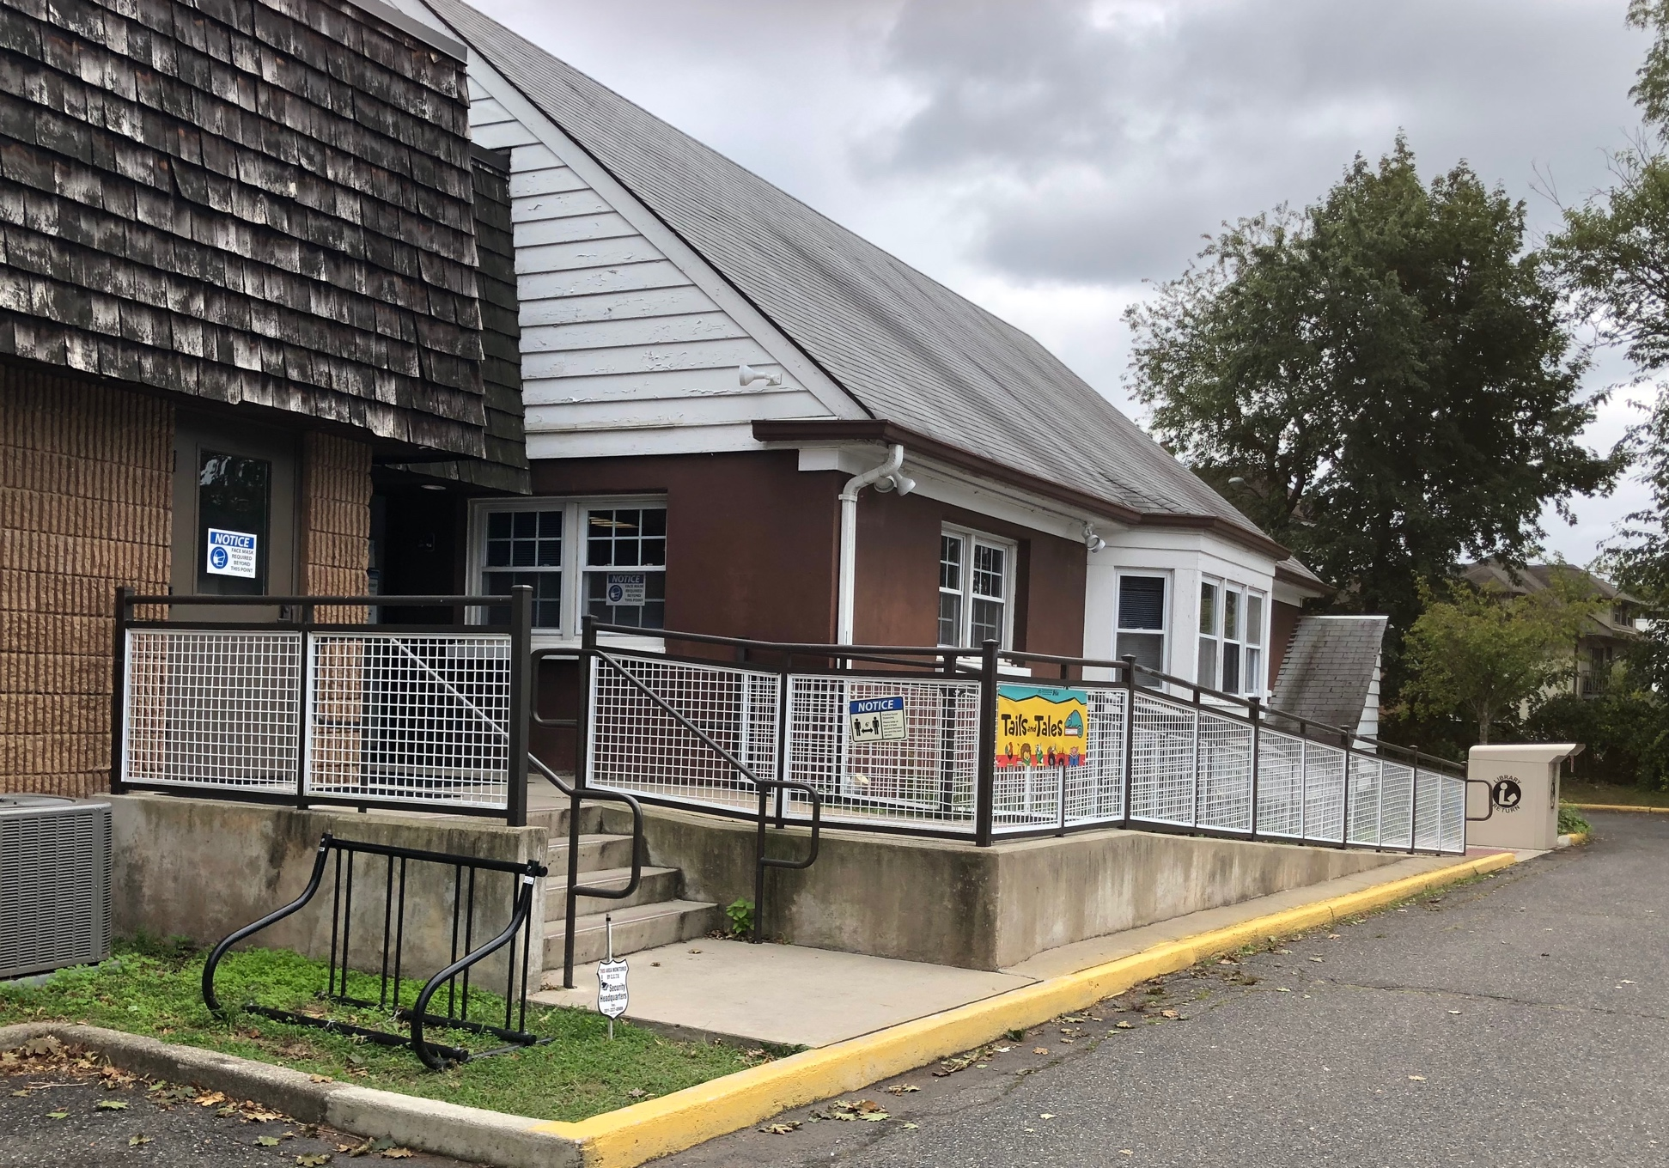
Dixon Homestead Library Exterior Building
FRONT ADDITION
BACK ADDITION

Slide 6

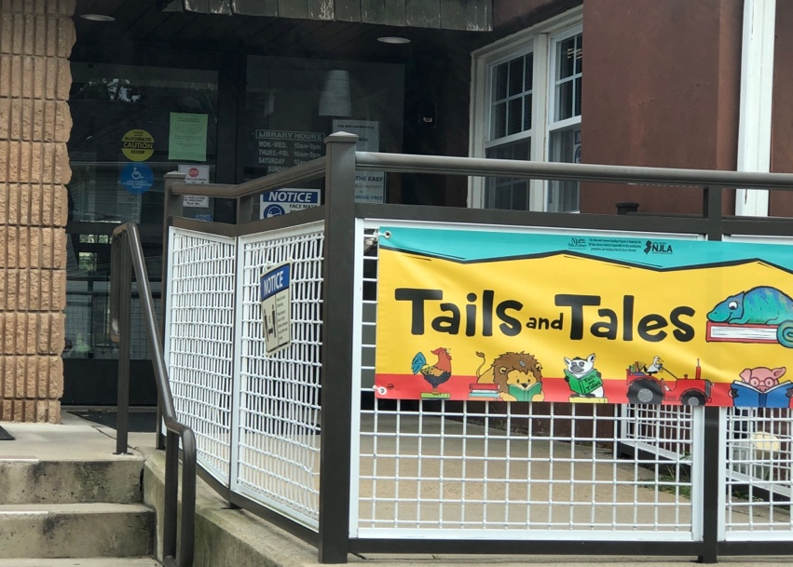
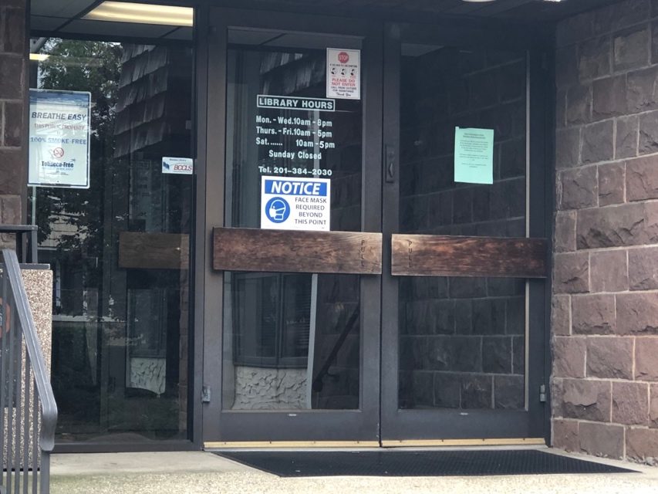
Bird’s Eye View and Main Entrances
Back Door – stair/ramp access
Dixon Homestead
Library Building
Front Door - stair access
Street to stairs access
EXIT
ENTER
Washington Ave

Slide 7
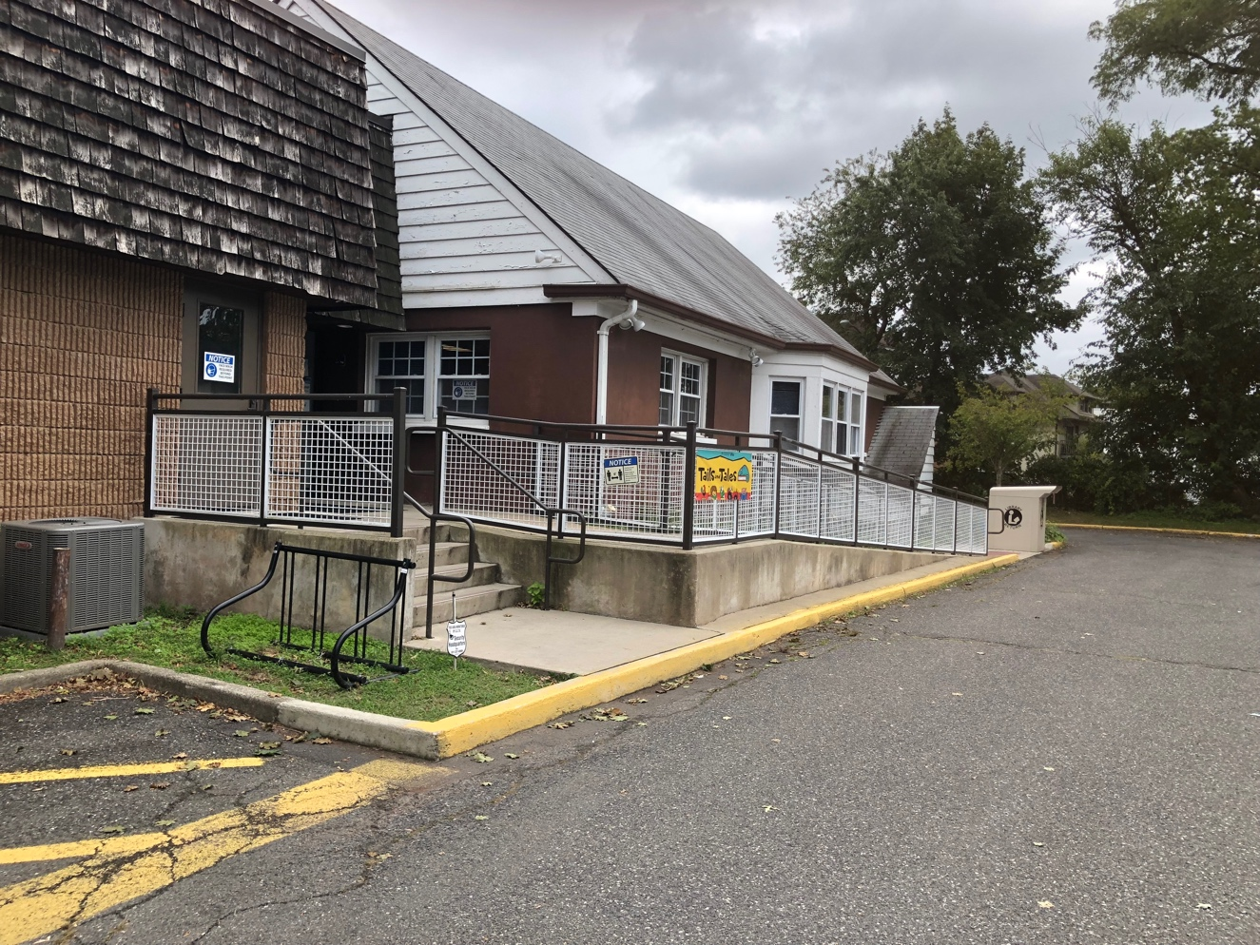
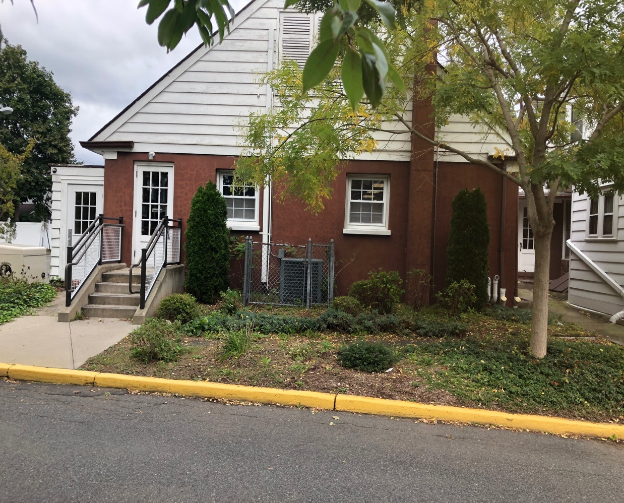
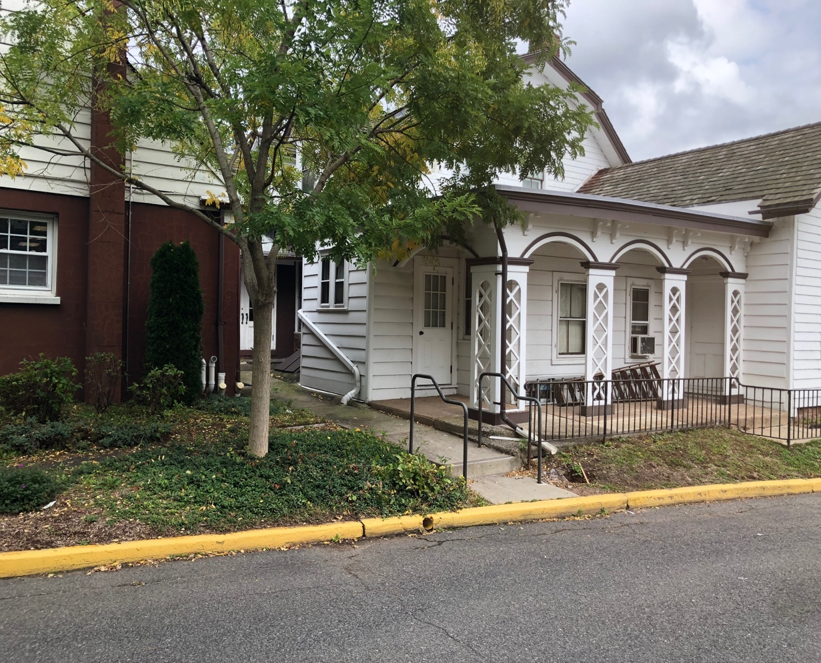
So Many Doors to the Library - 12!
2 main doors
10 other doors

Slide 8
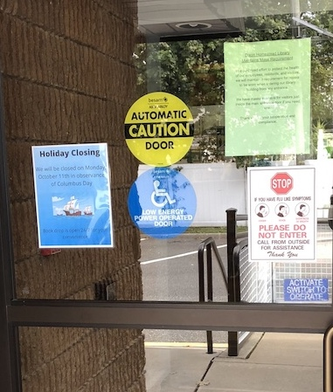
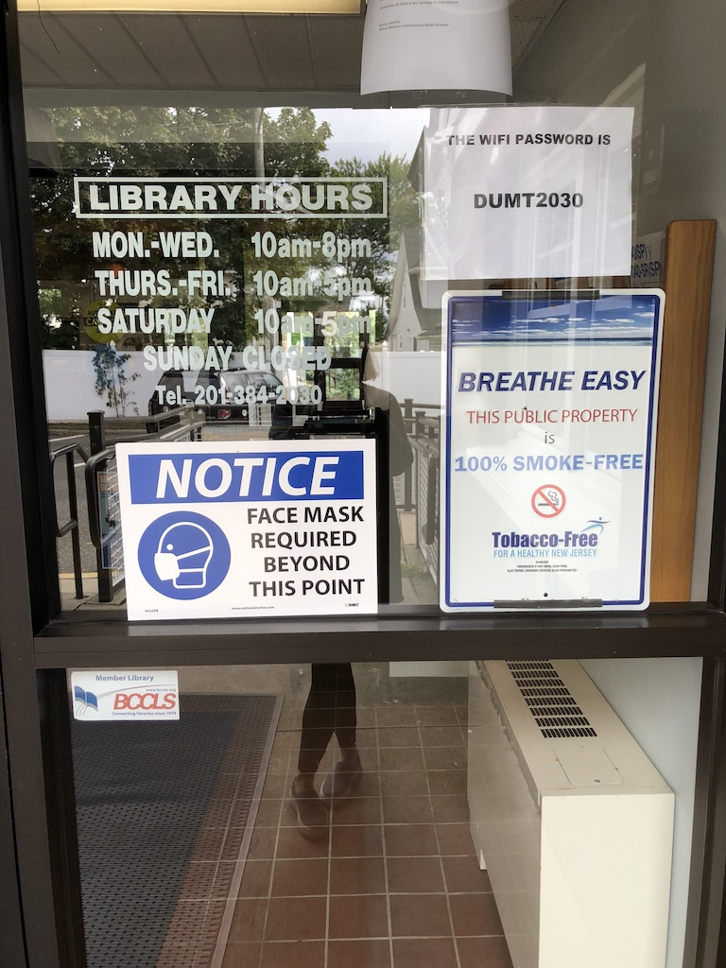
Signs, Signs, Everywhere!

Slide 9
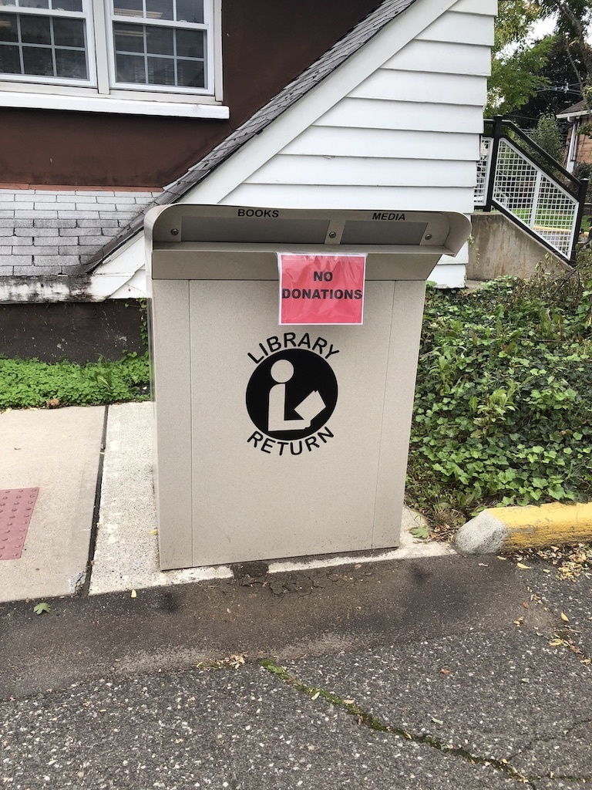
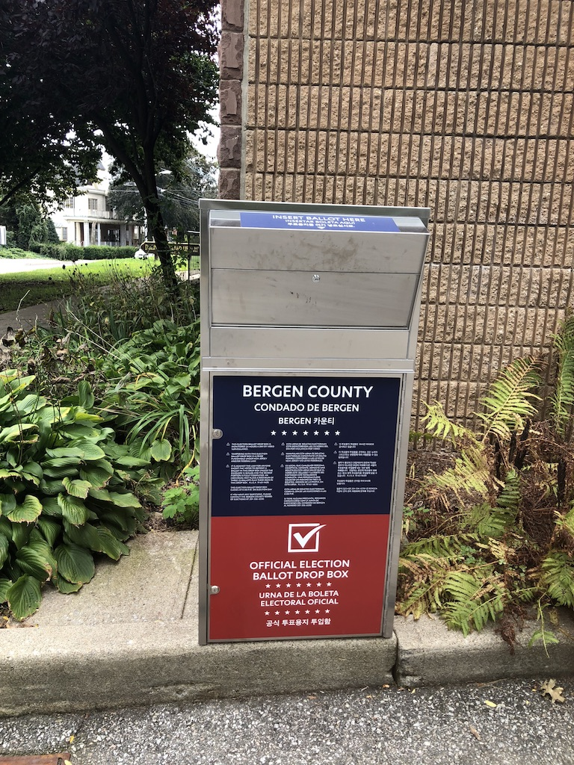
Drop Boxes- Book and Ballot

Slide 10
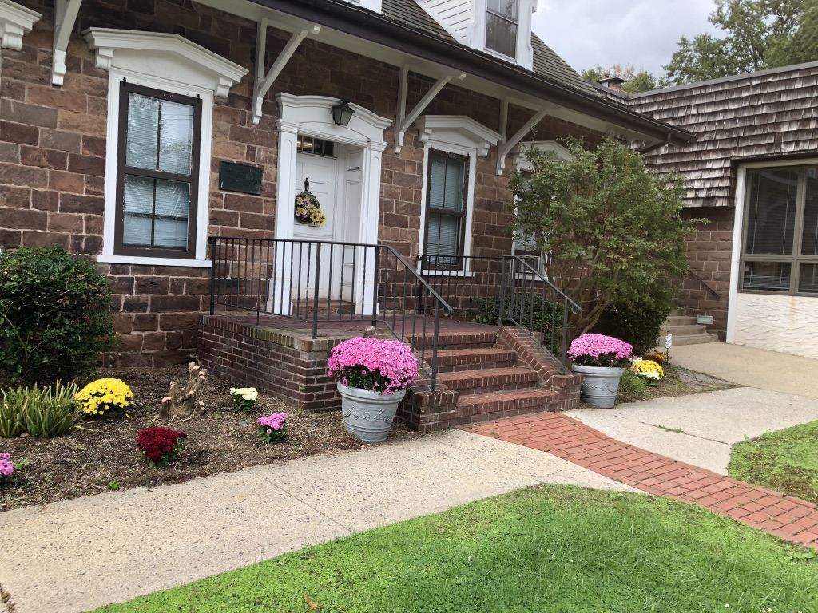
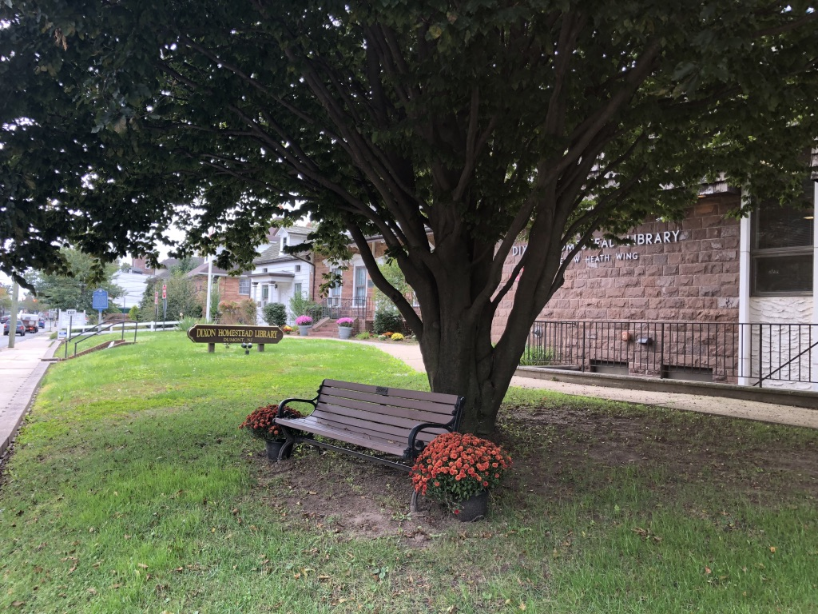
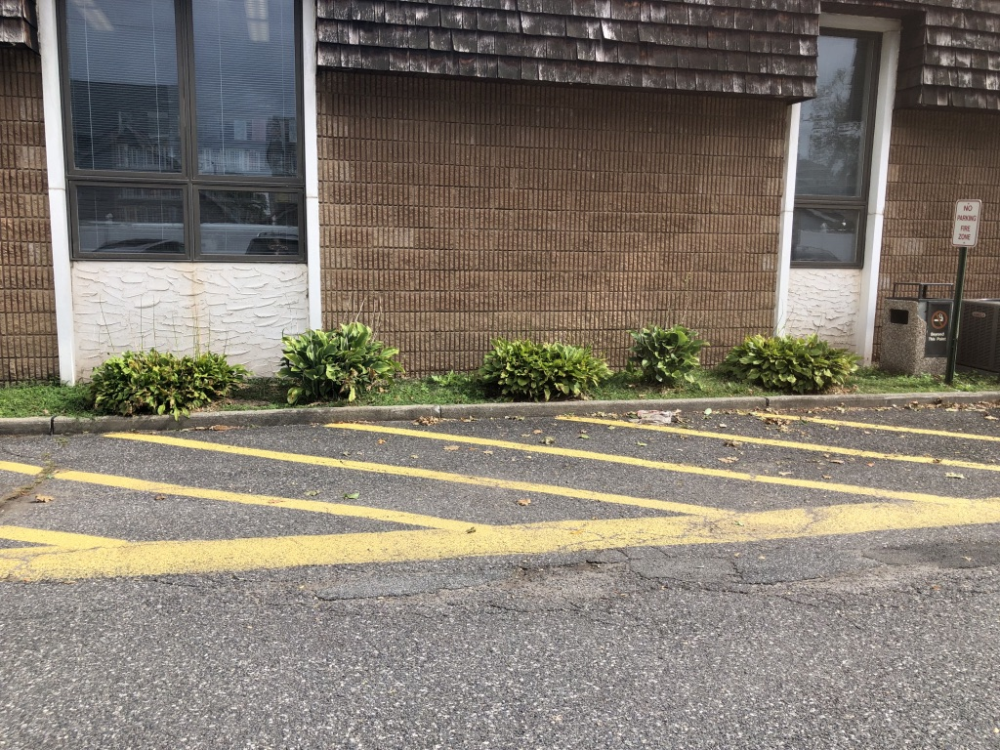
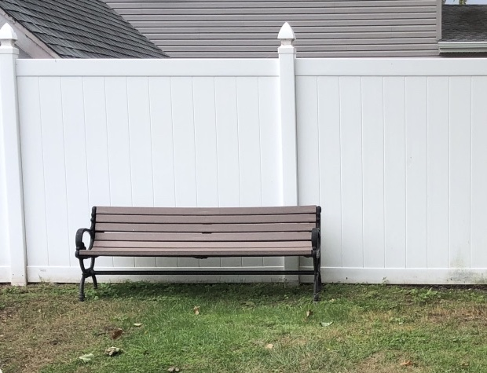
Grounds
FRONT
BACK

Slide 11

Conclusion

Slide 12
References
Dixon Homestead Library. (n.d.) About https://www.dumontlibrary.org/dixon-homestead-library-history-about-the-dumont-public-library-in-nj
How to Make your Library Great. (January 1, 2009) Project for Public Spaces. https://www.pps.org/article/libraryattributes
Old North Reformed Church. (n.d.) https://oldnorth.church/history
Rubin, R. E. and Rubin, R. G. (2020). Foundations of Library and Information Science (5th ed.). ALA Neal-Schuman
The Historical Marker Database. (n.d.) Derick Banta House https://www.hmdb.org/m.asp?m=7507

