Slide 1
MITRE ATTACK Framework Project By Stephen antwi
Overview of Mitre Att&ck Framework

Slide 2
Hey! Is Ransomware attack real?

Slide 3
Every internet-connected network is at risk. Be prepared!

Slide 4
Overview of MITRE ATTACK Framework
MITRE is a nonprofit organization created to provide engineering and technical guidance to the federal government. The organization originally developed the framework for use in a MITRE research project in 2013 and named for the data it collects, which is Adversarial Tactics, Techniques, and Common Knowledge-or, in acronym form, ATT&CK.
MITRE ATT&CK was released to the public for free in 2015, and today helps security teams in all sectors secure their organizations against known and emerging threats. And while MITRE ATT&CK originally focused on threats against Windows enterprise systems, today it also covers Linux, mobile, macOS, and ICS.

Slide 5
MITRE ATT&CK FRAMEWORK
MITRE ATT&CK is a documented collection of information about the malicious behaviors advanced persistent threat (APT) groups have used at various stages in real-world cyberattacks.
The MITRE ATTACK Framework is a curated knowledge base that tracks cyber adversary tactics and techniques used by threat actors across the entire attack lifecycle. The framework is meant to be more than a collection of data: it is intended to be used as a tool to strengthen an organization’s security posture.

Slide 6
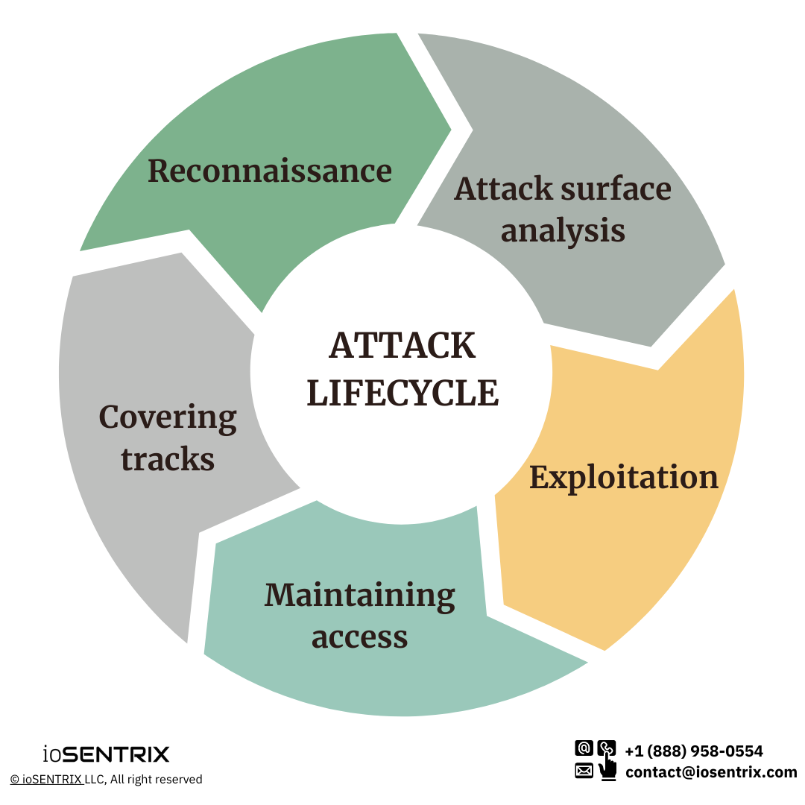
ATT&CK LIFECYCLE

Slide 7
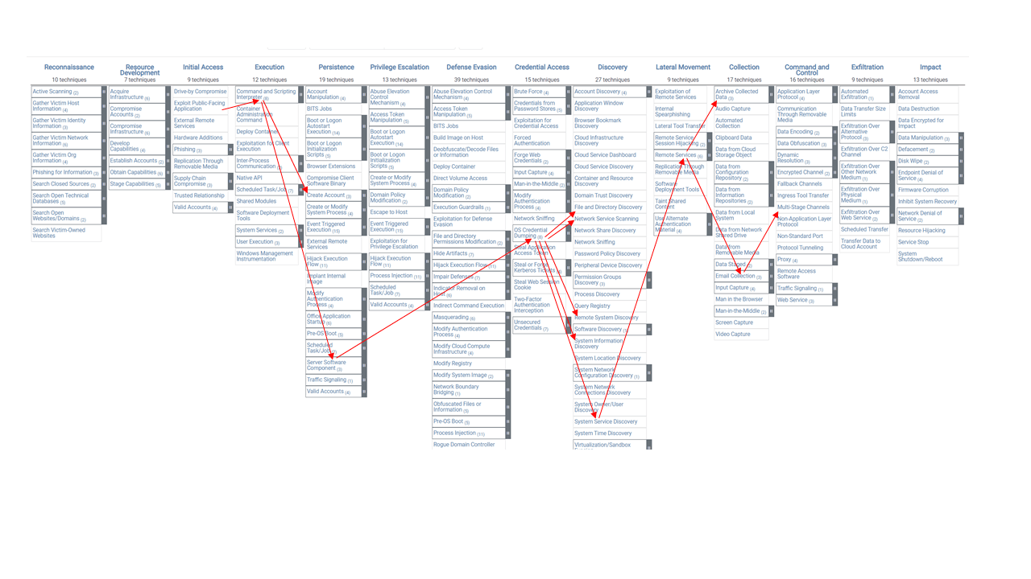
Fig2: Matrices/ platforms

Slide 8
ATTACK DESCRIPTION
The attack descriptions are group into 3, Tactics, Techniques, and Procedures (TTPs)
.Adversarial Tactics
-describe their goals, like getting inside your network or stealing credentials.
Techniques
-show how they do it
-spear phishing
Procedures / Common Knowledge
-highly detailed examples of the tools and actions of specific attacker groups.
-specific implementations of techniques

Slide 9
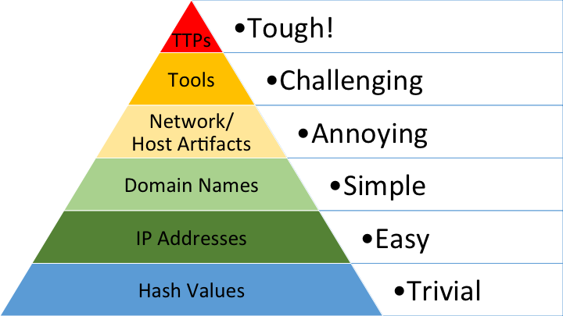
The pyramid of pain

Slide 10
HOW DO WE GET STARTED WITH MITRE ATT&CK (soc)
- Make an effort to comprehend how ATT&CK Framework operates.
- Investigate and consider the actions of your adversary.
- Investigate how adversary behave.
- Transform the behavior into a tactic.
- Determine which technique is applicable to the behavior.
- Compare your results.
- You can map your controls back logically to Mitre ATT&CK to assess the coverage they provide against the tactics and techniques they will likely face in your environment.

Slide 11
Why do ciso use the mitre att&ck fRAMEWORK
- A more detailed method to identifying enterprise risk.
- Cybersecurity Maturity Assessment-organization’s readiness to prevent, detect, contain and response to threat information assets.
- Increasing your visibility of the threat landscape.
- Enhancing your defensive posture.

Slide 12
Utilizing the MITRE ATT&CK Framework for Defense
Organizations can…
Map Attack Techniques to Defensive Controls
Proactively defend against attackers
Improve detection capabilities
Identify gaps in network

Slide 13

Mapping Attack Techniques to Defensive Controls
Example 1: Technique- Spear Phishing
Spear phishing is a common initial access technique used by attackers.
Organizations can implement email filtering and anti-phishing awareness programs to mitigate this technique.
Example 2: Technique- Lateral Movement
Lateral movement enables attacker to spread within a compromised network.
Organizations can implement network segmentation and proper access controls to restrict lateral movement.

Slide 14
Proactive Defense using the Framework
Example 1: Threat Hunting
Actively search for signs of attacker presence or activities.
Leverage the framework to identify gaps in their defenses and detect advanced threats.
Example 2: Red Teaming
Simulate real-world attacks to test an organizations defense
Identify vulnerabilities and weaknesses in security controls and incident response capabilities.
Example 3: Continues Monitoring
Establish baseline behaviors and detect anomalies.
Leverage SIEM solutions and advanced analytics to monitor for suspicious activities aligned with MITRE ATT&CK techniques.

Slide 15

Real World Examples
Example 1: APT29 (Cozy Bear) threat actor group
Used various techniques from the MITRE ATT&CK framework in their campaigns.
Techniques used, such as spear phishing (T1566.001), credential dumping (T1003), and lateral movement (T1028).
Example 1: Ransomware Attacks
Recent attacks, such as NotPetya, WannaCry, or Darkside.
Techniques used, such as remote services (T1021), powershell (T1086), and data encryption (T1486).
Defenders can utilize the framework to detect and mitigate these attacks.

Slide 16
Integrating MITRE ATT&CK into Organization
Step 1. Familiarize Yourself with the Framework
Step 2. Assess Your Current Security Controls
Step 3. Map Security Controls to Techniques
Step 4. Identify Priority Areas for Improvement
Step 5. Develop a Mitigation Strategy
Step 6. Implement that Strategy
Step 7. Continues Monitoring

