Slide 1
Best Window Displays
Attention-getting Devices
By Stephen Antwi

Slide 2
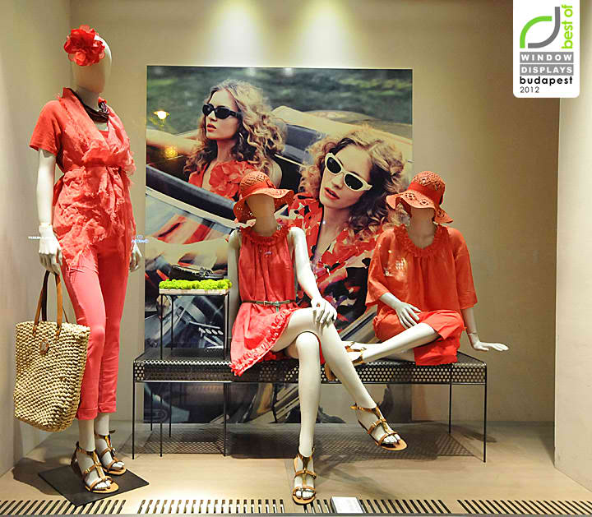
Attention-getting Devices
Example 1
The three attention-getting devices used in this example are color, lighting, and composition. This example is good since it uses bright red colors that may appeal to younger shoppers (Pegler & Kong, 2018). Also, the use of spotlights in the example helps the shoppers focus on the products. In addition, the various visual elements are arranged in a manner that allows the achievement of wholeness and unity. Finally, as evidenced in the example, these elements are arranged so the shoppers can experience the visual follow-through, allowing the shoppers to look at the entire display and individual parts.

Slide 3
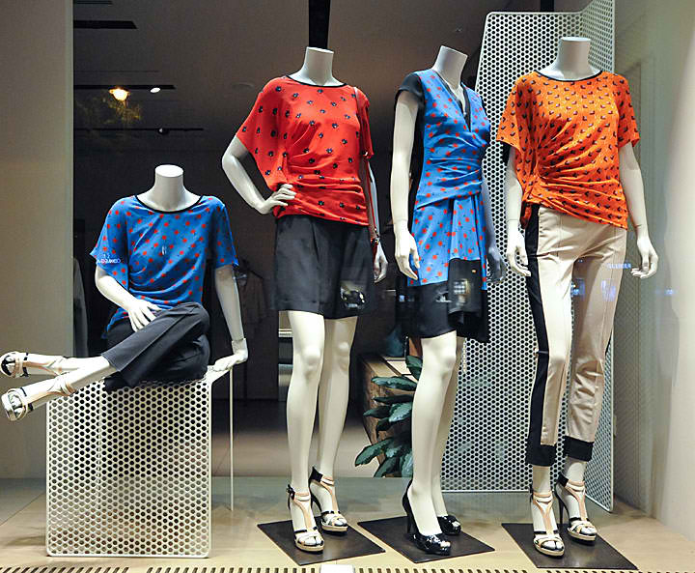
Example 2
This window display combines color, lighting, and repetition. It is a good window display because the mix of muted and bright colors helps attract young and older shoppers. The contrasting colors help the shoppers to notice the differences between the products. Also, the example is good since the softer lighting offers the display a warmer ambiance. Equally, repetition in the window makes the window display good. The pattern used in designing the three blouses is the same since they are all dotted. Also, the dress is dotted. The repetition helps hold the shopper's attention longer.

Slide 4
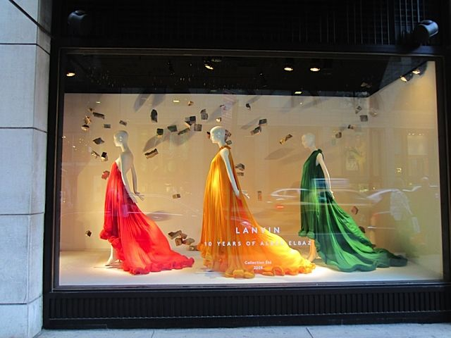
Example 3
This example combines color, repetition, and composition. The example is good since contrasting colors help the customers notice the three elements by drawing their eyes to each display. The use of repetition in the display, as evidenced by the size and pose of the mannequins, helps to create a strong visual effect. The mannequins are strung across the display and end in the same piece of the product with slight variations. Lastly, the three mannequins are arranged in a way that helps achieve wholeness and unity. They make a shopper look at the entire window and the parts of the elements.

Slide 5
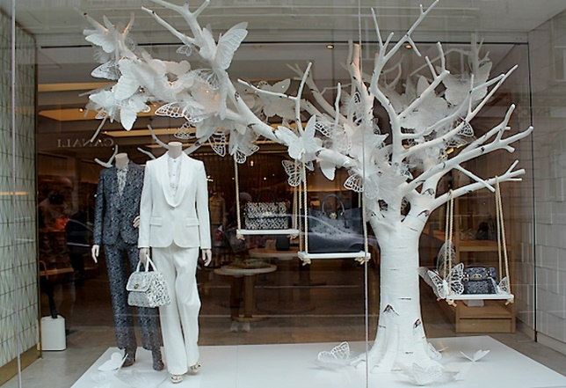
Example 4
This example uses color, line, and contrast attention-getters. This display is good because of its good color coordination. The use of black and white colors helps encourage the shoppers` interest in the merchandise. This color coordination also blends with the merchandise. Besides, the use of vertical lines makes the display good since it helps show the merchandise's strength and dignity. Likewise, the use of lighting in the display makes it good because it can catch the eye and move it to the merchandise.

Slide 6
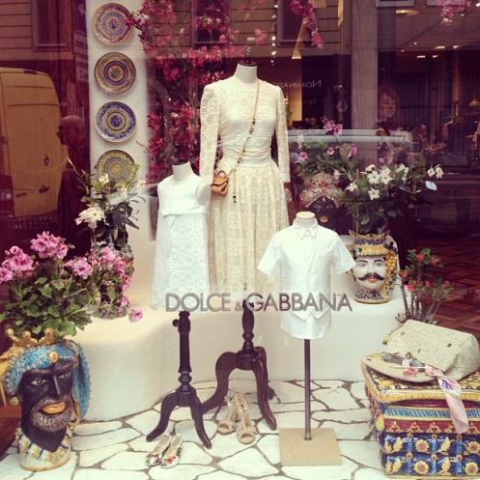
Example 6
This window display combines color, lighting, and composition. This display is good because it effectively uses color. The use of a group of colors of royal helps to signal royal or high-ranking individuals. Also, the display uses lighting to help catch the shoppers` eyes and carry them to the product. The lighting in the display in the foreground is brighter than in the background, helping attract the shoppers to the products. Eventually, the display is good because its composition helps create wholeness and unity. It has all the elements that help create a feeling of royalty.

Slide 7
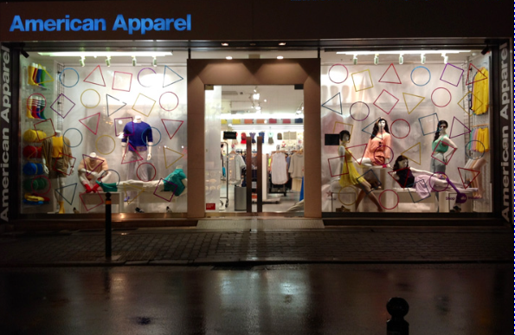
Example 5
The window displays combine three attention-getter devices – color, lighting, and scale. The display is good since it has used color appropriately. The use of bold colors and a white background make the merchandise more noticeable. These colors help attract the shoppers` eyes. In addition, the spotlight directs or carries the shoppers` eyes to the merchandise (Pegler & Kong, 2018). The use of slight differences in the scale also makes the display good because it helps reveal the differences between the merchandise on the right and left panels.

