Slide 1
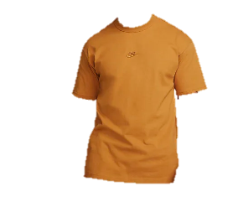
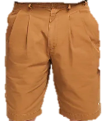
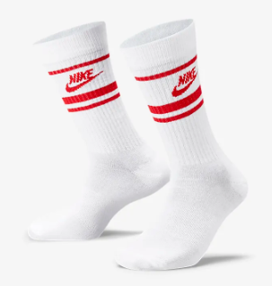
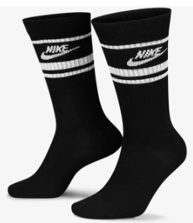
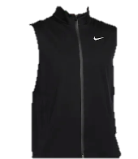
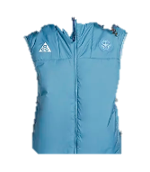
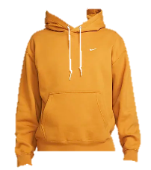
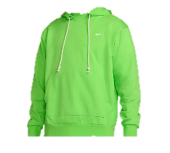
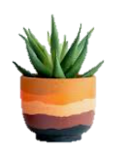
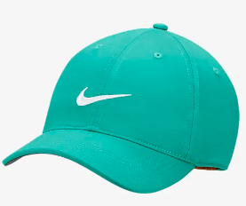
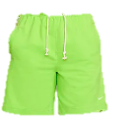
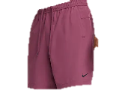
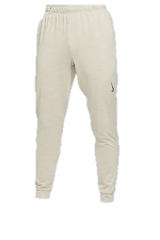
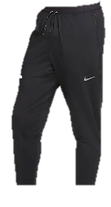
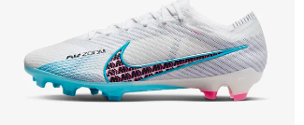
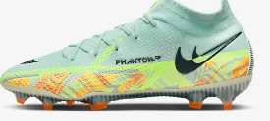
NIKE
The perimeter retail wall display maximizes the wall space to help sell more goods to increase the sales per square foot in the store. It displays 16 different products.
The use of shelving helps optimize the wall space by freeing the space for display.

Slide 2
Prop Display 1: Island
The island will be placed at the center of the store.
It will help increase the customer engagement by offering an interactive and engaging experience which draws the shoppers.
By placing the products on the island, the shoppers will be able to see them from all sides, helping draw their attention.

Slide 3
Prop Display 2: Bench
The bench will be placed at the back section of the store.
It will be strategically placed in front of the wall to allow the shoppers to have a better view of all products on the wall and floor displays.

Slide 4
Prop Display 3: Clear Box
The clear box prop will be used to display a pair of Nike shoes.
It will be placed on the table or stand in the store at an eye-level to allow the shoppers to view the shoes from all sides.

Slide 5
Prop Display 4: Potted Plant
The potted plant will be placed on one of the shelves on the display wall.
It will help attract the shoppers to look at the products on the wall display.

Slide 6
Prop Display 5: Shoe Mirror
The shoe mirror will be placed on the floor.
It will help the shoppers to have a better view of the shoes after wearing them to determine if they are fitting.
The shoe mirror will make the shopping easier for the customers.

Slide 7
Prop Display 6: Signage
The special signage (Nike logo) will be placed at the top of high-end wall display.
The use of Neon lighting will create an eye-catching effect that can grab the shoppers` attention.

Slide 8
Prop Display 7: Tablet Computers
This prop will be placed on top of the table on the floor.
It will allow the customers to access more information about the products they are interested in buying.

Slide 9
Prop Display 8: Themed Artwork
This prop will be placed on the background of the wall display.
It would attract the shoppers` attention to the products on display and remind them of the value they would derive by buying and using them.

Slide 10
Prop Display 9: Sports equipment
This prop will be placed on the floor near the entrance to the store.
It will help capture the shoppers` attention and direct them to the athletic products offered by Nike.

Slide 11
Prop Display 10: Fake Grass Artificial Mat
This prop will be placed on the floor in the store.
It can be used to display some of Nike`s latest shoes in an eye-catching and interesting way.

Slide 12
Prop Display 11: Ribbon Flower
The ribbon flower will be placed on some selected shoes on the shelves.
It would help draw the shoppers` attention to the shoes.

