Slide 1

Cybersecurity in Healthcare
Natalie Patton
CYSE201S: Cybersecurity and the Social Sciences
Notes:
. Cybersecurity in Healthcare:
--> Investigate the cybersecurity challenges in the healthcare sector, including the protection of patient data and the implications for public health.

Slide 2
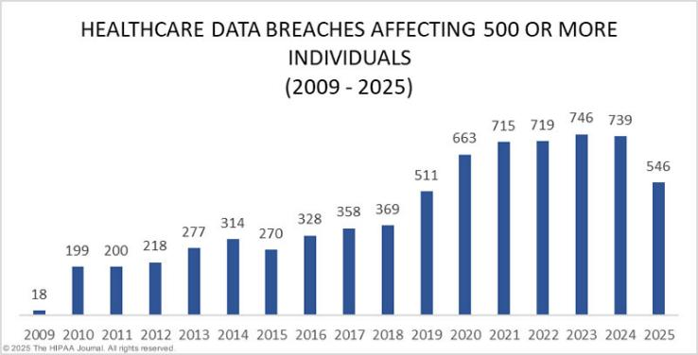
Why is Protecting Health Data Important?
PHI: Protected Health Information
PII: Personally Identifiable Information
Notes:
Explain phi and pii

Slide 3
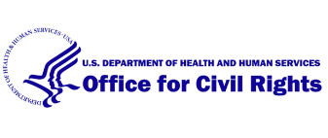
Regulations:
Health Insurance Portability and Accountability Act (HIPAA) is one of the most well-known laws guiding data privacy in the United States.
Established in 1996
Aims to protect Confidentiality, Integrity, and Availability of Protected Health Information.
The Healthcare Cybersecurity Act of 2025 is a newer regulation aiming to address the increase of attacks on healthcare institutions.
Cyber Performance Goals (CPGs) are voluntary guidelines designed by the Department of Health and Human Services to help businesses understand how to prepare for and respond to cyber threats and incidents.
Notes:
Outlines specific scenarios where information can be disclosed, how info must be protected, etc even includes guidelines for patients to understand their healthcare
Includes things like notifying patients for breach
Improved in 2024 to require related institutions, like health care providers, to strengthen protections of individual data
HCA2025 provides training, information regarding cyber threats, and mitigations
Things like national institute of standards and technology and cybersecurity infrastructure security agency cybersecurity performance goals
Regulations must be improved over time as researchers see the impact and effectiveness of new laws through natural experiments

Slide 4
Social Sciences Connections
Social Science Principles
Social Science experiments to determine causes of cybercrime and effectiveness of solutions.
Mitigation techniques
Employee training, improving “culture of security,” and understanding victimization.
Economic Principles
Notes:
Relativism
Objectivism
Ethical neutrality
determinism

Slide 5
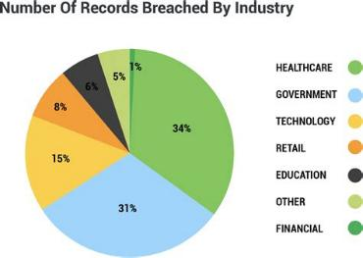
Cyber Attacks
As everything, including healthcare, becomes more digitized, attacks and incidents become more likely to put people’s data at risk.
Healthcare is often targeted because of how sensitive healthcare operations and data are.
Risks are also present from manufacturers, insurance companies, and more.
Notes:
Ransomware is one of the largest threats to hospitals, because people are more willing to pay to regain access to their systems when patient’s lives are on the line.
Other top threats include third-party breaches, data breaches, supply chain attacks, and zero-day exploits, according to health-sector security professionals.
Over the 12 months from March 2024 to March 2025, almost half of healthcare organizations experienced at least one data incident, such as a ransomware attack, hacking incident, or phishing attack, according to the cybersecurity firm Netwrix. For its 2025 Cybersecurity Trends Report, Netwrix surveyed 2,150 IT professionals from 121 countries in March 2025 and compared the findings to previous surveys conducted in 2024, 2023, and 2020.
Healthcare has long been targeted by threat actors due to the high value of patient records, and the fact that healthcare organizations cannot tolerate disruption, as it puts patient safety at risk. The sector is extensively targeted by ransomware groups as there is a higher probability that the ransom will be paid to prevent the publication of stolen data and ensure a fast recovery. In the past 12 months, 48% of healthcare organizations experienced at least one security incident that required a dedicated response from the security team.
Across all sectors, the number of organizations reporting no impact from security incidents is rapidly reducing. In 2023, 45% of respondents said there was no impact from security incidents, whereas in 2025 the percentage had fallen to just 36%. In 2024, 60% of organizations reported suffering financial damage due to cyberattacks, and the percentage jumped to 75% in 2025. Across all sectors, the number of organizations reporting financial damage of at least $200,000 almost doubled from 7% in 2024 to 13% in 2025.

Slide 6

Consequences
Cyberattacks that interrupt hospital services can cause severe harm and death to patients involved.
Even other types of attacks can cause serious impacts, such as interrupting insurance and preventing health data from being accessed by professionals.
Breaches on patient data not only impede privacy but can open them up to hackers, having data sold, and even make SSN or credit card information public.
Financial losses for the hospital can impact ability to provide care.
Fear and increased risk can impact patient trust.

Slide 7
Solutions
There are many ways healthcare institutions can work to prevent cyberattacks and protect patients.
Following current regulations and guidelines, as well as performing consistent reviews to ensure they maintain this, is an important step.
Additionally, individualized research and training can be done to ensure each organization is as secure as possible.

Slide 8
References
Alder, S. (2025, October 3). Healthcare Cyberattacks Costing $200K+ Rise 400% in a Year. The HIPAA Journal. https://www.hipaajournal.com/healthcare-cyberattacks-200k-increase-400pc/
Alder, S. (2025, May 26). Healthcare Data Breach Statistics. The HIPAA Journal. https://www.hipaajournal.com/healthcare-data-breach-statistics/
Centers for Disease Control and Prevention. (2024, September 10). Health insurance portability and accountability act of 1996 (HIPAA). Public Health Law; Centers for Disease Control and Prevention. https://www.cdc.gov/phlp/php/resources/health-insurance-portability-and-accountability-act-of-1996-hipaa.html
Reed, J. (2025, January 30). When ransomware kills attacks on healthcare facilities. Ibm.com. https://www.ibm.com/think/insights/when-ransomware-kills-attacks-on-healthcare-facilities
Rights (OCR), O. for C. (2015, September 10). HIPAA for Professionals. HHS.gov. https://www.hhs.gov/hipaa/for-professionals
World Health Organization. (2024, February 6). Cyber-attacks on critical health infrastructure. Www.who.int. https://www.who.int/news-room/questions-and-answers/item/cyber-attacks-on-critical-health-infrastructure
Yalpi, D. (n.d.). CYSE 201S Mid Term Study Guide. [PowerPoint Slides]; Canvas@ODU. https://canvas.odu.edu/courses/188032/files/52089953?module_item_id=8773119

