Slide 1



Professional Goals Statements
This Photo by Unknown Author is licensed under CC BY-NC-ND
Ogadimma Chibuike

Slide 2
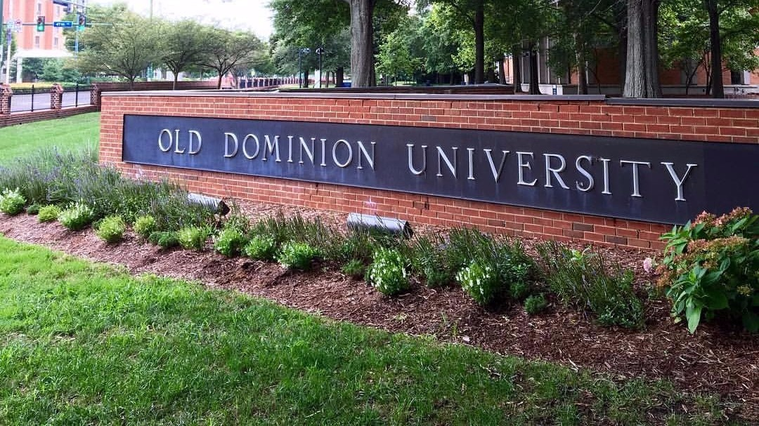
My name is Ogadimma and in December of 2022 I will be graduating with my Bachelor of Science degree in Cybersecurity from Old Dominion university. I have many goals for my future but for now I will discuss my career goals.

Slide 3

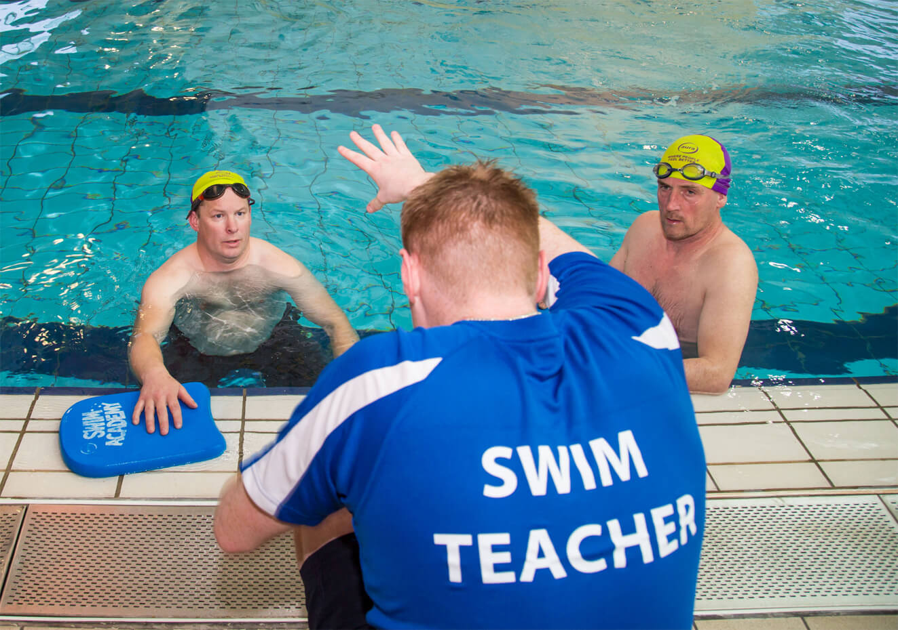

I would like to start off by stating my current work history. I first started working as a lifeguard for Prince William County Parks and Recreation as a lifeguard. I began working there when I was 15 years old and continued working there until I began attending school at ODU. I also have a retail background. I worked at a Nike factory store for 3 years. I also worked at Sephora and Sunglass Hut for about a year. Now I work as a Covid test collector and a swim instructor, as well as a job with ODU as a tech support analyst.

Slide 4

I chose to pursue a career in cybersecurity for many reasons. Since technology is evolving at such a high rate, there is a wide demand for jobs in the cybersecurity field. Another reason I chose this career is because father has worked in this field for many years, and I learned a lot of high-level skills from being around him.

Slide 5



Cyber security is interesting to me because I enjoy learning about how devices work as well as hacking, so I decided in a cybersecurity career. After I graduate, I will complete an internship, and gain certifications in Microsoft and Comptia A+. After that, I will find a job in cybersecurity doing intrusion detection. I am willing to work for the government or a private company like Tik-Tok, Google, or Amazon. I am also willing to relocate to find a job.

Slide 6
References
https://www.13newsnow.com/news/education/old-dominion-university-tuition-increasing-faculty-staff-getting-raises/434651830
https://www.swimnow.co.uk/general/how-to-become-a-qualified-swimming-instructor/
https://openhouse.es/wp-content/uploads/2018/12/Prueba-PCR-COVID-scaled.jpeg
https://acdro.org/cybersecurity-academy/
https://www.3g-infocom.com/comptia-a-comptia-network/
https://esatjournals.net/wp-content/uploads/2020/08/First-Jobs-in-Cybersecurity-780x470.jpeg

