Slide 1
Assignment #5 Password cracking
Old Dominion University
CS270 Linux Systems for Cyber Security
Ogadimma Chibuike

Slide 2
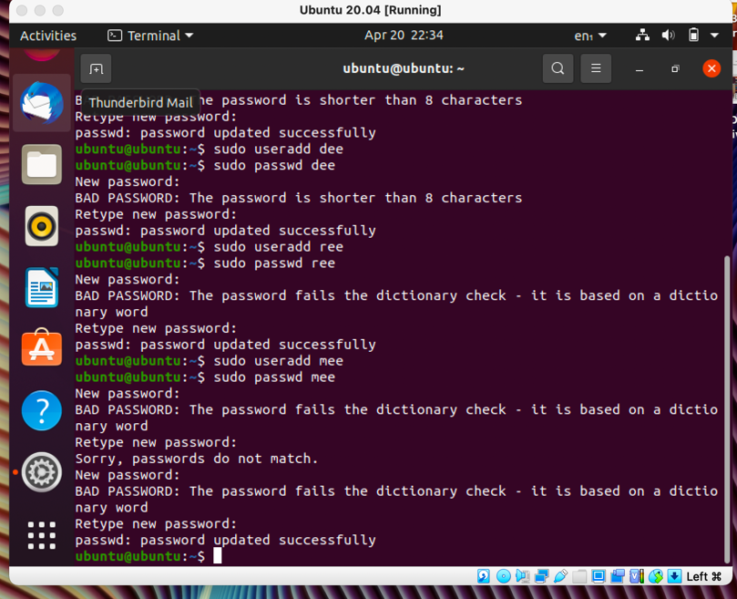
Step 1
1. Create 6 users in your Linux system, then assign each user a password that meets the following complexity requirement respectively.
You should list the passwords created for each user.

Slide 3
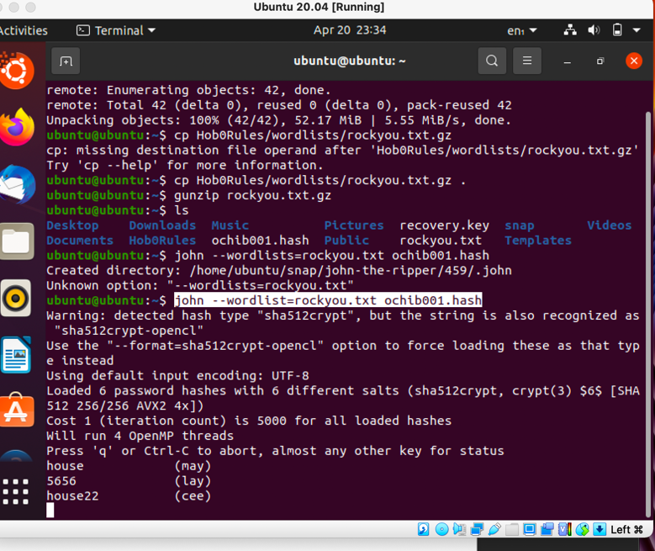
STEP 2
Export above users’ hash into a file named xxx.hash (replace xxx with your MIDAS ID) and use John the Ripper to crack their passwords in wordlist mode (use rockyou.txt). Keep your john the ripper cracking for at least 10 minutes.

Slide 4
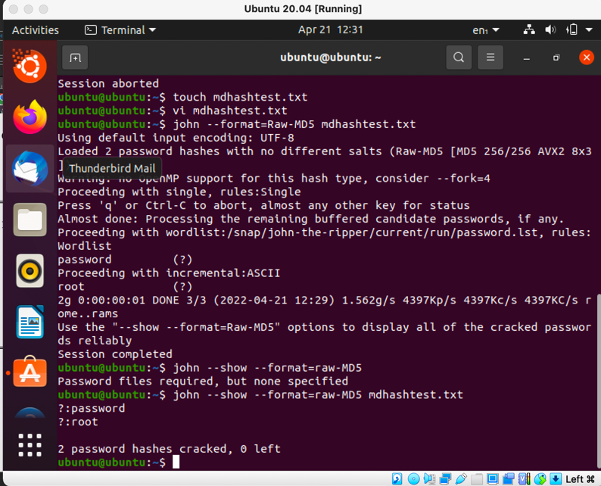
Step 3
Find and use the proper format in John the ripper to crack the following MD5 hash. Show your steps and results.
• 5f4dcc3b5aa765d61d8327deb882cf99
• 63a9f0ea7bb98050796b649e85481845

