Slide 1

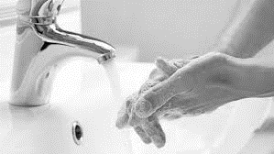
Hand Hygiene in Healthcare Workers
Group 3 Priyanka Patel, CJ Robinson, Brandon Young, Indira Jagdeo

Slide 2

Objectives
Background
Health Outcomes
Prevalence of Behavior
Difficulties of Change
Interventions
Socio-ecological Model
RE-AIM Elements

Slide 3

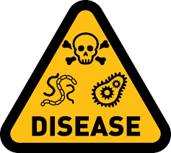

Background
HCAI
1 out of 25
Deaths
75,000
Infections
722,000
https://health.gov/hcq/prevent-hai.asp
Notes:
Hand washing has been costing the U.S. health care system billions of dollars each year because 1 out of 25 inpatients have been said to have healthcare-associated infection (HCAI) (https://health.gov/hcq/prevent-hai.asp. That adds up to about 722,000 infections a year, which leads to 75,000 patients dying each year because of their healthcare-associated infections (Edmond et al., 2014). Studies have shown that patients are getting infections because healthcare providers clean their hands less than half of the time they should on average (CDC, 2017). Poor hand hygiene in healthcare workers can cause numerous infections and complications in patients if the process is not done properly or at all.

Slide 4
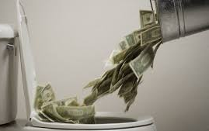

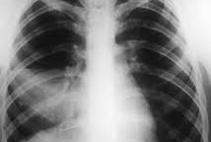

Results & Health Outcomes
Costing the U.S. health care system
billions of dollars
$28 to $45 billion per year
Pneumonia
Infection that inflames your lungs' air sacs (alveoli). The air sacs may fill up with fluid or pus, causing symptoms such as a cough, fever, chills and trouble breathing.
Notes:
https://www.ncbi.nlm.nih.gov/pmc/articles/PMC2827870/
https://medlineplus.gov/ency/article/000146.htm
https://www.lung.org/lung-health-and-diseases/lung-disease-lookup/pneumonia/symptoms-and-diagnosis.html
Hospital-acquired pneumonia
Hospital-acquired pneumonia is an infection of the lungs that occurs during a hospital stay. This type of pneumonia can be very severe. Sometimes, it can be fatal.
Causes
Pneumonia is a common illness. It is caused by many different germs. Pneumonia that starts in the hospital tends to be more serious than other lung infections because:
People in the hospital are often very sick and cannot fight off germs.
The types of germs present in a hospital are often more dangerous and more resistant to treatment than those outside in the community.
Pneumonia occurs more often in people who are using a respirator, which is a machine helps them breathe.
Hospital-acquired pneumonia can also be spread by health care workers, who can pass germs from their hands or clothes from one person to another. This is why hand-washing, wearing gowns, and using other safety measures is so important in the hospital.
People can be more likely to get pneumonia while in the hospital if they:
Abuse alcohol
Have had chest surgery or other major surgery
Have a weak immune system from cancer treatment, certain medicines, or severe wounds
Have long-term (chronic) lung disease
www.lung.org
Pneumonia Symptoms and Diagnosis
Pneumonia is an infection that inflames your lungs' air sacs (alveoli). The air sacs may fill up with fluid or pus, causing symptoms such as a cough, fever, chills and trouble breathing.
What Are the Symptoms of Pneumonia

Slide 5

How common is the problem

Slide 6
Prevalence of Behavior
40%
Compliant
60%
Non-compliant
Notes:
Hand washing is a health behavior hospital workers are constantly faced with. In 2002, the overall average adherence was at 40% (Boyce & Pittet, 2002). Non-compliance rate is high at 60% proving the health behavior is a common problem. The lack of compliance results to costly HCAI, increased mortalities, and decreased quality of life.

Slide 7
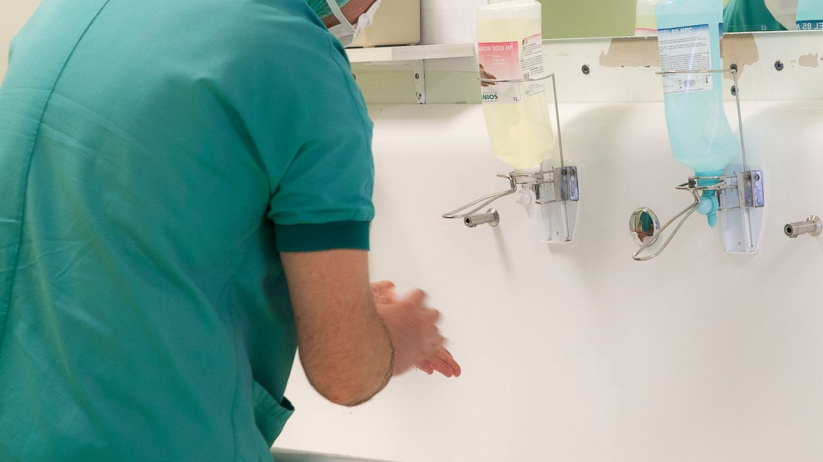

Difficulties of Change
Barriers:
skin irritation caused by hand cleaning agents, inaccessible hand hygiene supplies, use of gloves, forgetfulness, lack of knowledge of guidelines, insufficient time, high workload and understaffing
https://abcnews.go.com/Health/doctors-hand-hygiene-plummets-watched-study-finds/story?id=39737505 https://thefsforum.co.uk/events/breaking-down-the-barriers/
41% out of 200 survey respondents listed “dispensers/sinks not in a convenient location” as a barrier
32% of respondents reported “products dry our hands” as barriers.
Mitchell, A. (2017).
Notes:
(CJ did this one- reference is below Speaker notes):
-A survey of 200 health care providers was conducted to collect data on why health care providers are not completely compliant with the hand washing and hand hygiene guidelines.
Mitchell, A. (2017). Hand Hygiene: A Quality Improvement Project. Biomedical Journal of Scientific & Technical Research, 1(7). doi: 10.26717/bjstr.2017.01.000601
Getty Images. (n.d.). A surgeon washes his hands at hospital in Thonon, France in an undated stock photo. photograph, Thonon.
The Financial Services Forum. (n.d.). Treating Customers Fairly says: Consumers can be confident they are dealing with firms where the fair treatment of customers is central to the corporate culture. Products and services marketed and sold in the retail market are designed to meet the needs of identified consumer groups and are targeted accordingly. photograph, London.

Slide 8

Difficulties of Change Continued...
Personal beliefs
Religious Beliefs: Christians and Buddhist do not have specific hand hygiene indications stated in their rituals
https://www.thoughtco.com/culture-hearths-and-cultural-diffusion-1434496
Alcohol based hand rubs are prohibited in some relgions:
Hinduism and Islam: causes mental impairment
Sikhism: an offense requiring a penance
(WHO, 2009)
Notes:
Citation:
WHO Guidelines on Hand Hygiene in Health Care: First Global Patient Safety Challenge Clean Care Is Safer Care. Geneva: World Health Organization; 2009. 17, Religious and cultural aspects of hand hygiene. Available from: https://www.ncbi.nlm.nih.gov/books/NBK143998/
Picture retrieved from:
https://www.thoughtco.com/culture-hearths-and-cultural-diffusion-1434496

Slide 9
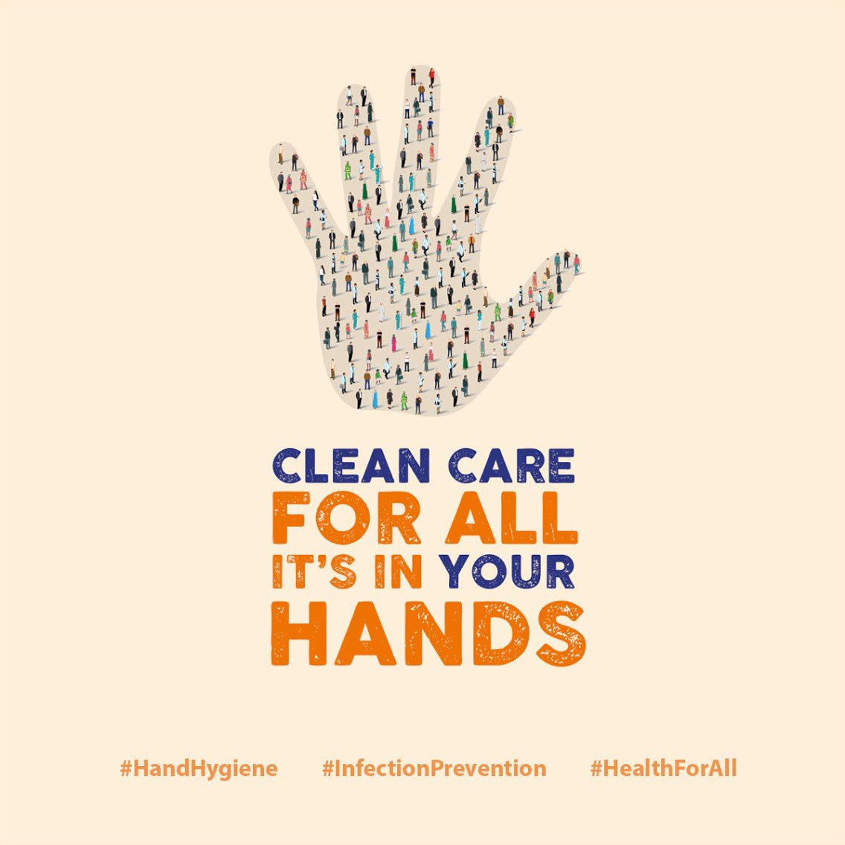
Intervention
WHO Save Lives: Clean Your Hands Campaign
Purpose: Bring awareness to our society by having healthcare facilities and professionals practice hand hygiene skills.
*Roughly 10 million healthcare workers are committing themselves to better their hand hygiene towards patient care.

Slide 10
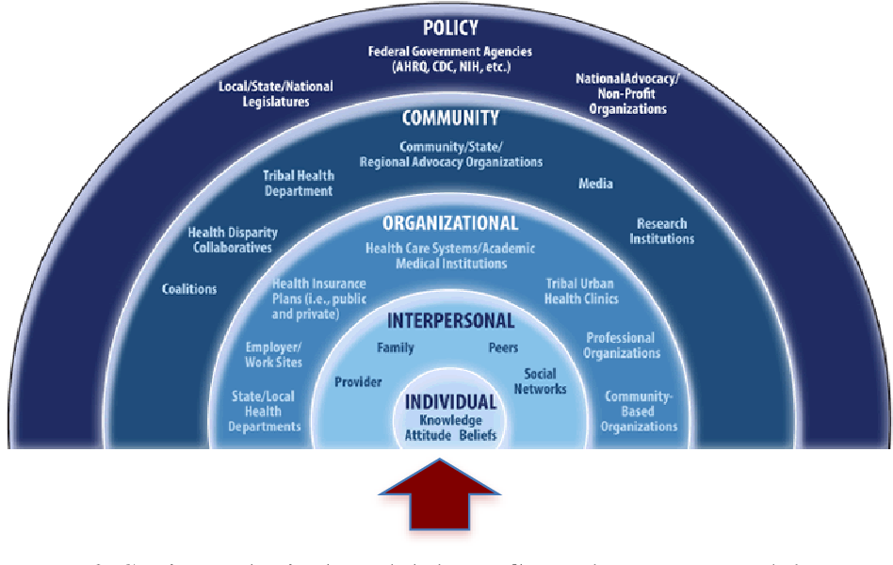
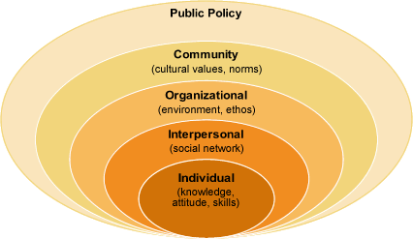
Socio Ecological Model
Organizational:
Traget: Multidisciplinary institute workers can be trained at large scale with higher efficacy rate
Community:
Outreach
Social Marketing
Increase awareness to different age groups (adolescents, adults)

Slide 11
Intervention: Based on Socio-Ecological Model
Five healthcare workers
Quality Assurance personnel
Interpersonal Practioner (IPP)
Healthcare Institute
Step 1: Project Launch
Step 2: Mid-point review
Step 3: Final review to see goals met
Plan
Each team is given a situation to plan workflow on how, when and where they will perfom hand hygiene
From each team atleast one person is placed in "Patient Zone" and "Healthcare Zone".
To achieve the goal, a simulation area was provided to mock the clinical setting and practice hand hygiene with a dummy
Educating peers tasks given to each team to increase the awarness
Action
Hand hygiene audit tool for recording compliance was provided to each team
Observer (QA) recorded the compliance during a patient encounter that team members performed the hand hygiene or not
IPP ensured the reliability between observers and responded to the question during the simulation.
Validation
Each team started collecting and documenting the data into a single hard copy of the institutional spreadsheet.
IP then approved and submitted to the hospital’s Infection Control Committee and made it accessible to all staff through the Institutional Dashboard.
Documentation
Notes:
Statistics stated that more than 15,000 healthcare facilities in 156 countries participated in this campaign movement.

Slide 12
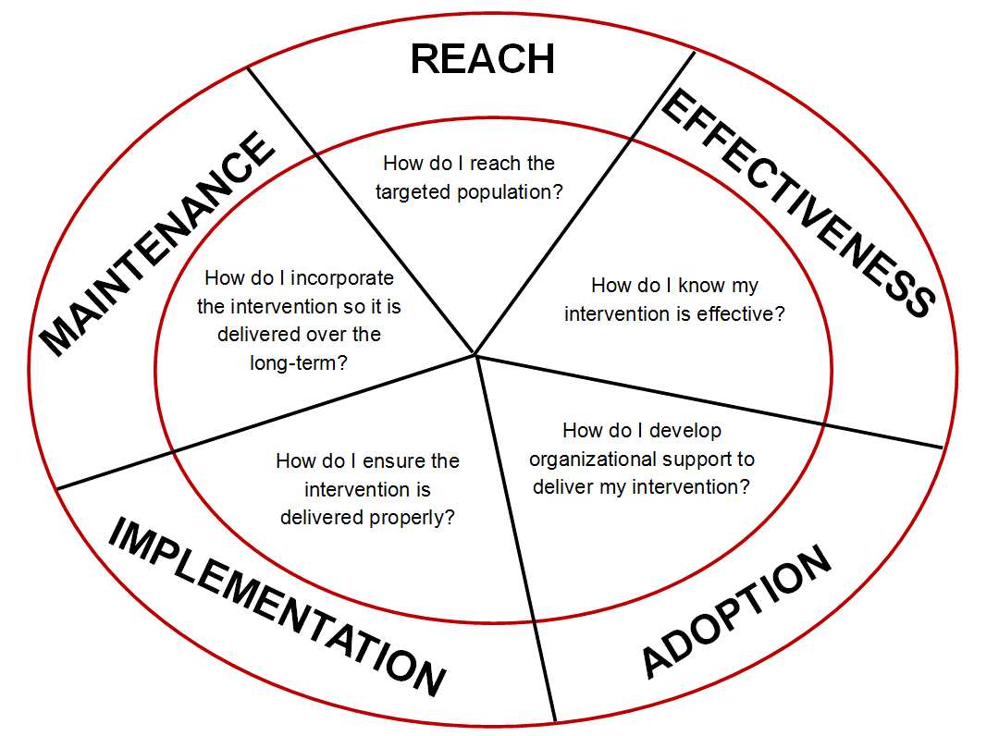
RE-AIM Elements
REACH: Intended for the health care workers and patients who are exposed to the intervention
EFFECTIVENESS: Prevalence of infectious disease related to hand hygiene will go down worldwide.
ADOPTION: Any multidisciplinary institute can use this evaluation model and review yearly to see the compliance rate of hand hygiene overall. Hospitals and healthcare clinics will be easily Implement and local public health department can help establishing the guidelines and help mandate in the local healthcare facilities.
IMPLEMENTATION: Can be used as long term evaluation process. Data will be reliable and replicable for the most of the healthcare facilities. However, it will take time to hire and train the experts who overlooks the process. Overall, this program is cost efficient as it does not require many resources to implement the plan. Recruiting the team might be challenging in the healthcare facilities as the shifts of the nurses and other workers are not consistence.
http://www.re-aim.org/
MAINTEINANCE: This exercise can do twice a year to make sure that all the workers are aligned. Observation and documentation steps conducted by the experts can be sustainable for long run as it involves the higher authorities. At the individual level, it will ensure that each employee is compliant with the hand hygiene process based on the WHO guidelines.

Slide 13
Summary

Slide 14
References
Edberg , M. (2020). Essentials of Health Behavior (3rd ed.). Burlington, Massachusetts: Jones & Barlett Learning.
Health.gov. (n.d.). Health Care-Associated Infection. Retrieved from https://health.gov/hcq/prevent-hai.asp
National Institutes of Health. (2018). Health care-associated infections â€“ an overview. Retrieved from https://www.ncbi.nlm.nih.gov/pmc/articles/PMC6245375/#b33-idr-11-2321
http://www.re-aim.org/
WHO highlights importance of good hand hygiene for patient safety. (2012, September25). Retrieved October 9, 2019, from https://www.who.int/mediacentre/news/notes/2012/hygiene_20120504/en/
Mitchell, A. (2017). Hand Hygiene: A Quality Improvement Project. Biomedical Journal of Scientific & Technical Research, 1(7). doi: 10.26717/bjstr.2017.01.000601

