Slide 1
Brands
Foreign Affairs October 13, 2020 Poll Bracket
Academic Sweet Sixteen
Beckley
Mearsheimer
Fazal
Norrlof
Ikenberry
Narlikar
Kupchan
Goddard
Lee
Taussig
Nexon
Cooley
Crawford
Strongly Disagree
Disagree
Neutral
Agree
Strongly Agree
Skinner
Weiss
“Great-power competition should be the central organizing principle of U.S. foreign policy.”

Slide 2
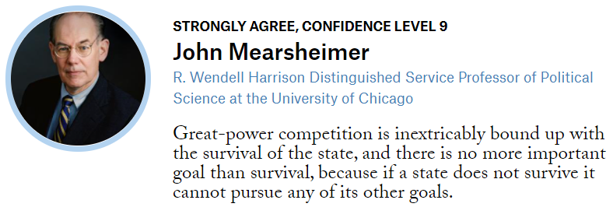
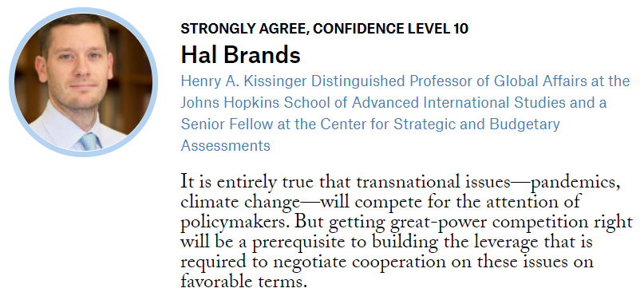

Slide 3
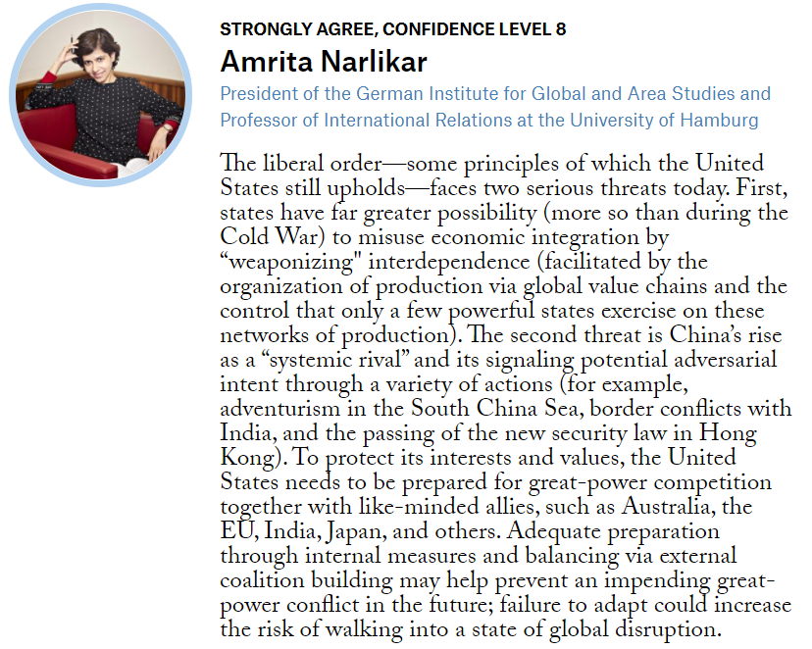
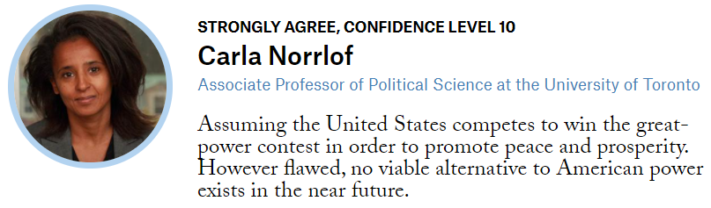

Slide 4
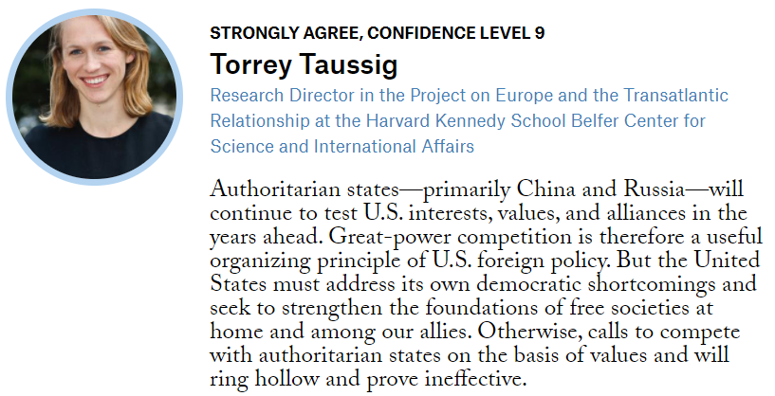
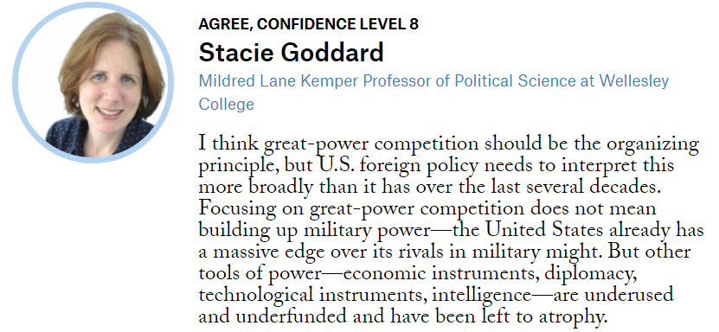

Slide 5
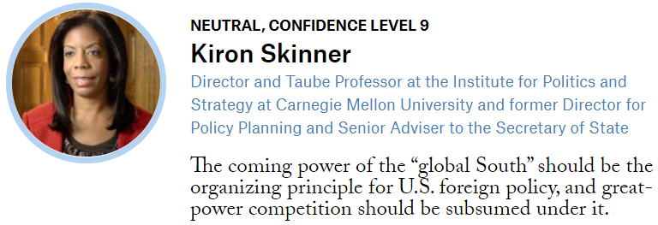
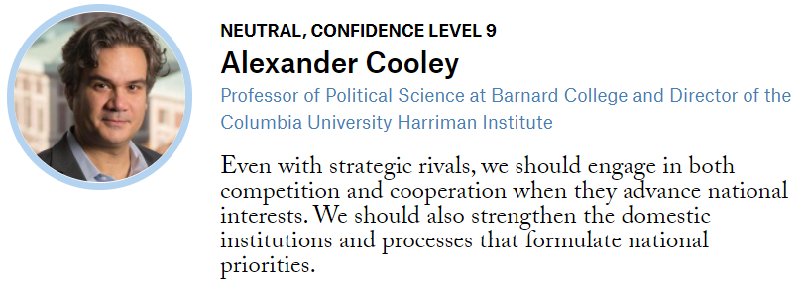

Slide 6
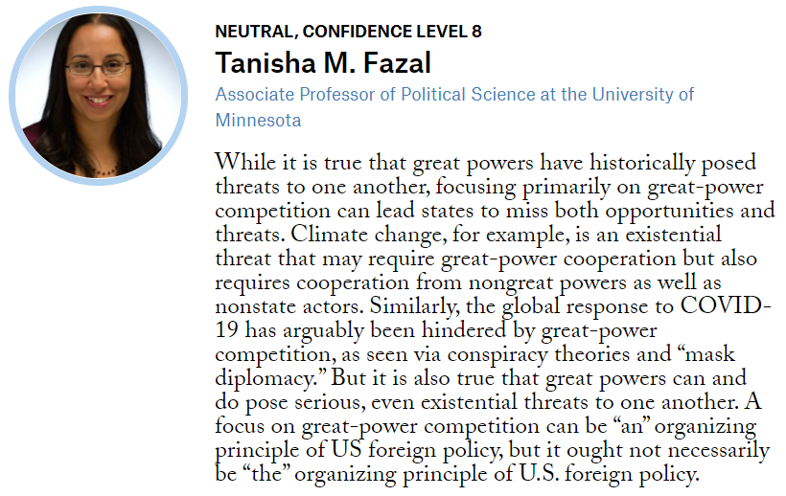
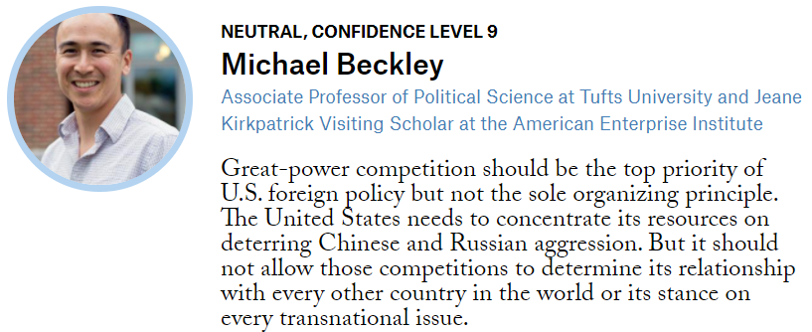

Slide 7
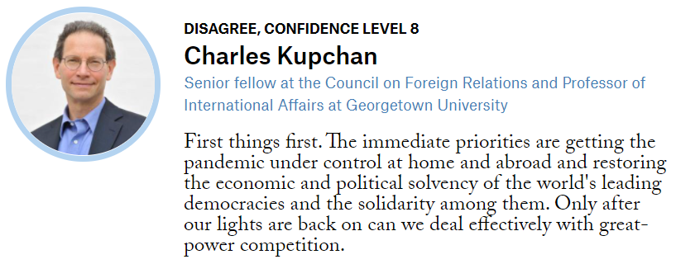
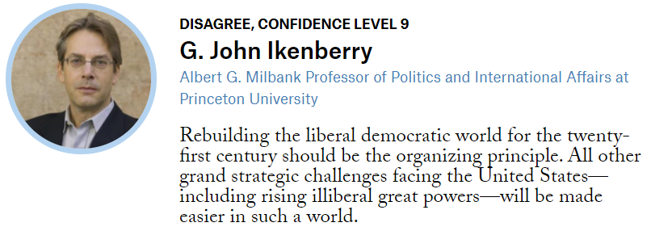

Slide 8
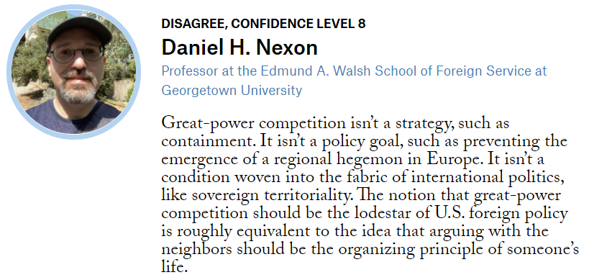
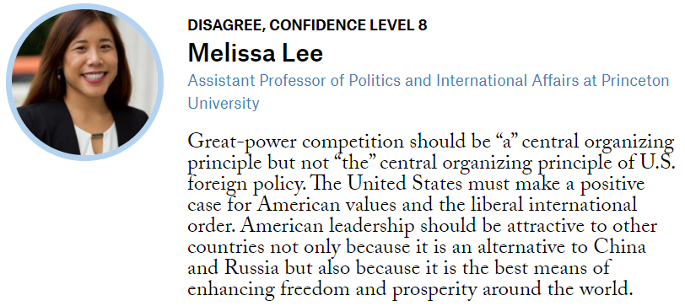

Slide 9
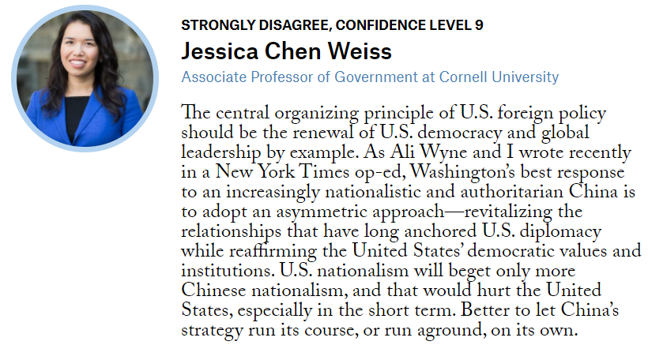
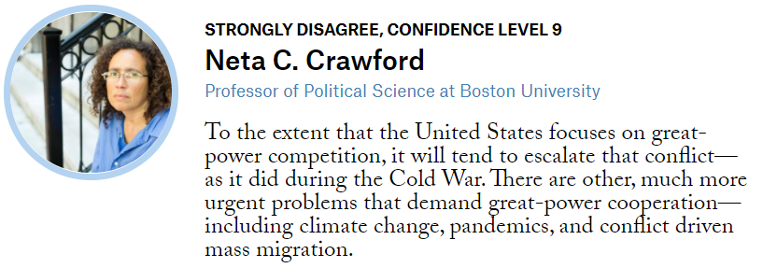

Slide 10
Elite Eight
Elite Eight
Elite Eight

Slide 11
Elite Eight
Elite Eight
Elite Eight

Slide 12
Elite Eight
Elite Eight
Elite Eight

Slide 13
Elite Eight
Elite Eight
Elite Eight

Slide 14
Final Four
Final Four
Final Four

Slide 15
Final Four
Final Four
Final Four

Slide 16
Championship
Championship
Championship

