Slide 1
Allison
Foreign Affairs February 16, 2021 Poll Bracket
Academic Sweet Sixteen
Fazal
Lind
Weiss
Fearon
Borgwardt
Goldgeier
Mastro
Goddard
Posen
Beckley
Layne
Cooley
Norrlof
Strongly Disagree
Disagree
Neutral
Agree
Strongly Agree
Nexon
Bensahel
“Donald Trump has irrevocably changed the course of U.S. foreign policy.”

Slide 2
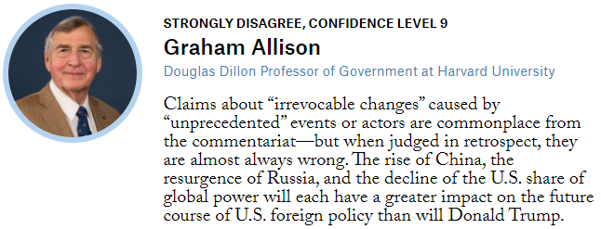

Slide 3
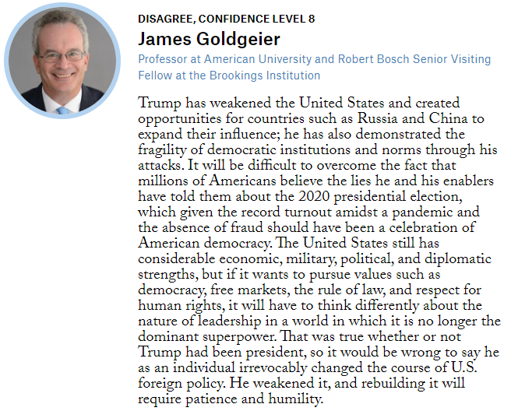
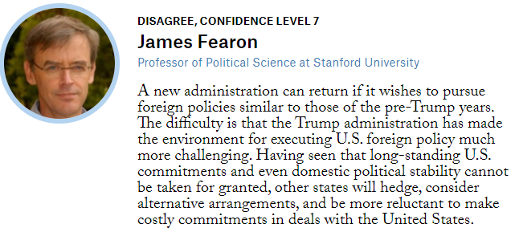

Slide 4
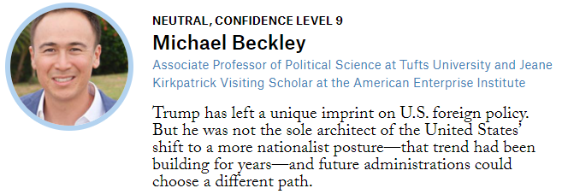
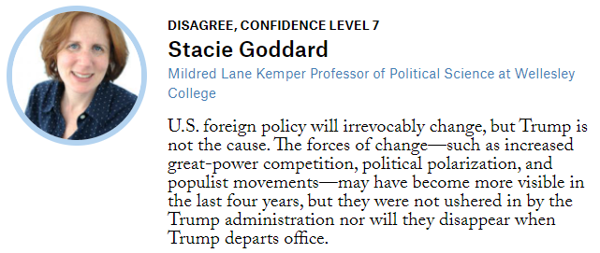

Slide 5
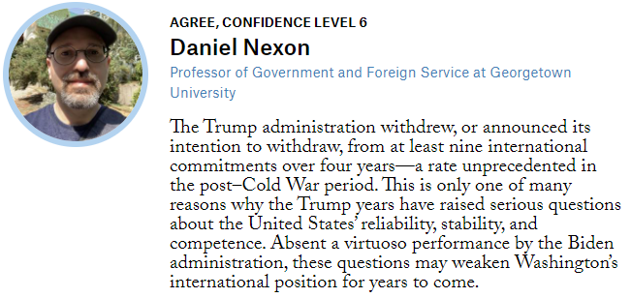
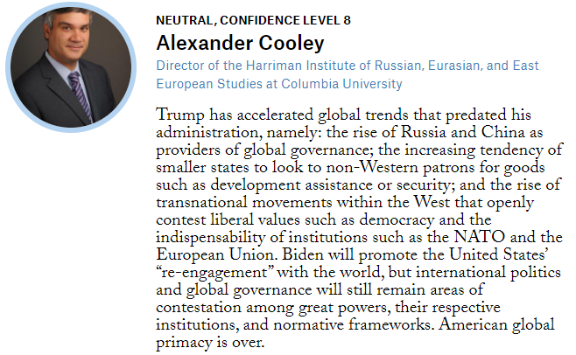

Slide 6
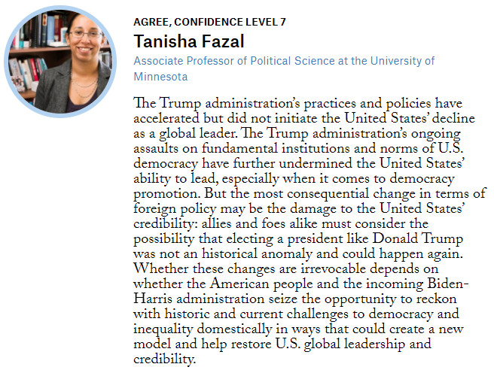
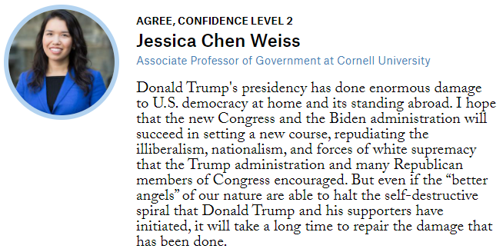

Slide 7
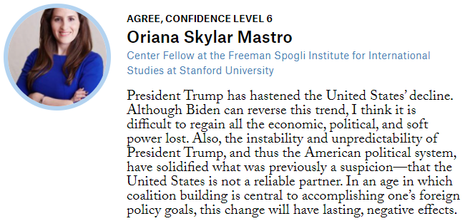
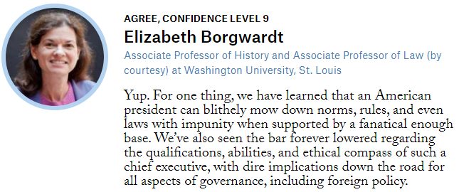

Slide 8
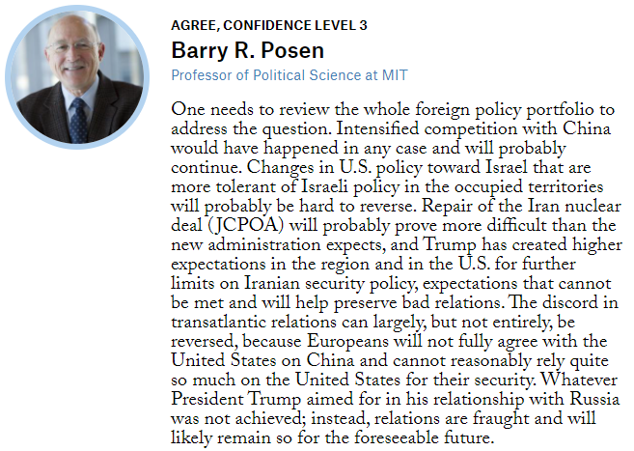
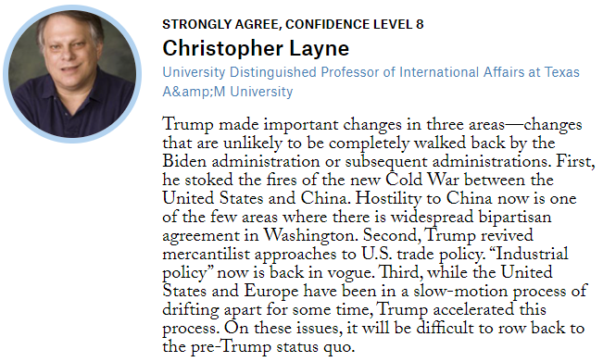

Slide 10
Elite Eight
Elite Eight
Elite Eight

Slide 11
Elite Eight
Elite Eight
Elite Eight

Slide 12
Elite Eight
Elite Eight
Elite Eight

Slide 13
Elite Eight
Elite Eight
Elite Eight

Slide 14
Final Four
Final Four
Final Four

Slide 15
Final Four
Final Four
Final Four

Slide 16
Championship
Championship
Championship

