Slide 1

Mearsheimer
Foreign Affairs October 19, 2021 Poll Bracket
Academic Sweet Sixteen
Lee
Beckley
Jisi
Menon
Nexon
Friedberg
Goldstein
Nathan
Huang
Hung
Ang
Goddard
Fazal
Strongly Disagree
Disagree
Neutral
Agree
Strongly Agree
Kokas
Khan
“U.S. foreign policy has become too hostile to China.”

Slide 2
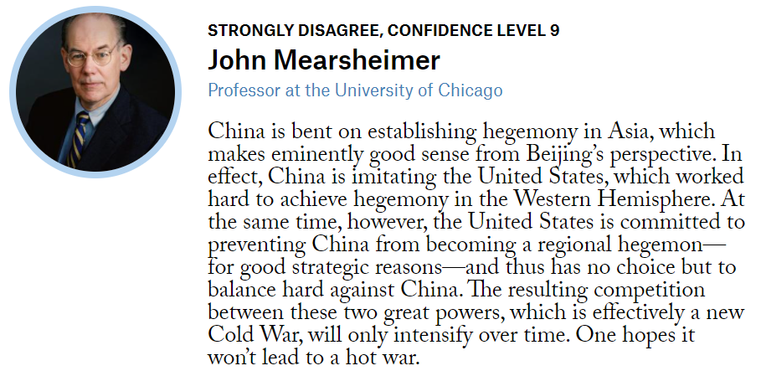
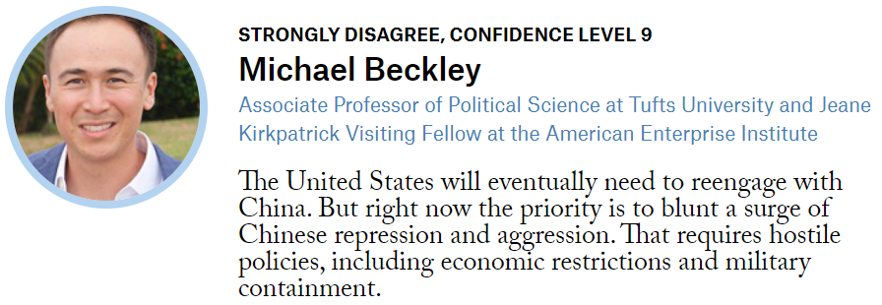

Slide 3
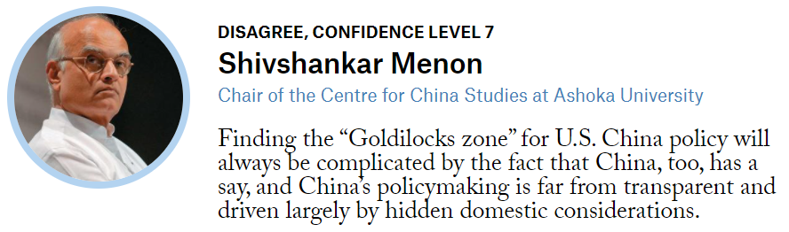
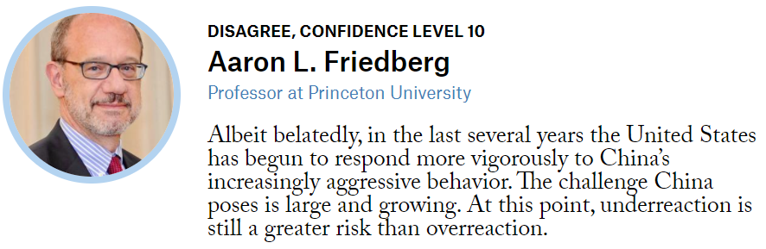

Slide 4
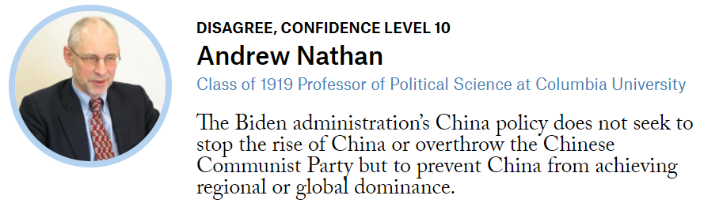
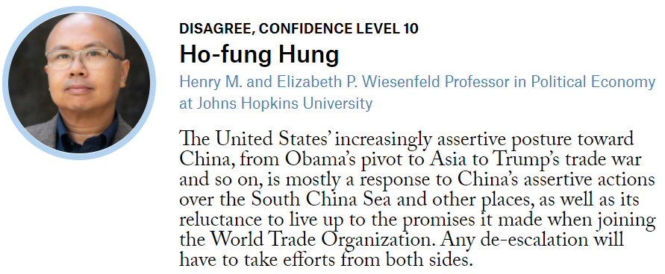

Slide 5
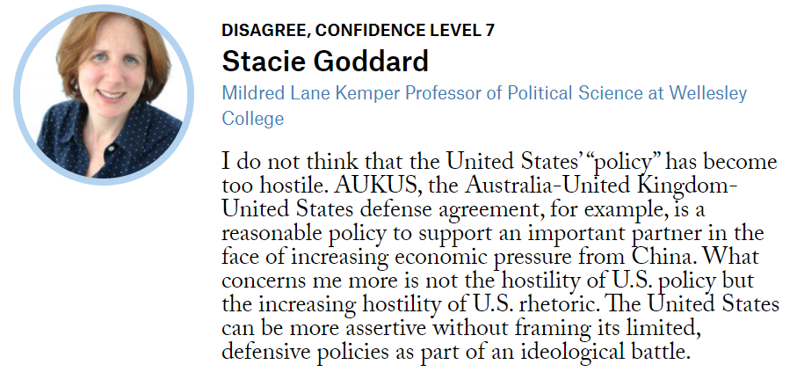
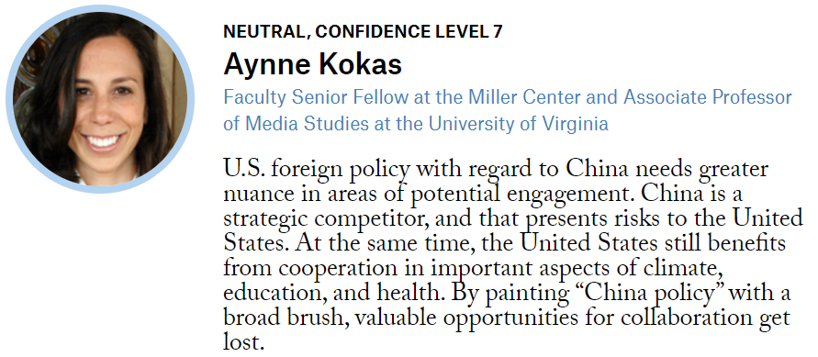

Slide 6
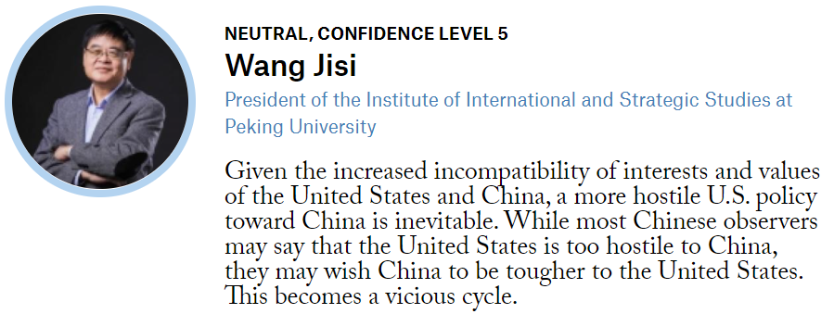
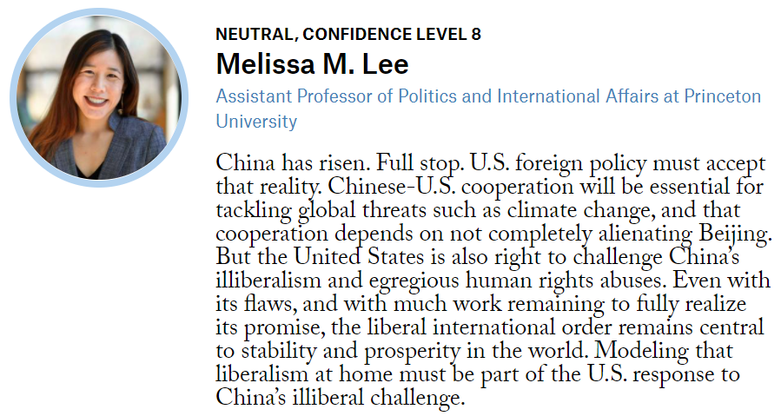

Slide 7
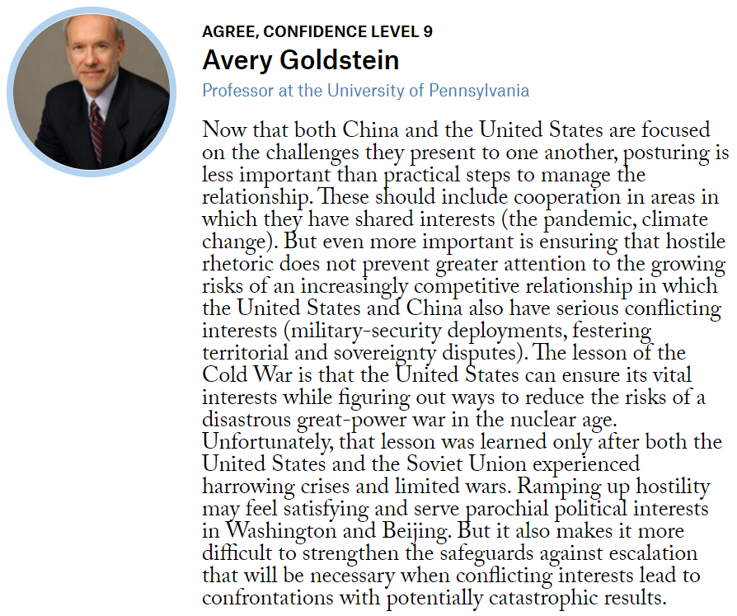
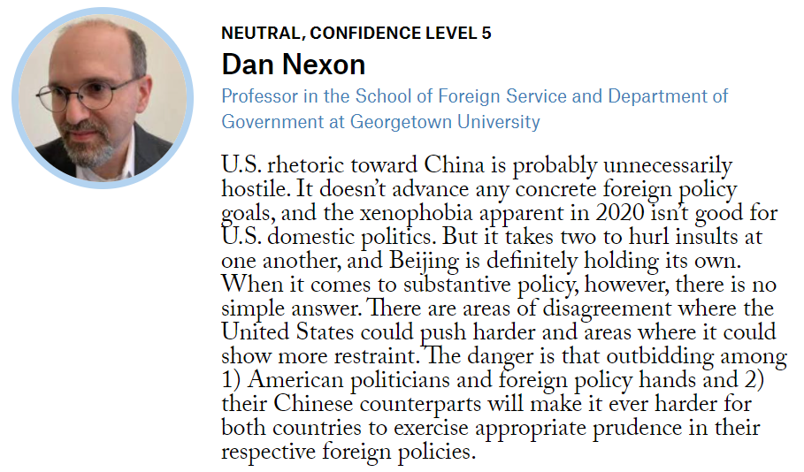

Slide 8
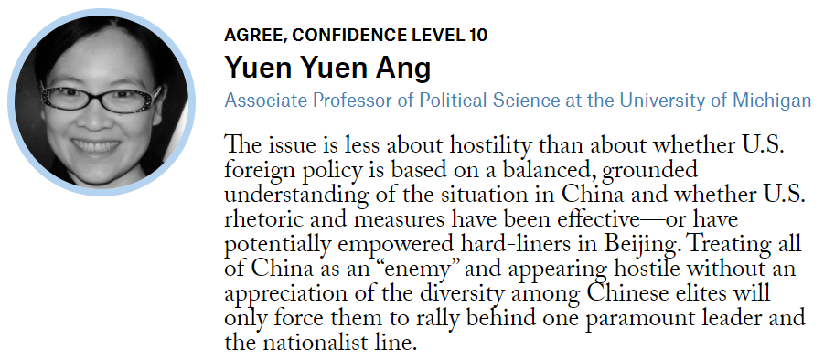
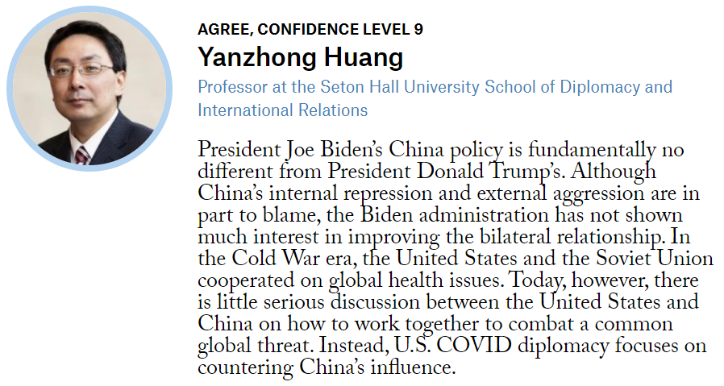

Slide 9
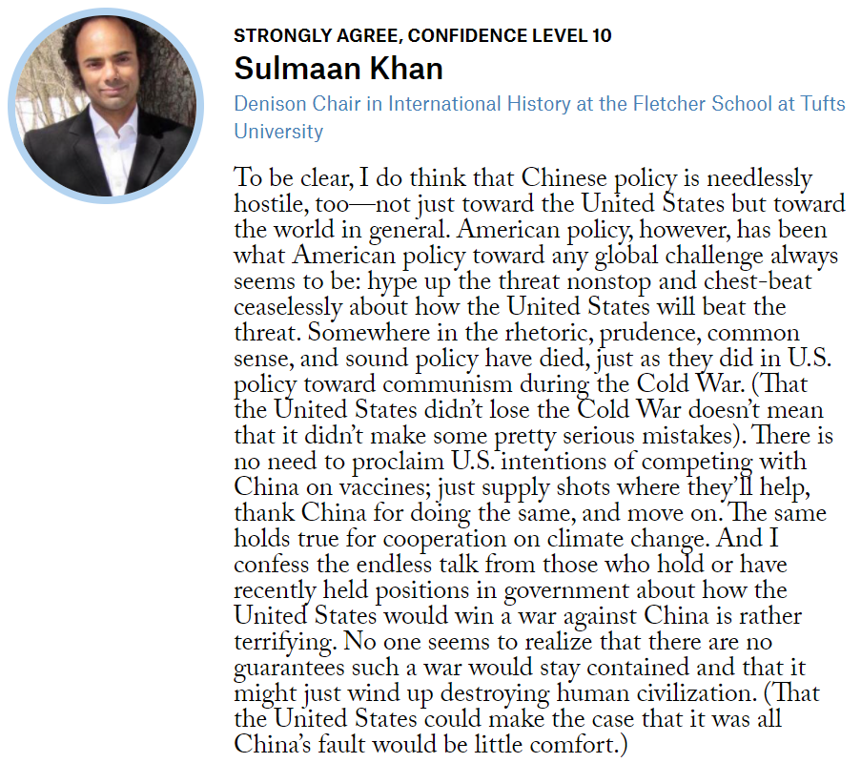
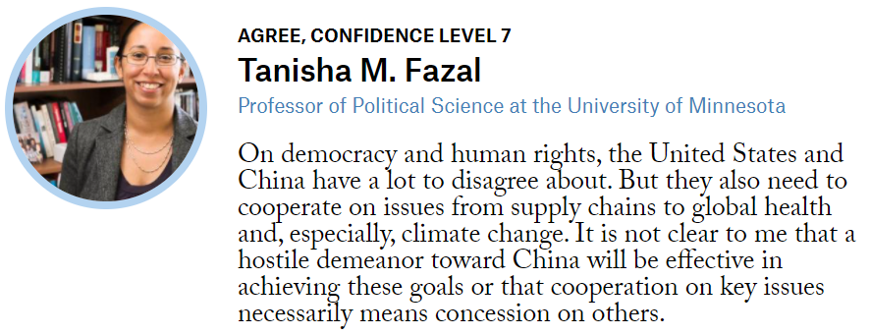

Slide 10
Elite Eight
Elite Eight
Elite Eight

Slide 11
Elite Eight
Elite Eight
Elite Eight

Slide 12
Elite Eight
Elite Eight
Elite Eight

Slide 13
Elite Eight
Elite Eight
Elite Eight

Slide 14
Final Four
Final Four
Final Four

Slide 15
Final Four
Final Four
Final Four

Slide 16
Championship
Championship
Championship

