Slide 1
Cybersecurity and Social Engineering
Solen Grossman
CYSE 201S: Cybersecurity and the Social Sciences
Diwakar Yalpi

Slide 2
Introduction to Social Engineering
When you’re using the internet, one common risk you may face is an email with a suspicious link, or a person alerting you about malicious software or an accounting error on your bank account. These are both examples of social engineering. This presentation will go over the core concepts of social engineering, its psychological and sociological impacts, some case studies of social engineering, and mitigating techniques to prevent becoming another case study.

Slide 3
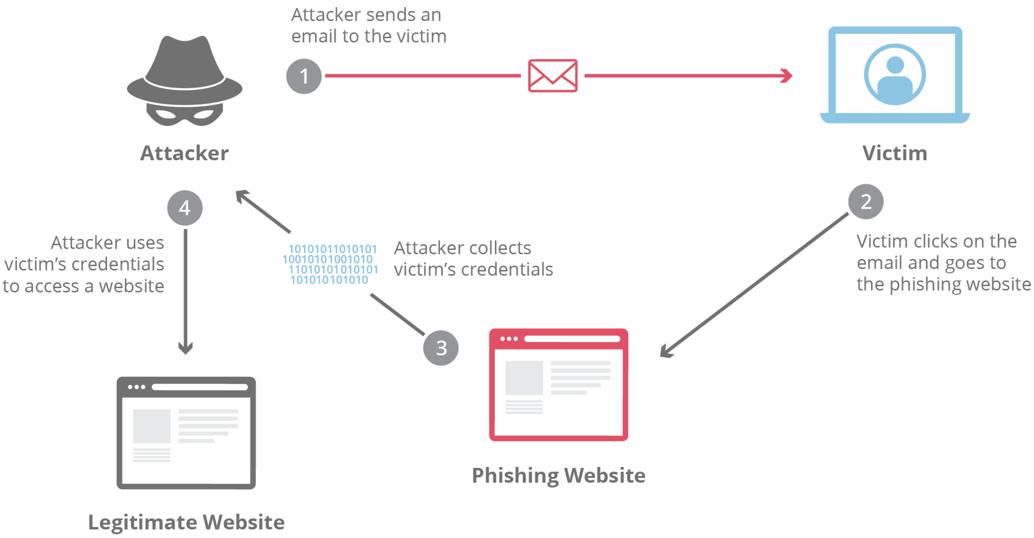
Core Concept
According to National Institute of Standards and Technology (NIST), Social Engineering is “An attempt to trick someone into revealing information (e.g., a password) that can be used to attack systems or networks.”
There are multiple kinds of Social Engineering:
Phishing: Deceptive emails.
Spear Phishing: Targeted emails.
Whaling: Targeting executives.
Vishing: Voice calls.
Smishing: Text messages.
Pretexting: Creating a false scenario/identity.
Tailgating: Physically following someone.
Quid Pro Quo: Offering a service in exchange for information.
Deep Fakes: Using AI to create convincing fake media.
Ramifications of Social Engineering
Phishing and spoofing attacks have comprised nearly 1 in 4 cyber crimes reported to the FBI's Internet Crime Complaint Center
A quarter of nation-state campaigns begin with conversations to disarm targets
Generative AI can be used to create convincing phishing messages in just 5 minutes
Social engineering attacks cost organizations about $130,000 in stolen data
Call center scams that target seniors and crypto traders have raked in $1.9 billion in losses in 2024

Slide 4
Psychology of the Attack: Biases & Rationalizations
There are five cognitive biases commonly used in social engineering:
Authority Bias: Making the victim trust and follow the advice of the attacker by posing as a high-ranking official or representative of a well-known company
Scarcity Bias: Making the victim more likely to take action by using language and tactics that create a sense of urgency
Social Proof Bias: Making the victim more likely to fall for the attack by using social media or other online platforms to manufacture support or interest in the scam
Reciprocity Bias: Making the victim feel obligated to return a favor or give something personal after offering something of value
Framing Bias: Making the victim more likely to make a decision based on how the information is presented using persuasive language and emotional appeals
Neutralization Theory is the theory that the criminal knows right for wrong but justifies their innocence in the matter; this can explain social engineers’ mindset. 3 types of neutralization are applicable:
Denial of Victim: The social engineer may claim the victim deserved it
Appeal to Higher Loyalty: The social engineer’s ingroup matters more than the victim
Condemnation of Condemners: Social engineers may claim condemners are just as culpable

Slide 5


Case Study: The 2016 Democratic National Committee (DNC) Hack
In 2016, one of the landmark cases of social engineering happened in the United States
Hackers, believed to be of Russian origin, conducted a a spear phishing attack by creating fake gmail accounts, invited DNC members through a link and change their passwords "due to unusual activity."
The hackers leaked hundreds of DNC email, where it was published by Wikileaks. They contained controversial and divisive content that may have influenced voters in the 2016 Presidential Election
Hacked emails also revealed severe lack of cybersecurity best practices, with head administrators using weak passwords for example

Slide 6
Mitigation Strategies
The Cybersecurity and Infrastructure Security Agency (CISA) recommends several ways to not fall for social engineering attempts
Be suspicious of unsolicited phone calls, visits, or email messages from individuals asking about sensitive information
If an individual claims to be from a legitimate organization, try to verify their identity by directly contacting the company from their official site
Do not provide personal information about your employer or yourself
Always check a website's security (If it's HTTPS for example or has a closed padlock icon which is a sign that your information is encrypted) before sending sensitive information
Contact the company if a website sent to you seems illegitimate
Alway have multi-factor authentication (MFA)
Furthermore, considering the 5 cognitive biases used by social engineers:
Always check the credentials of a supposed authority
Always keep a cool head and be suspicious of urgent messages
Vet all social proof and make sure they don't appear spoofed or manufactured
Never trust abnormal generosity
Read the information with a critical eye and don't let your emotions get to you
One central theme that rings through all of this - be humble but skeptical:
Accept that anyone, including IT professionals or one of the largest political parties in the most powerful country in the world, can fall for a social engineering attack
Constantly question unexpected requests, even (Actually especially) those that come from a supposed authority

Slide 7
Conclusion
Social engineering is when attackers try to manipulate you into disclosing sensitive information.
It is one of the most widespread and damaging forms of cyberattacks in cybersecurity.
Attackers rely on biases of authority, scarcity, social proof, reciprocity, and framing to manipulate their victims. They justify their social engineering through neutralization
Social engineering attempts can happen at the highest levels of society, as seen with the 2016 DNC hack which may have influenced the Presidential Election
Mitigations techniques include having a clear, critical, and skeptical mind when approached, always vetting the parties or sites involved to see if they’re legitimate, and further protecting yourself with MFA
Always be humbly skeptical about all internet interactions. If it sounds too good to be true, it likely is

Slide 8
References
CISA. (2021, February 1). Avoiding Social Engineering and Phishing Attacks. Cybersecurity and Infrastructure Security Agency CISA; CISA. https://www.cisa.gov/news-events/news/avoiding-social-engineering-and-phishing-attacks
Crane, C. (2023, January 16). 12 Social Engineering Statistics That Will Make You Question Everything. Hashed out by the SSL StoreTM. https://www.thesslstore.com/blog/social-engineering-statistics/
Crumbaugh, J. (2024, April 18). Top 5 Cognitive Biases Used by Social Engineers. Phishfirewall.com. https://www.phishfirewall.com/post/top-5-cognitive-biases-used-by-social-engineers
Gatefy. (2021, June 21). 10 real and famous cases of social engineering attacks. Gatefy. https://gatefy.com/blog/real-and-famous-cases-social-engineering-attacks/

