Slide 1
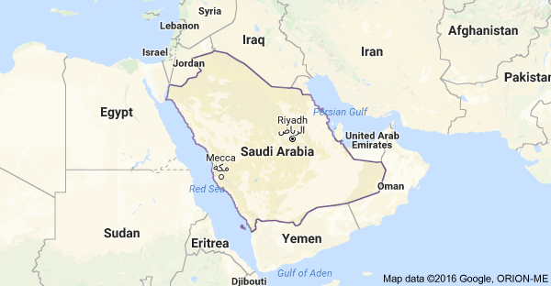

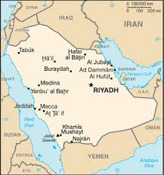
Saudi Arabia
Fawziyya Abu-Khalid

Slide 2
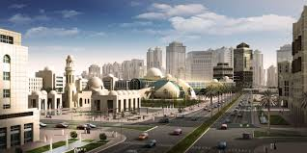
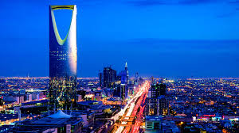
Population of 28,160,273 people
Immigrants make up 30% of the population
90% Arab, 10% Afro-Asian
Official Language: Arabic
Official Religion: Islam
85-90% Sunni, 15-10% Shia
More than 30% of the population are a part of a different religion
Non-Muslims not granted Saudi citizenship
Non-Muslim places of worship are not permitted
No religious freedom: not permitted to express beliefs other than Sunni Islam
Government: Absolute Monarchy

Slide 3
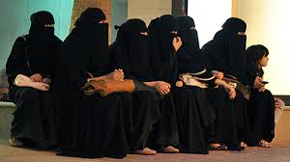
Social structure
Women in the Saudi Arabian kingdom are required to have a male guardian: such as a father or a husband. Her male guardian is responsible to make all of her legal, work, travel, study, marital, and medical decisions.
Family is very important within their culture
They have a Sunni-run government and their entire lives are based off of following Sunni Islamic rules.
hi

Slide 4
History of the country
613 – Islam founded by Muhammad in Arabia
1517 – Arabia is taken over by the Ottoman Empire
1902 – Abd-al-Aziz begins taking over various provinces of the Ottoman Empire
1916 – The local government of Mecca declared Arabia independent from the Ottoman Empire
1932 – Abd-al-Aziz unifies all the provinces he owns in to the current state of Saudi Arabia
1938 – Oil is discovered and Aramco is founded (Arabic American Oil Company)
1960 – Becomes founding member of OPEC (Organization of Petroleum Exporting Countries)
1973 – Saudi Arabia leads an oil boycott against western countries that supported Israel in the October War. Oil prices quadruple
1980 – Saudi Arabia takes full control of Aramco
2001 – Al-Quadea personnel, who happen to be Saudi nationals, perform the September 11th Attacks
2011 – Public protests for social reform banned

Slide 5
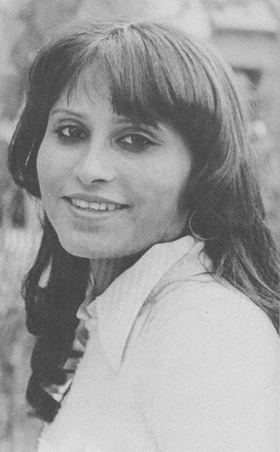
Fawziyya abu-khalid
Artist name: Fawziyya Abu-Khalid
DOB: 1955
Country/Place of birth: Riyadh, Saudi Arabia
Religious affiliation: Muslim
Education: American University of Beirut
Lewis and Clark College
Politics: has criticized the Wahhabism interpretation of Islamic law in Saudi Arabia
Relevant Literary or Philosophical movement:
Genres: Poetry
Main themes: Women’s rights/liberation
Style: Free verse, Arabic and Islamic allusions
Examples: Mother’s Inheritance
Other: Her work is censored and banned in Saudi Arabia due to Wahhabism. She breaks the social norm by refusing to be anonymous in her writings, despite being a woman.

Slide 6
Works cited
News, BBC. "Saudi Arabia Profile - Timeline." BBC News. N.p., n.d. Web. 16 Oct. 2016. http://www.bbc.com/news/world-middle-east-14703523
1000, By. "Saudi Arabia." Culture of. N.p., n.d. Web. 16 Oct. 2016. <http://www.everyculture.com/Sa-Th/Saudi-Arabia.html>.
(www.dw.com), Deutsche Welle. "Women in Saudi Arabia Are Caught in a System of Gender Apartheid | Globalization | DW.COM | 30.12.2013."DW.COM. N.p., n.d. Web. 16 Oct. 2016. <http://www.dw.com/en/women-in-saudi-arabia-are-caught-in-a-system-of-gender-apartheid/a-17330976>.
"Saudi Arabia Guide." Comisceo Global. N.p., n.d. Web. 16 Oct. 2016. <http://www.commisceo-global.com/country-guides/saudi-arabia-guide>.
"The World Factbook: SAUDI ARABIA." Central Intelligence Agency. Central Intelligence Agency, n.d. Web. 16 Oct. 2016. <https://www.cia.gov/library/publications/the-world-factbook/geos/sa.html>.
Duiker, William J., and Jackson J. Spielvogel. The Essential World History. 8th ed. Vol. 2. N.p.: Cengage Learning, 2015. Print.

