Slide 1
Creating a more sustainable workplace
Shewit Adane
Old Dominion University
MPH 784: Creating Sustainable Environmental Futures
Dr. Steven M. Becker

Slide 2
Setting
The Genetics and IVF Institute is a full-service fertility facility located in Fairfax, Virginia.
Assisting individuals and couples create families since 1984.
This organization consists of multiple branches
I’m employed within the Fairfax Cryobank division.
Fairfax Cryobank offers:
Fertility preservation
Donor program

Slide 3
My Specific Role
My role is a laboratory technician within the Fairfax Cryobank department.
My position consist of various tasks including:
Performing semen analyses and cryopreservation of semen
Data entry, verification and filing of laboratory records and blood reports.
Identifying problems that may adversely affect specimens
Venipuncture
Packing and sending out serology

Slide 4
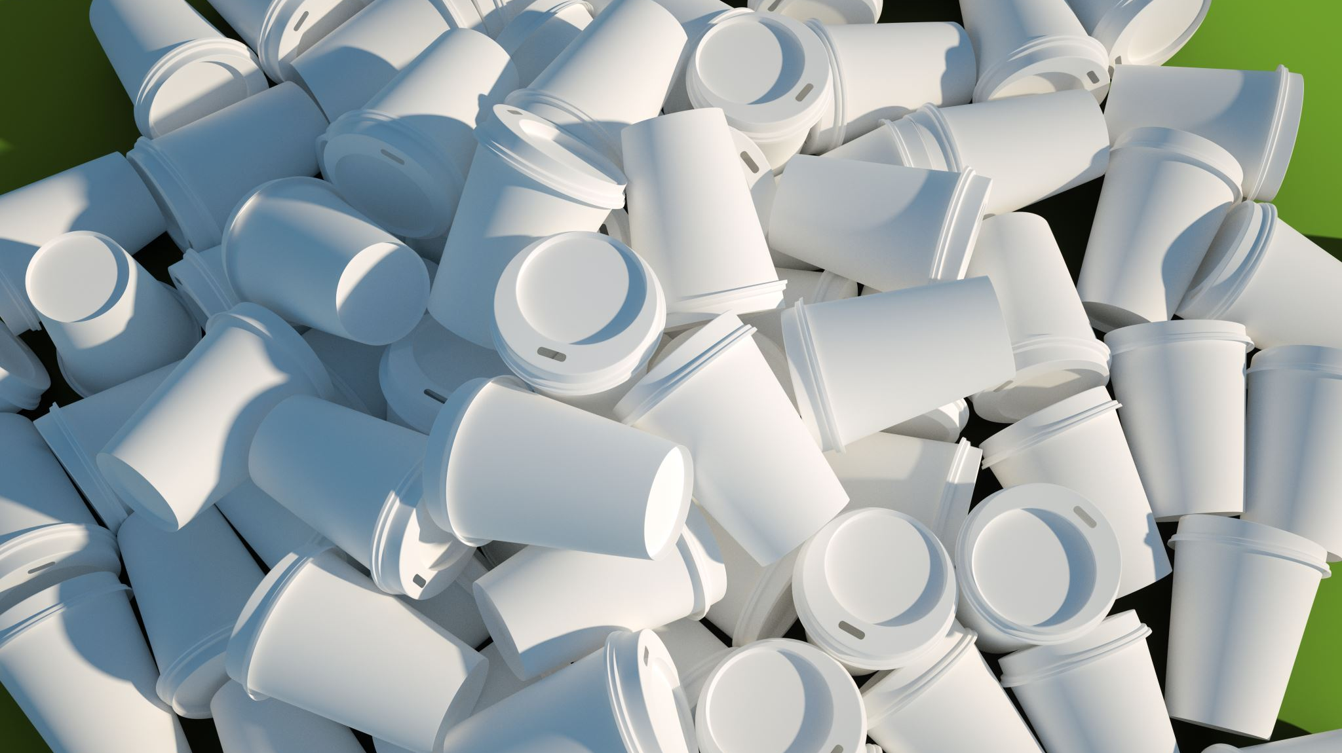
Current Practices
Operational practices are obsolete and not environmentally friendly.
The organization does not utilize any form of recycling services.
Paperwork is documented both electronically and physically
Plenty of paper is discarded
Snacks are purchased for the clients and donors
Food waste is regularly produced
Monthly meals
Employer purchase staff lunch when goals are reached

Slide 5
Recommendations
Recycling services in the facility
Exclusively buy food products that produce recyclable food waste.
Plant-based, sustainable alternatives to the monthly meals

Slide 6
Public Health Benefits
Reducing waste and recycling existing products in the workplace can aid in:
Environmental protection
Natural resource conservation
Long-term sustainability

Slide 7
Public Health Benefits cont.
Encourage staff to incorporate more plant-based meals into their diets.
Lead to reductions in greenhouse gas emissions
Lower risk of cardiovascular disease, type 2 diabetes, and mortality from diet-related noncommunicable diseases

Slide 8
Reference:
Physicians Committee for Responsible Medicine. (n.d.). A Vegan Diet: Eating for the Environment. Physicians Committee for Responsible Medicine. Retrieved November 25, 2022, from https://www.pcrm.org/good-nutrition/vegan-diet-environment
U.S. Department of Health and Human Services. (n.d.). Environmental programs benefits of recycling. National Institutes of Health. Retrieved November 25, 2022, from https://nems.nih.gov/environmental-programs/pages/benefits-of-recycling.aspx

