Slide 1
2025
Periodontal Disease: The Hidden Pathway to Infection Transmission
Presented by: Verneshia Heidelberg

Slide 2

Perspective Statement
How often is dental care neglected? For whatever the reasons: finances, time, fear or low on the priority list, most tend to avoid not only the Dentist, but at home dental care as well. Dental care plays a huge role in infectious diseases. The implications of bad dental hygiene is well beyond oral health. Research shows a link between periodontal disease and the transmission of systemic infectious diseases. This is extended to cardiovascular disease, respiratory infections, and even diabetes. This happens because the bacteria enters your bloodstream and from there travels throughout your entire body. This triggers immune responses, and it is ultimately how the spread of infections start. Good dental hygienve is not a luxury practice or a backburner chore. It is necessary and often times critical for our overall health.
03

Slide 3
CONTENTS
PART
ONE
Abstract
PART
TWO
Pathogenesis
PART
THREE
Systemic Infections and Physiology of Periodontal Disease
PART
FOUR
Vulnerable Populations and Research/Future Direction
PART
FIVE
Conclustion

Slide 4
Abstract
Periodontal disease is often dismissed and seen as a simple dental issue, but growing evidence suggests it plays a significant role in systemic health. The disease, caused by bacterial infections in the gums and supporting structures of the teeth, has dangerous implications that extend far beyond the oral cavity. Through bacterial migration and entry into the bloodstream, periodontal pathogens contribute to a multitude of systemic infections and diseases. Some of these include cardiovascular conditions, respiratory illnesses, diabetes, and pregnancy complications. This paper will explore the pathogenesis of periodontal disease, its microbial components, mechanisms of systemic transmission, physiological responses, and vulnerable populations. It will also discuss current research and future directions in prevention, management, and treatment.

Slide 5
Pathogenesis
Periodontal disease develops due to the colonization of pathogenic bacteria in the subgingival environment.
The primary initiating factor is a build up of dental plaque
Over time, if plaque is consistently occuring, this can lead to gingivitis
Periodontal pathogens actively manipulate the host’s immune response to establish chronic infections. P. gingivalis, for example, is known for destabilizing the complement system and disrupting neutrophil responses
Dental plaque is the initial stage of biofilm development. Biofilm is very complex, and it has what called a three dimensional organization
Biofilms are dense communities where bacteria communicate via quorum sensing
Notes:
2)Dental plaque is a biofilm that is made up of bacteria, various food particles, and saliva. If this plaque is not removed, it will harden into tartar. This then irritates the gums and promotes inflammation. 3)Gingivitis eventually and inevitably progresses into periodontitis. What escalates this progression is the interaction between microbial communities and host responses 4)These bacteria release what are called proteolytic enzymes and toxins that degrade the tissue and modulate immune signaling. They survive within biofilms, protected from both immune attacks and antibiotics. This all contributes to persistent infection. 5) It forms when biofilm-producing bacteria in an aqueous environment, in this cause the mouth, adhere to solid surfaces. It then goes on to produce a network of extracellular polymeric substances (EPS), adopting a “multicellular lifestyle”. Within hours of brushing, something called pellicle proteins attract early colonizers. These bacteria then multiply and produce extracellular polymers that facilitate adherence and recruitment of anaerobic, gram-negative bacteria 6) Quorum sensing is a process in which it helps induce microbial biofilm formation. It has enhances virulence. It does this by regulating the metabolic activity of plankton cells. They then coordinate activities that enhance survival. These structures are resistant to antimicrobials, and that is how they also contribute to persistent infection

Slide 6
01 Systemic Infections & Mechanisms of Infection
①
②
The oral cavity is a central hub for microbial exchange. In periodontal disease, ulcerations in the gingival epithelium provide a direct route for bacteria to escape the oral environment
Transmission through the bloodstream also occurs during daily activities like brushing your teeth, chewing, and even flossing.
i.Bacteria enters the surrounding tissues by way of lymphatic channels and mucosal surfaces. In some vulnerable populations, like the elderly, bacteria from the oral cavity can then migrate to the lungs through aspiration. This leads to things like pneumonia.
When a person has periodontal disease their gums tend to be inflamed. When doing everyday activities, like brushing, chewing, or even flossing, it can cause damaged areas and allow bacteria to enter the bloodstream by way of these injuries.
03

Slide 7
02 Physiology of the Body’s Response
When bacteria builds up in the gums, the body reacts by way of inflammation. This is its natural defense against infection.
This quick reaction is meant to stop the infection early and repair any minor damage
When it is chronic, the body stays in a constant state of defense, which will eventually start to damage healthy gum tissue and the bones that supports the teeth
Chemicals released during this immune response, like cytokines, which are messenger proteins, can enter the bloodstream and travel to other organs
Research shows that these inflammatory signals may interfere with how the body heals and can contribute to diseases like heart problems, diabetes, and even issues during pregnancy.
The body produces specialized cells to attack the bacteria, but in gum disease, this response often becomes out of balance.
This “immune hijacking” leads to even more inflammation and tissue breakdown, making it harder for the body to heal and more likely for bacteria to spread into the bloodstream
The ongoing stress on the immune system may cause low-grade inflammation throughout the body, which has been linked to serious health problems
03
Notes:
1)This happens first as an acute inflammatory response, where immune cells like white blood cells rush to the gums to try to fight off the harmful bacteria 2)However, if poor oral hygiene is continued, this inflammation doesnt go away. Instead, it evolves to become chronic. 3)This long-term inflammation is not only the cause of gum recession and tooth loss, but it can also affect the entire body. 5)At the same time, the immune system then becomes more active, trying to keep the infection in check 6)Certain bacteria, like Porphyromonas gingivalis, can trick the immune system by disabling some defenses while fueling others 8) So, what starts as a simple gum problem can ripple outward, eventually affecting a person’s overall health.

Slide 8
03 Vulnerable Populations
During pregnancy, hormonal changes make the gums more sensitive to plaque and bacteria. This increases the risk of developing gum disease or escalating gum disease that has already occurred. But beyond swollen or bleeding gums, periodontal disease in pregnant women has been linked to serious complications like preterm birth, low birth weight, and pre-eclampsia
When harmful bacteria from the mouth enter the bloodstream, it can then travel to the arteries and contribute to plaque buildup. This condition is known as atherosclerosis
For diabetics, poor blood sugar control can make it harder for the body to fight infections, including those in the gums. At the same time, gum disease can worsen insulin resistance, making diabetes more difficult to manage
For the elderly, the immune system may be too weak to contain infections effectively, which allows oral bacteria to spread and cause systemic issues such as pneumonia or bloodstream infections. As people age, they may also experience dry mouth, take medications for other bodily functions that in-turn affect oral health, or struggle with proper brushing and flossing due to aging or arthritis. This all makes them more susceptible to gum disease
Pregnant women
Preexisting health conditions (cardiovascular)
Individuals with diabetes
Elderly
03

Slide 9
04 Preventative Measures
Prevention includes, but not limited to, daily oral hygiene, regular dental visits, public health education, antimicrobial therapies, and periodontal screening for patients with systemic diseases.
03

Slide 10
05 Research/Future Direction
A major advancement highlighted by Makkar and Sriram (2025) is the use of organotypic models and organ-on-chip systems, which simulates the structure and function of human gum tissue in a laboratory setting
OoC systems work by emulating barrier tissues such as skin-on-chip, lung-on-chip, and gut-on-chip. They mimic various micro-physiological interactions between host barrier tissues, microbes, materials, and environmental factors
This represents a significant leap from only animal studies or standard petri dish experiments, which offers more accurate insights into the cellular and molecular processes involved in periodontal disease
Looking ahead, these technologies could lead to personalized medicine approaches, where treatments are tailored to a patient’s unique genetic and microbial profile
The future of periodontal research is interdisciplinary, meshing together biology, engineering, and precision medicine to develop more effective and individualized strategies for oral and systemic health.
03
Notes:
Recent reseaThese advanced models allow researchers to closely observe how specific bacteria, like Porphyromonas gingivalis, interact with human cells in real time under controlled conditionsrch in periodontal disease is moving beyond traditional diagnostics and treatment to focus on the complex interactions between host tissues and microbes. 3)One of the most exciting aspects of this research is the ability to replicate immune responses, inflammatory signaling, and tissue degradation in a way that mirrors human biology. These platforms can also be used to test new therapies like anti-inflammatory drugs, probiotics, or gene-targeting agents

Slide 11
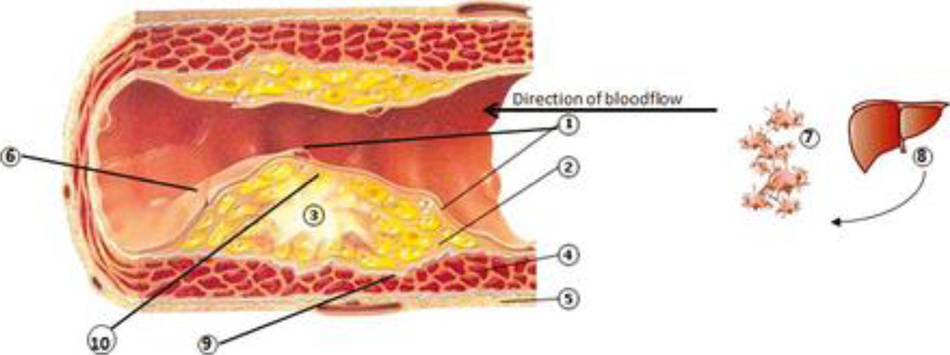
Figure #1
Figure 1: Inflammatory mechanisms linking periodontal diseases to cardiovascular diseases.
03

Slide 12
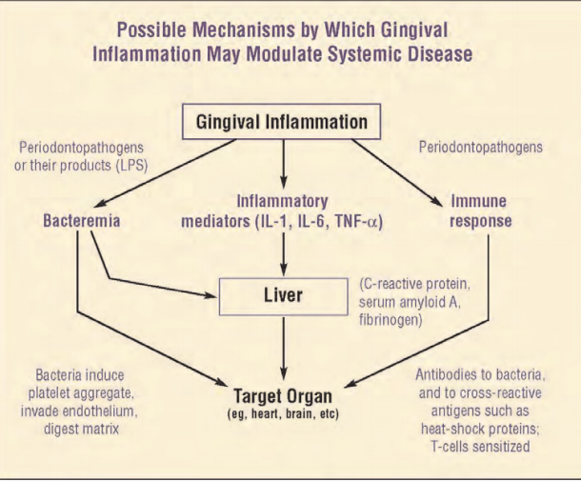
DATA ANALYSIS
Figure 2. showcases a theoretical pathway mechanism for how inflammation modulates the systemic disease.
03

Slide 13
Conclusion
Periodontal disease is a systemic threat. Its ability to facilitate the transmission of infection is the reason why oral health needs to be taken seriously. As research reveals the intricate mouth-body connections, it becomes clear that dental hygiene is critical to preventing a wide range of systemic diseases. It’s not just about preventing bad breath or having whiter teeth. It’s not a luxury. It is proving to be a necessity to prevent avoidable disruptions to our already complicated bodily functions.

Slide 14
Key References
1.Wang, P.-L. (2010a). Roles of oral bacteria in cardiovascular diseases — from molecular mechanisms to clinical cases: Treatment of periodontal disease regarded as biofilm infection: Systemic Administration of Azithromycin. Journal of Pharmacological Sciences 113, 126–133.
2.Hajishengallis, G. (2014). Periodontitis: From microbial immune subversion to systemic inflammation. Nature Reviews Immunology 15, 30–44.
3.Panagakos, F., and Scannapieco, F. (2011). Periodontal inflammation: From gingivitis to systemic disease? Gingival Diseases - Their Aetiology, Prevention and Treatment.
4.Fiorillo, L., Cervino, G., Herford, A.S., Lauritano, F., D’Amico, C., Lo Giudice, R., Laino, L., Troiano, G., Crimi, S., and Cicciù, M. (2018). Interferon crevicular fluid profile and correlation with periodontal disease and wound healing: A systemic review of recent data. International Journal of Molecular Sciences 19, 1908.
5.Fentoğlu, Ö., Köroğlu, B.K., Hiçyılmaz, H., Sert, T., Özdem, M., Sütçü, R., Tamer, M.N., Orhan, H., Ay, Z.Y., Öztürk Tonguç, M., et al. (2010). Pro-inflammatory cytokine levels in association between periodontal disease and hyperlipidaemia. Journal of Clinical Periodontology 38, 8–16.
6.Breivik, T.J., Gjermo, P., Gundersen, Y., Opstad, P.K., Murison, R., Hugoson, A., von Hörsten, S., and Fristad, I. (2024). Microbiota‐immune‐brain interactions: A new vision in the understanding of periodontal health and disease. Periodontology 2000 96, 20–41.
7.Kranz, A., Feierabend, N., Sliwka, D., Wiesegart, A., Abele, H., and Graf, J. (2022). Assessment of the association of periodontal diseases in pregnant women and the efficacy of periodontal treatment in the context of premature births and pregnancy complications – a narrative review. Geburtshilfe Und Frauenheilkunde 82, 831–841.
8.Cho, Y.-D., Kim, W.-J., Ryoo, H.-M., Kim, H.-G., Kim, K.-H., Ku, Y., and Seol, Y.-J. (2021b). Current advances of epigenetics in periodontology from Encode Project: A Review and Future Perspectives. Clinical Epigenetics 13.
9.Song, W., Bo, X., Dou, H., Fan, Q., and Wang, H. (2024). Association between periodontal disease and coronary heart disease: A Bibliometric analysis. Heliyon 10.
10.Makkar, H., and Sriram, G. (2025). Advances in modeling periodontal host–microbe interactions: Insights from organotypic and organ-on-chip systems. Lab on a Chip 25, 1342–1371.
11.Preda, V. G., & Săndulescu, O. (2019). Communication is the key: biofilms, quorum sensing, formation and prevention. Discoveries (Craiova, Romania), 7(3), e100.
12.Schenkein, H. A., & Loos, B. G. (2013). Inflammatory mechanisms linking periodontal diseases to cardiovascular diseases. Journal of clinical periodontology, 40 Suppl 14(0 14), S51–S69. https://doi.org/10.1111/jcpe.12060
03

Slide 15
2025
THANK YOU FOR WATCHING
Questions?

