Slide 1

The History of Hampton University (and why you should attend)
By : Mekhi Crocker-Linen

Slide 2
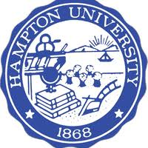
The Opening of Hampton University
On April 1, 1868, Samuel Armstrong opened “Hampton Normal and Agricultural Institute” with a mission.
Obtaining experience in trades and industrial skills were emphasized, as Negro youth were expected to lead their people first by example and build strong character.
Students were able to pay their way through school by working several jobs throughout campus.

Slide 3
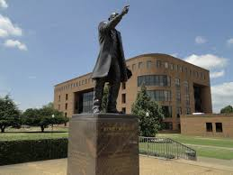
New Students
By the year of 1872, Hampton Normal and Agricultural Institute began to flourish and draw in new students from all over the country.
A new student by the name of Booker T. Washington, arriving from West Virginia in 1872, worked his way through Hampton.
He later left then returned back to Hampton to teach. Also, he helped found Tuskegee Institute in Alabama in 1881.

Slide 4
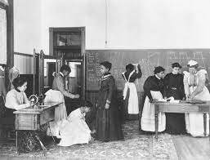
Arrival of Native Americans
April 18, 1878 - A group of Native Americans arrived in Hampton from Fort Sill.
Hampton created a Native American education program that lasted more than 40 years.
The last student graduated from this program in 1923.

Slide 5
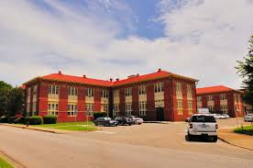
A New Era : The Trade School
Throughout the 1880’s and 1890’s, Hampton saw a significant increase in enrollment.
Several buildings were constructed, including Whipple Barn, Holly Tree Inn, and the Armstrong-Slater Trade School. Most of these buildings were built by students at Hampton.
Some of programs the new Trade school offered :
Farming -Painting
Carpentry -Tailoring
Printing -Music

Slide 6
Hampton Institute - 1900’s
Enhancing Hampton’s curriculum was the main focus during the 1900’s.
Several new programs were added and expectations were raised. They began to build a strong reputation.
Some new Buildings include the Library Science School and the Robert C. Ogden Auditorium.
On July 1, 1930, Hampton Normal and Agricultural Institute became Hampton Institute.
Then, Principal- Dr. George Phenix title was changed President.

Slide 7
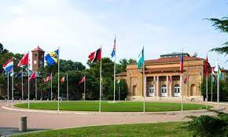
Growth of Hampton Institute
Eventually, the trades in the Trade School were phased out due to decreased enrollment.
New programs began to take place, including graduate school studies such as Mathematics and Chemistry.
Twelve new buildings were constructed, new programs and departments were established, faculty numbers increased, and student enrollment surpassed 2,000 by 1969.
Some new programs include
-Computer technology -Mass Media Arts -Cooperative Education

Slide 8
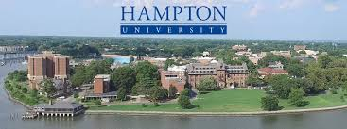
Now known as Hampton University
Dr. William R Harvey was elected the twelfth President of Hampton Institute in 1978.
By 1983, student enrollment increased by nearly four thousand.
In 1984, after a nine-month study, the name was changed to Hampton University.

Slide 9

Hampton University - Today
Hampton University continues to thrive. It is known to be one of the top HBCUs in the USA.
Hampton has 10 accredited schools and colleges
Their most popular schools include the School of Pharmacy, Scripps Howard School of Journalism and Communication, and the School of Nursing.
As of 2019, Hampton offers over 40 undergraduate programs.
HU is also known for their popular Basketball & Football team.

Slide 10
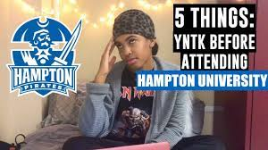
Interested in attending HU? KNOW THE COSTS
Hampton University is a well-known University. Many people find interest in this school for several different reasons. BUT, Hampton comes with a hefty tuition rate.
Average Tuition (All Students) - $ 24,950
Comprehensive Fee - $2,824.
Average Room/Board - $12,366
Undergraduate Per Credit Hour - $604
Notes:
Reasons? Parents, Scholarships, etc

Slide 11
Interested in attending HU? Pros
It’s an HBCU, so the focus is on providing a supportive atmosphere that will help African American students thrive.
Good Academic reputation
It’s near the beach
It’s a great size University (not too large)
Well known programs that have proven to help students succeed in their field of study.
Looking into mentorship? Excellent mentorship programs

